Slide 1
Edges

Slide 2
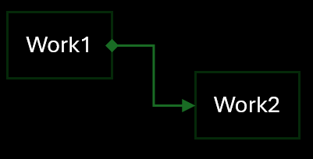
W2 |> W1 > W2 : W1 => W2
Work1
Work2
Work1 -> Work2: Start, ReverseReset

Slide 3
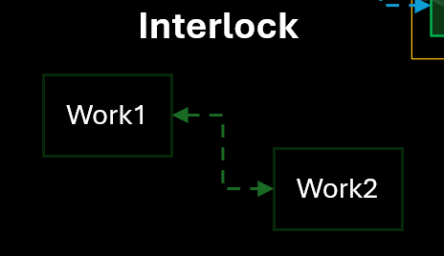
W1 |> W2 |> W1 : W1 <|> W2
Work1
Work2
Reset, ReverseReset

Slide 4
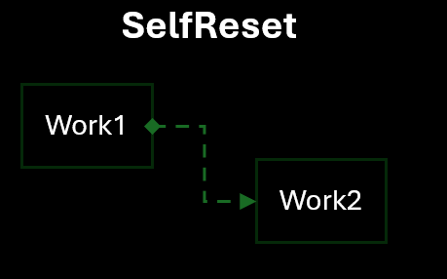
W1 <|> W2; W1 > W2 : W1=|>W2
Work1
Work2
Start + Interlock

Slide 5
MES
MES
BUFFER
S201
_RBT1
S201_RBT1 |> BUFFER > MES => BUFFER;

Slide 6
Cycle1
W1
W2
Web UI 확인 필요!

Slide 7
Cycle2
W1
W2
W3

Slide 8
W1 > W2
Work1
Work2

Slide 9
W1 |> W2
Work1
Work2

