Slide 1
Edges

Slide 2
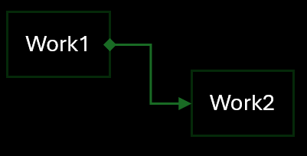
F1
Work1
Work2
Work1 -> Work2: Start, ReverseReset

Slide 3
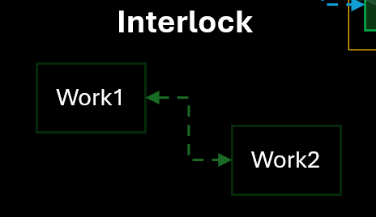
F2
Work1
Work2
Reset, ReverseReset

Slide 4
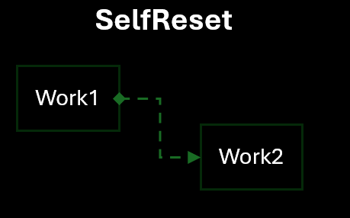
F3
Work1
Work2
Start + Interlock

Slide 5
S1
Work1
Work2

Slide 6
S2
Work1
Work2

