Slide 1
toDo
项目报告
基于安卓平台的备忘录app
段士童
彭奥

Slide 2
Introduction
This project is to develop a light and efficient memo application on the Android platform. It has a powerful event management mechanism, which can remind users properly at the right time. And It can also display the events that haven’t done on the lock screen, which makes users management their events conveniently.

Slide 3
Project Goals
Easy to operate and easy to learn
Little resource occupation
To display the events on the lock screen
Providing full memo function and reminder function

Slide 4
Details
For each event, there are attributes for event titles, content, priority, time, repetition and number of repetitions. Once the unfinished events have been done, the system would change it automatically into finished events. Users can also manually change finished events into unfinished events.

Slide 5
UML Diagram

Slide 6
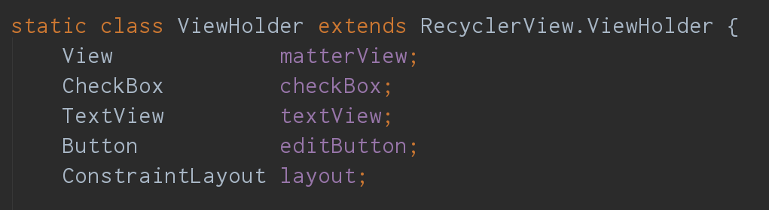
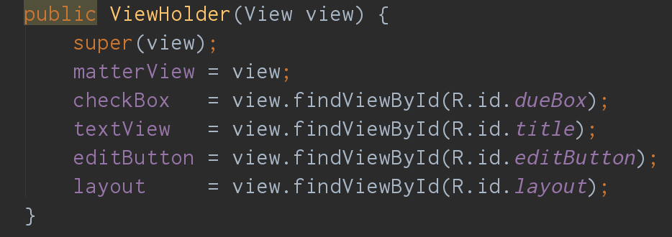
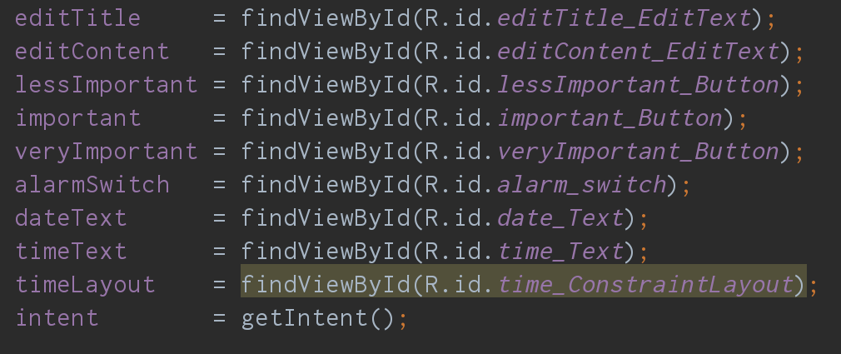
UI Design
墨刀是一款在线原型设计与协同工具，借助墨刀，产品经理、设计师、开发、销售、运营及创业者等用户群体，能够搭建为产品原型，演示项目效果。借助墨刀和Iconfont，我们初步实现了界面的设计。并结合墨刀中给出的android代码，在android studio上将界面进行了实现。

Slide 7
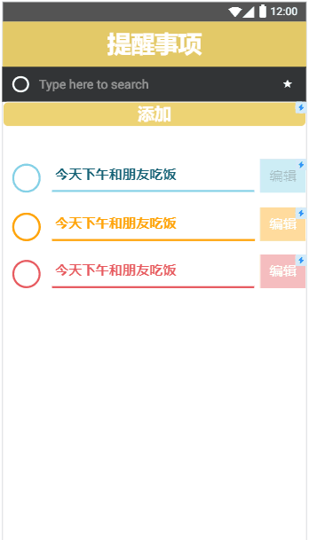
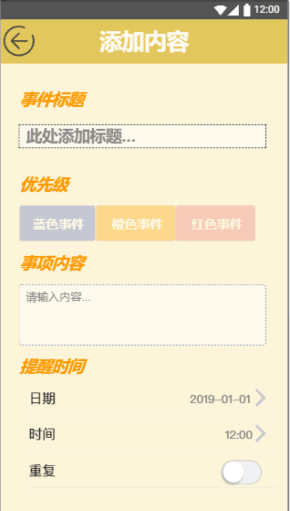
UI Design

Slide 8
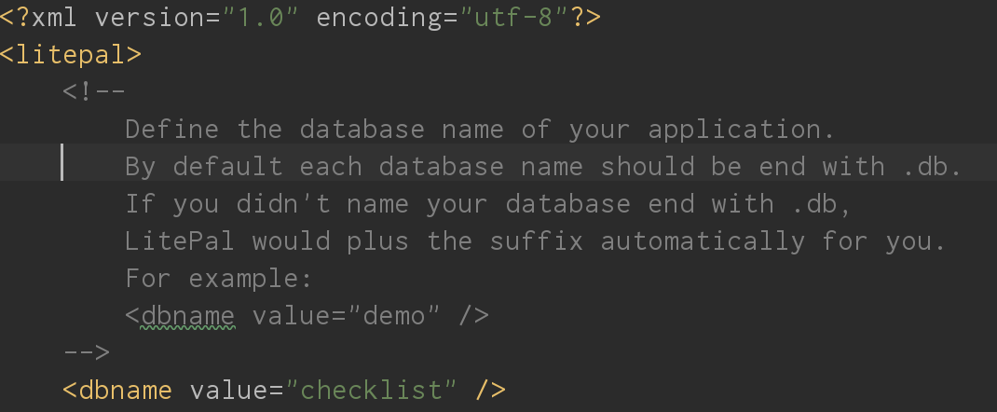
DataBase
数据库我们使用了LitePal
LitePal是一款开源的Android数据库框架，采用了对象关系映射(ORM)的模式，将平时开发时最常用的一些数据库功能进行了封装，使得开发者不用编写一行SQL语句就可以完成各种建表、増删改查的操作。

Slide 9
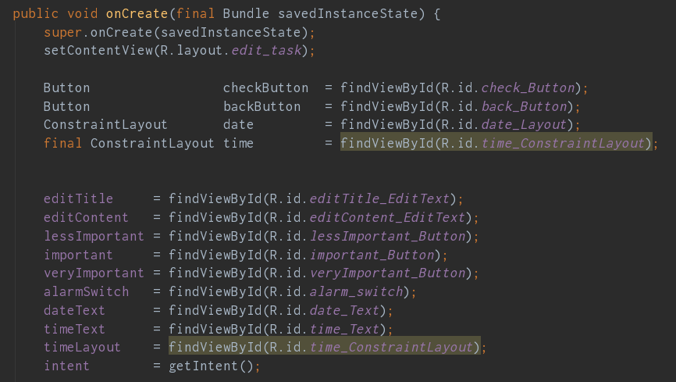
Edit Activity
备忘录主要实现得是增、删、改、查四项功能:
增加事件

Slide 10
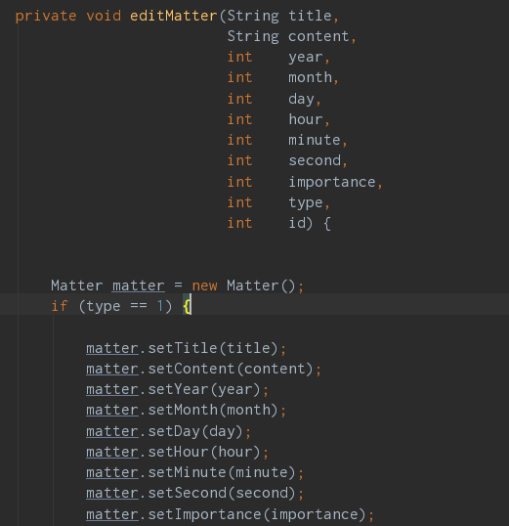
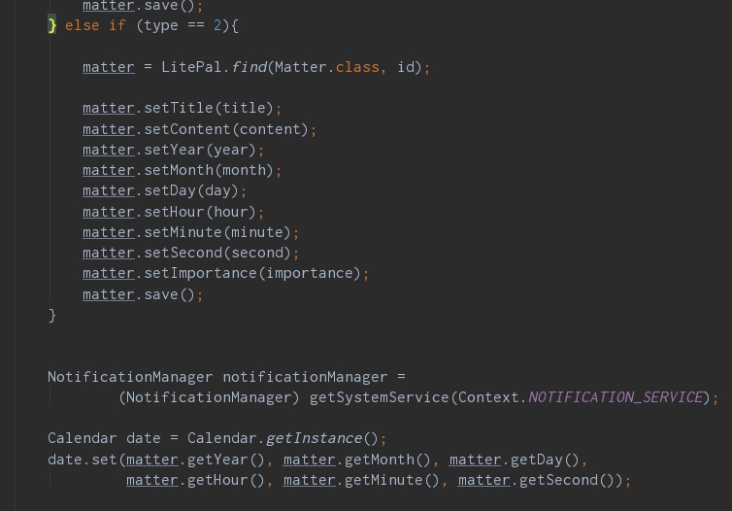
Edit Activity
修改事件

Slide 11
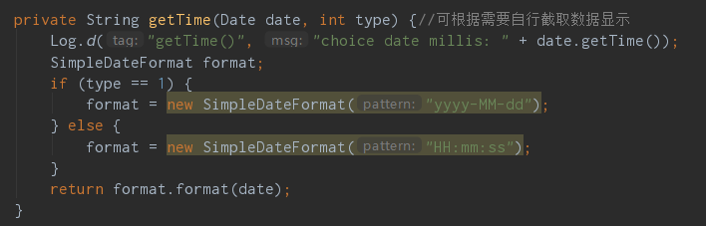
Edit Activity
查询事件时间

Slide 12
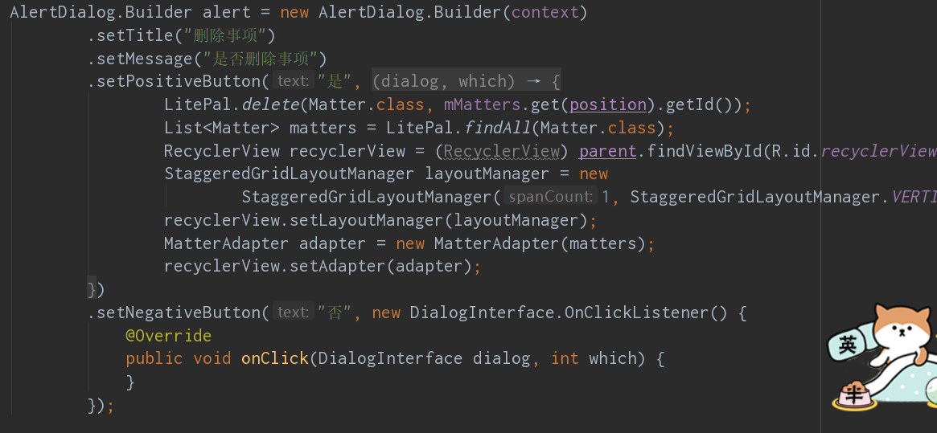
Edit Activity
删除事件

Slide 13
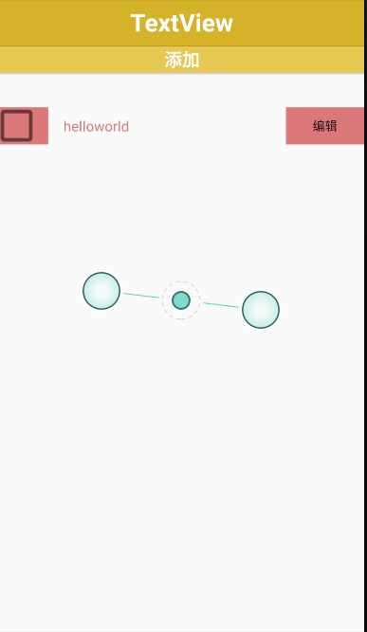
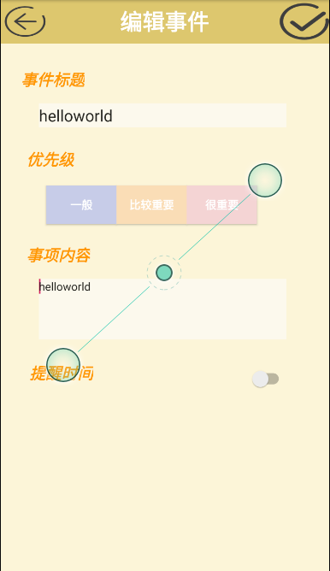
Display

Slide 14
分工
UI设计、测试、项目文档 、类图
45 %-50% 段士童
Android开发、程序逻辑实现
50%-55% 彭奥

Slide 15
GitHub：

