Slide 1



研发部MySQL&Linux简单交流会
谢炎 2018年6月29日

Slide 2




CONTENT
1、MySQL 库表设计规范
2、MySQL 语句书写规范
3、 MySQL 计划
4、Linux脚本书写

Slide 3
MySQL 库表设计规范
根据最近迁移MySQL遇到的一些问题的一些探讨.
交流

Slide 4


04
＊
MySQL8.0 数据迁移遇到的坑
这坑是比较恶心的.
交流下吧，定一个规则
研发部全体开发者
设计数据库表名的时候一定要规避mysql的关键词，
例如system， 如果真的需要叫这个名字， 在书写sql语句的时候必须在表名加上 [ ` ` ] , 注意这个符号不是单引号，而是波浪线对应的符号，单撇号？ 还是叫什么， 还必须得英文输入法下才能打出来 .

Slide 5
05
＊
MySQL 语句书写规范
这个问题还是比较严峻的，这个涉及好维护的问题。
统一规范
关键词大写，例如LEFT JION 、ON、WHERE.

Slide 6
05
＊
MySQL 数据更新规范
这个问题还是比较严峻的，这个涉及好维护的问题。
线上发布的数据库，如有需要修改字段或者表结构的，必须要书写SQL语句，在本地测试然后到线上执行，不要用Navicat直接可视化修改， SQL语句执行后，要做保留，以备出问题后，好追踪问题.
统一规范

Slide 7
MySQL 计划
为了以后说要换为MySQL8.0的计划而规范吧.
交流

Slide 8
08
＊
Linux脚本书写
Linux脚本书写分为以下几个步骤， 并且有两种书写方式， 脚本赋值运行权限：chmod +x a.sh
01
02
两种书写方式
有后啜名的书写方式
一种有后啜名 .sh
另一种没有后啜名
直接把终端敲的命令放入一个文件保存，赋予脚本运行权限，即可使用。
03
04
没有后啜名书写方式
脚本通用性书写方式
书写的时候需要加前缀 #! /bin/bash 这个是说明这是一个shell脚本文件， 后面就可以直接书写命令
可以直接运行脚本的时候传递参数，传递参数以空格隔开，例如运行 a.sh脚本 ./a.sh start init 看到脚本文件后面有两个参数，参数在脚本中接受是$1 $2 第几个参数就是$几

Slide 9
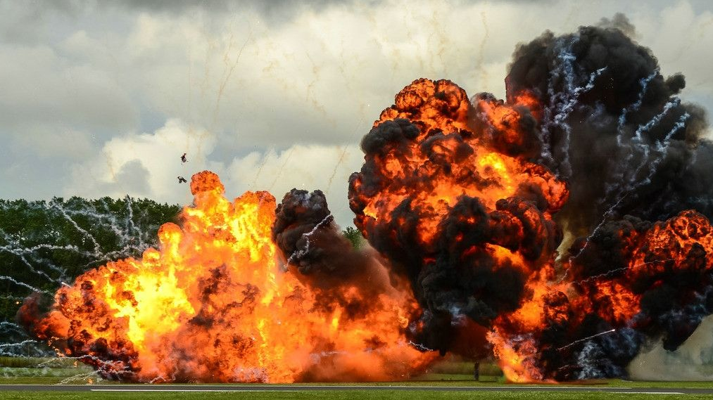
09
＊
下一步大爆炸
蹦 ， git要来了， 这次是真的要来了！
GitLab环境搭建
SVN代码移植GitLab
全体使用GitLab

Slide 10
项目配置文件规范化
慢慢，正在探索中.
敬请期待

Slide 11




THANK YOU

Slide 12
10
＊
PERFORM BETTER
WE ARE THE DIEHL GROUP ARCHITECTS, A FULL-SERVICE DESIGN ANDCONSULTING FIRM SPECIALIZING IN FORENSIC ARCHITECTURE, QUALITY ASSURANCE, AND EXPERT WITNESS TESEIMONY.
9:00
10:00
ADDRESS
EMERGENCY CONTACT
It’s easy to get to know your coworkers and their
stories.
It’s easy to get to know your coworkers and their
stories.

Slide 13
12
＊
PERFORM BETTER
WE ARE THE DIEHL GROUP ARCHITECTS, A FULL-SERVICE DESIGN ANDCONSULTING FIRM SPECIALIZING IN FORENSIC ARCHITECTURE, QUALITY ASSURANCE, AND EXPERT WITNESS TESEIMONY.
11:00
12:00
13:00
BANK INFO
BIRTHDAYS
COMPANY ASSETS
It’s easy to get to know your coworkers and their
stories.
It’s easy to get to know your coworkers and their
stories.
It’s easy to get to know your coworkers and their
stories.

Slide 14
13
＊
PERFORM BETTER
WE ARE THE DIEHL GROUP ARCHITECTS, A FULL-SERVICE DESIGN ANDCONSULTING FIRM SPECIALIZING IN FORENSIC ARCHITECTURE, QUALITY ASSURANCE, AND EXPERT WITNESS TESEIMONY.
15:00
16:00
CONTACT INFO
BIRTHDAYS
It’s easy to get to know your coworkers and their
stories.
It’s easy to get to know your coworkers and their
stories.

Slide 15

14
Get employee
Kin gets employee files, addresses, emergency contacts, bank info, and other data into a single, secure location and notifies you when any of it is updated.

Slide 16
15
＊
REQUIRES RESEARCH
WE ARE THE DIEHL GROUP ARCHITECTS, A FULL-SERVICE DESIGN ANDCONSULTING FIRM SPECIALIZING IN FORENSIC ARCHITECTURE, QUALITY ASSURANCE, AND EXPERT WITNESS TESEIMONY.
ADDRESS
BIRTHDAYS
It’s easy to get to know your coworkers and their stories.
It’s easy to get to know your coworkers and their stories.
EMERGENCY
COMPANY ASSETS
It’s easy to get to know your coworkers and their stories.
It’s easy to get to know your coworkers and their stories.
BANK INFO
CONTACT
It’s easy to get to know your coworkers and their stories.
It’s easy to get to know your coworkers and their stories.

Slide 17
16
＊
REQUIRES RESEARCH
WE ARE THE DIEHL GROUP ARCHITECTS, A FULL-SERVICE DESIGN ANDCONSULTING FIRM SPECIALIZING IN FORENSIC ARCHITECTURE, QUALITY ASSURANCE, AND EXPERT WITNESS TESEIMONY.
85%
33¥
BANK INFO
25%
PPT模板下载：www.1ppt.com/moban/ 行业PPT模板：www.1ppt.com/hangye/
节日PPT模板：www.1ppt.com/jieri/ PPT素材下载：www.1ppt.com/sucai/
PPT背景图片：www.1ppt.com/beijing/ PPT图表下载：www.1ppt.com/tubiao/
优秀PPT下载：www.1ppt.com/xiazai/ PPT教程： www.1ppt.com/powerpoint/
Word教程： www.1ppt.com/word/ Excel教程：www.1ppt.com/excel/
资料下载：www.1ppt.com/ziliao/ PPT课件下载：www.1ppt.com/kejian/
范文下载：www.1ppt.com/fanwen/ 试卷下载：www.1ppt.com/shiti/
教案下载：www.1ppt.com/jiaoan/
字体下载：www.1ppt.com/ziti/

Slide 18


17
＊
REQUIRES RESEARCH
WE ARE THE DIEHL GROUP ARCHITECTS, A FULL-SERVICE DESIGN ANDCONSULTING FIRM SPECIALIZING IN FORENSIC ARCHITECTURE, QUALITY ASSURANCE, AND EXPERT WITNESS TESEIMONY.
BANK INFO
Physical facilities have broad compliance certifications Service-level compliance on near-term roadmap Preparedness
COMPANY
ASSETS
Physical facilities have broad compliance certifications Service-level compliance on near-term roadmap Preparedness, testing, refinement
Physical facilities have broad compliance certifications Service-level compliance on near-term roadmap Preparedness, testing
+75%

Slide 19
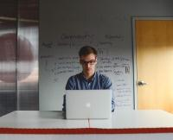







18
＊
REQUIRES RESEARCH
WE ARE THE DIEHL GROUP ARCHITECTS, A FULL-SERVICE DESIGN ANDCONSULTING FIRM SPECIALIZING IN FORENSIC ARCHITECTURE, QUALITY ASSURANCE, AND EXPERT WITNESS TESEIMONY.

Slide 20
EMERGENCY
19
＊
REQUIRES RESEARCH
WE ARE THE DIEHL GROUP ARCHITECTS, A FULL-SERVICE DESIGN ANDCONSULTING FIRM SPECIALIZING IN FORENSIC ARCHITECTURE, QUALITY ASSURANCE, AND EXPERT WITNESS TESEIMONY.
BIRTHDAYS
BANK INFO
Title
Resource Pooling
35KM
105KM
65KM
Automation
15h
23h
8h
Storage
small
big
---
Self Service
35KM
105KM
65KM
Mission Critical
15h
23h
8h

