Slide 1
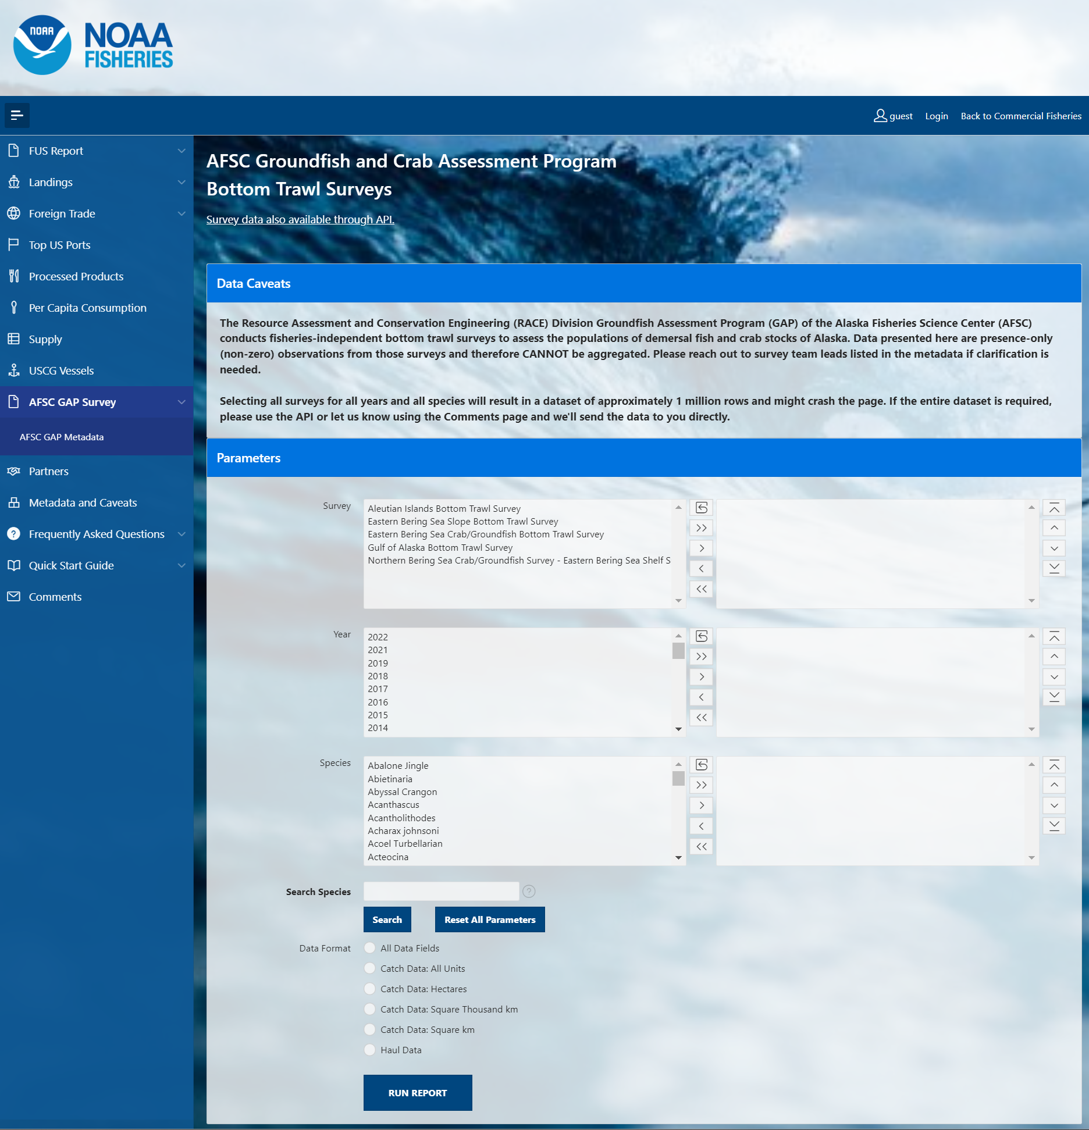
foss_1_interface.png

Slide 2
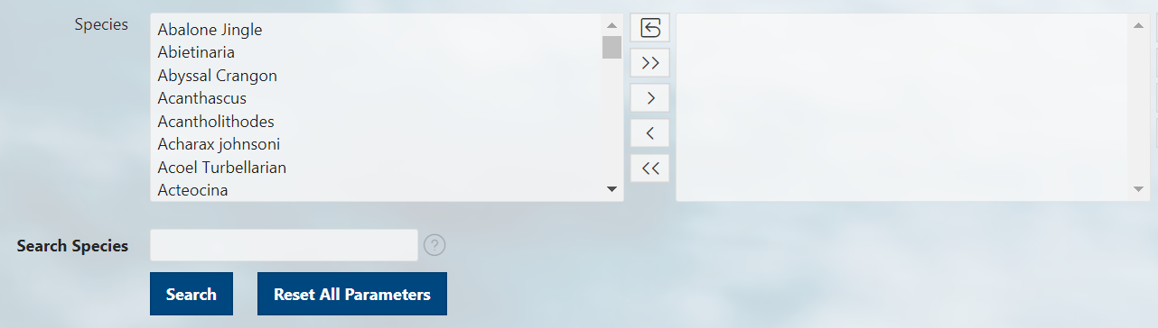
foss_2_select.png
Options box Selection box
Reset box options and selections boxes
Move all options from options box to selection box
Move specifically selected options from the options box to the selection box
Move specifically selected options from the selection box to the options box
Remove all options from selection box
Manually scroll through all options/selections
Type a term of the organism’s common name
Reset all parameters for entire form, not just species searches

Slide 3
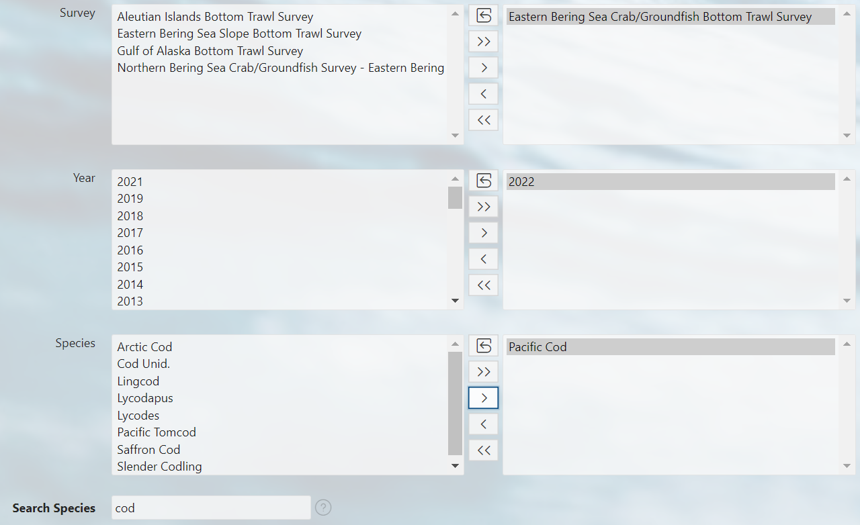
foss_3_selected.png

Slide 4
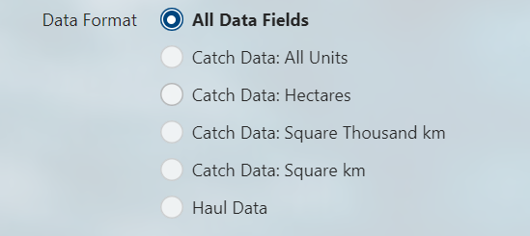
foss_4_data_format.png
All Data Fields: Presence and Absence (zero-filled)
All Data Fields: Presence-only (non-zero)
Catch data: Presence and Absence (zero-filled)
Catch data: Presence-only (non-zero)
Haul Data

Slide 5
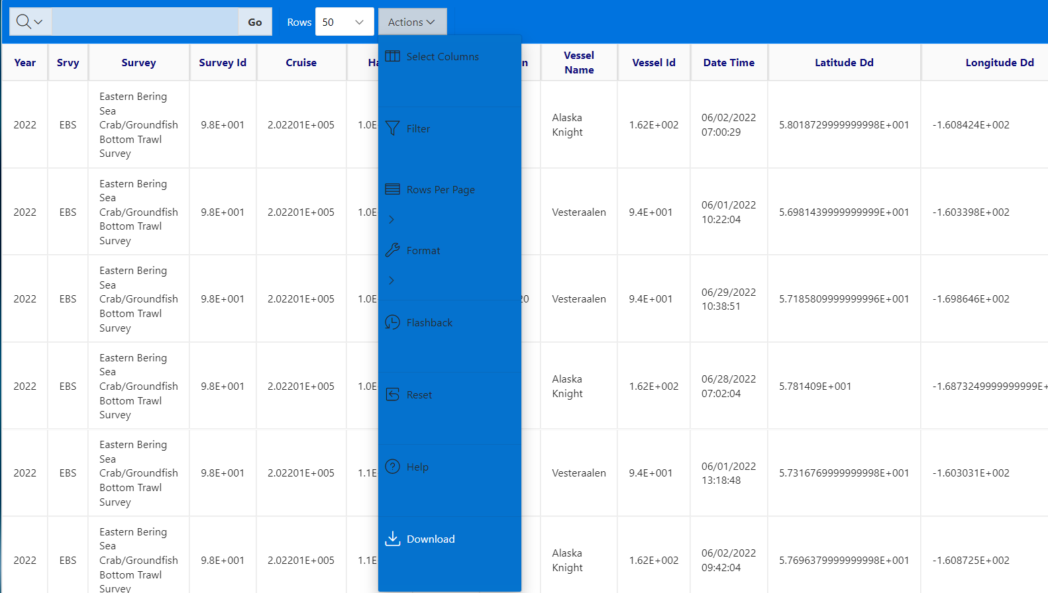
foss_5_run_report.png

Slide 6
OLD

Slide 7
Current Workflow
NEW SCHEMA
** draft table names
CURRENT TABLE
CURRENT SCHEMA
NEW TABLE**
R ENVIRONMENT
GAP_PRODUCTS
RACEBASE
HAUL
CATCH
PROUDCTION_CPUE
LENGTH
gapindex R Package
PRODUCTION_BIOMASS
SPECIES
PRODUCTION_SIZECOMP
DESIGN_TABLE
SPECIMEN
STRATUM
PRODUCTION_AGECOMP
STRATUM_GROUPINGS
RACE_DATA
V_CRUISES
METADATA_COLUMN
METADATA_TABLE

Slide 8
Proposed Workflow
NEW SCHEMA
CURRENT TABLE
GAP_PRODUCTS
CURRENT SCHEMA
RACEBASE
NEW TABLE
R ENVIRONMENT
PROUDCTION_CPUE
HAUL
PRODUCTION_BIOMASS
CATCH
PRODUCTION_SIZECOMP
LENGTH
PRODUCTION_AGECOMP
SPECIES
SPECIMEN
CRUISE
RACEBASE_FOSS
gapindex R Package
RACE_DATA
JOIN_CPUE_HAUL
DESIGN_TABLE
JOIN_CPUE_CATCH
STRATUM
STRATUM_GROUPINGS
[AKFIN]
METADATA_COLUMN
…
METADATA_TABLE

Slide 9
GitHub Workflow
metadata: support for table documentation
data-requests: non-standard data requests
gap_products: standard index production
gapindex
R Package
Other research and exploratory analyses
gap_bs_data_report and [goa/ai repo]: standard data reports
AKFIN data
model-based-indices: Model-based index production (ModSquad)
gap_public_data: FOSS data portal

Slide 10
Proposed Oracle Schema Workflow *schema names not final
RACE_DATA/REF Data tier 1: Reference tables that support all RACE shema. Read access to all users.
GAP_PRODUCTS
Data tier 3: Production-level tables for official use. Available to all users read-only
RACE_EDIT/ATSEA/RAW
Data tier 0-1: Tables directly from the boat. Supervisor/database manager-limited access.
RACEBASE_FOSS:
Data tier 4: Pipeline to OST. Available to all users read-only. Standard data ONLY.
gapindex R Package
RACEBASE/ RACE_DATA
Data tier 2: Cleaned internal use data. Includes nonstandard hauls, etc.
RACE_Archive Data tier NA: Stuff we are not emotionally ready to part with, but is basically useless
[AKFIN]
Data tier 4: Pipeline to AKFIN. Available to all users read-only. Data for Stock Assessments.

Slide 11
currrent * = new; italics = join
cpue_0fill
hauljoin
analysis_area
species_code
[cpue]
race_data
ref
race_base
gap_products
public (akfin/foss/gh)
affiliation
agency
…
cruise
cruisejoin
..[listing]
haul
hauljoin
species_code
[env]
performance
length
hauljoin
species_code
sex
length_class
frequency
*special_collection
cruisejoin
requester
Desc
[type]
targets
count_collected
performance
performance
description
vessel
vessel_id
…[listing]
bio_abund
cruisejoin (srvy+yr)
stratum
species_code
analysis_area
[count]
[biomass]
[abundance]
[cpue_mean]
prod data
catch
hauljoin
species_code
count
weight
taxon_conf
species_codetaxon_conf
species
species_code
…[listing]
voucher
cruisejoin
voucher_id
species_code
…
*stomach
hauljoin
species_code
sex
length_class
…
station_allocation
station
year
srvy
stratum
stratum
area
area_type
year_calc
special_collections
cruisejoin
requester
desc
targets
count_collected
specimen
cruisejoin
voucher_id
species_code
[taxonomics]
age_len_comp
cruisejoin (srvy+yr)
stratum
species_code
analysis_area
sex
comp (age/len)
value (age/len class)
abundance
len_[mean/sd] (age)
age_len_comp
cruisejoin (srvy+yr)
stratum
species_code
analysis_area
sex
comp (age/len)
value (age/len class)
abundance
len_[mean/sd] (age)
*count_field_collections
hauljoin
species_code
sex
type
desc
length_types
species_code
length_type
desc
station
station
area
area_type
year_calc
station_allocation
cruisejoin
requester
desc
targets
count_collected
Length_weight-age
species_code
[params]
desc

Slide 12
Current * = doesn’t exist yet
race_data
ref
race_base
gap_products
public (akfin/foss)
vessel
haul
catch tablet
performance
specimen tablet
net_mens
cpue_0fill
length tablet
gear_codes
station_allocation
(foss+akfin) Cpue_0fill
stomach tablet
cruise
marport sensors
haul_types
catch
marport app
stratum
akfin.bio_abund
wheelhouse
station
voucher
bio_abund
ES60
taxon_conf
species_ taxonomics
specimen
akfin.age_len_comp
light meter
photos
length
age_len_comp
length_types
shapefile, grids
*life_stages
CTD
affiliation
*age (age&growth)
*count_field_collections
length_ weight_age
*stomach (s lab)
meas_units
*special_collection
*atmospheric

