Slide 1
Ignite Title
Your Name Or Subtitle

Slide 2
Fill In A Text Box For Every Slide First

Slide 3
So That None Of Your Slides Are Blank

Slide 4
It Shouldn’t Be A Long Sentence That Goes On And On And On

Slide 5
Just A Word
Or Two

Slide 6
Flange

Slide 7
Or Shunt

Slide 8
You Don’t Want A Thing To Read

Slide 9
Just A Reminder Of What To Talk About

Slide 10
No One Wants To Read This. Or Watch You Read It

Slide 11
Besides, You’re Going To Replace Them With Pictures

Slide 12
Because No One Wants To Read “I Really Like Dogs”

Slide 13


Slide 14
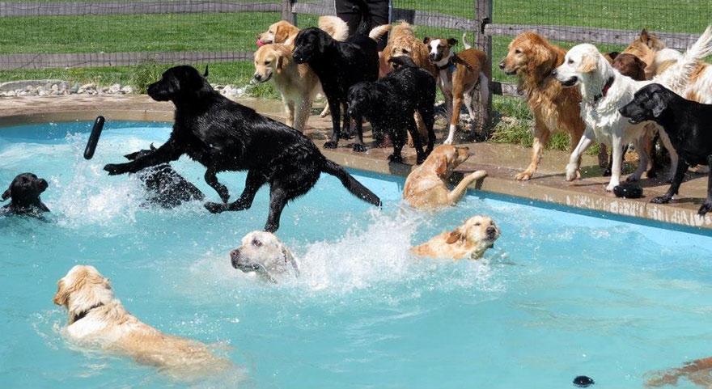

Slide 15


Slide 16
But If You Get Hung Up Looking For Pictures

Slide 17
At Least You’ve Got A Cue To Talk About

Slide 18
But If It’s Text, And You Improvise, People Will Know

Slide 19
But Not If It’s A Picture…

Slide 20
