Slide 1
Web engine – wikipedia
Yoad ben-David , elad duani

Slide 2
Contents:
Primary goals
indexing
Search function
Summary

Slide 3
PRIMARY GOALS
Learning and implementing the IR techniques learned in the course
Dealing with big data
Retrieving a precise results of 7M documents!
Dealing with bugs ;)

Slide 4
indexing
Body, anchor(hyperlinks), titles
THE TF-IDF SCORE WAS CALCULATED AT THE GENERATION OF THE INDEX IN ORDER TO SAME CALCULATION TIMES

Slide 5
The main deal: search(), the engine himself:
We used the following principals:
Tfidf (normalizing by max_term)
Cosine similarity (normalizing by max_term)
Page Ranking
Our idea of implementing was to take a percentages of the weights of each of our indexes

Slide 6
AREAS OF GROWTH
NO MATTER WHAT WE CHANGED IN THE FUNCTION, OR WHICH OTHER IDEA OF ALGORITHMS WE TRIED (with the same principals) the average stayed the same:
OF…..
TUDODUDODODDOOO

Slide 7
AVG TIME == ~1.3
AVG PRECISION == ~ 0.37

Slide 8
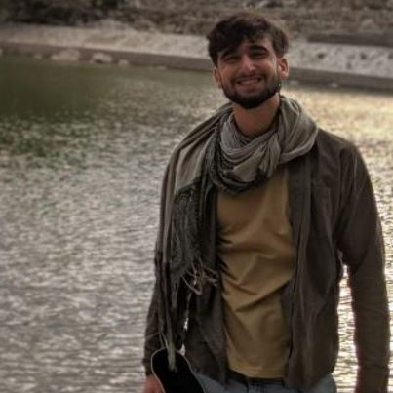
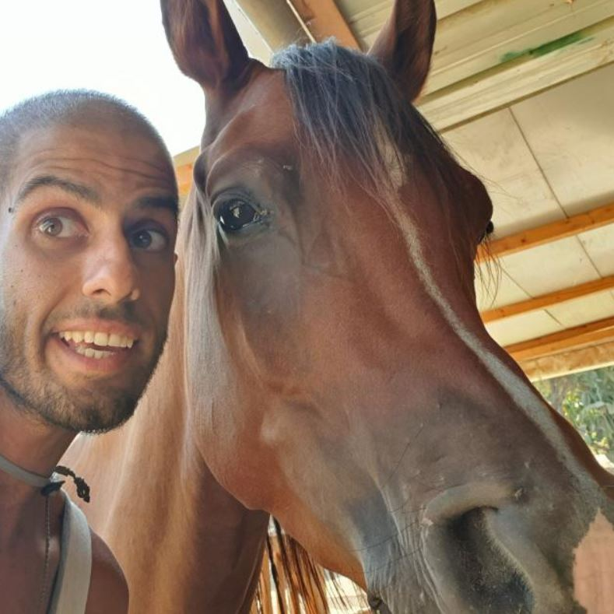
MEET OUR TEAM
Elad duani
Yoad ben david
President
Co-chief dev-ops

Slide 9
SUMMARY
We learned a lot of the project, although it was the hardest and most stressful so far, we improved our bugs capability, and mastering IR full power

Slide 10
THANK YOU
NIR GRINBERG
CLUSTER
INSTANCE
MEMORY

