Slide 1


Distributed System
Fault-Tolerant Key-value Server/client using MPI
Group Members:
1) Nguyen Minh Duong – USTHBI7-048
2) Vu Xuan Huy – USTHBI7- 084
3) Le Canh Duong – USTHBI7-047
4) Nguyen Minh Duc – USTHBI7 – 038
5) Pham Van Duan – USTHBI7 - 034

Slide 2
Outline
Fault-Tolerant Key-value Server/client using MPI
Introduction
Objective
State of the art
Methodology
Evaluation
Conclusion

Slide 3
INTRODUCTION
Fault-Tolerant Key-value Server/client using MPI

Slide 4
Why do we need this
A long trend in the high performance distributed systems is the increase of the number of nodes. As a consequence, the probability of failures in supercomputers and distributed systems also increases. So fault tolerance becomes a key property of parallel applications.

Slide 5
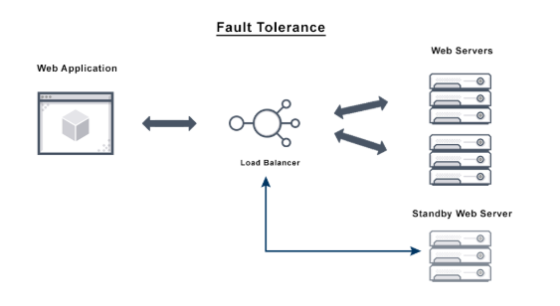
What ?
Faul-tolerant
The goal of fault tolerant computer systems is to ensure business continuity and high availability by preventing disruptions arising from a single point of failure. Fault tolerance solutions therefore tend to focus most on mission-critical applications or systems.

Slide 6
What ?
Key-value
A key-value store, or key-value database, is a data storage paradigm designed for storing, retrieving, and managing associative arrays, a data structure more commonly known today as a dictionary or hash. Dictionaries contain a collection of objects, or records, which in turn have many different fields within them, each containing data.

Slide 7
What ?
Message-passing Interface (MPI)
MPI is a library specification for message-passing, proposed as a standard by a broadly based committee of vendors, implementors and users.
MPI consists of a header file "mpi.h", a library, a runtime system
MPI can be used with c/c++, fortran

Slide 8
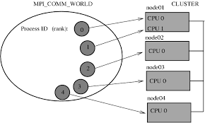
What ?
Messeage-passing Interface (MPI)
MPI is a specification for the developers and users of message passing libraries.
MPI primarily addresses the message-passing parallel programming model: data is moved from the address space of one process to that of another process through cooperative operations on each process.

Slide 9
OBJECTIVE
Fault-Tolerant Key-value Server/client using MPI

Slide 10
Our goal
The goal of fault tolerant computer systems is to ensure business continuity and high availability by preventing disruptions arising from a single point of failure. In this project, we try to create the ability to respond to a power failure.

Slide 11
State of the art
Fault-Tolerant Key-value Server/client using MPI

Slide 12
High Availability
High availability (HA) is the ability of a system or system component to be continuously operational for a desirably long length of time.
Fault tolerant systems provide an excellent safeguard against equipment failure, but can be extraordinarily expensive to implement because they require a fully redundant set of hardware that needs to be linked to the primary system. High availability architecture is much more cost effective, but also bring with them the possibility of costly downtime, even if that downtime only lasts for a few moments.

Slide 13
Disaster Recovery
While high availability and fault tolerance are exclusively technology-centric, disaster recovery encompasses much more than just software/hardware elements. HA and FT focus on addressing the isolated failures in an IT system. DR, on the contrary, deals with failures of a much bigger scope, as well as the consequences of such failures. Incorporating high availability or fault tolerance cannot ensure protection from disasters, but both of them can complement disaster recovery strategies in an efficient manner.

Slide 14
Methodology
Fault-Tolerant Key-value Server/client using MPI

Slide 15
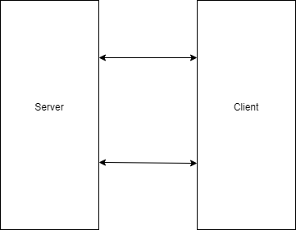
4. Method

Slide 16
4. Method
MPI_Init() starts the MPI runtime environment.
MPI_Finalize() shuts down the MPI runtime environment.
MPI_Comm_size() get the number of processes, Np
MPI_Comm_rank() gets the process ID of the current process which is between 0 and Np-1

Slide 17
4. Method
MPI_Open_port() open the port
MPI_Comm_connect() to connect
MPI_Comm_disconnect() to disconnect
MPI_Comm_accept accept the connect
MPI_Send() send a message from the current process to another process (the destination)
MPI_Recv() receives a message on the current from another process(the source)

Slide 18
4. Method
Nearly all MPI functions return an integer status code:
MPI_SUCCESS if the function completed without error,
Otherwise an error code is returned,

Slide 19
4. Method
Nearly all MPI functions return an integer status code:
MPI_SUCCESS if the function completed without error,
Otherwise an error code is returned,

Slide 20
4. Method
Compiling a program for MPI is almost just like compling a regular C or C++ program
The C complier is mpicc and the complier is mpic++
For example , to compile hello.c
"mpicc hello.c -o hello"

Slide 21
4. Method
Set key and value
Get key and show value of key
Delete the key with value

Slide 22
Conclusion
Fault-Tolerant Key-value Server/client using MPI

Slide 23
5. Conclusion
What we have done
Simple server/client using MPI
What we have not done
Apply fault tolerance key value

Slide 24
Some materials
An introduction to MPI by William Gropp and Ewing Lusk, Argonne National Laboratory
MPI Programming Model: Desert islands Analogy by Henry Neeman

Slide 25
6. Demo
Demo

Slide 26

Thank You For Listening

