Slide 1
Retrieval Augmented Generation
Duarte Santos – 124376

Slide 2
Table of Contents
What is RAG?
RAG structure
Advantages and Limitations of RAG
RAG Use Cases
Conclusions

Slide 3
What is Retrieval Augmented Generation?
RAG is a framework, proposed by Patrick Lewis in 2020, that combines retrieval-based systems with generative AI models to improve the relevance and accuracy of generated content.
This approach leverages both explicit knowledge from retrieved documents and the implicit knowledge encoded in language models, resulting in more accurate and context-sensitive responses.

Slide 4
RAG Components
Retrieval: The system queries a knowledge base or external data source (e.g., databases, documents, or APIs) to fetch relevant context or information based on the input prompt
Generation: A generative model, such as GPT, uses the retrieved information to produce a coherent and contextually accurate response or output

Slide 5
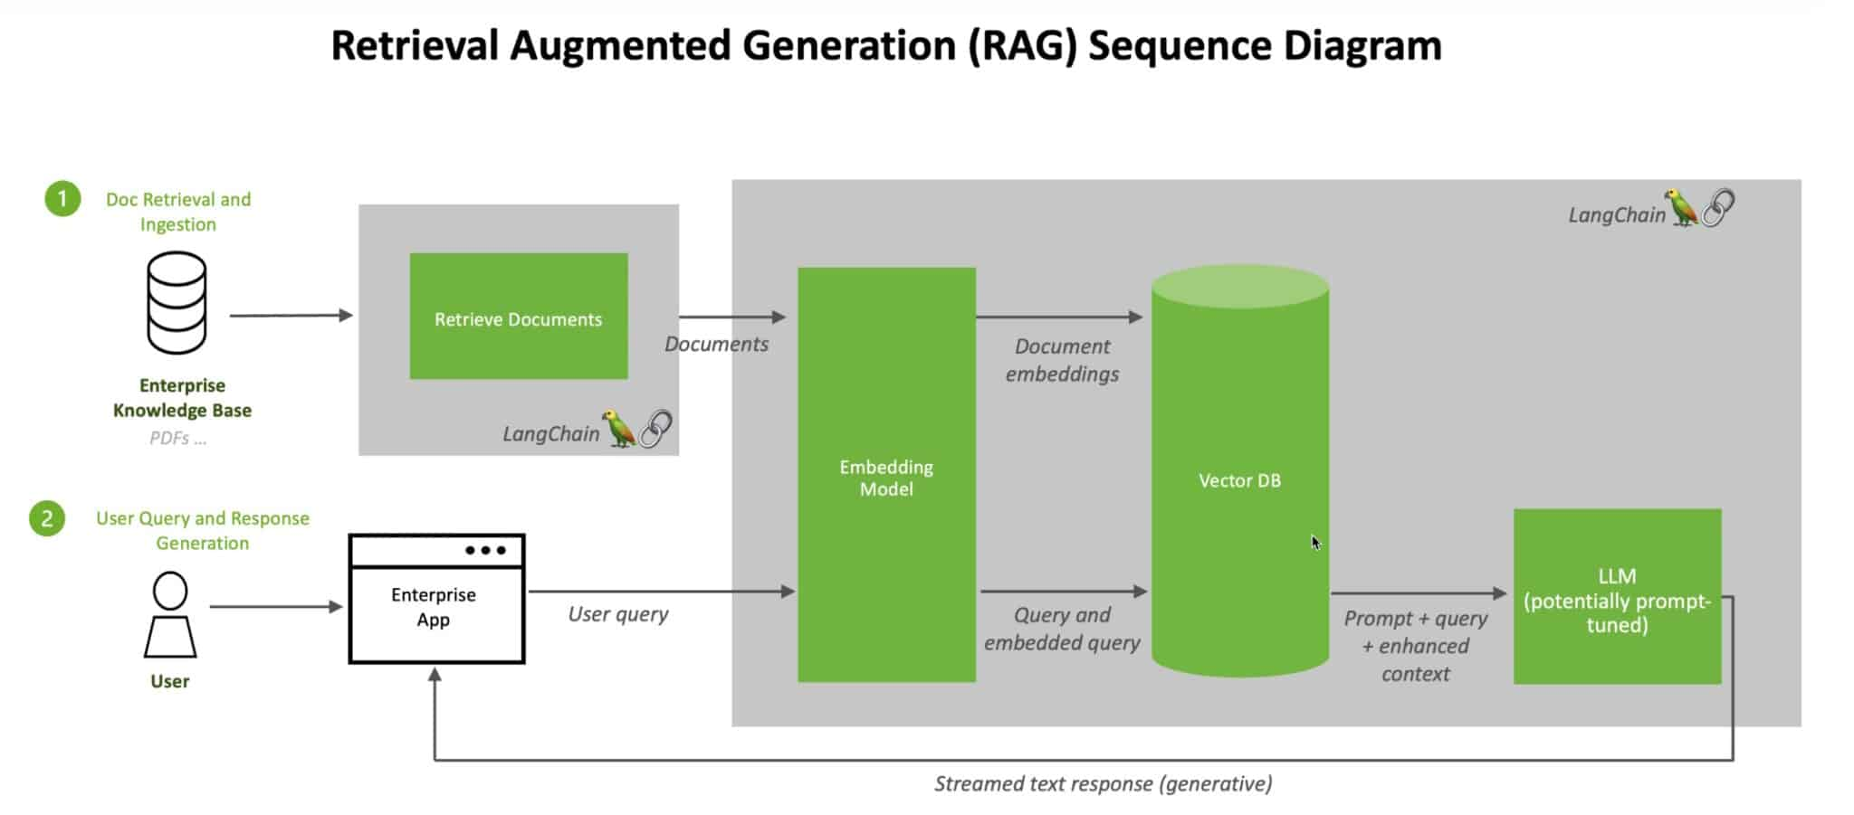
How RAG works?
https://blogs.nvidia.com/blog/what-is-retrieval-augmented-generation/

Slide 6
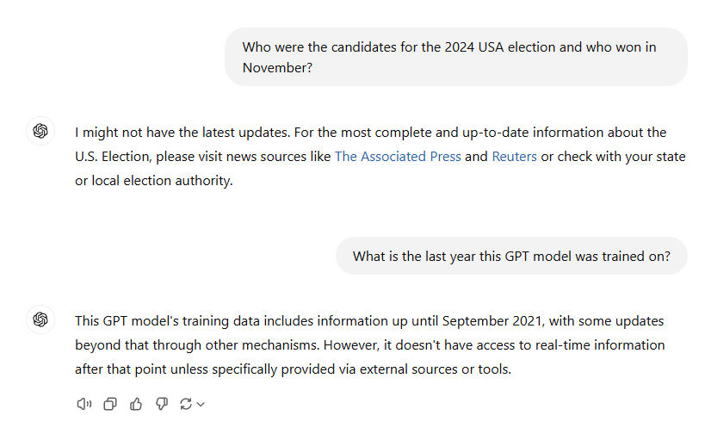
RAG Example

Slide 7
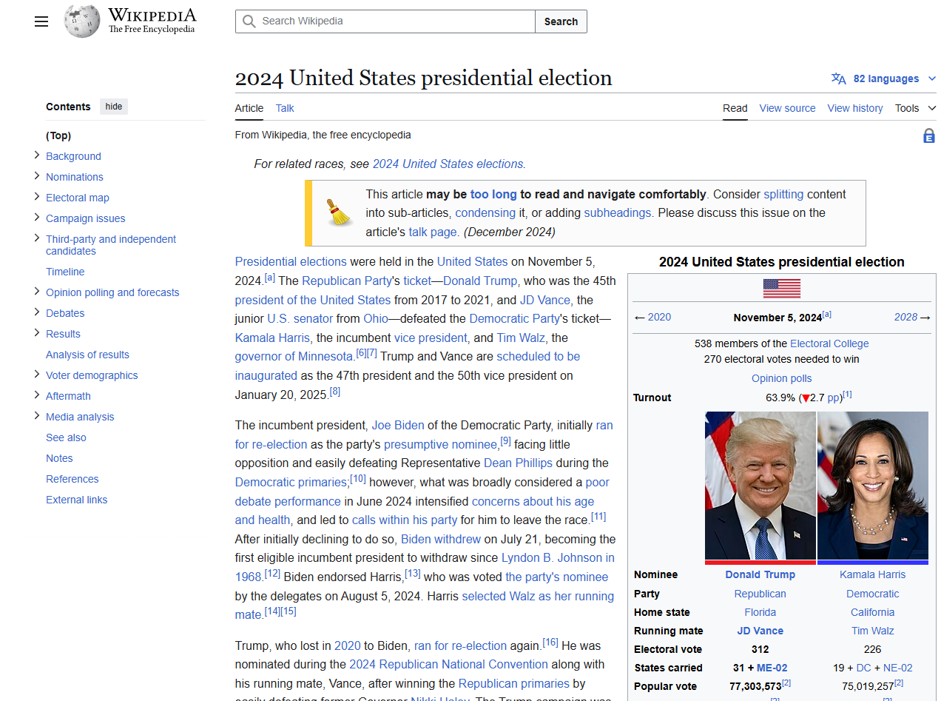
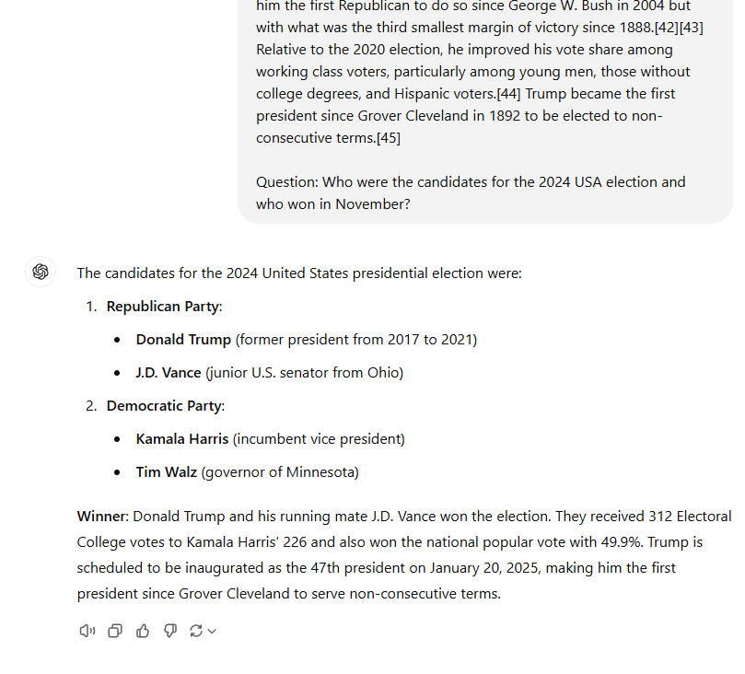
RAG Example
https://en.wikipedia.org/wiki/2024_United_States_presidential_election

Slide 8
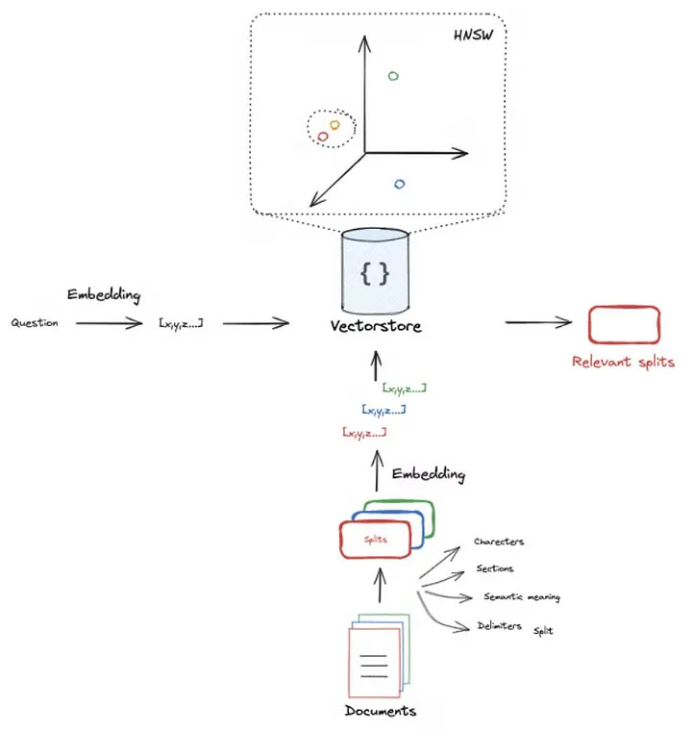
Embeddings improvements
Split the documents into smaller chunks to enable faster searching and more specific retrieval.
https://medium.com/@dinabavli/rag-basics-basic-implementation-of-retrieval-augmented-generation-rag-e80e0791159d

Slide 9
Advantages and Limitations of RAG
Improved Accuracy
Reduced LLMs Hallucinations
Modularity
Dynamic Knowledge Update
Domain Adaptability
Complex Architecture
Latency
Potential for Irrelevant Context
Scalability of Retrieval

Slide 10
RAG Use Cases
Customer Support Chatbots
Scientific Research
Legal Assistance
Enterprise Document Search

Slide 11
Future of RAG
Integration with Real-Time and Dynamic Knowledge
Multilingual retrieving and synthesizing evidence from diverse multilingual sources
Multimodal data (images, vídeo, sound etc...) support
Smaller Models with External Knowledge

Slide 12
Conclusions
Retrieval Augmented Generation offers flexibility, adaptability, and efficiency, making it ideal for a wide range of use cases.
As research and technology progress, RAG systems will become more sophisticated, real-time, and domain-specific, opening new frontiers for AI applications

Slide 13

Questions?

