Slide 1


Artificial Life
Fluid and Particle Density Simulation
Henrique Matos – 64369
Duarte Gonçalves - 64465

Slide 2
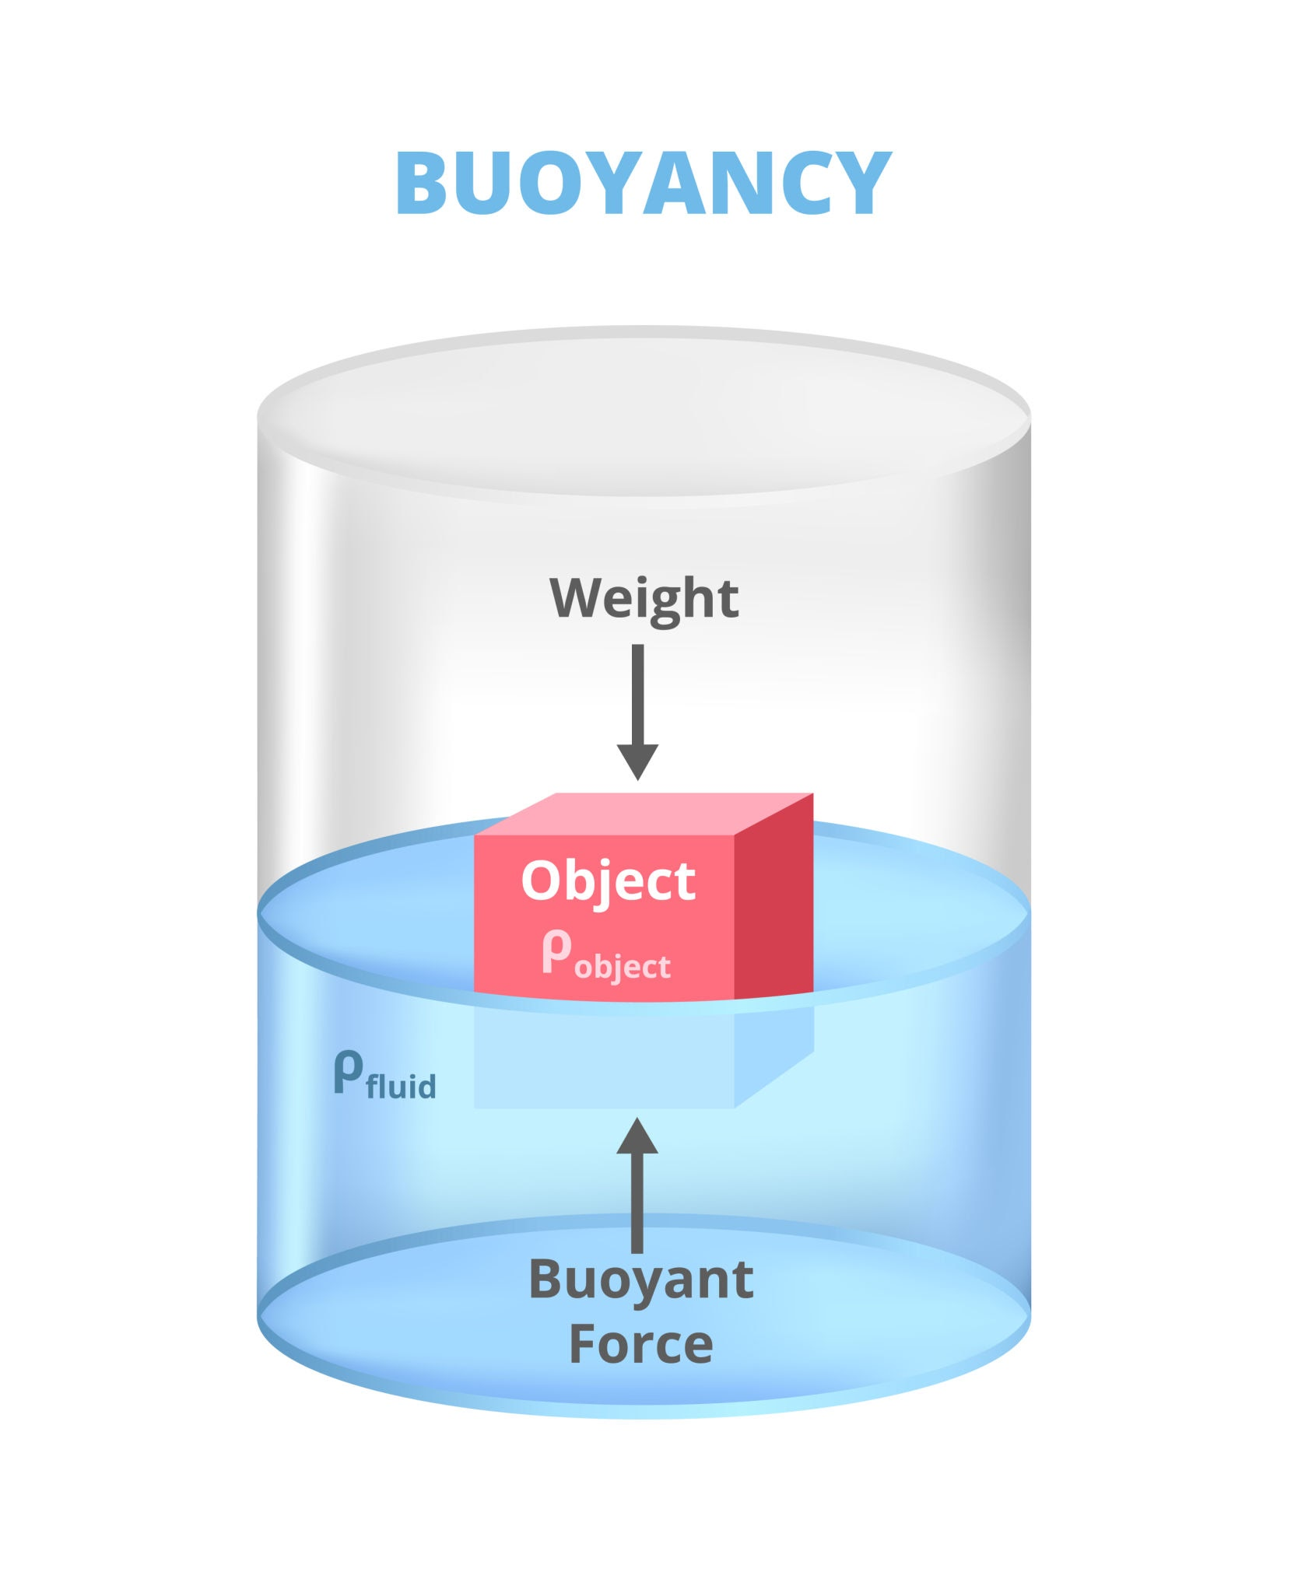
Objectives
A Tube filled with liquid will have two bodies:
The first will fall into the tube, to observe buoyancy;
The second one, with different density will emerge from the bottom to observe buoyancy as well;
Interactability with GUI;
Buoyancy Effect

Slide 3


Development Tools
Java 1.8
Framework – Processing Java Library

