Slide 1
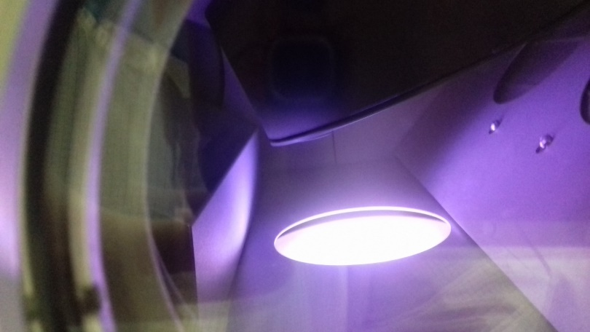
Lab 1 – Vacuum systems and components
In this lab the students should become familiar with several vacuum systems at INESC-MN and understand the basic modules of a vacuum system.
Topics to address: Creating vacuum. vacuum pumps, chambers and valves. Automation of the pumping cycles. Principles and hands-on.
The preparation for the experimental work in a vacuum system requires the students to research on the following topics:
What is a vacuum system?
What are the main components in a vacuum system?
How can the pressure be read?
Why the need of low pressure systems in microtechnologies for materials deposition and patterning.
Measuring pressure down to 10⁻⁹ Torr: reviewing different gauges and their principles of operation. De-assembly of a pressure sensor for filament cleaning.
Monitoring pumping speed using mechanical pumps, turbomolecular pumps and cryogenic pumps.

Slide 2
QUIZ -1
1- Qual a pressão típica medida nos seguintes sistemas:
Dentro de uma lâmpada de filamento………………….
Num aspirador doméstico…………………………………….
Num túnel de um acelerador de partículas…………..
Numa câmara de deposição de grafeno (durante a deposição)
Numa câmara de deposição de filmes finos cristalinos (eg. molecular beam epitaxy MBE durante a deposição)
2- Como funcionam os sensores de pressão do tipo Pirani, do tipo Penning e de filamento quente (Bayard-Alpert)?
3- Como funcionam as bombas de vácuo: rotativas, turbomoleculares e criogénicas?

Slide 3
Lab 2 – Reading the pressure
In this lab the students should become familiar with one vacuum machine (Nordiko 2000), and understand the mechanisms for reducing the pressure inside the chamber and the ultimate pressure reachable with the pumps used.
The experimental work will focus on the following points:
Design the vacuum schematics of the machine, in particular the chamber under study (Nordiko 2000 machine)
Understand the sequence of steps needed to pump the chamber from atmospheric pressure, and then vent the chamber from low pressures.
Measure in real time the chamber pressure, during the pumping and venting cycles
At the end of the work, the students should comment on:
Identify the pump specifications, and estimate the ultimate pressure the chamber could achieve

Slide 4
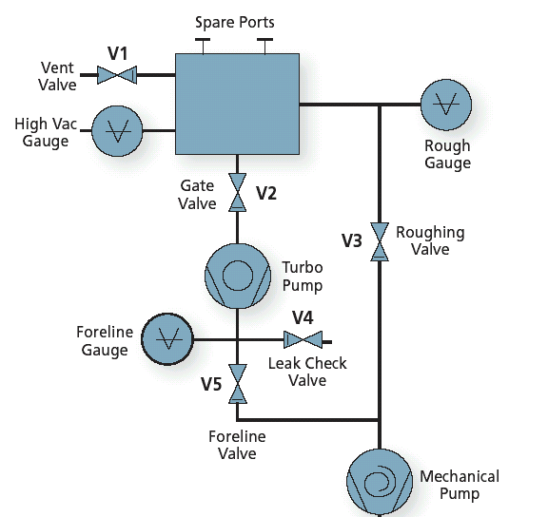
QUIZ - 2
1- Qual a sequência de passos necessários para fazer
o venting de uma câmara que está a 10⁻⁸ Torr?
[use os elementos do esquema ao lado para ilustrar a sequencia de passos,
identificando ex. quais as válvulas abertas/fechadas e bombas ligadas/desligadas, etc]
2- Qual a sequência de passos necessários para bombear uma
câmara desde a pressão atmosférica até 10⁻⁸ Torr?
[use os elementos do esquema ao lado para ilustrar a sequencia de passos,
identificando ex. quais as válvulas abertas/fechadas e bombas ligadas/desligadas, etc]
3- No esquema ao lado, o que mudaria se a bomba de alto vácuo fosse
Uma bomba criogénica, em vez de turbomolecular?
4- Como é feita a medida da pressão enquanto é bombeada desde a pressão atmosférica até 10⁻⁸ Torr?
5- Quantas (e quais) bombas de vácuo e válvulas são necessárias para bombear um sistema até 10⁻⁸ Torr?
Notes:
https://www.instructables.com/Venting-a-Vacuum-Chamber/

Slide 5
Lab 3 – Advanced functionalities in a vacuum system
In this lab the students should identify the basic components needed to build a complex tool based on a vacuum system.
Several examples will be described and the students should provide a short description of:
Mechanisms used for the manipulation of samples in vacuum environments
Mechanisms and feedthroughs for optical, electrical, thermal, characterization of processes inside a chamber
Materials compatible with vacuum systems.
Gas and water handling in vacuum chambers.
Photo
Schematics
Brief description of the component
----------------------------------------------------
--------------------------

Slide 6
Lab 4 – Leaks and vacuum quality
In this lab the students should become familiar with the methods used for vacuum quality monitoring
The experimental work will focus on the following points:
Identify possible causes for leaks, leading to an increase of the base pressure
Measuring the atmosphere inside a vacuum system using a residual gas analyzer for mass spectroscopy.
Monitoring the air molecules partial pressure during pumping cycles from atmosphere pressure (~10² Torr) down to ~10⁻⁷ Torr. Leak detectors.
How to: Perform a leak test using Helium and a leak detector

Slide 7
QUIZ - 3
1- Identifique algumas caracteristicas dos components de vácuo para conseguir atingir pressões inferiores a 10⁻⁸ Torr.
2- Como distinguir se uma fuga na câmara de vácuo é causada por uma abertura ao ar ou à água?
3- Investigue sobre estratégias para eliminar a água na atmosfera de uma câmara de vácuo.

Slide 8
