Slide 1
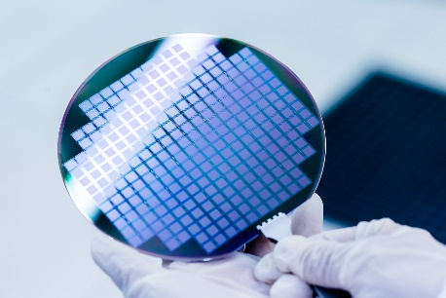
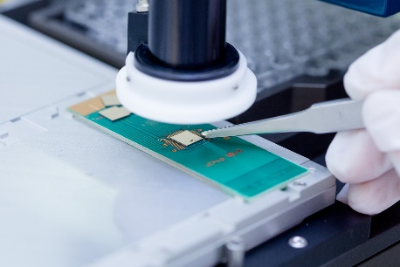
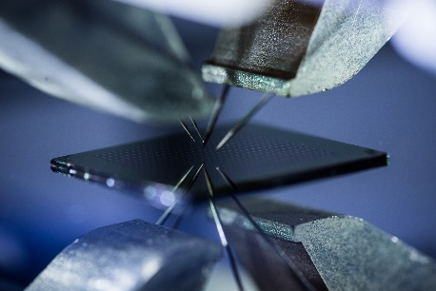
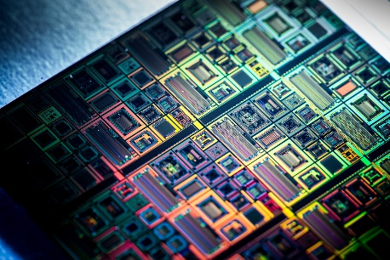
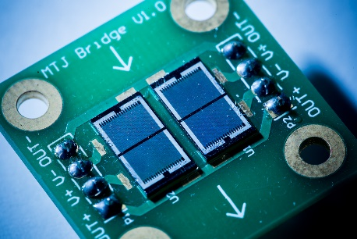
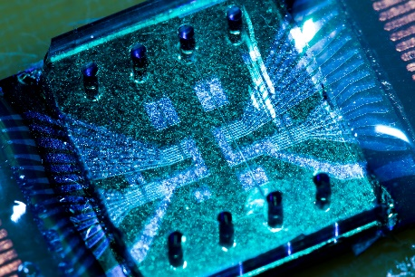
Round Table
MPW #15 Report
Maria Carvalho – Rita Macedo - Susana Cardoso

Slide 2
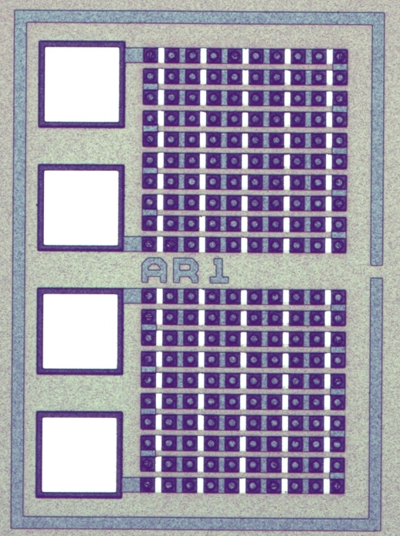
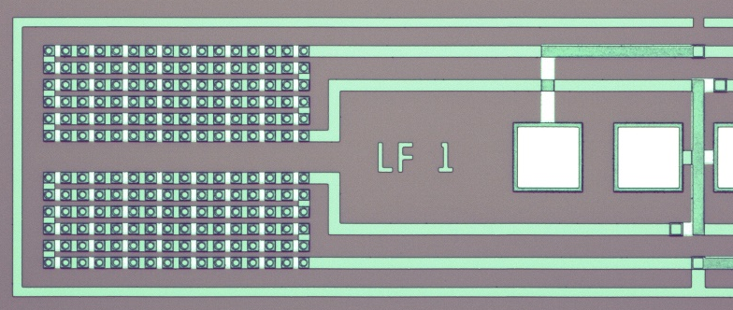
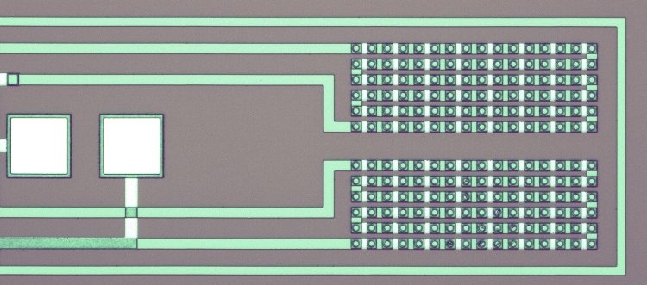
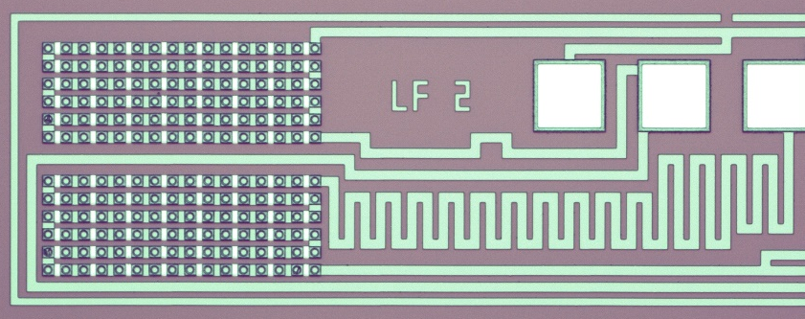
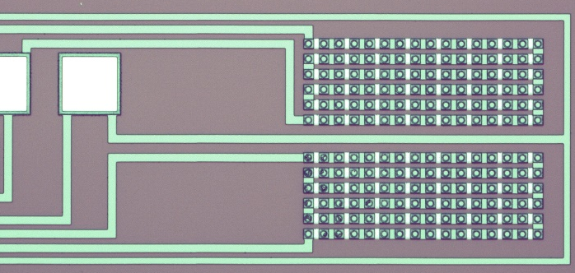
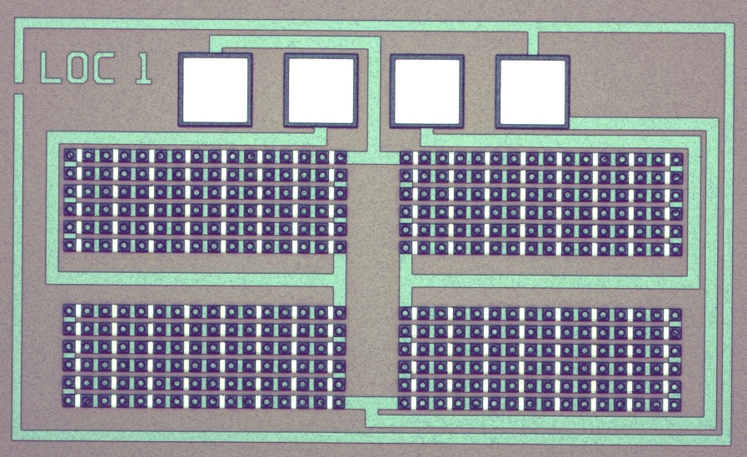
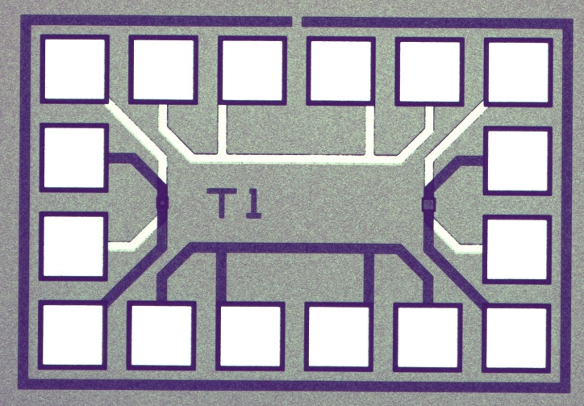
6 Passivation II
6.1 – SiO₂ deposition
Thickness deposited: 3000 Å
Conditions: 300°C
6.3 - SiO₂ etch
Recipe: SiO2_Vias_etch_112s
Nominal etch time: 112s,
0% overetch
6.4 - Ashing
Recipe: O2_Ashing_15mT_240s
6.5 – TiWN removal
Etch steps: 200s @ 60°

