Slide 1
Network and Computer Security
NotIST: Secure Note-Taking Application

Slide 2
Project Overview
Local-first architecture prioritizing security
End-to-end encryption for all sensitive data
Secure collaboration features
Strong authentication and access control
Addressing the growing need for private, secure note-taking solutions

Slide 3
Secure Document Format
Security Requirements
[SR1] Confidentiality: Only authorized users can access content
[SR2] Integrity: Tamper detection for individual notes
[SR3] Integrity: Detection of missing notes
[SR4] Authentication: Only owners can access their notes
Implementation
AES-CBC for content encryption
HMAC-SHA256 for integrity verification
Unique symmetric key per note

Slide 4
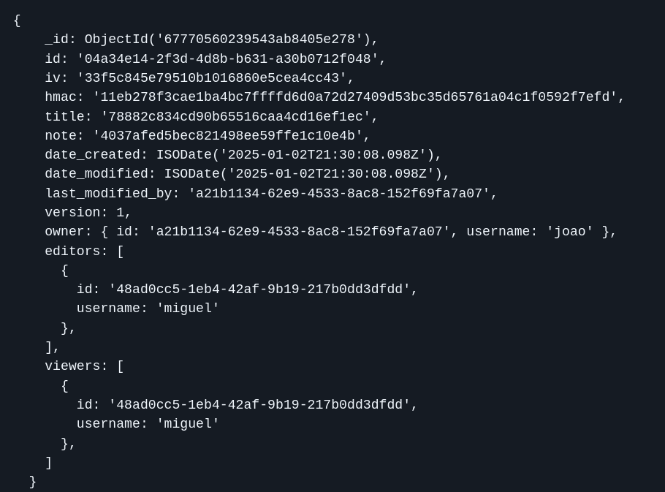
Secure Document Format
Locally a note is a folder with:
encrypted note key in a file
all encrypted versions of the note in separate files
Encrypted fields: title, note, hmac
Integrity protection: HMAC covers all encrypted content

Slide 5
Security Architecture
Key Management
Master Key: Derived from user password (PBKDF2)
Note Keys: Unique symmetric key per note
User Keys: Public/private key pair for sharing
Authentication
Digital signatures on all requests
Timestamp verification for replay protection
Public key infrastructure for identity verification

Slide 6
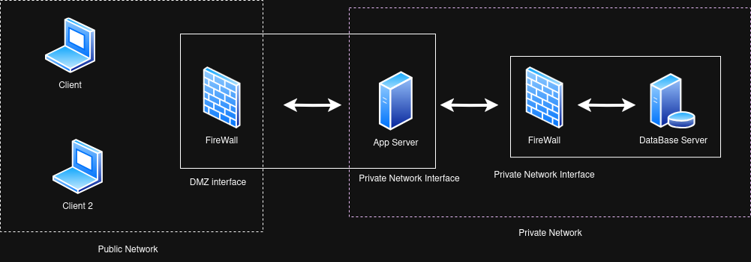
Infrastructure Setup
Components
Client Application (Python TUI)
Application Server (192.168.1.228:5000)(192.168.56.15:27017)
Database Server (192.168.56.17:27017)
Security Measures
TLS for client-server communication
Mutual TLS between servers
Firewall rules on both servers
Network segregation for database
Vagrant to provision and easily deploy

Slide 7
Security Challenge Implementation
Requirements
[SRA1] Authentication: Only authorized access
[SRA2] Integrity: Verify note content
[SRA3] Version Integrity: Track changes securely
Solution
End-to-end encryption with public key infrastructure
Secure key distribution for collaboration
Version control with cryptographic verification

Slide 8
live demo…

Slide 9
Conclusions
Achievements
Secure local-first architecture
Strong encryption and integrity protection
Secure collaboration features
Comprehensive access controls
Future Enhancements
Key rotation mechanism
Advanced access control features

