Slide 1
Network and Computer Security
NotIST: Secure Note-Taking Application
Grupo A62: Duarte São José, João Maçãs, Miguel Parece

Slide 2
Local Security
Secure Document
[SR1] Confidentiality: Only the owner of the notes can see their content.
[SR2] Integrity: The owner of the notes can verify they were not tampered with.
[SR3] Integrity: The owner of the notes can verify if some note is missing.
[SR4] Authentication: Only the owner of the notes can access them.
Implementation
AES-CBC for content encryption
HMAC-SHA256 for integrity verification
Unique symmetric key per note

Slide 3
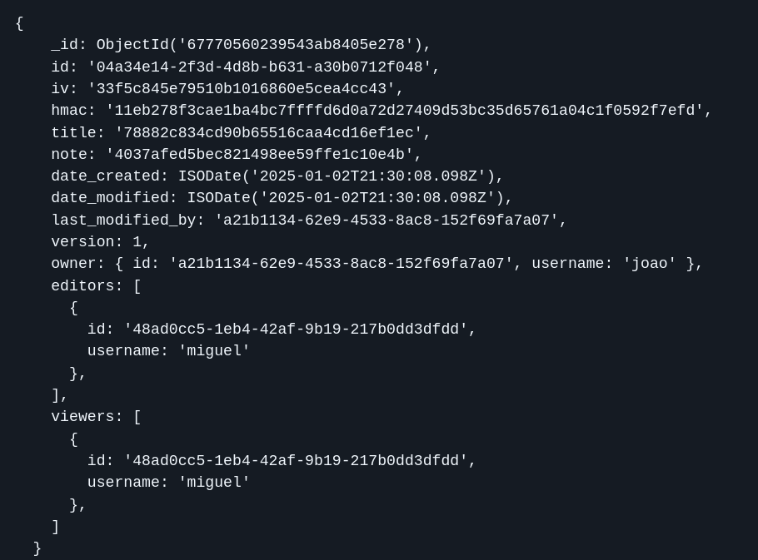
Secure Document Format
Locally a note is a directory with:
The note key encrypted in a file
All encrypted versions of the note in separate files
Encrypted fields: title, note
Integrity protection: HMAC covers all encrypted content

Slide 4
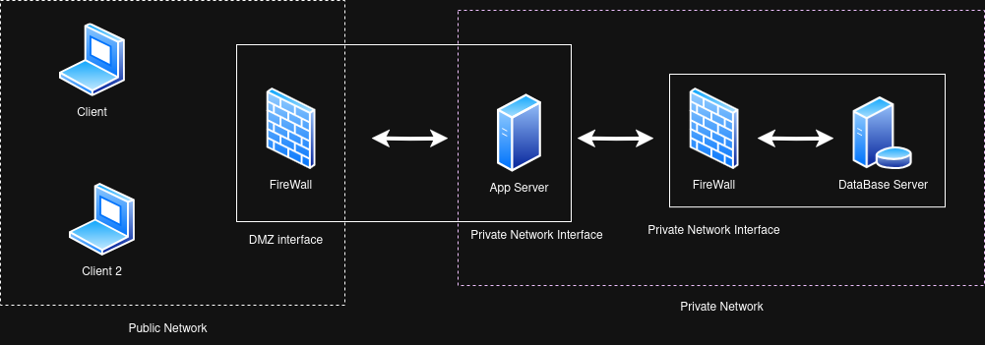
Infrastructure Setup
Components
Client Application (Python TUI)
Application Server (192.168.1.228:5000) (192.168.56.15)
Database Server (192.168.56.17:27017)
Security Measures
TLS for client-server communication
Mutual TLS between servers
Firewall rules on both servers
Network segregation for database
Vagrant to provision and easily deploy

Slide 5
Security Architecture
Keys
Master Key (memory only): Derived from user password (PBKDF2)
Note Keys: Unique symmetric key per note
User Keys: Public/private key pair for sharing
Security
Digital signatures on all requests
Timestamp verification for replay protection

Slide 6
Security Challenge Implementation
Requirements
[SRA1] Authentication: Only authenticated and authorized users can see the content of the notes.
[SRA2] Integrity: Anyone that has access to the note can verify its integrity.
[SRA3] Integrity: It is possible to verify the integrity of the notes throughout their versions.
Solution
End-to-end encryption with public key
Secure key distribution for collaboration
Version control on the server-side

Slide 7
Live demo…
MasterKey KDF, KeyPair, Local File
Create and edit note -> push explain the request
Key sharing

Slide 8
Conclusions
Main Results
Successfully achieved all the security goals outlined in the requirements.
Identified additional vulnerabilities that could be addressed in future iterations for enhanced security.
Key Learnings
Gained in-depth knowledge of encryption techniques and their implementation in Python.
Explored the principles and challenges of building local-first applications, emphasizing user control and offline functionality.

