Slide 1
MULTIAI
Multi-AI Response Interface & Comparison Platform
One Prompt. Multiple AI Perspectives. Intelligent AI Workspace.
Student Team Members:
• D. Sathwik (2451-24-751-016) • E. Sahithi (2451-24-751-017) • K. Harshil (2451-24-751-024)
Project Supervisor: Dr. MVR Jyothisree, Associate Professor, Dept. of CSE-Allied, MVSREC

Slide 2
Project Abstract
Core Motivation & Methodology:
In the current Artificial Intelligence paradigm, engineers and researchers face severe interface fragmentation when querying different Large Language Models (LLMs). Each LLM service has distinct response tones, accuracy variations, and latency rates. Multi-AI addresses this friction by introducing a unified response interface and comparison playground.
Key Project Highlights:
• Parallel Broadcasting: Executes prompts concurrently across Google Gemini, Liquid LFM, Groq Llama, Qwen HF, and Cohere.
• Intelligent Workspace Features: Provides automatic consensus summaries, AI-selected best responses, voice speech conversions, and collaborative AI debate simulators.
• Session Resiliency: Uses Mongoose bulkWrite syncing configurations to ensure secure data tracking without data loss.

Slide 3
Problem Statement
Current Disorganized Workflow
• Repeated Prompting: Typing identical prompts across multiple model portals.
• Too Many Tabs: Desktop clutter with multiple browser windows open.
• Time Consuming: Manual page swapping takes minutes instead of seconds.
• No Latency/Token Metrics: Lack of structured API metrics for benchmarking.
• Workflow Interruption: Disrupts development cycles and research flows.
The Multi-AI Unified Solution
• Unified Input Dock: One centralized prompt bar submits queries to all selected targets.
• Parallel Async Fetch: Resolves responses concurrently using event loops.
• Automatic Consensus: Generates combined consensus summaries dynamically.
• Secure Vault: Local browser encryption for custom keys storage.
• Dynamic Grid layouts: Auto-scales cards based on model selection.

Slide 4
Project Objectives
Unified AI Workspace
Consolidate multiple LLM integrations under a single panel.
Response Comparison
Display side-by-side answers for real-time benchmark analysis.
Reduce Website Switching
Eliminate multi-tab browser swapping for prompt testing.
Improve Productivity
Compare logic outputs in seconds rather than minutes.
Scalable Integrations
Easily expand backend connectors for new upstream providers.
Resilient Session Syncs
Protect logs and system settings via differential bulk write operations.

Slide 5
Project Scope
Current Development Scope:
• Concurrent APIs: Integrations with Gemini, Groq, Qwen, Liquid, Cohere.
• Core AI Tools: Automated Consensus summaries, Best Response rating judge.
• Synchronized State: Differential MongoDB syncing using Mongoose bulk writes.
• Secure Vault: Secure local vaults managing developer keys.
Future Roadmap Expansion:
• Image Analysis: Upload image assets for object categorization.
• OCR Scanning: Parse local documents and PDFs into prompt contexts.
• Extension Addons: Browser plugins for instant sidebar prompting.
• Cloud Sync: Secure remote key syncs using zero-knowledge encryption.

Slide 6
Application Areas
Education
Students and academic scholars compare model reasoning pathways and logic formats side-by-side.
Software Development
Developers review code snippet alternatives generated concurrently to select optimal scripts.
Research
Prompt engineering researchers benchmark model latencies, token lengths, and response qualities.
Business
Marketing teams contrast copywriting models to select the most engaging tone variations.
Content Creation
Writers leverage model styling instructions (Expertise presets) to speed up editorial creation.
Personal Productivity
Individuals run unified automated daily workflows without multi-tab playground browser switching.

Slide 7
Existing System Deficiencies
Feature | Traditional Playgrounds | MULTIAI Workbench
Model Panel views | Single panel or Sequential selection | Side-by-side dynamic grid panels
Execution Routing | Linear queries, slow models block threads | Parallel async execution (Promise.allSettled)
Consensus summaries | None, user manual comparison | AI-synthesized consensus fallbacks engine
Key vaults (BYOK) | Account wide or none (exposes keys) | Local vaults managed via client-side storage
Session Sync | Clears & replaces records (data loss risks) | Resilient Mongoose differential bulkWrite syncs

Slide 8
Proposed System Workflow
User Prompt
Text or voice queries entered in central bar.
Multi-AI Router
Express gateway maps parallel integrations.
Parallel Fetch
Concurrently query Gemini, Groq, Cohere API.
Unified Display
Typewritten cards display latent statistics.

Slide 9
Technology Stack
Frontend
Client Presentation Layer
• HTML5 & CSS Variables • ES6+ JavaScript • Chart.js Visualization • Web Speech API
Backend Gateway
REST APIs Router Layer
• Node.js runtime • Express.js framework • Axios Http client • JWT Token security
Database Layer
Session Data Storage
• MongoDB Community • Mongoose ODM mapping • Resilient bulkWrite syncs • Database fallbacks
AI Providers
Third-party APIs Layer
• Gemini Flash REST • OpenRouter Gateway • Groq Cloud API • Cohere Command SDK

Slide 10
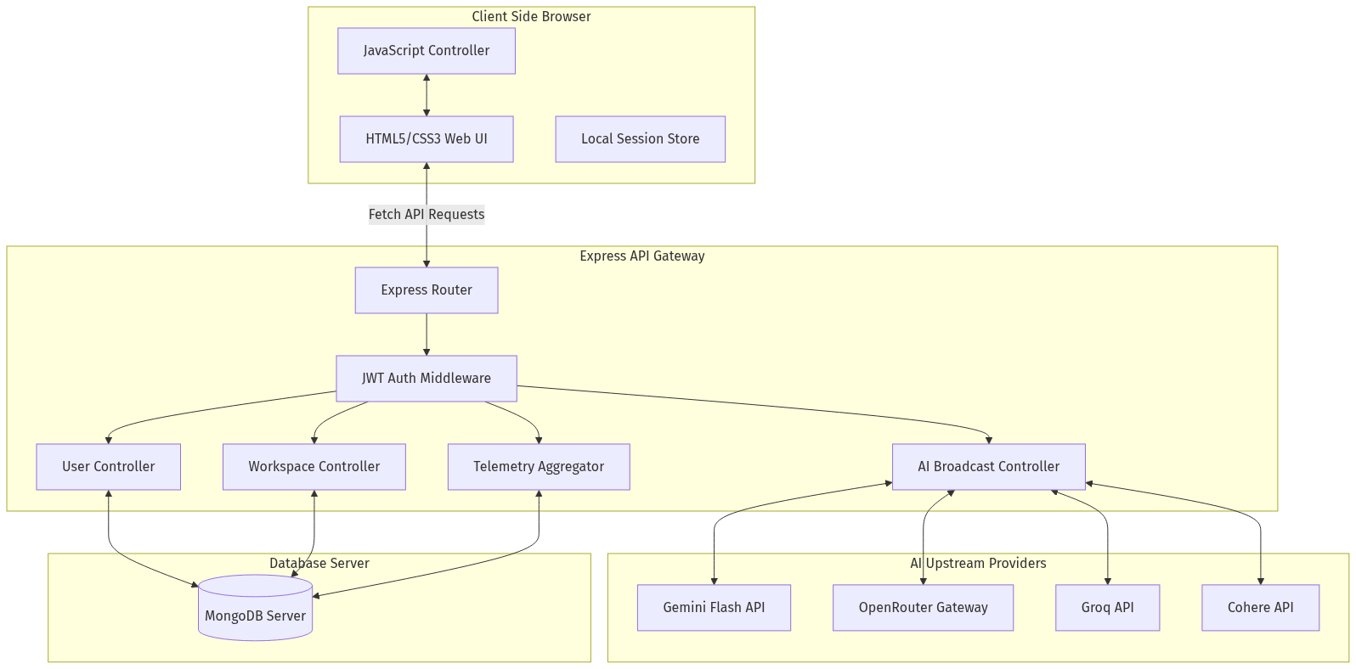
System Architecture Diagram

Slide 11
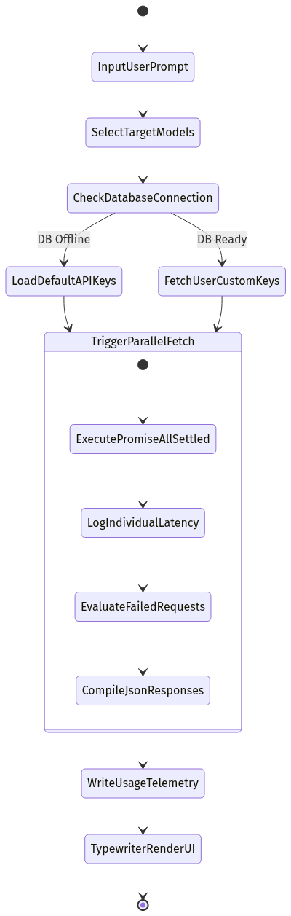
System Flowchart

Slide 12
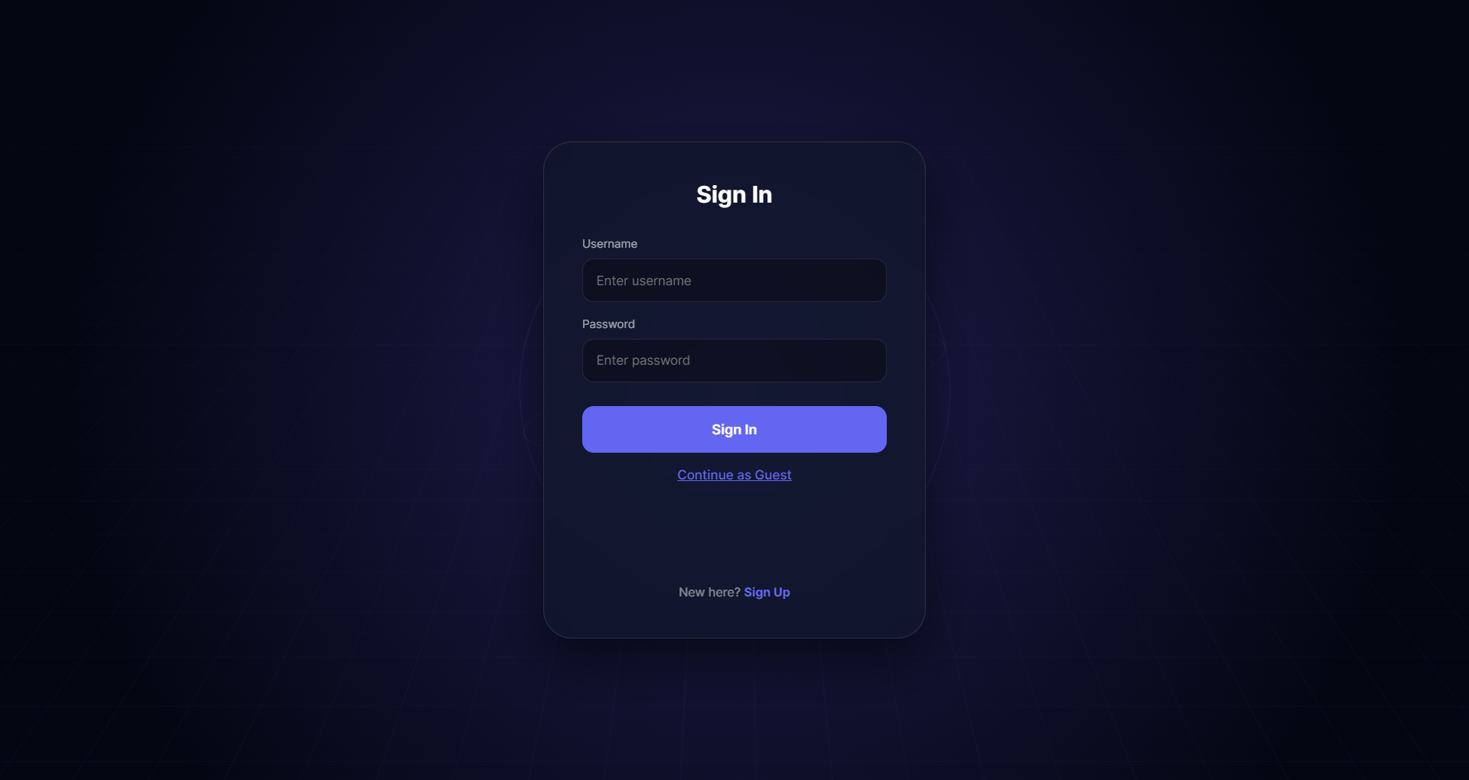
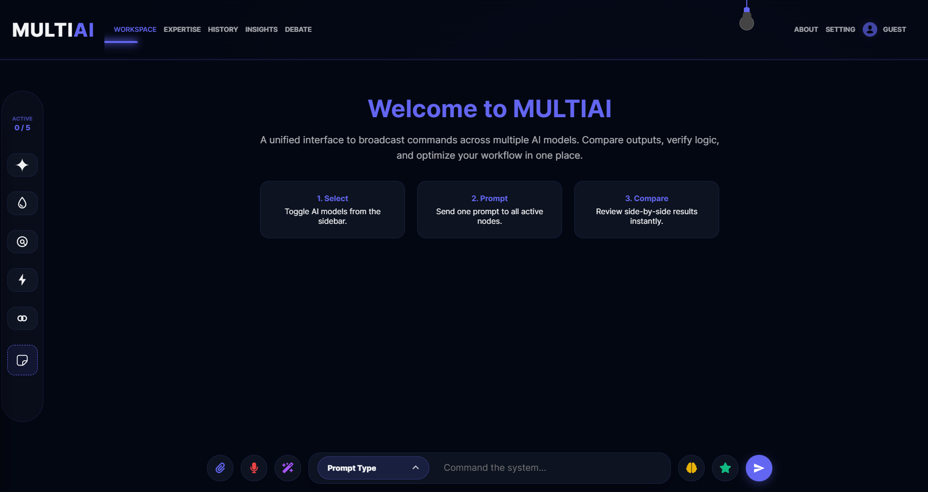
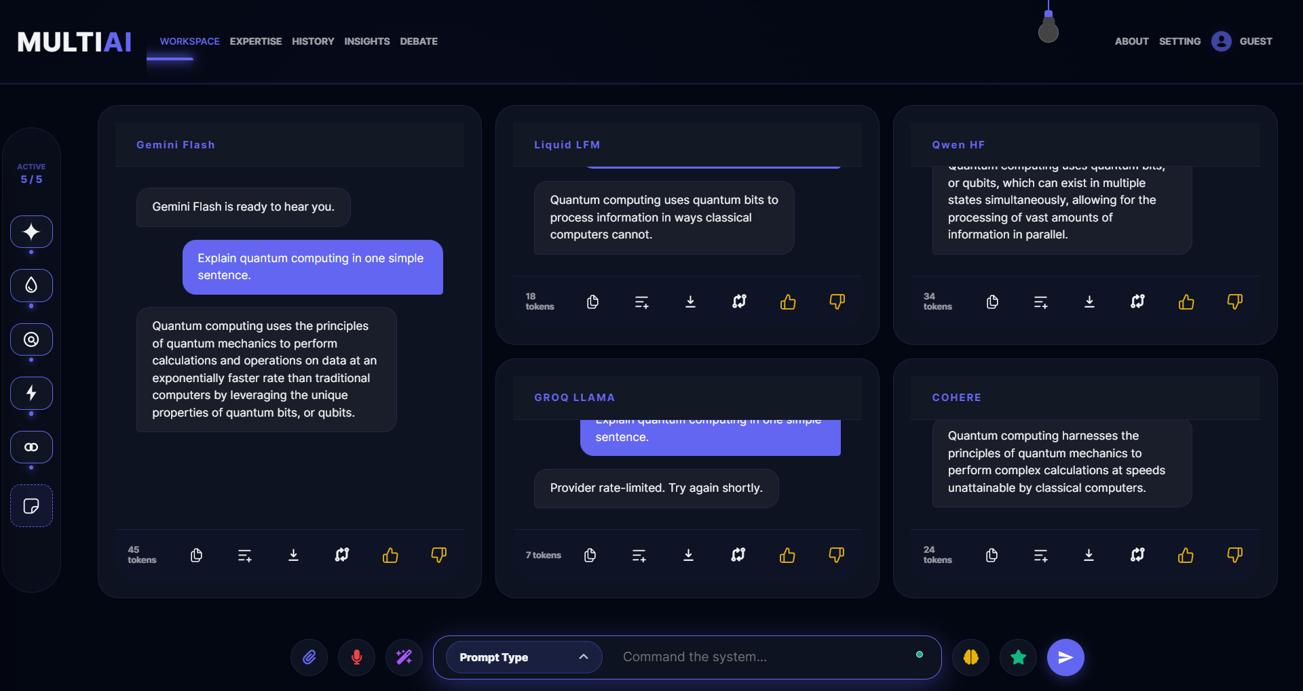
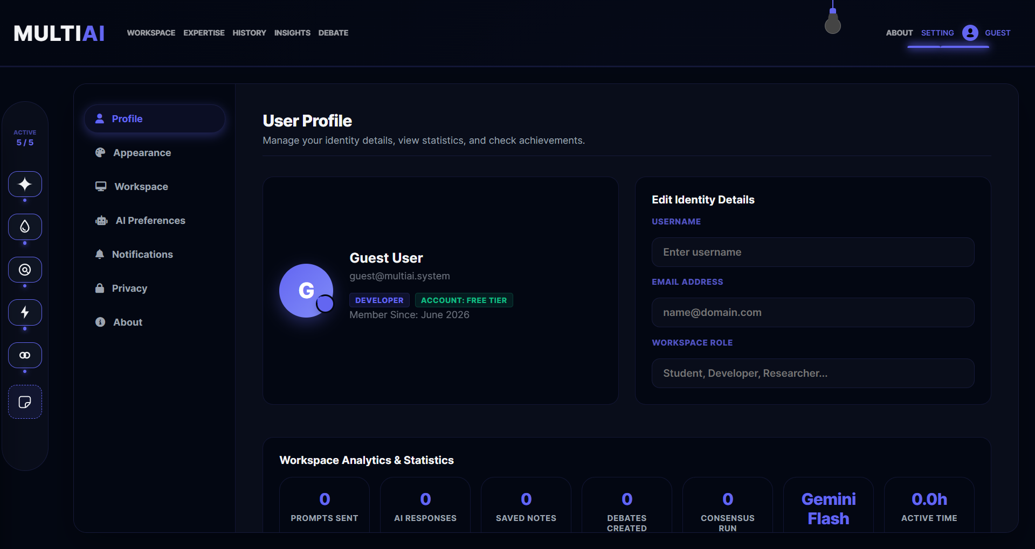
User Interface Panels
Secure login Portal
Dashboard Landing View
Typewrite Broadcast Output
Settings & Credentials Configuration

Slide 13
Core Features List
Prompt Optimizer
Refines short input queries into descriptive prompt paragraphs automatically.
Consensus Synthesis
Combines responses from different providers into a single, cohesive consensus.
Best Response Judge
Leverages an autonomous evaluate agent to score, select and highlight optimal candidate response.
Speech to Text Recognition
Integrates native webkitSpeechRecognition API triggers for voice search queries.
Mobile Scratchpad notepad
Supports transient data saves with instant text downloading features.
AI Debate Arena Simulator
Simulates alternating turn-based debates between models on customized topics.

Slide 14
Integrated Models Portfolio
Model Target | Provider | Purpose | Strength
Gemini Flash | Google GenAI | Fast, structured responses | Low Latency & Parallel Streams
Liquid LFM | OpenRouter Gateway | Reasoning & Coding tasks | High Logical consistency
Groq Llama | Groq Cloud API | Llama 3 context processing | Highest query throughput speed
Qwen HF | HuggingFace | Multilingual text completion | High Accuracy in translation
Cohere | Cohere REST SDK | Prose and content creation | Creative tone flexibility

Slide 15
System Module Architecture
User Authentication
Manages signup, database registers, JWT session generation, password hashing.
Workspace Manager
Handles active targets state, UI dynamic scaling and typewriter streams.
AI APIs Gateway
Routes Axios fetches concurrently using async event handlers.
resilient Sync
Differential Upserts sync chat records without data loss.
Speech voice Capture
Connects Web Speech webkitSpeechRecognition API listeners directly to search elements.
Telemetry Logging
Aggregates latency counters inside ApiUsage MongoDB collections.

Slide 16
Implementation Roadmap Timeline
Phase 1: Environment Setup
Setup backend repositories, Node routing frameworks, and establish initial MongoDB connections.
Phase 2: Frontend & UI design
Create glassmorphic workspace panels, prompt bars, and responsive theme toggles.
Phase 3: Parallel API gateways
Develop Axios fetches concurrently using Promise.allSettled arrays routing.
Phase 4: Validation & Deploy
Manual integration checks, telemetry testing, and production deployment on Render.

Slide 17
Validation & Testing Results
Test ID | Test Scenario | Expected Outputs | Status
TC-1 | Concurrent broadcast prompts execution | Responses typewrite side-by-side alongside latency telemetry | PASS
TC-2 | Consensus synthesis query failover | Auto-fallback to OpenRouter if primary key is missing | PASS
TC-3 | Mongoose session sync check | No records lost during differential bulk write saves | PASS
TC-4 | Responsive mobile viewport layout grid | Cards list stacks correctly with compact bottom docks | PASS

Slide 18
System Advantages
Time Efficiency
Reduces prompt testing time from minutes to seconds.
Logical Contrast
Directly compare reasoning quality between models on a single grid.
No Destructive Overwrite
Prevents database loss through robust differential syncs.
Secure Key storage
Keys are stored locally, avoiding cloud leakage.
Custom Personas
Steer model behaviors instantly with preset instructions.
Responsive Layouts
Aesthetics render correctly on desktops, tablets and mobile screens.

Slide 19
Future Roadmap
System Roadmap Scale-up Features:
• Server-Sent Events (SSE) Streaming: Character-by-character real-time response rendering.
• Local LLMs running offline: Integrate WebGPU-based engines like WebLLM directly in the client.
• OCR document scanning: Read text from documents and PDFs directly into prompt contexts.
• Vector database RAG search: Semantic search across historic user conversation logs.

Slide 20
Thank You
Questions & Discussion
One Prompt. Multiple AI Perspectives. Intelligent AI Workspace.

