Slide 1
A Deep Learning Based Heart Attack Risk Prediction with Explainable AI
PROJECT GUIDE:
Dr. Selvi Ravindran ASSOCIATE PROFESSOR
IST DEPARTMENT
ANNA UNIVERSITY
NAME: VAISHALI DUBEY
ROLL NO: 2023179003
MCA SS
IST DEPARTMENT
MCA SS VIVA
1

Slide 2
CONTENT
INTRODUCTION
PROBLEM STATEMENT
OBJECTIVE
LITERATURE SURVEY
Limitations
ARCHITECTURE DIAGRAM
Data Preprocessing
TabTransformerGRU
SHAPLEY
MODEL EVALUATION
RESULTS
CONCLUSION AND FUTURE WORK
REFERENCES
MCA SS VIVA
2

Slide 3
INTRODUCTION
Heart attack is one of the leading causes of death globally, needing early and accurate risk detection.
Traditional methods lack adaptability and often fail to generalize across diverse patient profiles.
Deep Learning can discover hidden patterns in clinical data for better risk prediction.
The Prediction integrates advanced deep learning techniques with Explainable AI to detect on early stages.
Leverages Deep Learning techniques to solve critical healthcare challenges by providing accurate predictions for actionable recommendations.
Deep learning models offer high accuracy in medical predictions.
MCA SS VIVA
3

Slide 4
PROBLEM STATEMENT
Despite significant advances in medical science and technology, heart attacks remain a leading cause of death globally. Current prediction systems, heart attack risk prediction methods often rely on traditional clinical assessments or basic machine learning models that struggle to capture complex interactions among diverse patient data. These approaches may lack accuracy, fail to generalize across populations, and are often difficult to interpret, limiting clinical trust and timely intervention. This project proposes a hybrid deep learning model combining TabTransformer and GRU to effectively learn from both categorical and numerical clinical features. By integrating SHAP explainability, it offers transparent, trustworthy predictions. The system is deployed as a real-time web application, enabling accessible and interpretable heart attack risk assessment.
MCA SS VIVA
4

Slide 5
OBJECTIVE
To Develop a predictive model using Deep Learning techniques to assess the risk of heart attack based on clinical parameters, demographic factors, and patient history.
Enhances prediction accuracy by integrating embedding layers for categorical feature representation and a GRU for capturing sequential patterns, culminating in a fully connected layer for refined classification.
To Develop a web-based application that allows users to input their health parameters, analyze key contributing factors influencing heart attack risk by identifying the most clinical features causing disease.
MCA SS VIVA
5

Slide 6
LITERATURE SURVEY(1/4)
PAPER TITLE | AUTHOR | PUBLICATION & YEAR | PROS & CONS | LIMITATIONS
Heart Disease Prediction Using Novel Ensemble and Blending Based Cardiovascular Disease Detection Networks: EnsCVDD-Net and BlCVDD-Net | Hira Khan, Nadeem Javed, Tariq Bashir, Mariam Akbar, Nabil Alrajeh, Sheraz Aslam | IEEE ACCESS 2024 | Reduces errors and makes data handling more accurate. Complex to implement with diverse data types. Requires more computational resources. | Only prediction system is available . Working with Binary Datasets.
Cardiovascular Disease Prediction using Deep Learning | Paranthaman M, Yaathash B, Santhosh S, Sanjairam M | IEEE 2022 | Makes the model faster and more efficient. Difficult to implement patient-specific advice. May increase computational costs. | Implementing personalized recommendations becomes challenging due to diverse individual needs.
MCA SS VIVA
6

Slide 7
LITERATURE SURVEY(2/4)
PAPER TITLE | AUTHOR | PUBLICATION & YEAR | PROS & CONS | LIMITATIONS
Heart disease risk prediction using deep learning techniques with feature augmentation | Maria Teresa Garcia-Ordas, Martin Bayon-Gutierrez, Jose Aveleira-Mata, Jose Alberto Benitez-Andrades | SPRINGER 2023 | Achieves a 90% precision, significantly improving detection accuracy. Complex analysis due to high variable count. Requires advanced deep learning expertise. | The model may not account for all potential risk factors or uncommon conditions. Requires significant computational resources for training and evaluation.
A one-dimensional convolutional neural network-based deep learning approach for predicting cardiovascular disease | Dhafer G. Honi, Laszlo Szathmary | ScienceDirect 2024 | Achieves high prediction accuracy of 99.95%, significantly improving performance. Relies on extensive testing and optimization, which can be time-consuming. Requires specialized knowledge in deep learning for implementation. | Implementing the model necessitates specialized expertise in deep learning, making it harder for beginners. Achieving high accuracy requires extensive testing and optimization, which can be time-intensive.
MCA SS VIVA
7

Slide 8
LITERATURE SURVEY(3/4)
PAPER TITLE | AUTHOR | PUBLICATION & YEAR | PROS /CONS | LIMITATIONS
Cardiovascular Disease Prediction using Machine Learning Methods | Tugba Palabas | IEEE CONF 2024 | Achieves 99% accuracy using the Random Forest classifier. Requires extensive preprocessing and normalization of the dataset. Performance varies significantly across classifiers, necessitating multiple evaluations. | Dependence on dataset quality and preprocessing techniques for achieving high accuracy.
Heart Disease Prediction using Machine Learning Techniques | Devansh Shah, Samir Patel & Santosh Kumar Bharti | ScienceDirect 2020 | Utilizes supervised learning algorithms to predict heart disease effectively. May not generalize well to larger, more diverse datasets. | Limited testing with less dataset which may limit generalizability.
MCA SS VIVA
8

Slide 9
LITERATURE SURVEY(4/4)
PAPER TITLE | AUTHOR | PUBLICATION & YEAR | PROS /CONS | LIMITATIONS
Heart Diseases Prediction Using machine learning and Deep learning Models | Himanshi, Srinibas Pattanai, Kanishk Nayak | IEEE CONFERENCE 2024 | Improved accuracy in early heart disease detection. Enables personalized care via diverse data integration. Data privacy concerns challenge ethical application. Complex models reduce interpretability and clinical trust. | Computational demands challenge clinical scalability. Model interpretability limits clinician trust. Data imbalance increases potential prediction bias.
Research of Heart Disease Prediction Based on Machine Learning | Shuge Oyuang | IEEE CONFERENCE 2022 | Enhances real-time, data-driven clinical decisions. Integrates diverse data for personalized predictions. Each ML method applies only to a specific scope. Non-uniform data restricts broad generalization. | Heterogeneous clinical data limits standardization. Bias and imbalance may affect prediction accuracy.
MCA SS VIVA
9

Slide 10
LIMITATIONS
Limited Data and Generalization
Imbalanced Class Distribution
Lack of Model Explainability
High Computational Overhead
Absence of External or Cross-Dataset Validation
MCA SS VIVA
10

Slide 11
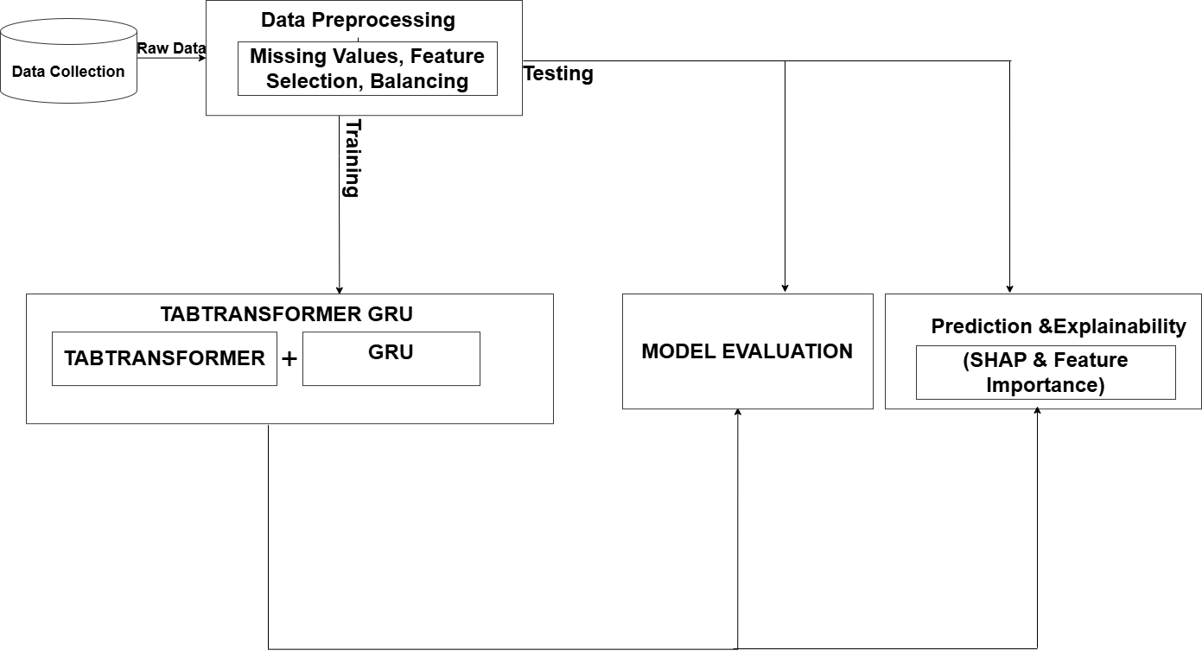
ARCHITECTURE DIAGRAM
MCA SS VIVA
11

Slide 12
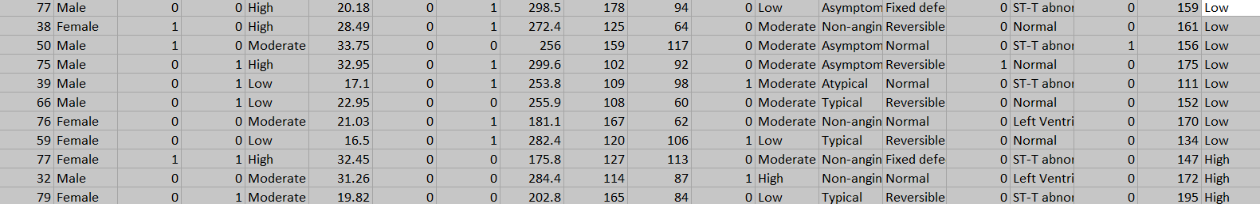
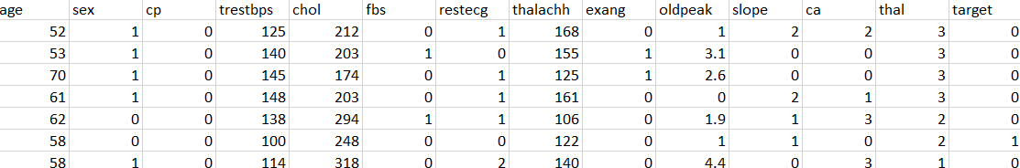
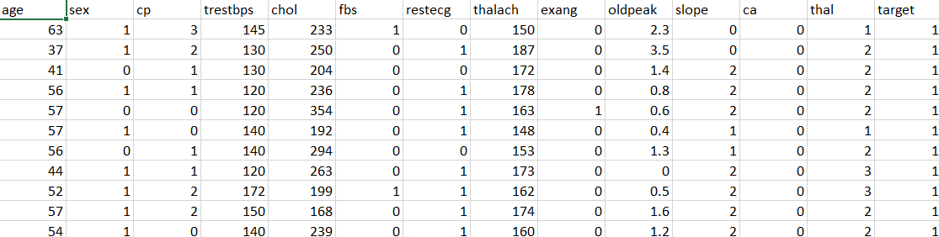
DATA PREPROCESSING
Feature Selection
Missing Value Handling
Categorical Encoding
Numerical Feature Scaling
Class Imbalance Handling
Train-Test Split
BEFORE:
AFTER:
MCA SS VIVA
12

Slide 13
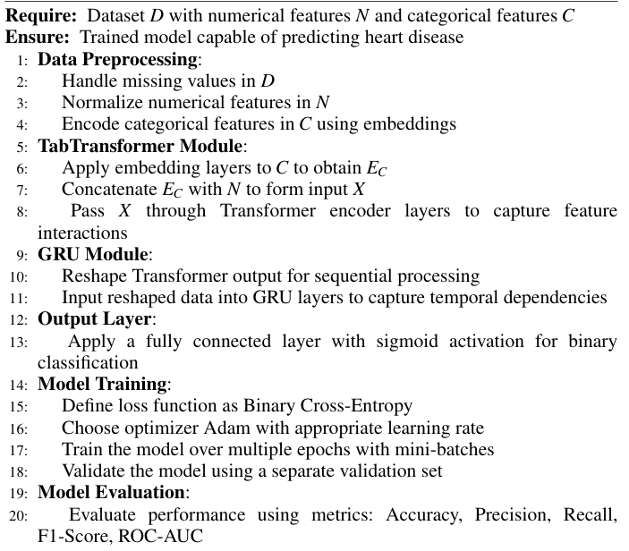
TABTRANSFORMERGRU ALGORITHM
MCA SS VIVA
13

Slide 14
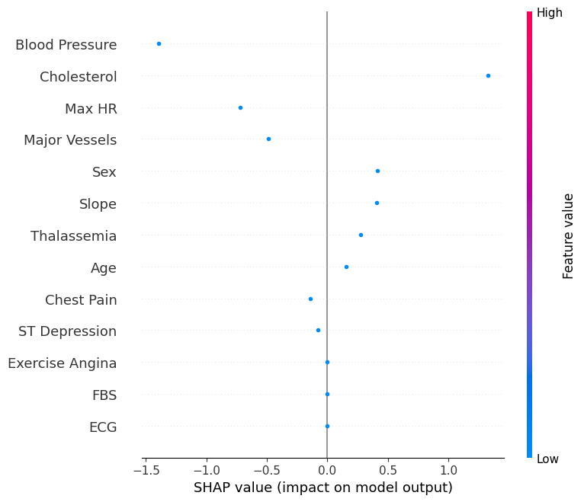
SHAPLEY
Input- Model, Data
Prediction Interpretability (Contribution of features)
SHAP Score(+ve / -ve)
Transparent, patient-specific decision-making

Slide 15
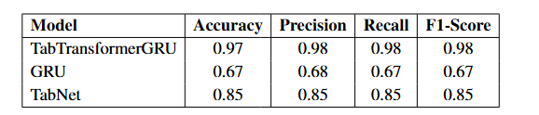
MODEL EVALUATION
MCA SS VIVA
14

Slide 16
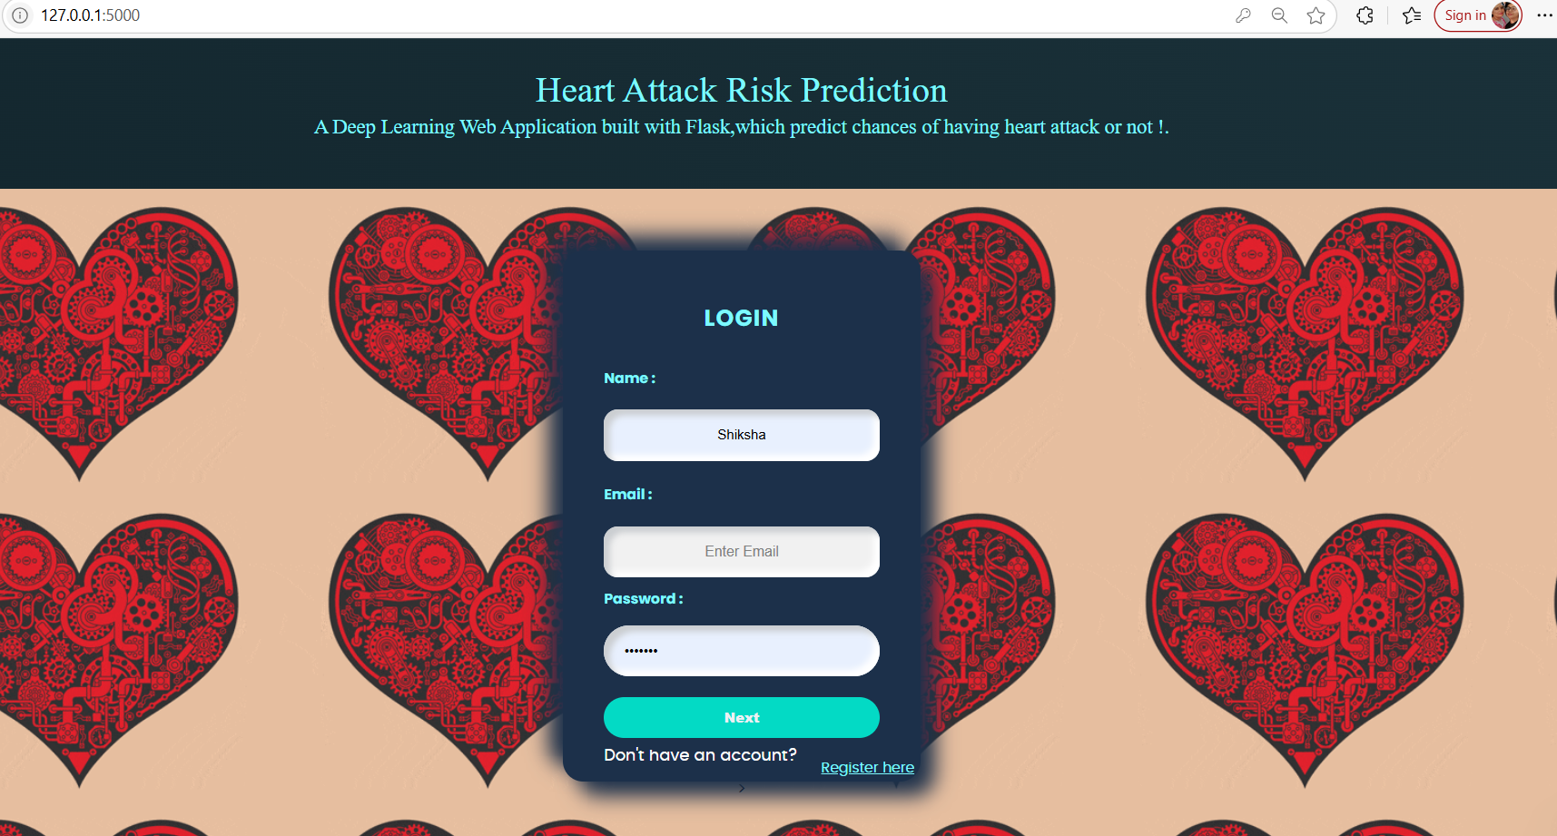
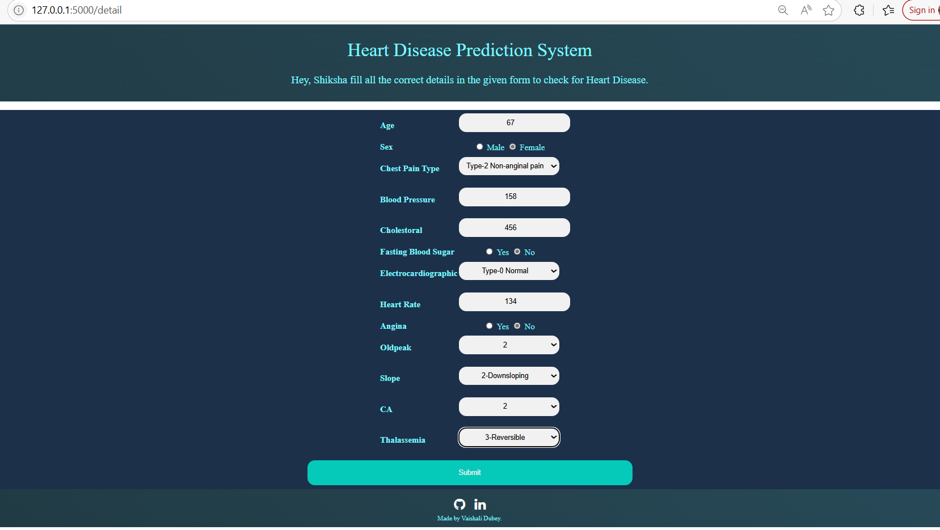
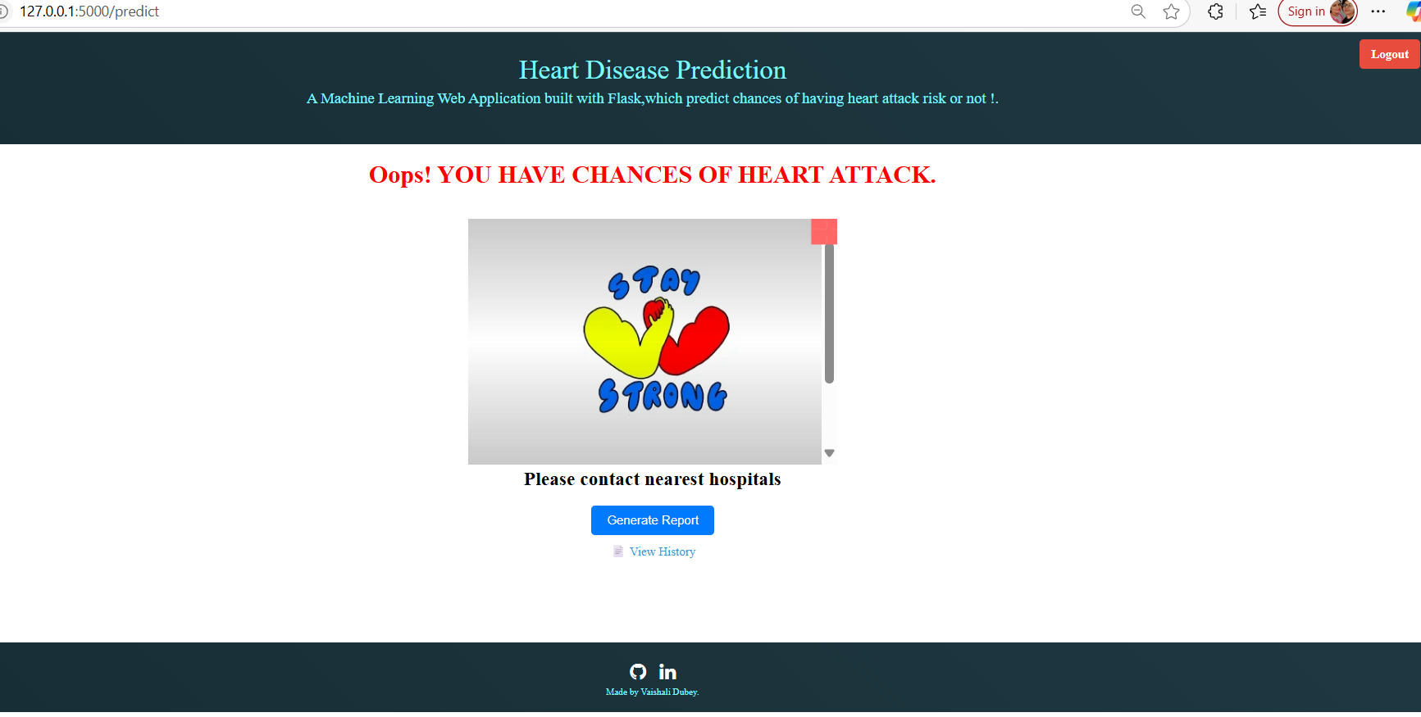
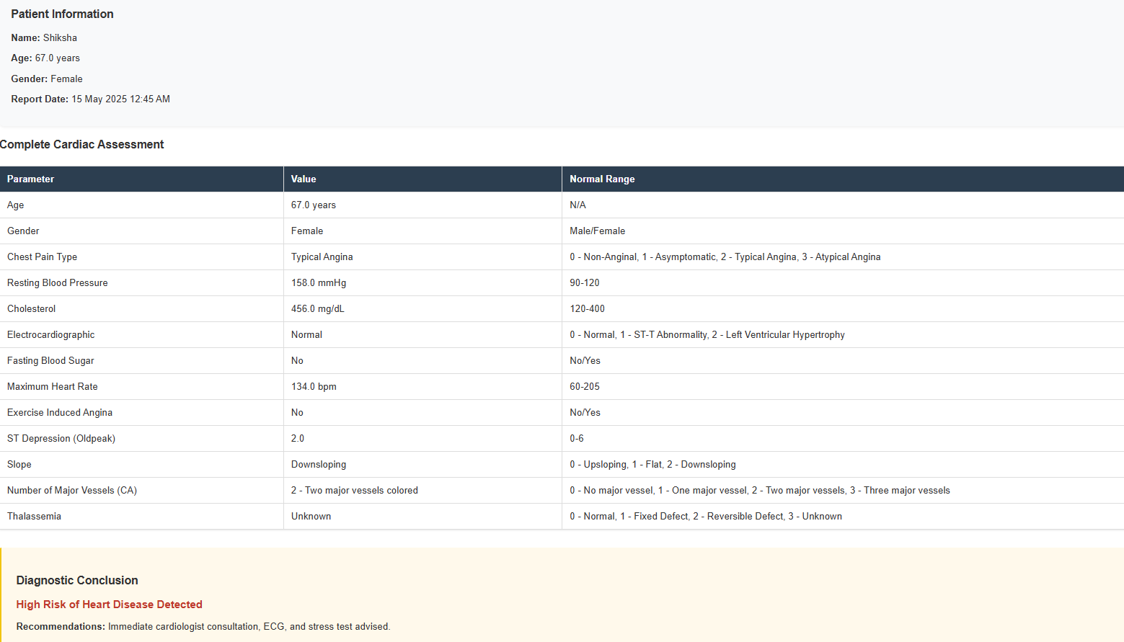
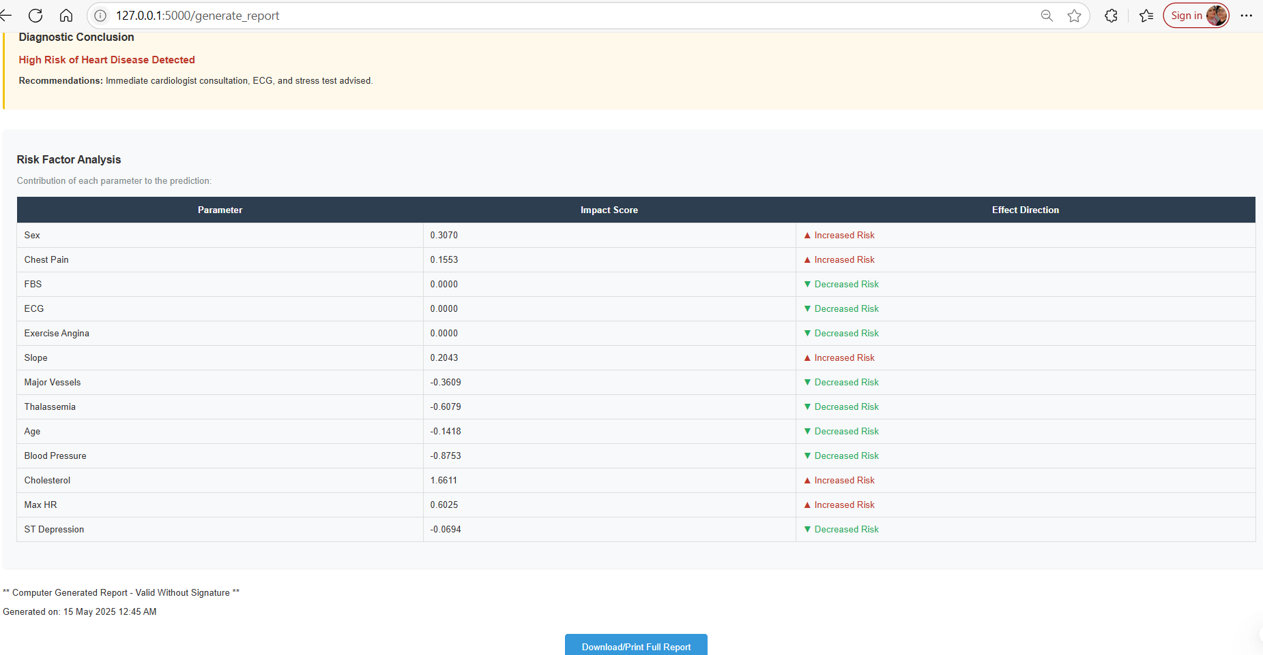
RESULTS
REF: PDF
DEMO: LINK
MCA SS VIVA
15

Slide 17
CONCLUSION AND FUTURE WORK
CONCLUSION:
The proposed system effectively predicts heart attack risk using a hybrid deep learning model combining TabTransformer and GRU, achieving 97% accuracy. It handles imbalanced and noisy data efficiently and integrates SHAP for explainability, making predictions transparent and trustworthy. The model is deployed via a Flask web app, enabling real-time, user-friendly risk assessment along with detailed feature-based explanations, making it suitable for clinical decision support.
FUTURE WORK:
sensor signals to enrich input diversity
personalized health recommendations
preventive cardiology
MCA SS VIVA
16

Slide 18

REFERENCES
M. B. Abubaker and B. Babayigit, ‘‘Detection of cardiovascular diseases in ECG images using machine learning and deep learning methods’’, IEEE Trans. Artif. Intell., vol. 4, no. 2, pp. 373–382, Apr. 2023.
M. Inam, Z. Samad, E. M. Vaughan, A. Almas, B. Hanif, A. M. Minhas, Z. Jarrar, F. Z. Habib, S. Sheikh, D. Zhu, and S. S. Virani, ‘‘Global cardiovascular research: Gaps and opportunities,’’ Current Cardiology Rep., vol. 25, no. 12, pp. 1831–1838, Dec. 2023
F. Agyekum, A. A. Folson, B. Abaidoo, L. T. Appiah, Y. Adu-Boakye, H. Ayetey, and I. K. Owusu, ‘‘Behavioural and nutritional risk factors for cardiovascular diseases among the Ghanaian population—A crosssectional study,’’ BMC Public Health, vol. 24, no. 1, p. 194, Jan. 2024
S.M. Vincent Paul, S. Balasubramaniam, P. Panchatcharam, P. Malarvizhi Kumar and A. Mubarakali, "Intelligent Framework for Prediction of Heart Disease using Deep Learning", Arabian Journal for Science and Engineering, vol. 47, pp. 2159-2169, 2021).
M.T. García-Ordás, M. Bayón-Gutiérrez, C. Benavides, J. Aveleira-Mata and J.A. Benítez-Andrades, "Heart disease risk prediction using deep learning techniques with feature augmentation", Multimedia Tools and Applications, pp. 1-15, 2023)
MCA SS VIVA
17

Slide 19
REFERENCES
F. Agyekum, A. A. Folson, B. Abaidoo, L. T. Appiah, Y. Adu-Boakye, H. Ayetey, and I. K. Owusu, ‘‘Behavioural and nutritional risk factors for cardiovascular diseases among the Ghanaian population A cross sectional study,’’ BMC Public Health, vol. 24, no. 1, p. 194, Jan. 2024
A. Kumar, K. U. Singh, and M. Kumar, ‘‘A clinical data analysis based diagnostic systems for heart disease prediction using ensemble method,’’ Big Data Mining Analytics, vol. 6, no. 4, pp. 513–525, Dec. 2023.
Y. Shen, J. Zhu, Z. Deng, W. Lu, and H. Wang, ‘‘EnsDeepDP: An ensemble deep learning approach for disease prediction through metagenomics,’’ IEEE/ACM Trans. Comput. Biol. Bioinf., vol. 20, no. 2, pp. 986–998, Mar. 2023.
C. J. Ejiyi, Z. Qin, J. Amos, M. B. Ejiyi, A. Nnani, T. U. Ejiyi, V. K. Agbesi, C. Diokpo, and C. Okpara, ‘‘A robust predictive diagnosis model for diabetes mellitus using Shapley-incorporated machine learning algorithms,’’ Healthcare Analytics, vol. 3, Nov. 2023, Art. no. 100166
. Chaurasia and A. Chaurasia, ‘‘Novel method of characterization of heart disease prediction using sequential feature selection-based ensemble technique,’’ Biomed. Mater. Devices, vol. 1, no. 2, pp. 932–941, Sep. 2023.
MCA SS VIVA
18

Slide 20
Thank You
MCA SS VIVA
19

