Slide 1

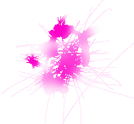

AquaCanvas
Team Dubuworld
Daeyoung Kim
Jaegyum Kim
Brian Sui
Shenrui Wu
Real-Time Watercolor Simulation
A digital painting tool that simulates water flow, pigment transport, and drying over time.
Notes:
Project intro: AquaCanvas is our CS184 final project and the goal is to build a painting tool that behaves more like real watercolor instead of just painting a textured brush. We are building it in Godot Engine 4.x, and the key idea is to simulate water flow, pigment transport, and drying over time. [Sources] - User-provided project description in chat.

Slide 2
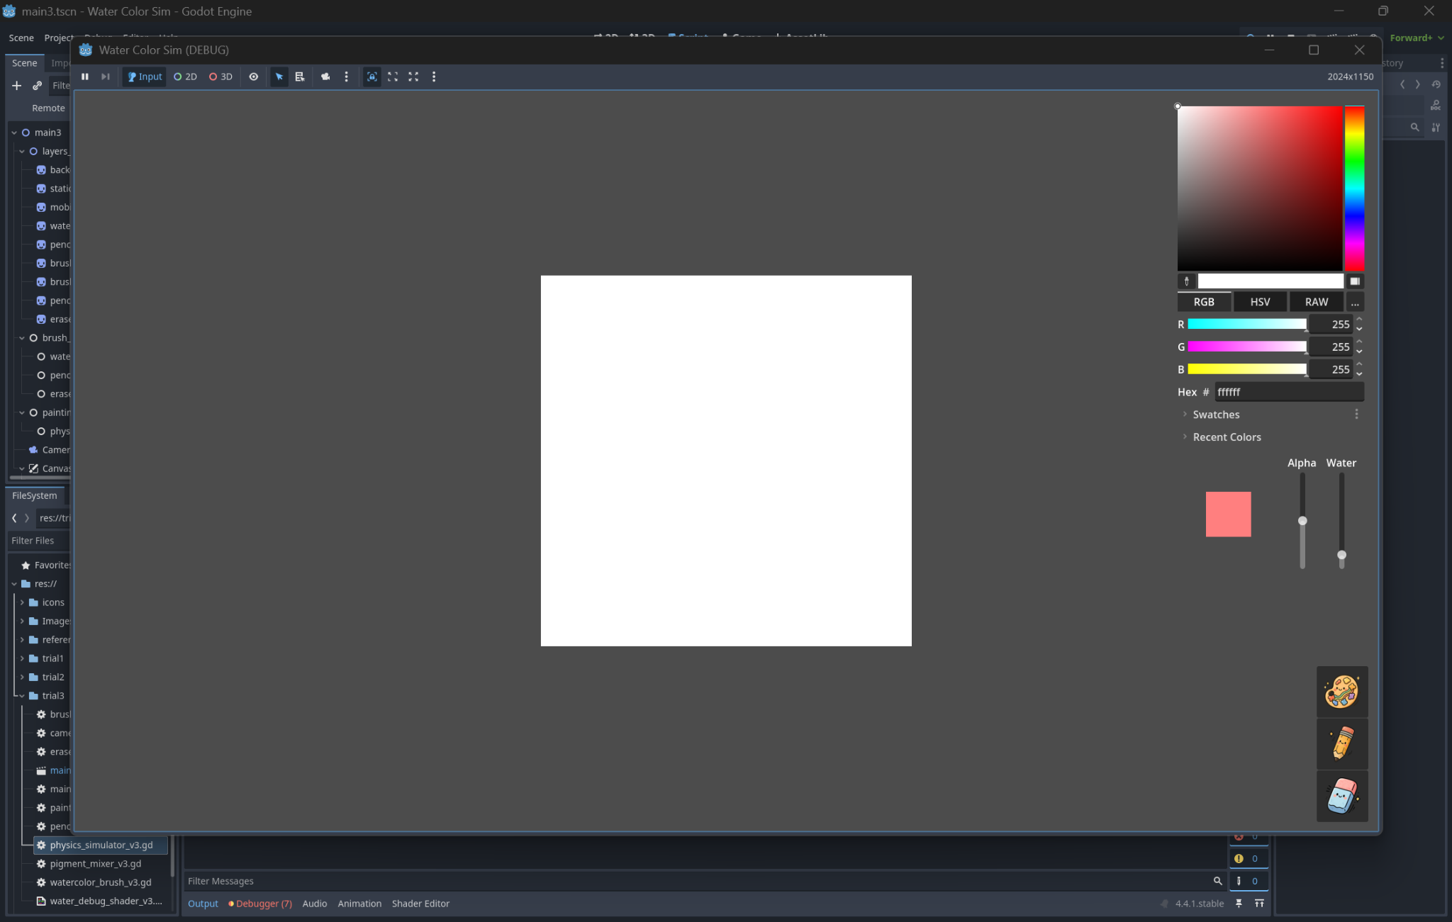
What We Built So Far
CPU prototype running interactively on a small canvas
Working CPU simulation on a 64×64 canvas
All 5 physics stages run each frame: water displacement, momentum, evaporation, pigment diffusion, and deposition
Improved water transport with a 4-direction redistribution scheme
Fixed checkerboard artifacts from the original paper formulation
Built tools: pressure-sensitive watercolor brush, pencil, eraser, color picker, and tilt controls (WASD)
At 64×64, the CPU version runs at interactive frame rates
Simulation Pipeline
1. Water displacement
2. Inertia / momentum
3. Evaporation
4. Pigment diffusion
5. Deposition
Notes:
The biggest milestone so far is that all five parts of the watercolor simulation are connected and running together every frame in the CPU prototype. One issue we hit was a checkerboard artifact in the water redistribution step, so we replaced the original formulation with a 4-direction redistribution scheme that behaves better visually. We also built the user-facing painting tools already, including Wacom pressure input and canvas tilt controls so paint can drip in different directions. [Sources] - User-provided progress summary in chat.

Slide 3
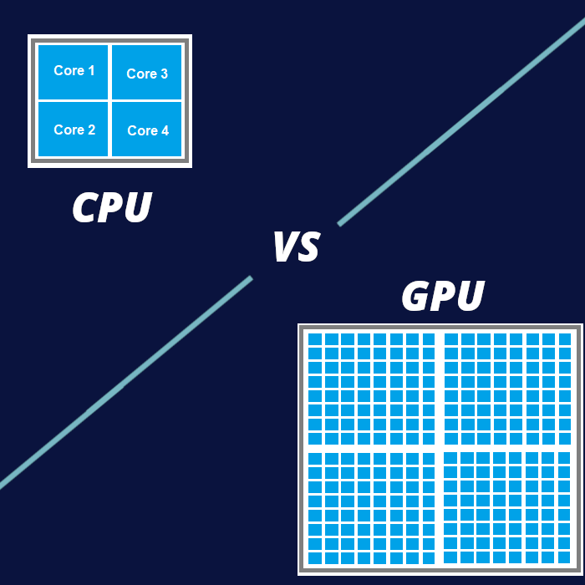
What’s Next
Move from correctness on CPU to scale and performance on GPU
1. Port to GPU
2. Validate Output
3. Scale Resolution
4. Benchmark
Port the simulation to GLSL compute shaders using Godot RenderingDevice API
Make sure GPU output matches CPU results at 64×64
Scale to 512×512 or larger while preserving watercolor behavior
Compare CPU vs. GPU FPS and measure the speedup
Main remaining work
Port the CPU prototype to compute shaders for performance
Keep the math and behavior consistent during the CPU → GPU transition
Show clear evidence that larger canvases become practical with the GPU version
Notes:
Right now the CPU version is mainly our correctness prototype. It lets us verify that the watercolor behavior is working before we optimize. The next major step is moving the simulation to GLSL compute shaders in Godot. We want to first match CPU output at 64×64, then scale up to larger canvases like 512×512 or beyond, and finally compare FPS between the two versions. [Sources] - User-provided remaining work summary in chat.

