Slide 1
CSE 219 Computer science III
Event programming with javafx

Slide 2
Event Programming
In event-driven programming, code is executed upon activation of events.
Operating Systems constantly monitor events
Ex: keystrokes, mouse clicks, etc…
The OS:
sorts out these events
reports them to the appropriate programs

Slide 3
Where do we come in?
For each control (button, combo box, etc.):
define an event handler
construct an instance of event handler
tell the control who its event handler is
Event Handler?
code with response to event
a.k.a. event listener

Slide 4
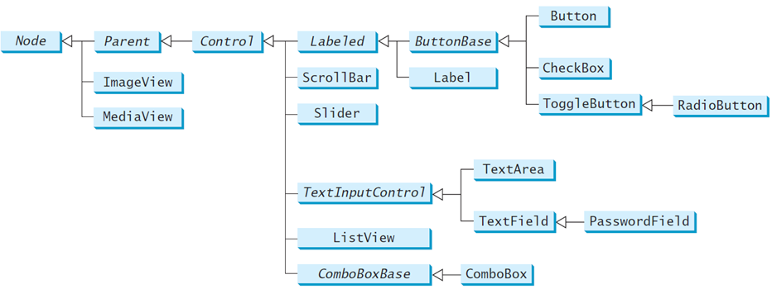
Java’s Event Handling
An event source is a GUI control
JavaFX: Button, ChoiceBox, ListView, etc.
different types of sources:
can detect different types of events
can register different types of listeners (handlers)
Notes:
http://docs.oracle.com/javase/8/javafx/user-interface-tutorial/ui_controls.htm

Slide 5
Java’s Event Handling
When the user interacts with a control (source):
an event object is constructed
the event object is sent to all registered listener objects
the listener object (handler) responds as you defined it to

Slide 6
Event Listeners (Event Handler)
Defined by you, the application programmer
you customize the response
How?
Inheritance & Polymorphism
You define your own listener class
implement the appropriate interface
define responses in all necessary methods

Slide 7
Event Objects
Contain information about the event
Like what?
location of mouse click
event source that was interacted with
etc.
Listeners use them to properly respond
different methods inside a listener object can react differently to different types of interactions

Slide 8
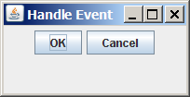
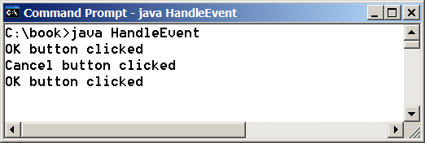
public class HandleEvent extends Application {
public void start(Stage primaryStage) {
HBox pane = new HBox(10);
Button btOK = new Button("OK");
Button btCancel = new Button("Cancel");
OKHandler handler1 = new OKHandler ();
btOK.setOnAction(handler1);
CancelHandler handler2 =
new CancelHandler ();
btCancel.setOnAction(handler2);
pane.getChildren().addAll(btOK, btCancel);
Scene scene = new Scene(pane);
primaryStage.setScene(scene);
primaryStage.show();
}…/*main*/}

Slide 9
class OKHandler implements EventHandler<ActionEvent> {
@Override
public void handle(ActionEvent e) {
System.out.println("OK button clicked");
}
}
class CancelHandler implements
EventHandler<ActionEvent> {
@Override
public void handle(ActionEvent e) {
System.out.println("Cancel button clicked");
}
}

Slide 10
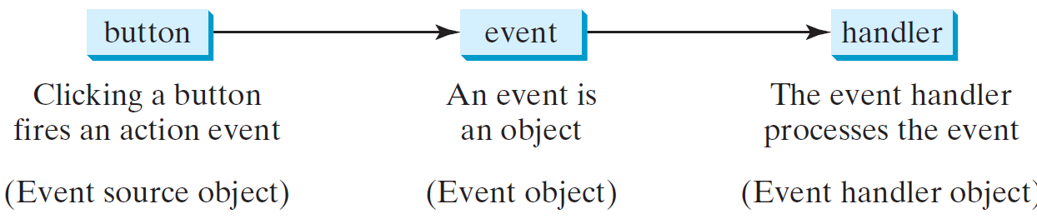
Handling GUI Events
Source object: Button
Event object: ActionEvent
Listener objects: OkHandler, CancelHandler

Slide 11
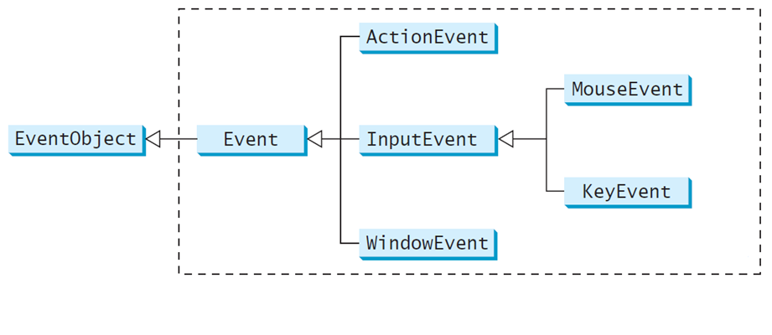
Event Classes

Slide 12
Event Information
Event objects have info about the event:
e.g. the source object (via getSource())
EventObject subclasses are for special events:
such as button actions
window events
component events
mouse movements
keystrokes

Slide 13
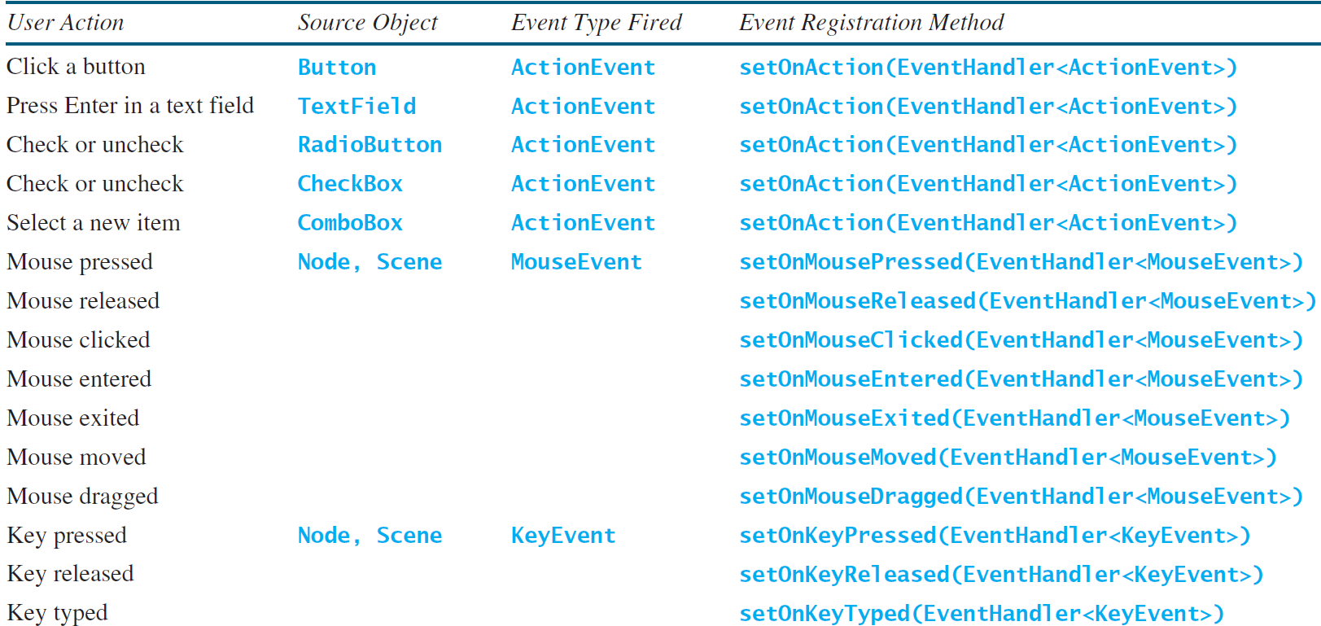
Selected User Actions and Handlers

Slide 14
Inner Class Listeners
A listener class typically for a particular GUI component (e.g., one button).
Any object instance of the inner handler class has access to all GUI fields of the outer class.
Specify via OuterClass.this.?
It will not be shared by other applications.

Slide 15
what’s the output?
public class OuterClass {
private int outerData = 0;
private InnerClass iC1;
private InnerClass iC2;
public OuterClass()
{
iC1 = new InnerClass();
iC2 = new InnerClass();
}
public void update() {
iC1.updateFromInner();
iC2.updateFromInner();
iC2.updateFromInner();
}
public void print() {
System.out.println(outerData);
System.out.println(iC1.innerData);
System.out.println(iC2.innerData);
}
public static void main(String[] args)
{
OuterClass x = new OuterClass();
System.out.println(x.outerData);
}
The Inner class is a class is a member of another class.
class can reference the data and methods defined in the outer class
is compiled as OuterClass$InnerClass.class
class InnerClass
{
private int innerData = 0;
public void updateFromInner()
{
OuterClass.this.outerData++;
this.innerData--;
}
}
}

Slide 16
Anonymous Inner Classes
Inner class listeners can be shortened using anonymous inner classes
inner classes without a name.
combines declaring an inner class and creating an instance of the class in one step
new SuperClassName/InterfaceName() {
// Implement or override methods in superclass/interface
// Other methods if necessary
}

Slide 17
Anonymous Inner Classes Example
We could use this:
btOK.setOnAction(new EventHandler<ActionEvent>() {
@Override
public void handle(ActionEvent e) {
System.out.println("OK button clicked");
}
});
Instead of this:
OKHandler handler1 = new OKHandler();
btOK.setOnAction(handler1);

Slide 18

public class AnonymousHandlerDemo extends Application {
public void start(Stage primaryStage) {
HBox hBox = new HBox();
Button btNew = new Button("New");
Button btOpen = new Button("Open");
hBox.getChildren().addAll(btNew, btOpen);
btNew.setOnAction(new EventHandler<ActionEvent>() {
@Override
public void handle(ActionEvent e) {
System.out.println("Process New");
}
});
btOpen.setOnAction(new EventHandler<ActionEvent>() {
@Override
public void handle(ActionEvent e) {
System.out.println("Process Open");
}
});
Scene scene = new Scene(hBox, 300, 50);
primaryStage.setTitle("AnonymousHandlerDemo");
primaryStage.setScene(scene);
primaryStage.show();
} …}

Slide 19
Simplifying Event Handing Using Lambda Expressions
Lambda expression is a new feature in Java 8.
Predefined functions for the type of the input.
Lambda expressions can be viewed as an anonymous method with a concise syntax.

Slide 20

public class LambdaHandlerDemo extends Application {
@Override
public void start(Stage primaryStage) {
HBox hBox = new HBox();
hBox.setSpacing(10);
hBox.setAlignment(Pos.CENTER);
Button btNew = new Button("New");
Button btOpen = new Button("Open");
Button btSave = new Button("Save");
Button btPrint = new Button("Print");
hBox.getChildren().addAll(btNew, btOpen, btSave, btPrint);
btNew.setOnAction(e -> {
System.out.println("Process New");
});
btOpen.setOnAction(e -> {
System.out.println("Process Open");
});
btSave.setOnAction(e -> {
System.out.println("Process Save");
});
btPrint.setOnAction(e -> {
System.out.println("Process Print");
});
…

Slide 21
Single Abstract Method Interface (SAM)
The statements in the lambda expression is all for that method.
If it contains multiple methods, the compiler will not be able to compile the lambda expression.
So, for the compiler to understand lambda expressions, the interface must contain exactly one abstract method.
Such an interface is known as a functional interface, or a Single Abstract Method (SAM) interface.

Slide 22
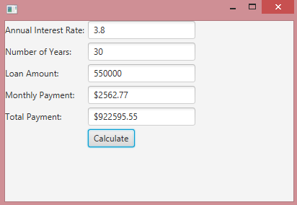
Loan Calculator
public class LoanCalculator extends Application {
private Stage primaryStage;
private TextField tfAnnualInterestRate;
private TextField tfNumberOfYears;
private TextField tfLoanAmount;
private TextField tfMonthlyPayment;
private TextField tfTotalPayment;
private Button btCalculate;
private Scene scene;
@Override
public void start(Stage initPrimaryStage) {
primaryStage = initPrimaryStage;
layoutGUI();
initHandlers();
}
…

Slide 23
Loan Calculator
…
public void layoutGUI() {
tfAnnualInterestRate = new TextField();
tfNumberOfYears = new TextField();
tfLoanAmount = new TextField();
tfMonthlyPayment = new TextField();
tfTotalPayment = new TextField();
btCalculate = new Button("Calculate");
GridPane gridPane = new GridPane();
scene = new Scene(gridPane, 400, 250);
primaryStage.setScene(scene);
primaryStage.show();
…

Slide 24
Loan Calculator
…
gridPane.setHgap(5);
gridPane.setVgap(5);
gridPane.add(new Label("Annual Interest Rate:"), 0, 0);
gridPane.add(tfAnnualInterestRate, 1, 0);
gridPane.add(new Label("Number of Years:"), 0, 1);
gridPane.add(tfNumberOfYears, 1, 1);
gridPane.add(new Label("Loan Amount:"), 0, 2);
gridPane.add(tfLoanAmount, 1, 2);
gridPane.add(new Label("Monthly Payment:"), 0, 3);
gridPane.add(tfMonthlyPayment, 1, 3);
gridPane.add(new Label("Total Payment:"), 0, 4);
gridPane.add(tfTotalPayment, 1, 4);
gridPane.add(btCalculate, 1, 5);
}
…

Slide 25
Loan Calculator
public void initHandlers() {
btCalculate.setOnAction(e -> calculateLoanPayment());
}
private void calculateLoanPayment()
{
double interest = Double.parseDouble(tfAnnualInterestRate.getText());
int year = Integer.parseInt(tfNumberOfYears.getText());
double loanAmount = Double.parseDouble(tfLoanAmount.getText());
Loan loan = new Loan(interest, year, loanAmount);
tfMonthlyPayment.setText(String.format("$%.2f", loan.getMonthlyPayment()));
tfTotalPayment.setText(String.format("$%.2f", loan.getTotalPayment()));
}
public static void main(String[] args)
{
launch(args);
}
}

Slide 26
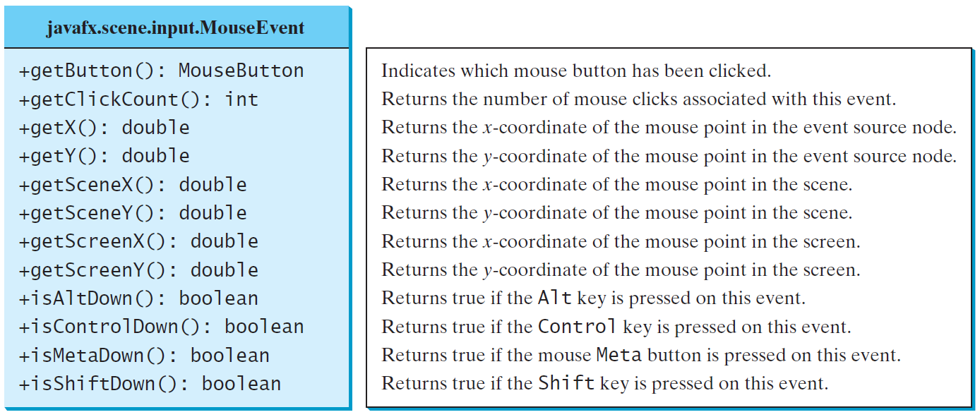
MouseEvent

Slide 27
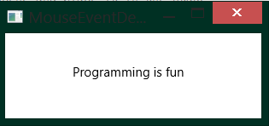
public class MouseEventDemo extends Application {
@Override
public void start(Stage primaryStage) {
Pane pane = new Pane();
Text text = new Text(20, 20, "Programming is fun");
pane.getChildren().addAll(text);
text.setOnMouseDragged(e -> {
text.setX(e.getX());
text.setY(e.getY());
});
Scene scene = new Scene(pane, 300, 100);
primaryStage.setTitle("MouseEventDemo");
primaryStage.setScene(scene);
primaryStage.show();
}
public static void main(String[] args) {
launch(args);
}
}

Slide 28
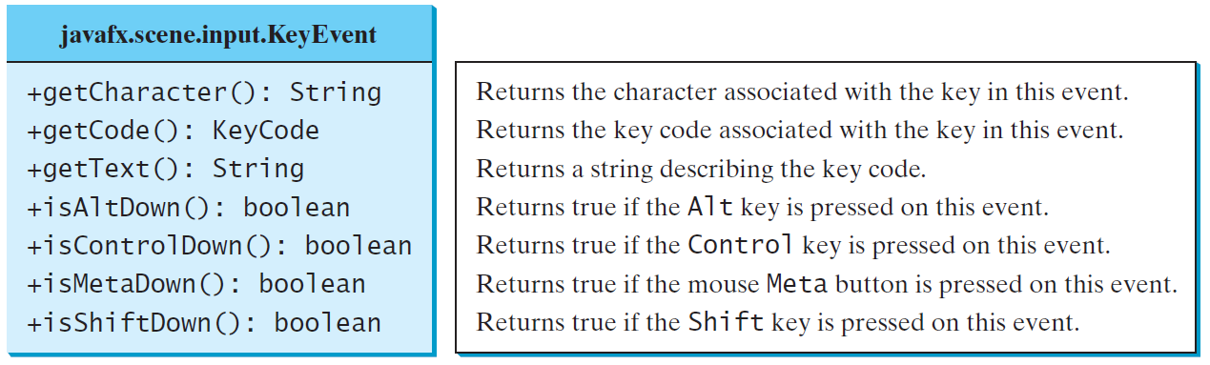
The KeyEvent Class

Slide 29


public class KeyEventDemo extends Application {
@Override
public void start(Stage primaryStage) {
Pane pane = new Pane();
Text text = new Text(20, 20, "A");
text.setFocusTraversable(true);
pane.getChildren().add(text);
text.setOnKeyPressed(e -> {
switch (e.getCode()) {
case DOWN: text.setY(text.getY() + 10); break;
case UP: text.setY(text.getY() - 10); break;
case LEFT: text.setX(text.getX() - 10); break;
case RIGHT: text.setX(text.getX() + 10); break;
default:
if (Character.isLetterOrDigit(e.getText().charAt(0)))
text.setText(e.getText());
}
});
Scene scene = new Scene(pane);
primaryStage.setTitle("KeyEventDemo");
primaryStage.setScene(scene);
primaryStage.show();
}
…

Slide 30
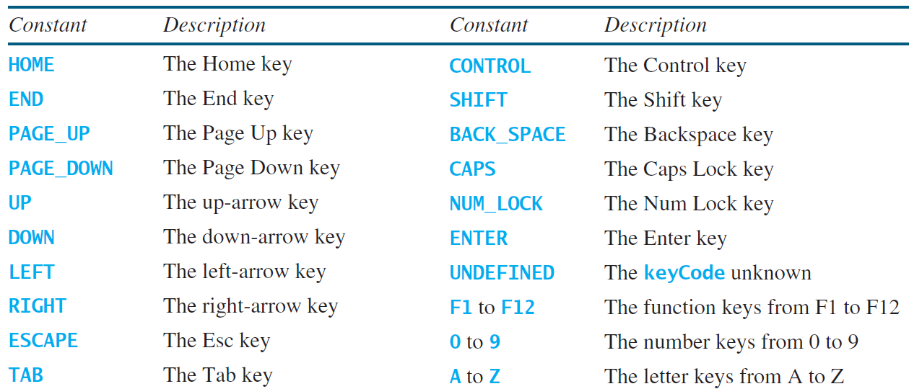
The KeyCode Constants

Slide 31
JavaFX support for mobile devices
JavaFX has event programming support for mobile devices:
javafx.scene.input.SwipeEvent, javafx.scene.input.TouchEvent, javafx.scene.input.ZoomEvent.
Example:
http://docs.oracle.com/javase/8/javafx/events-tutorial/gestureeventsjava.htm
http://docs.oracle.com/javase/8/javafx/events-tutorial/toucheventsjava.htm

