Slide 1
CSE 219 Computer science III
Graphical user interfaces with javafx

Slide 2
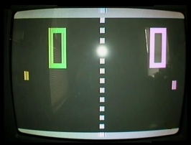
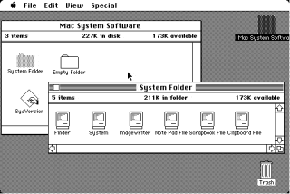
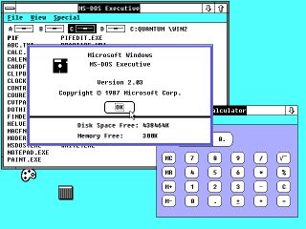
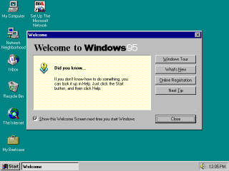
GUI Examples

Slide 3
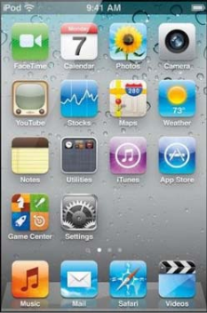
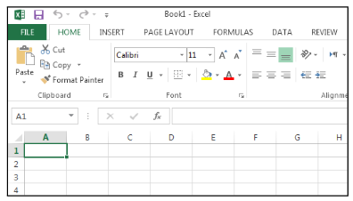
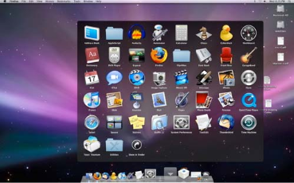
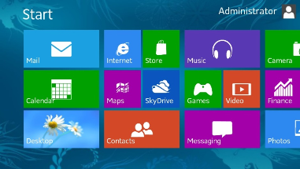
More recent GUIs

Slide 4
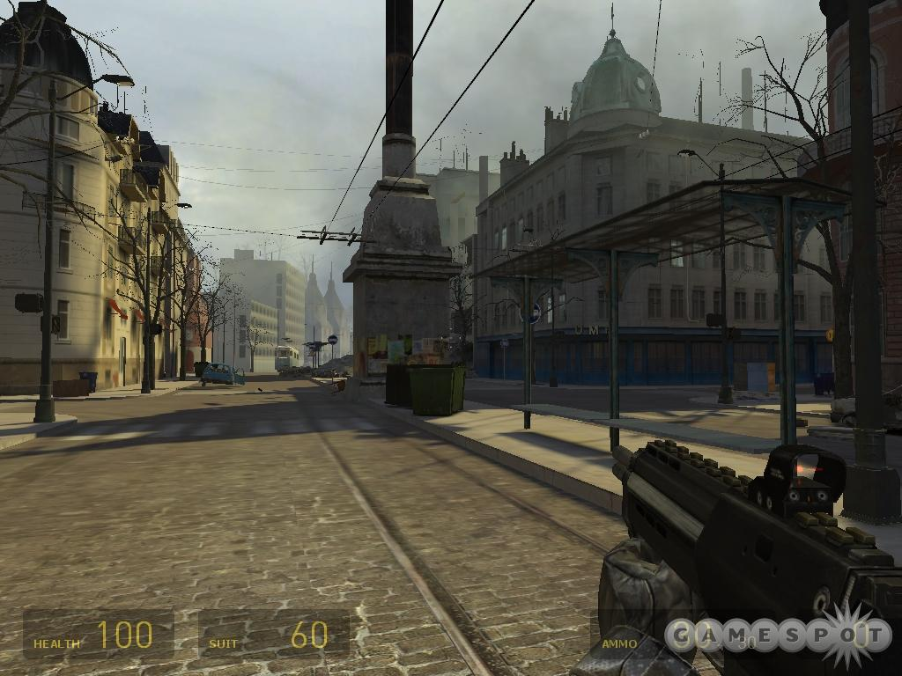

Slide 5
GUI
Graphical User Interface (GUI)
provides user-friendly human interaction
One typically uses frameworks for building GUIs
JavaFX (as of Java8, 2014)
replaces Swing/AWT
You’ll spend much of your life learning new Web UI frameworks

Slide 6
How do GUIs work?
A giant loop
Construct GUI Components
Render GUI
Check to see if any input
Respond to user input
Exit App

Slide 7
Example, a mouse click on a button
Operating System recognizes mouse click
determines which window it was inside
notifies that program
Program runs in loop
checks input buffer filled by OS
if it finds a mouse click:
determines which component in the program
if the click was on a relevant component
respond appropriately according to handler

Slide 8
GUI Look vs. Behavior
Look
physical appearance
custom component design
containment
layout management
Behavior
interactivity
event programmed response

Slide 9
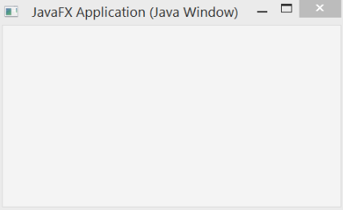
What does a GUI framework do for you?
Provides ready made visible, interactive, customizable components
you wouldn’t want to have to code your own window

Slide 10
Primary javafx classes
Stage
javafx.application.Application
entry point for JavaFX applications
javafx.stage.Stage
top level JavaFX container
javafx.scene.Scene
container for all content in a scene graph
javafx.scene.Node
base class for scene graph nodes
Scene
Ok
Button

Slide 11
It all starts with application
javafx.application.Application
When one gets created:
JavaFX creates an application thread for running the application start method, processing input events, and running animation timelines.
So what do we do?
Override App’s start method!

Slide 12
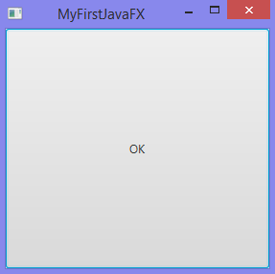
Our first JavaFX App
public class MyFirstJavaFX extends Application {
@Override
public void start(Stage primaryStage) {
Button btOK = new Button("OK");
Scene scene = new Scene(btOK, 200, 250);
primaryStage.setTitle("MyFirstJavaFX");
primaryStage.setScene(scene);
primaryStage.show();
}
public static void main(String[] args) {
launch(args);
}
}

Slide 13
Lots of inherited properties
java.lang.Object
javafx.stage.Window
javafx.stage.Stage
java.lang.Object
javafx.scene.Node
javafx.scene.Parent
javafx.scene.layout.Region
javafx.scene.layout.Pane

Slide 14
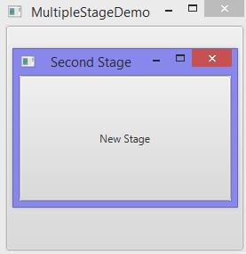
Multistage Demo
public class MultipleStageDemo extends Application {
@Override
public void start(Stage primaryStage) {
Scene scene = new Scene(new Button("OK"), 200, 250);
primaryStage.setTitle("MultipleStageDemo");
primaryStage.setScene(scene);
primaryStage.show();
Stage stage = new Stage();
stage.setTitle("Second Stage");
stage.setScene(new Scene(new Button("New Stage"), 100, 100));
stage.show();
}
public static void main(String[] args) {
launch(args);
}
}

Slide 15
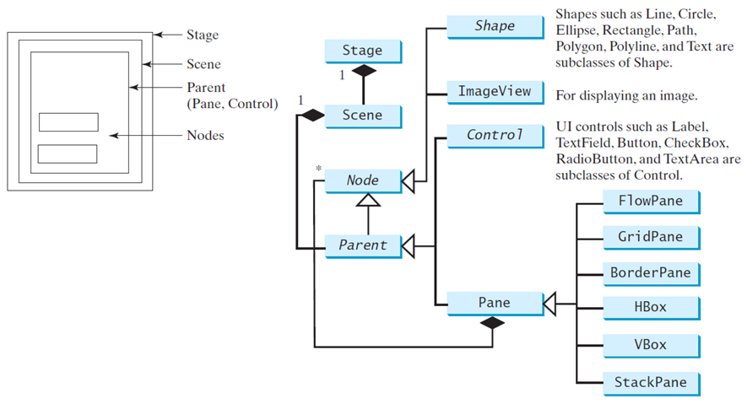
Panes, ui controls, and shapes

Slide 16

A button is a control
public class ButtonInPane extends Application {
@Override
public void start(Stage primaryStage) {
StackPane pane = new StackPane();
pane.getChildren().add(new Button("OK"));
Scene scene = new Scene(pane, 200, 50);
primaryStage.setTitle("Button in a pane");
primaryStage.setScene(scene);
primaryStage.show();
}
public static void main(String[] args) {
launch(args);
}
}

Slide 17
stackpane
/* The StackPane layout pane places all of the nodes within
a single stack with each new node added on top of the
previous node. This layout model provides an easy way to
overlay text on a shape or image and to overlap common
shapes to create a complex shape. */
Note with it we can do CSS-style rotation

Slide 18
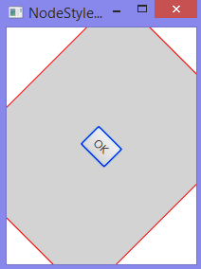
CSS Rotation!
public class NodeStyleRotateDemo extends Application {
@Override
public void start(Stage primaryStage) {
StackPane pane = new StackPane();
Button btOK = new Button("OK");
btOK.setStyle("-fx-border-color: blue;");
pane.getChildren().add(btOK);
pane.setRotate(45);
pane.setStyle("-fx-border-color: red;
-fx-background-color: lightgray;");
Scene scene = new Scene(pane, 200, 250);
primaryStage.setTitle("NodeStyleRotateDemo");
primaryStage.setScene(scene);
primaryStage.show();

Slide 19
Layout panes
JavaFX provides many types of panes for organizing nodes in a container.
Class | Description
Pane | base class for layout panes. it contains the getChildren() method for returning a list of nodes in the pane
StackPane | places the nodes on top of each other in the center of the pane
FlowPane | places the nodes row-by-row horizontally or column-by-column vertically
GridPane | places the nodes in the cells in a two-dimensional grid
BorderPane | places the nodes in the top, right, bottom, left, and center regions
HBox | places the nodes in a single row
VBox | places the nodes in a single column

Slide 20
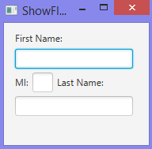
Flow Pane
public class ShowFlowPane extends Application {
@Override
public void start(Stage primaryStage) {
FlowPane pane = new FlowPane();
pane.setPadding(new Insets(11, 12, 13, 14));
pane.setHgap(5);
pane.setVgap(5);
pane.getChildren().addAll(new Label("First Name:"),
new TextField(),
new Label("MI:"));
TextField tfMi = new TextField();
tfMi.setPrefColumnCount(1);
pane.getChildren().addAll(tfMi, new Label("Last Name:"), new TextField());
Scene scene = new Scene(pane, 210, 150);
primaryStage.setTitle("ShowFlowPane");
primaryStage.setScene(scene);
primaryStage.show();

Slide 21
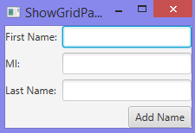
Grid pane
public class ShowGridPane extends Application {
@Override
public void start(Stage primaryStage) {
GridPane pane = new GridPane();
pane.setAlignment(Pos.CENTER);
pane.setHgap(5.5);
pane.setVgap(5.5);
pane.add(new Label("First Name:"), 0, 0);
pane.add(new TextField(), 1, 0);
pane.add(new Label("MI:"), 0, 1);
pane.add(new TextField(), 1, 1);
pane.add(new Label("Last Name:"), 0, 2);
pane.add(new TextField(), 1, 2);
Button btAdd = new Button("Add Name");
pane.add(btAdd, 1, 3);
GridPane.setHalignment(btAdd, HPos.RIGHT);
Scene scene = new Scene(pane);
primaryStage.setTitle("ShowGridPane");
primaryStage.setScene(scene);
primaryStage.show();
}

Slide 22
Let’s make a custom pane
class CustomPane extends StackPane {
public CustomPane(String title) {
getChildren().add(new Label(title));
setStyle("-fx-border-color: red");
setPadding(new Insets(11.5, 12.5, 13.5, 14.5));
}
}

Slide 23
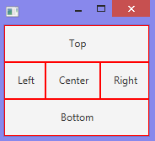
Borderpane
public class ShowBorderPane extends Application {
@Override
public void start(Stage primaryStage) {
BorderPane pane = new BorderPane();
pane.setTop(new CustomPane("Top"));
pane.setRight(new CustomPane("Right"));
pane.setBottom(new CustomPane("Bottom"));
pane.setLeft(new CustomPane("Left"));
pane.setCenter(new CustomPane("Center"));
Scene scene = new Scene(pane);
primaryStage.setScene(scene);
primaryStage.show();
}

Slide 24
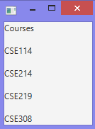
vbox
public class ShowVBox extends Application {
@Override
public void start(Stage primaryStage) {
VBox vBox = new VBox(15);
vBox.getChildren().add(new Label("Courses"));
Label[] courses = {new Label("CSE114"),
new Label("CSE214"),new Label("CSE219"),new Label("CSE308")
};
for (Label course: courses) {
vBox.getChildren().add(course);
}
Scene scene = new Scene(vBox);
primaryStage.setScene(scene);
primaryStage.show();
}

Slide 25

hbox
public class ShowHBox extends Application {
@Override
public void start(Stage primaryStage) {
HBox hBox = new HBox(15);
hBox.getChildren().add(new Label("Courses"));
Label[] courses = {new Label("CSE114"),
new Label("CSE214"),new Label("CSE219"),new Label("CSE308")
};
for (Label course: courses) {
hBox.getChildren().add(course);
}
Scene scene = new Scene(hBox);
primaryStage.setScene(scene);
primaryStage.show();
}

Slide 26
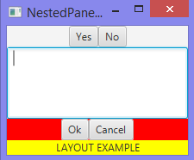
How about nested panes?
…
FlowPane northPane = new FlowPane();
northPane.setAlignment(Pos.CENTER);
northPane.getChildren().add(new Button("Yes"));
northPane.getChildren().add(new Button("No"));
…

Slide 27
nested panes
…
BorderPane southPane = new BorderPane();
FlowPane northSouthPane = new FlowPane();
northSouthPane.setAlignment(Pos.CENTER);
northSouthPane.setStyle("-fx-background-color: red");
northSouthPane.getChildren().add(new Button("Ok"));
northSouthPane.getChildren().add(new Button("Cancel"));
FlowPane southSouthPane = new FlowPane();
southSouthPane.setAlignment(Pos.CENTER);
southSouthPane.setStyle("-fx-background-color: yellow");
southSouthPane.getChildren().add(new Label("LAYOUT EXAMPLE"));
southPane.setTop(northSouthPane);
southPane.setBottom(southSouthPane);
…

Slide 28
nested panes
…
BorderPane pane = new BorderPane();
pane.setTop(northPane);
pane.setCenter(new TextArea());
pane.setBottom(southPane);
Scene scene = new Scene(pane, 210, 150);
…

