Slide 1
CSE 219 Computer science III
Graphics2D with javafx

Slide 2
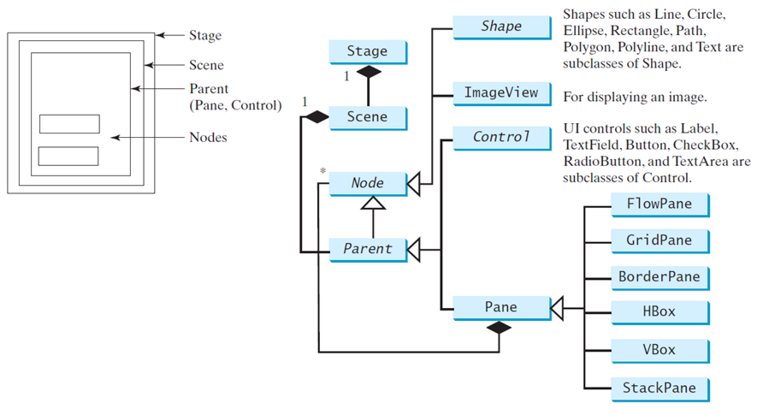
Panes, ui controls, and shapes

Slide 3
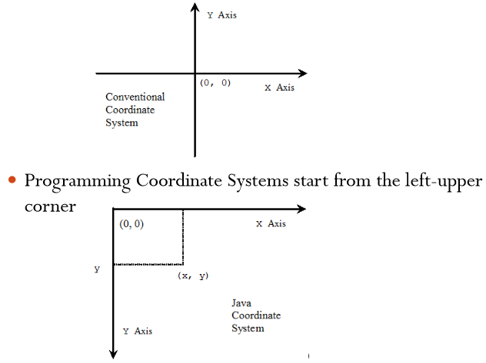
Display a shape

Slide 4
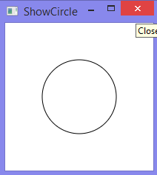
A Circle is a Shape
public class ShowCircle extends Application {
@Override
public void start(Stage primaryStage) {
Circle circle = new Circle();
circle.setCenterX(100);
circle.setCenterY(100);
circle.setRadius(50);
circle.setStroke(Color.BLACK);
circle.setFill(null);
Pane pane = new Pane();
pane.getChildren().add(circle);
Scene scene = new Scene(pane, 200, 200);
primaryStage.setTitle("ShowCircle");
primaryStage.setScene(scene);
primaryStage.show();
}
…

Slide 5
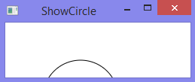
Binding properties
JavaFX introduces a new concept called a binding property that enables a target object to be bound to a source object
If the value in the source object changes, the target property is also changed automatically
The target object is simply called a binding object or a binding property
Resizing the window in the previous example would cover
the shape:

Slide 6

Circle bound to center
public class ShowCircleCentered extends Application {
@Override
public void start(Stage primaryStage) {
Pane pane = new Pane();
Circle circle = new Circle();
circle.centerXProperty().bind(pane.widthProperty().divide(2));
circle.centerYProperty().bind(pane.heightProperty().divide(2));
circle.setRadius(50);
circle.setStroke(Color.BLACK);
circle.setFill(Color.WHITE);
pane.getChildren().add(circle);
Scene scene = new Scene(pane, 200, 200);
primaryStage.setTitle("ShowCircleCentered");
primaryStage.setScene(scene);
primaryStage.show();
}

Slide 7
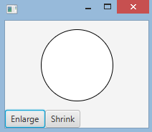
public class ControlCircle extends Application {
private CirclePane circlePane = new CirclePane();
@Override
public void start(Stage primaryStage) {
HBox hBox = new HBox();
Button btEnlarge = new Button("Enlarge");
Button btShrink = new Button("Shrink");
hBox.getChildren().add(btEnlarge);
hBox.getChildren().add(btShrink);
btEnlarge.setOnAction(new EnlargeHandler());
btShrink.setOnAction(new ShrinkHandler());
BorderPane borderPane = new BorderPane();
borderPane.setCenter(circlePane);
borderPane.setBottom(hBox);
BorderPane.setAlignment(hBox, Pos.CENTER);
Scene scene = new Scene(borderPane, 200, 150);
primaryStage.setScene(scene); primaryStage.show();
} …
Shrinking/Enlarging Circle

Slide 8
Shrinking/Enlarging Circle
// Inner Class
class EnlargeHandler implements EventHandler<ActionEvent> {
@Override
public void handle(ActionEvent e) {
circlePane.enlarge();
}
}
class ShrinkHandler implements EventHandler<ActionEvent> {
@Override
public void handle(ActionEvent e) {
circlePane.shrink();
}
}
}

Slide 9
class CirclePane extends StackPane {
private Circle circle = new Circle(50);
public CirclePane() {
getChildren().add(circle);
circle.setStroke(Color.BLACK);
circle.setFill(Color.WHITE);
}
public void enlarge() {
circle.setRadius(circle.getRadius() * 1.2);
}
public void shrink() {
circle.setRadius(circle.getRadius() * .8);
}
}
Shrinking/Enlarging Circle

Slide 10
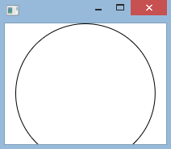
Using the mouse
public class ControlCircleWithMouse extends Application {
private CirclePane circlePane = new CirclePane();
@Override
public void start(Stage primaryStage) {
HBox hBox = new HBox();
hBox.setSpacing(10);
hBox.setAlignment(Pos.CENTER);
circlePane.setOnMouseClicked(e -> {
if (e.getButton() == MouseButton.PRIMARY) {
circlePane.enlarge();
}
else if (e.getButton() == MouseButton.SECONDARY) {
circlePane.shrink();
}
});
…

Slide 11
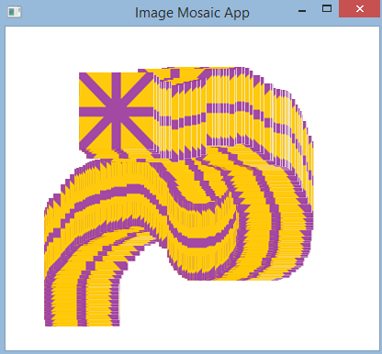
canvas
Rendering Alternative
Surface we can render to
Mirrors HTML5 Canvas usage

Slide 12
public class ImageMosaicApp extends Application {
Stage primaryStage;
Scene scene;
Canvas canvas;
GraphicsContext gc;
Image logo1Image, logo2Image;
ArrayList<Point2D> logo1Locations, logo2Locations;
public void start(Stage initPrimaryStage) {
primaryStage = initPrimaryStage;
initStage();
initData();
initGUI();
initHandlers();
}

Slide 13
public void initStage() {
primaryStage.setTitle("Image Mosaic App");
Screen screen = Screen.getPrimary();
Rectangle2D bounds = screen.getVisualBounds();
primaryStage.setX(bounds.getMinX());
primaryStage.setY(bounds.getMinY());
primaryStage.setWidth(bounds.getWidth());
primaryStage.setHeight(bounds.getHeight());
}

Slide 14
public void initData() {
logo1Locations = new ArrayList();
logo2Locations = new ArrayList();
logo1Image = new Image("Logo1.png");
logo2Image = new Image("Logo2.png");
}

Slide 15
public void initGUI() {
canvas = new Canvas();
gc = canvas.getGraphicsContext2D();
Group root = new Group();
root.getChildren().add(canvas);
scene = new Scene(root);
primaryStage.setScene(scene);
primaryStage.show();
canvas.setWidth(scene.getWidth());
canvas.setHeight(scene.getHeight());
}

Slide 16
public void initHandlers() {
canvas.setOnMouseClicked(mouseEvent -> {
Point2D point = new Point2D(mouseEvent.getX(), mouseEvent.getY());
if (!logo1Locations.contains(point))
logo1Locations.add(point);
draw();
});
canvas.setOnMouseDragged(mouseEvent -> {
Point2D point = new Point2D(mouseEvent.getX(), mouseEvent.getY());
if (!logo2Locations.contains(point))
logo2Locations.add(point);
draw();
});
}

Slide 17
public void draw() {
Iterator<Point2D> it = logo1Locations.iterator();
while (it.hasNext()) {
Point2D p = it.next();
gc.drawImage(logo1Image, p.getX(), p.getY());
}
it = logo2Locations.iterator();
while (it.hasNext()) {
Point2D p = it.next();
gc.drawImage(logo2Image, p.getX(), p.getY());
}
}
public static void main(String[] args) {
launch();
}
}

Slide 18
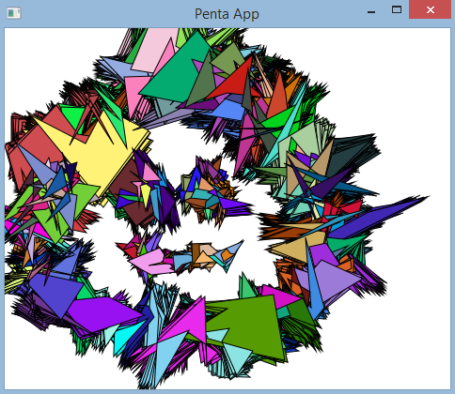
public class PentaApp extends Application {
private Stage primaryStage;
private Scene scene;
private Canvas canvas;
private GraphicsContext gc;
private ArrayList<double[]> xPoints;
private ArrayList<double[]> yPoints;
private ArrayList<Color> colors;
@Override
public void start(Stage initPrimaryStage) {
primaryStage = initPrimaryStage;
initStage();
initData();
initGUI();
initHandlers();
}

Slide 19
public void initStage() {
primaryStage.setTitle("Penta App");
Screen screen = Screen.getPrimary();
Rectangle2D bounds = screen.getVisualBounds();
primaryStage.setX(bounds.getMinX());
primaryStage.setY(bounds.getMinY());
primaryStage.setWidth(bounds.getWidth());
primaryStage.setHeight(bounds.getHeight());
}
public void initData() {
xPoints = new ArrayList();
yPoints = new ArrayList();
colors = new ArrayList();
}

Slide 20
public void initGUI() {
canvas = new Canvas();
gc = canvas.getGraphicsContext2D();
Group root = new Group();
root.getChildren().add(canvas);
scene = new Scene(root);
primaryStage.setScene(scene);
primaryStage.show();
canvas.setWidth(scene.getWidth());
canvas.setHeight(scene.getHeight());
}

Slide 21
public void initHandlers() {
canvas.setOnMouseClicked(mouseEvent -> {
if (mouseEvent.getClickCount() == 2) {
xPoints.clear();
yPoints.clear();
colors.clear();
gc.clearRect(0, 0, canvas.getWidth(), canvas.getHeight());
}
});

Slide 22
canvas.setOnMouseDragged(mouseEvent -> {
double x = mouseEvent.getX();
double y = mouseEvent.getY();
double[] xs = new double[5];
double[] ys = new double[5];
// CENTER
xs[0] = x;
ys[0] = y - (int)(Math.random() * 20) - 1;
// TOP-RIGHT POINT
xs[1] = x + (int)(Math.random() * 15) + 1;
ys[1] = y - (int)(Math.random() * 10) - 1;

Slide 23
// BOTTOM-RIGHT POINT
xs[2] = x + (int)(Math.random() * 10) + 1;
ys[2] = y + (int)(Math.random() * 15) + 1;
// BOTTOM-LEFT POINT
xs[3] = x - (int)(Math.random() * 10) - 1;
ys[3] = y + (int)(Math.random() * 15) + 1;
// TOP-LEFT POINT
xs[4] = x - (int)(Math.random() * 15) - 1;
ys[4] = y - (int)(Math.random() * 10) - 1;

Slide 24
…
xPoints.add(xs);
yPoints.add(ys);
int r = (int)(Math.random() * 256);
int g = (int)(Math.random() * 256);
int b = (int)(Math.random() * 256);
colors.add(Color.rgb(r,g,b));
PentaApp.this.draw();
});
}

Slide 25
public void draw() {
for (int i = 0; i < xPoints.size(); i++) {
double[] xVertices = xPoints.get(i);
double[] yVertices = yPoints.get(i);
for (int j = 0; j < 5; j++) {
xVertices[j] += (int)(Math.random()*9) - 4;
yVertices[j] += (int)(Math.random()*9) - 4;
}
Color color = colors.get(i);
gc.setFill(color);
gc.fillPolygon(xVertices, yVertices, 5);
gc.setStroke(Color.BLACK);
gc.strokePolygon(xVertices, yVertices, 5);
}
}

