Slide 1
CSE 219 Computer science III
Software Development lifecycle

Slide 2
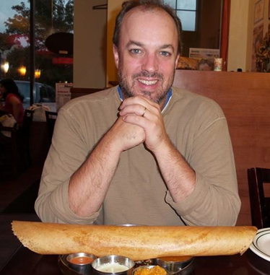
Who am i?
Richard McKenna
richard@cs.stonybrook.edu
New CS 216
M/W 1pm-2pm
T/Th 2:30pm – 4pm
http://www.cs.stonybrook.edu/~richard

Slide 3
Course homepages
http://www.cs.stonybrook.edu/~richard/suny-korea/cse219
syllabus
schedule (lecture slides, hw, etc …)
etc.
http://blackboard.stonybrook.edu
grades

Slide 4

Textbook #1
Head First Object Oriented Design and Analysis
(on-line version)
by Brett McLaughlin, Gary Pollice, David West
Published by O'Reilly Media, Inc. 2006
Print ISBN-10: 0-596-00867-8
Print ISBN-13: 978-0-596-00867-3

Slide 5

Textbook #2
Head First Design Patterns
(on-line version)
by Eric T Freeman, Elisabeth Robson, Bert Bates, Kathy Sierra
Published by O'Reilly Media, Inc. 2004
Print ISBN-10: 0-596-00712-4
Print ISBN-13: 978-0-596-00712-6

Slide 6
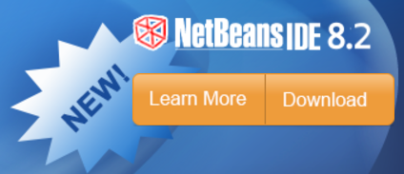
Course ide
Download
http://netbeans.org/downloads/index.html

Slide 7
How are grades computed?
Recitations 10 %
4 Homework Assignments 20 % (5 % each)
Final Project 20 %
Exam #1 20 %
Exam #2 30%
100 %
Note CEAS Policy: The Pass/No Credit (P/NC) option is not available for this course.

Slide 8
Academic dishonesty
All work you submit for homework, projects, or exams MUST be your own work.
PLEASE UNDERSTAND THESE RULES

Slide 9
Course description
Development of the basic concepts and techniques from Computer Science I and II into practical programming skills that include a systematic approach to program design, coding, testing, and debugging. Application of these skills to the construction of robust programs of thousands of lines of source code. Use of programming environments and tools to aid in the software development process.
NOTE: You must have taken CSE 214 and received a grade of "C" or better in order to take this course

Slide 10
Course topics
Project Technologies Basics
GUIs & Event Programming
2D Graphics
Software Design (UML)
Design Patterns
Programming style
Algorithms and data structure selection
Code maintenance & documentation

Slide 11
Course topics (continued)
Effectively using an IDE & associated tools for:
Designing
Code editing
Testing
Debugging
Revision control
Profiling
Documentation
Deployment

Slide 12
SO WHAT IS THIS COURSE REALLY ABOUT?
Short Answer:
OOP mastery
No more toys
Plan, then do (design, then code)
Student to Pro

Slide 13
The long answer
Learn methodologies for building high quality software systems
What properties make a software system high quality?
correctness
efficiency
ease of use
reliability/robustness
maintainability
modifiability
extensibility
scalability

Slide 14
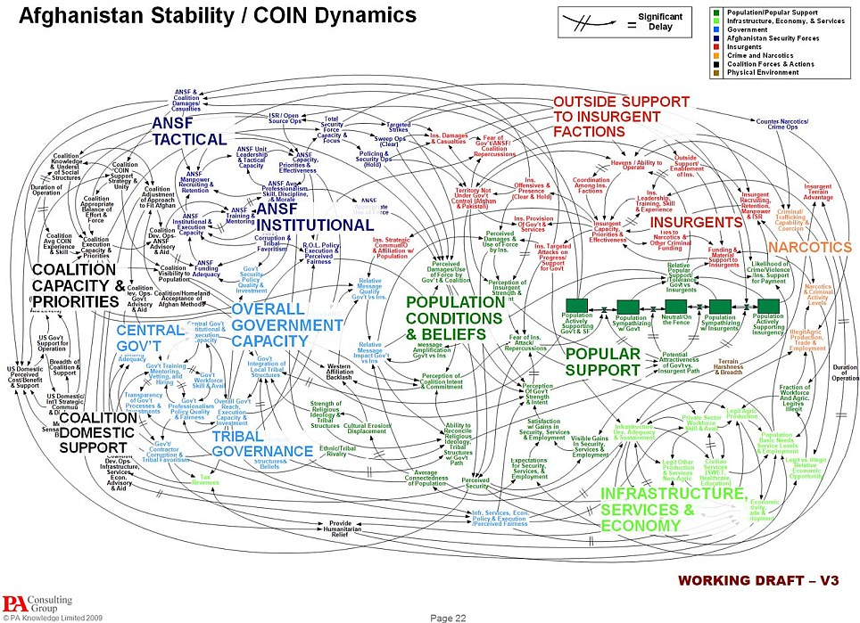
klocs
As programs get larger, these goals become much more difficult to achieve. Why?
program complexity
team complexity
Notes:
Ref: http://i.dailymail.co.uk/i/pix/2010/04/28/article-0-09562375000005DC-283_964x699.jpg

Slide 15
How can these properties be achieved?
By using well proven, established processes preferably while taking advantage of good tools
Requirements Analysis
Design & Document
Evaluate Design
Code
Test
Deploy
Profile
Debug

Slide 16
Other steps to consider
Integration
Maintenance

Slide 17
integration
Done in large projects
Combine developed software into a cohesive unit
A
B
C
D
E
ABCDE

Slide 18

Software maintenance
Follows Deployment
Monitoring and Updating deployed software
Notes:
Ref: http://img.timeinc.net/time/daily/2009/0903/3mile_island_0326.jpg

Slide 19
Software jobs
Not all of you are going to be programmers
but you should know how to design, program, test, debug software
Other types of jobs:
Designer
Tester
Database, Network, Security Administrator
Project Leader
Manager
Founder/CEO
Professor
etc …
NOTE: designers & programmers on a project may not be the same people

Slide 20
Design, then code
We will design all classes before coding
not easy to do
UML is used for software design
You cannot design a system unless you really understand the necessary technology
designs cannot be created without a little testing
trying out different small-scale examples (HWs 1 & 2)

Slide 21
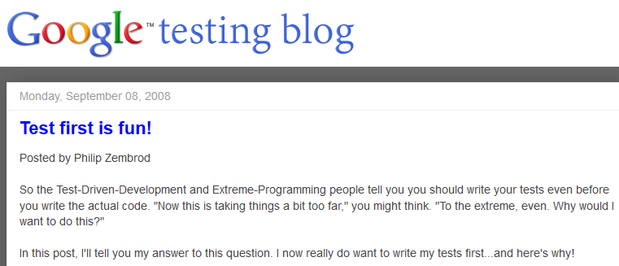


Updated software development lifecycle
Waterfall Model
many variations
Requirements Analysis
Design
Evaluate Design
Code
Test, Debug, & Profile Components
Integrate
Test, Debug, & Profile Whole
Deploy
Maintain

Slide 22
The HW Plan
HW 1 –Technology Ramp-Up – GUIs, Events, HTML/CSS/JS, JSON & XML
HW 2 - UML Design
HW 3 – Implementation Stage #1
HW 4 – Implementation Stage #2
Final Project – Completed Work

Slide 23
Your project?
goLogoLo

