Slide 1
[ 3.483301] scsi2 : ioc0: LSI53C1030 B0, FwRev=01032920h, Ports=1, MaxQ=128, IRQ=17
[ 3.484223] pcnet32: pcnet32.c:v1.35 21.Apr.2008 tsbogend@alpha.franken.de
[ 3.596378] scsi 2:0:0:0: Direct-Access VMware, VMware Virtual S 1.0 PQ: 0 ANSI: 2
[ 3.596544] scsi target2:0:0: Beginning Domain Validation
[ 3.596709] scsi target2:0:0: Domain Validation skipping write tests
[ 3.596874] scsi target2:0:0: Ending Domain Validation
[ 3.597039] scsi target2:0:0: FAST-40 WIDE SCSI 80.0 MB/s ST (25 ns, offset 127)
[ 3.603477] sd 2:0:0:0: [sda] 41943040 512-byte logical blocks: (21.4 GB/20.0 GiB)
[ 3.603642] sd 2:0:0:0: [sda] Write Protect is off
[ 3.603807] sd 2:0:0:0: [sda] Mode Sense: 61 00 00 00
[ 3.603951] sd 2:0:0:0: [sda] Cache data unavailable
[ 3.604116] sd 2:0:0:0: [sda] Assuming drive cache: write through
[ 3.604281] sd 2:0:0:0: [sda] Cache data unavailable
[ 3.604446] sd 2:0:0:0: [sda] Assuming drive cache: write through
[ 3.604732] sd 2:0:0:0: Attached scsi generic sg1 type 0
[ 3.619325] sda: sda1 sda2 < sda5 >
[ 3.619710] sd 2:0:0:0: [sda] Cache data unavailable
[ 3.619875] sd 2:0:0:0: [sda] Assuming drive cache: write through
[ 3.620040] sd 2:0:0:0: [sda] Attached SCSI disk
[ 4.738439] VMware vmxnet3 virtual NIC driver - version 1.0.25.0-k-NAPI
[ 4.750461] VMware PVSCSI driver - version 1.0.1.0-k
[ 4.846474] EXT4-fs (sda1): mounted filesystem with ordered data mode. Opts: (null)
[ 16.766824] Adding 916476k swap on /dev/sda5. Priority:-1 extents:1 across:916476k
[ 17.373058] udev: starting version 151
[ 17.714467] EXT4-fs (sda1): re-mounted. Opts: errors=remount-ro
[ 19.328225] shpchp: Standard Hot Plug PCI Controller Driver version: 0.4
[ 19.529979] lp: driver loaded but no devices found
[ 20.100677] [341]: VMCI: shared components initialized.
[ 20.100746] Probing for vmci/PCI.
[ 20.100804] vmci 0000:00:07.7: PCI INT A -> GSI 16 (level, low) -> IRQ 16
[ 20.100857] Found vmci/PCI at 0x1080, irq 16.
[ 20.100905] VMCI: using capabilities 0x4.
[ 20.100977] [341]: VMCI: Host capability check: PASSED.
[ 20.101035] Registered vmci device.
[ 20.102700] [341]: VMCI: Using guest personality
[ 20.102707] [341]: VMCI: host components initialized.
[ 20.115578] [341]: VMCI: Module registered (name=vmci,major=10,minor=57).
[ 20.115582] [341]: VMCI: Using host personality
[ 20.115584] [341]: VMCI: Module (name=vmci) is initialized
[ 20.895544] piix4_smbus 0000:00:07.3: Host SMBus controller not enabled!
[ 21.752996] udev: renamed network interface eth0 to eth2
[ 24.692219] parport_pc 00:08: reported by Plug and Play ACPI
[ 24.692485] parport0: PC-style at 0x378, irq 7 [PCSPP,TRISTATE]
[ 26.715880] lp0: using parport0 (interrupt-driven).
[ 26.880864] input: ImPS/2 Generic Wheel Mouse as /devices/platform/i8042/serio1/input/input2
[ 27.172200] ppdev: user-space parallel port driver
[ 29.267906] ENS1371 0000:02:02.0: PCI INT A -> GSI 16 (level, low) -> IRQ 16
Notes:
Bonjour à tous,
Vous êtes prêt :D

Slide 2
Comment un hacker voit votre site web ?
Rémi Dubois – Code Name Dubzsploitsec 64 bit tty1
login:
HumanTalk
_
Password:
_
HumanTalk@kali:~#
su -
Password:
_
Notes:
Présentation
ESAIP Etc …
Eden-solution
Pourquoi ce choix ?
Approche qu’un hacker peut avoir d’un site.

Slide 3
#########################################################
[*] Sommaire
#########################################################
root@kali:~#
cat /etc/presentation.conf
_
chap(1) { subject=Rappel ; langage=FR-utf8 ; }
chap(2) { subject=Demo ; langage=FR-utf8 ; }
chap(4) { subject=Outils ; langage=FR-utf8 ; }
chap(5) { subject=CERT-FR ; langage=FR-utf8 ; }
chap(6) { subject=Questions ; langage=FR-utf8 ; }
root@kali:~#
clear
_
_

Slide 4
root@kali:~#
/sbin/attacks -–arg1
_
Problèmes de cryptographie : 65%
Qualité du code : 62%
CRLF Injection : 53%
XSS : 50%
SQL Injection : 32%
/sbin/cost --total
_
root@kali:~#
Coût total : 773 000 €
_
_
root@kali:~#
clear
Notes:
Votre site est pour la plupart du temps une porte d’entrée
Source d’information énorme

Slide 5
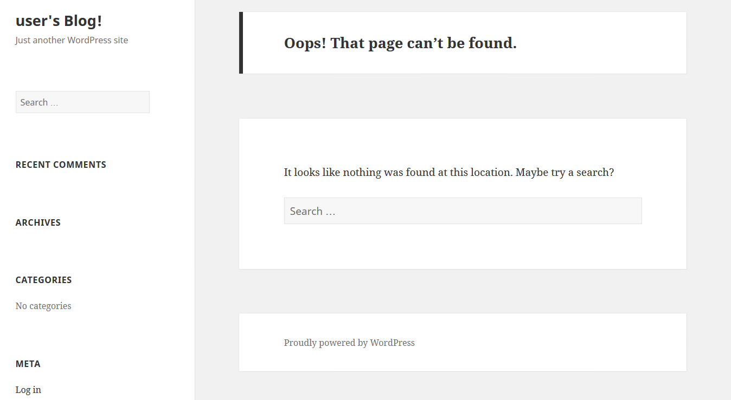
root@kali:~#
/etc/demo/attacks | grep -B Wordpress
_
_
_
root@kali:~#
clear
Notes:
Présentation de l’attaque sur un wordpress
Attaque fictif sur un wordpress « maison »

Slide 6

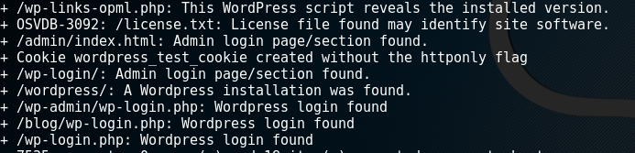
root@kali:~#
/etc/demo/attacks | grep -B Wordpress
_
Port 80 et 443 ouvert avec un service Apache.
_
_
root@kali:~#
clear
Notes:
Nmap : Outils de découverte réseau, ports etc …
Nikto : Scanneur de vulnérabilité web et d’information
Wpscan : Scanneur de vulnérabilité wordpress complet

Slide 7
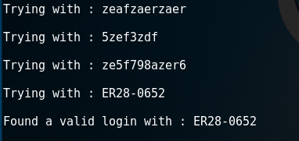
root@kali:~#
/etc/demo/attacks | grep -B Wordpress
_
_
_
root@kali:~#
clear

Slide 8
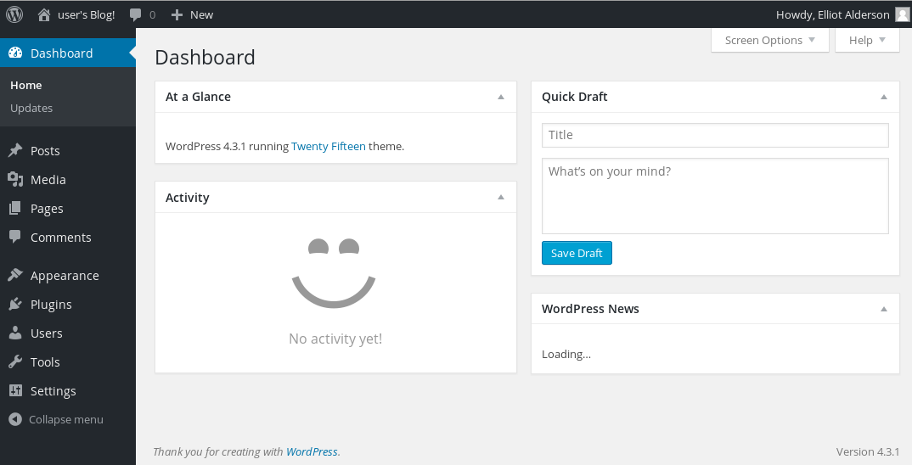
root@kali:~#
/etc/demo/attacks | grep -B Wordpress
_
_
_
root@kali:~#
clear
Notes:
Accés à l’administration
Bon bah pour moi ça me suffit pas, il m’en faut plus là !!

Slide 9
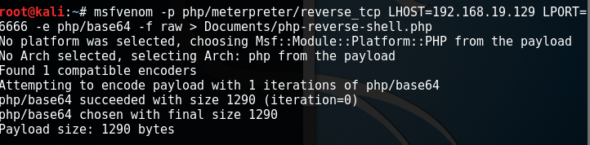
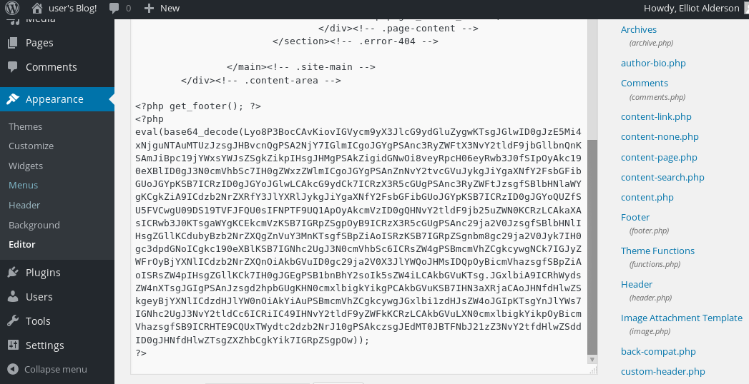
root@kali:~#
/etc/demo/attacks | grep -B Wordpress
_
_
_
root@kali:~#
clear
Notes:
Msfvenom : Outils lié à metasploit qui permet de faire énormément de chose
Virus
Backdoor
Maintien de l’accés etc ..
Code implémenté dans la page 404.

Slide 10
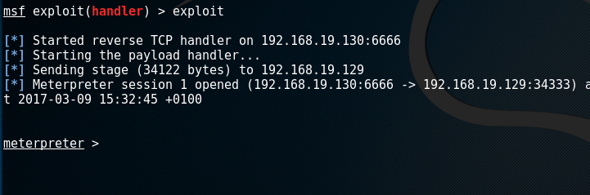
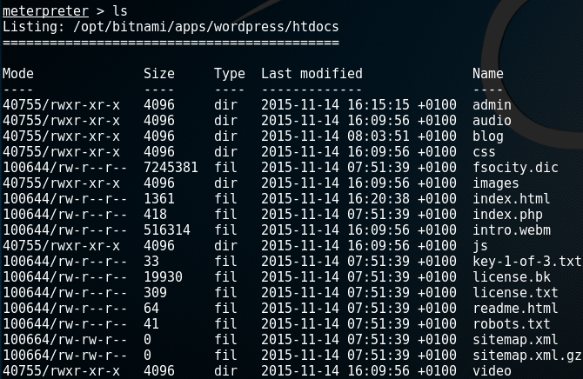
root@kali:~#
/etc/demo/attacks | grep -B Wordpress
_
_
_
root@kali:~#
clear
Notes:
J’ouvre metasploit : L’outil fétiche des hackers
Je lance une écoute
Et j’ai un accés console sur le serveur

Slide 11
_
root@kali:/home/Security/Exploit#
ls Tools
Exploitation_Tools Forensics
Information_Gathering Maintaining_Access
Privilege_Escalation Reverse_Engineering
Stress_Testing Vulnerability_Assessment
cat > top_tools.memo
_
root@kali:/home/Security/Exploit#
Découverte d’information: nmap, netdiscover
_
Evaluation de Vulnerabilités : Wpscan, nessus, nikto
_
Outils d’Exploitation : John, Burp, metasploit, sqlmap, Github
_
Augmentation de privilège: meterpreter, exploitdb
_
Maintien de l’accès: msfencode, msfpayload
_
^C
root@kali :/home/Security/Exploit #
clear
_
_

Slide 12
CERTFR-2017-0314(1) CERTFR CERTFR-2017-0314 (1)
NAME
www.cert.ssi.gouv.fr
SYNOPSIS
CERT-FR est un dictionnaire de vulnérabilités de sécurité:
[ -i CERT-FR]
[ -d date ]
[ -n numéro incrémenté]
SUMMARY
<< La bonne pratique >>
Regarder de temps en temps le site
Suivre le compte @CERT-FR
Lire les fiches
SEE ALSO
OWASP – CVE

Slide 13
root@kali:/var/www/html/Twitter#
_
ABC/abc --info
Absolute Bash Command
* Info : @RemiDubz
root@kali:/var/www/html/Linkedin#
_
DEF/def --info
Define External flood
* Info : /dubsremi
root@kali:/var/www/html/mywebsite#
_
man github.com
_
Good Hacking Instruction
* Info : github.com/Dubzctf

