Slide 1
Sort algorithms
Vũ Ngọc nam: 20176832
Lê đình quyền: 20176859
trần xuân Đức: 20176720

Slide 2
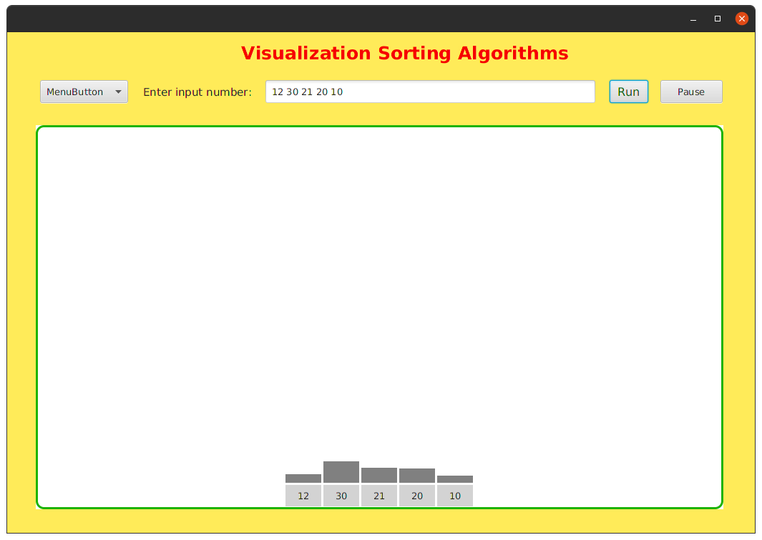
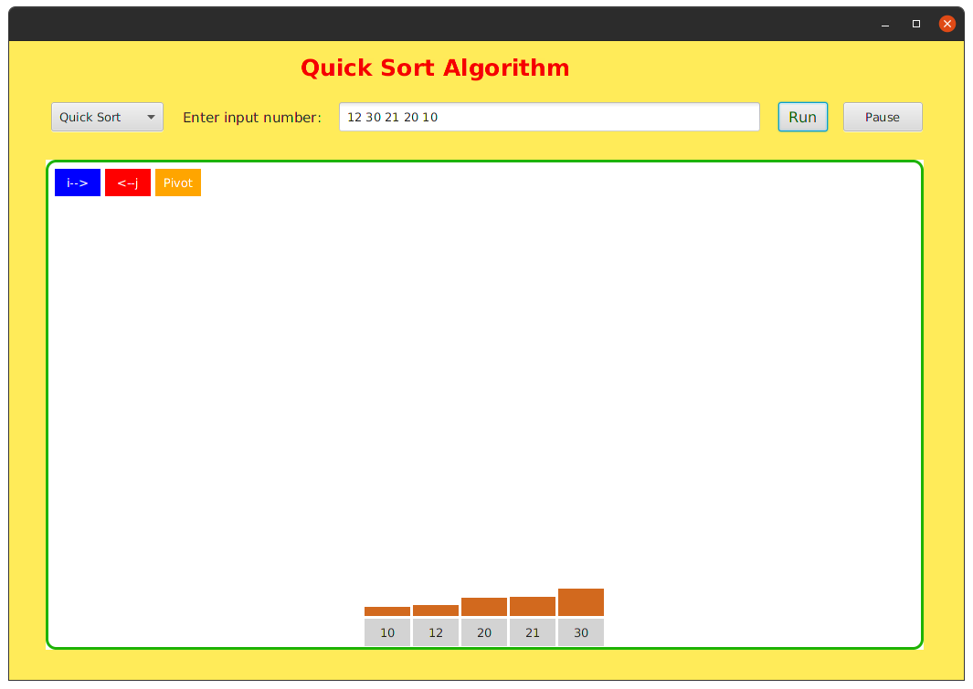
problem statement
The application demonstrate sort algorithm
sorting

Slide 3
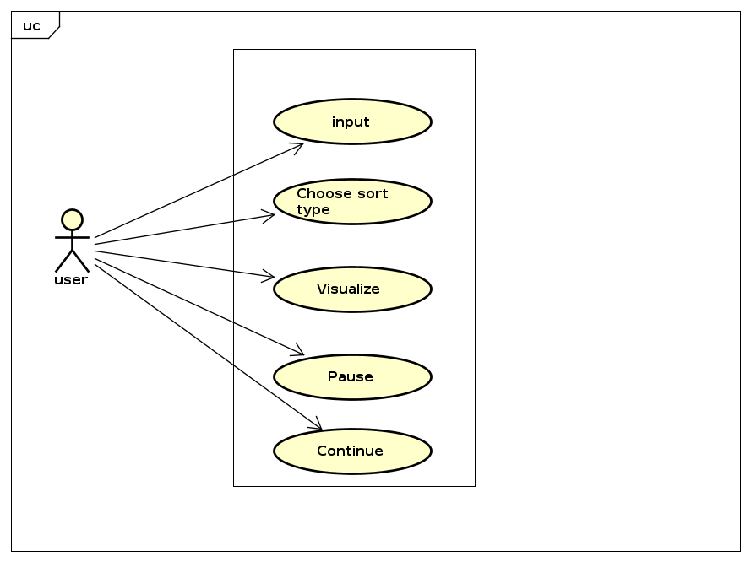
Use-case diagram

Slide 4
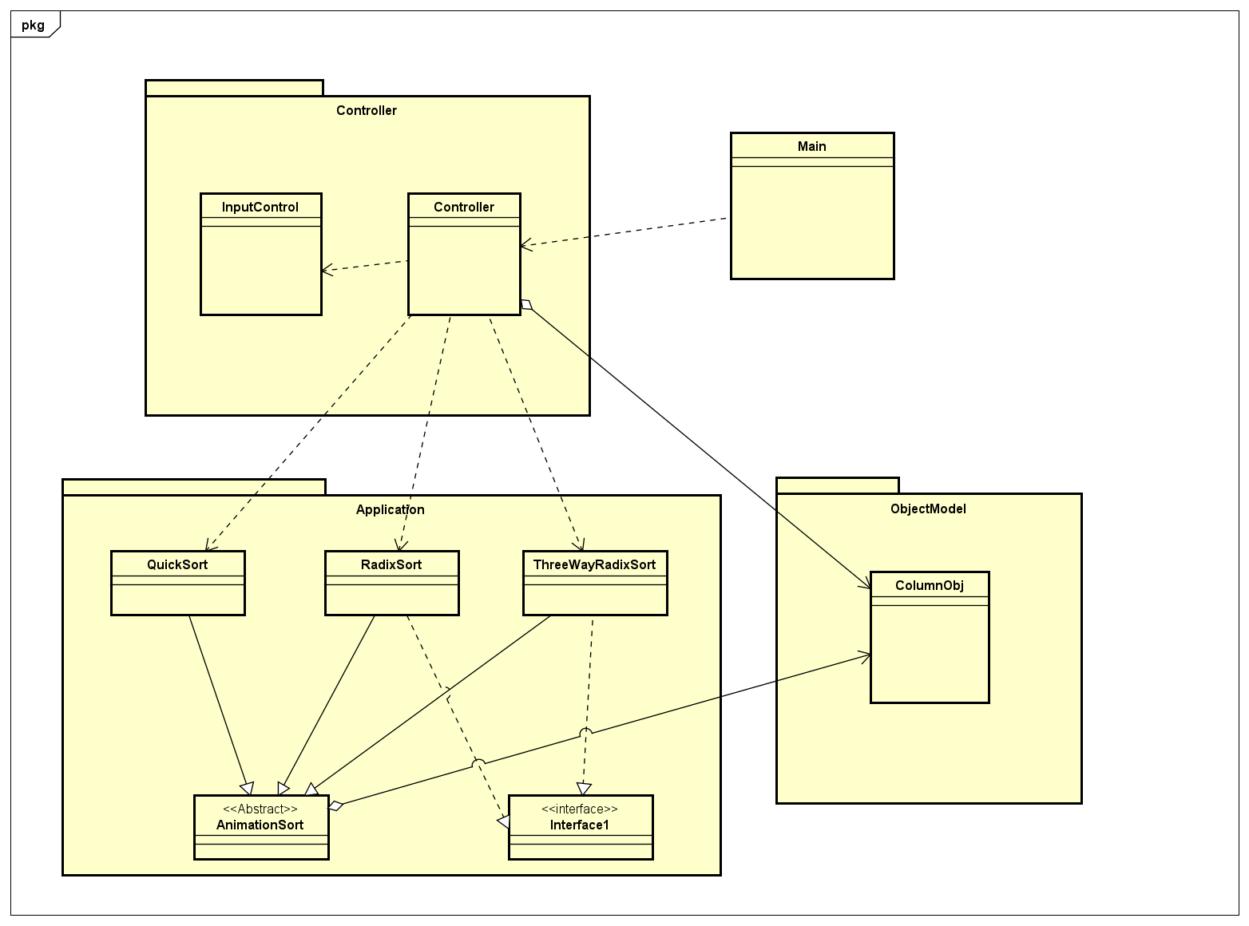
General class diagram

Slide 5
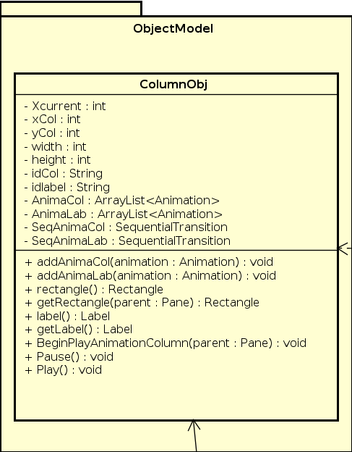
Package: objectmodel

Slide 6
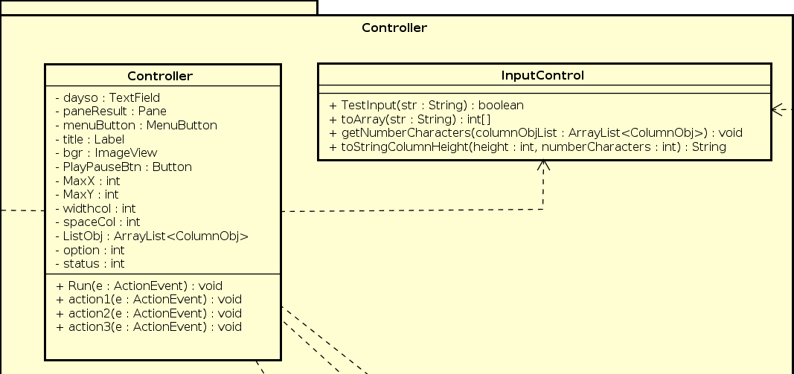
Package: controller

Slide 7
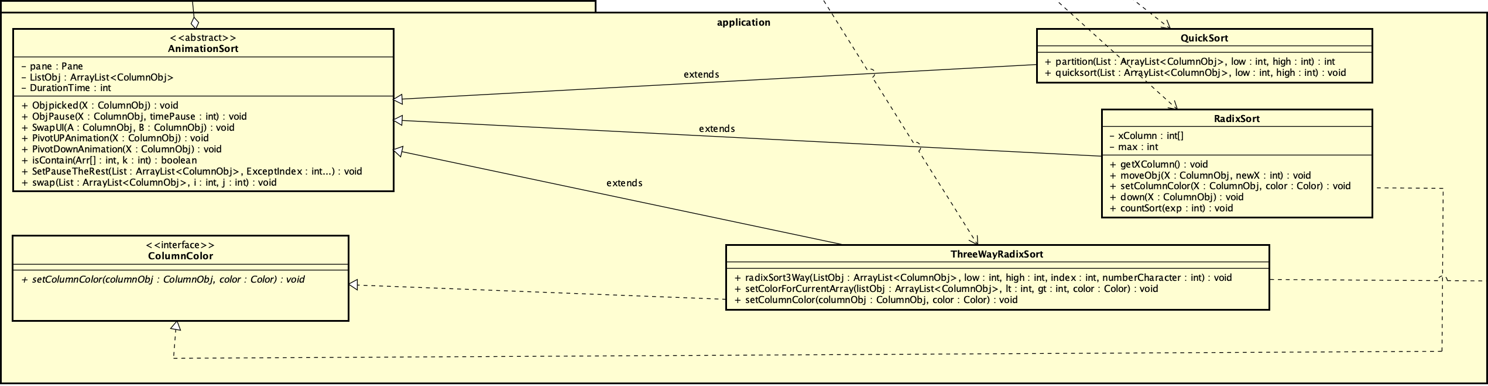
Package: application

Slide 8
Demo

Slide 9
Thank you for listening

