Slide 1

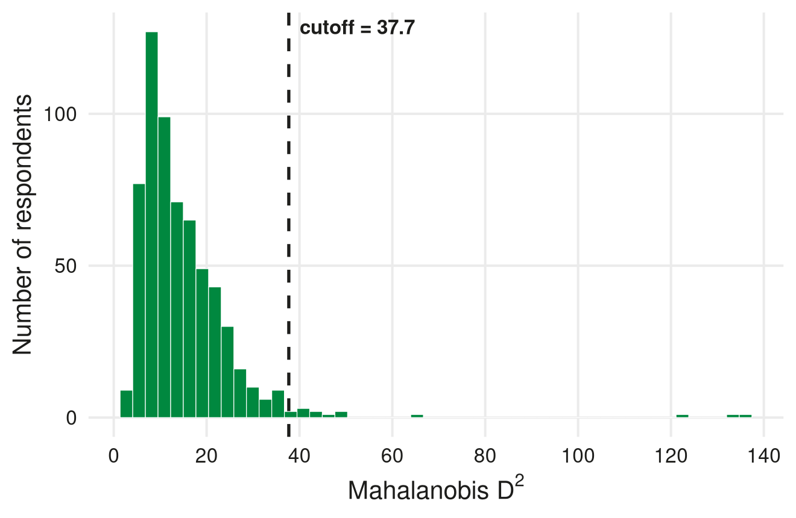
BACKUP → METHODS
How We Flagged the 14 Multivariate Outliers
Mahalanobis distance across 15 core WTM indicators, with a χ²-based cutoff
What Mahalanobis distance measures:
for each respondent, how far their combination of scores sits from the “typical” respondent — accounting for how the 15 variables correlate with each other, not just their individual ranges.
The 15 indicators used
Conflict experience (7)
CP_WB1–4, CP_A1–3
Costs (2)
TC1 damaged area, log economic loss
Benefits (2)
IC1 general attitude, IB ecological value
Tolerance (4)
Tol1, Tol2, Tol3, Tol4
Threshold: D² values approximately follow a χ² distribution with df = 15 (one per variable) under multivariate normality. We flag respondents beyond the p<.001 cutoff: D² > 37.7.
14 of 625 (2.2%) flagged
Split evenly: 7 Baoxing / 7 Qingchuan, 7 with-compensation / 7 without — not concentrated in either group.
3 respondents are extreme (D² = 124–136); the remaining 11 sit just past the cutoff (D² = 38–50).
Source: Mahalanobis distance on 15 WTM indicators, n=625; claude_analysis/output/tables/05_multivariate_outliers.csv
Notes:
Backup slide for Q&A on the outliers slide. Mahalanobis distance is the standard multivariate generalisation of a z-score: instead of asking 'how many standard deviations is this one variable from its mean,' it asks 'how far is this respondent's whole profile across 15 variables from the average profile, accounting for how those 15 variables correlate with each other.' Two respondents can each look unremarkable on every single variable individually, but be a joint outlier because of an unusual COMBINATION -- that's what this catches and a univariate check would miss. We used 15 indicators spanning all four core WTM blocks: conflict experience (7 items), tangible costs (2), intangible benefit/general attitude (2), and the four tolerance items. Under multivariate normality, the squared Mahalanobis distance approximately follows a chi-squared distribution with degrees of freedom equal to the number of variables -- 15 here -- which is what lets us attach a p-value and pick a principled cutoff rather than an arbitrary one. We used p<.001, i.e. D-squared beyond 37.7. Fourteen respondents (2.2%) exceed that, split exactly evenly by county and by compensation status, so this isn't picking up a group-level pattern, just individually unusual response profiles. Three of the fourteen are far beyond the rest (D-squared in the 120s-130s) and probably deserve a closer manual look if anyone wants to audit specific respondent IDs -- those are in the source CSV.

