Slide 1

EDA → SAMPLE
Who We Surveyed, Where, and When
Respondents by county
• 625 household respondents across two counties in Sichuan Province, China, both bordering Giant Panda National Park.
• Baoxing county: n=160, surveyed 15–31 August 2024.
• Qingchuan county: n=465, surveyed 10 March – 10 April 2025 — seven months later.
• Two linked data sources: a cleaned 625×57 analysis file, and the original 625×~200 raw Qualtrics export, which we mined for additional fields not in the cleaned file.
Source: data/3_Data.xlsx (Input Data + Raw data sheets), n=625; claude_analysis/output/tables/00_data_quality_summary.csv
Notes:
Sets the scene before any modelling: 625 respondents, two counties near Giant Panda National Park, surveyed seven months apart. We worked from two linked sources -- the cleaned analysis sheet Mengxi's team built, and the original raw Qualtrics export, which still contains several fields (personal encounter history, mitigation-strategy detail, hunting perceptions) that never made it into the cleaned file and that we recovered for the extended analysis.

Slide 2
EDA → CONFOUNDING
Compensation Participation Is Confounded with County
Application rate by county
• In Baoxing, 119 of 160 respondents (74%) reported applying for compensation.
• In Qingchuan, only 158 of 465 (34%) did — a chi-square test confirms this gap is not chance (χ²=77.1, df=1, p<.001).
• The two counties were also surveyed seven months apart: Baoxing in August 2024, Qingchuan in March–April 2025.
• Geography and timing move together with compensation status — any comparison across compensation groups must control for county/survey wave.
Source: EDA on Wildboar-Compensation-on-Tolerance data (n=625); claude_analysis/output/tables/02_compensation_group_tests.csv
Notes:
This is the single most important EDA fact for interpreting anything about compensation later. Compensation participation cannot be read on its own: it is entangled with which county someone lives in, and those counties were surveyed at different times of year, a season apart. Every model comparing compensation groups needs an explicit county/site control -- we do this throughout the modelling section, and show the compensation effect survives it.

Slide 3
EDA → COMPARISON
Compensation Recipients Differ in Assets, Not in Who They Are
Differs significantly (p < .05)
No significant difference
Total cropland
p < .001
Age
p = .401
Total livestock
p < .001
Gender
p = .318
Household assets
p < .001
Education
p = .383
Agricultural income share
p = .017
Annual income
p = .599
Reading this: compensation participation is not “as-if random,” but it also isn’t just a proxy for being richer or poorer — it tracks farm/livestock exposure (more assets at risk of damage) and county, not demographics.
Source: Wilcoxon/chi-square tests, with- vs. without-compensation groups, n=625; claude_analysis/output/tables/02_compensation_group_tests.csv
Notes:
Second key EDA fact: who actually applies for compensation? Households with more cropland, more livestock, more household assets, and a higher share of income from farming are significantly more likely to have applied -- makes sense, they have more at stake to claim against. But age, gender, education and income show no significant difference. So compensation status is not simply standing in for wealth or demographics in general -- it specifically tracks farm/livestock exposure and, as the previous slide showed, county.

Slide 4
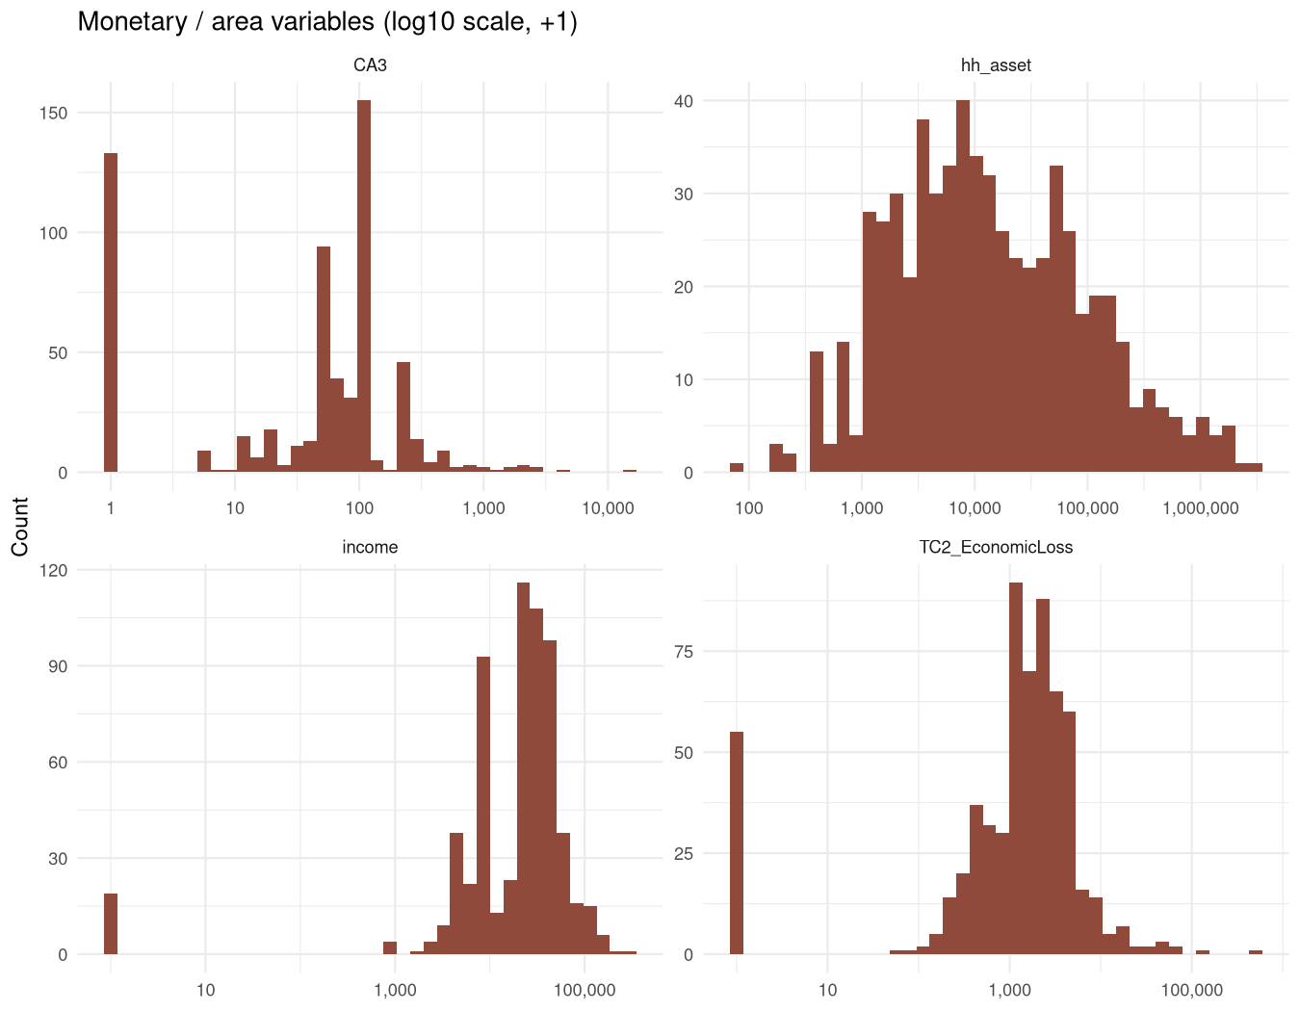
EDA → DISTRIBUTIONS
A Few Extreme Households Would Dominate Any Linear Model
• Household assets range from 77 to 3,087,729 RMB across respondents.
• Annual household income ranges from 0 to 300,000 RMB.
• Reported economic loss from wild-boar damage ranges from 0 to 503,300 RMB.
• Willingness to pay for insurance ranges from 0 to 15,000 RMB/year.
• All four are heavily right-skewed (see distributions, right) — log(1+x)-transformed before entering any model so a handful of large landholders don’t dominate the fit.
Source: EDA on Wildboar-Compensation-on-Tolerance data, n=625; claude_analysis/output/figures/02_monetary_distributions.png
Notes:
Before modelling, we always look at the shape of continuous variables. Income, household assets, damage-related economic loss and insurance willingness-to-pay are all heavily right-skewed with a long tail of large values -- typical for monetary survey data. Left untransformed, a small number of wealthy or heavily-affected households would dominate any linear relationship involving them. We log-transform all four (log(1+x), which keeps zero-valued households in the data) before they enter any model.

Slide 5
EDA → DATA QUALITY
Not All Missing Values Mean the Same Thing
• 2nd/3rd descriptive-word ratings: 45 (7%) and 155 (25%) of 625 respondents show a ‘0’ — not a real rating, but “no word given.”
• Compensation timeliness/satisfaction: undefined for the 348 of 625 (56%) who never applied — the question literally doesn’t apply to them.
• Compensation-percentage fields: 9 and 4 respondents (of 625) report values above 100% — plausible, not obviously data errors.
Why this matters before modelling: treating a placeholder ‘0’ as a real “very positive” score, or a structurally-undefined field as a real “zero,” would quietly bias every downstream estimate. See the Missing Value Treatment slide for exactly how each case is handled.
Source: EDA on Wildboar-Compensation-on-Tolerance data, n=625; claude_analysis/output/tables/00_data_quality_summary.csv
Notes:
Third data-quality fact from EDA: missingness in this dataset is not one uniform thing, it has (at least) three different causes that each need different treatment. A blank third word is not a neutral opinion. A blank payment-satisfaction score for someone who never got a payment is not a zero. And a compensation request for more than 100% of assessed loss is not obviously a typo. We flag all three here descriptively; the Missing Value Treatment slide covers exactly how each is handled in the cleaned analysis dataset.

Slide 6
EDA → DATA QUALITY
A Small Number of Multivariate Outliers, Flagged Not Removed
• Flagged via Mahalanobis distance across 15 core Wildlife Tolerance Model indicators (conflict experience, costs, benefits, tolerance items), threshold p<.001.
14
of 625 respondents
(2.2%)
• Kept in the primary analysis — a statistical outlier is not automatically a data error.
• Every core structural result is re-estimated excluding them as a robustness check (see Robustness section): all paths stable in sign, magnitude and significance.
Source: Mahalanobis distance screen on Wildboar-Compensation-on-Tolerance data, n=625; claude_analysis/output/tables/05_multivariate_outliers.csv
Notes:
Last EDA fact before we move to measurement and modelling: a routine multivariate outlier screen, using Mahalanobis distance across the core Wildlife Tolerance Model indicators, flags 14 of 625 respondents (2.2%) as extreme at the p<.001 threshold. We don't remove them by default -- an outlier isn't automatically an error, it could be a real household with an unusual profile. Instead we carry them into the main analysis and separately re-run every core structural path excluding them, later, as a robustness check. They turn out not to change any conclusion.

