Slide 1
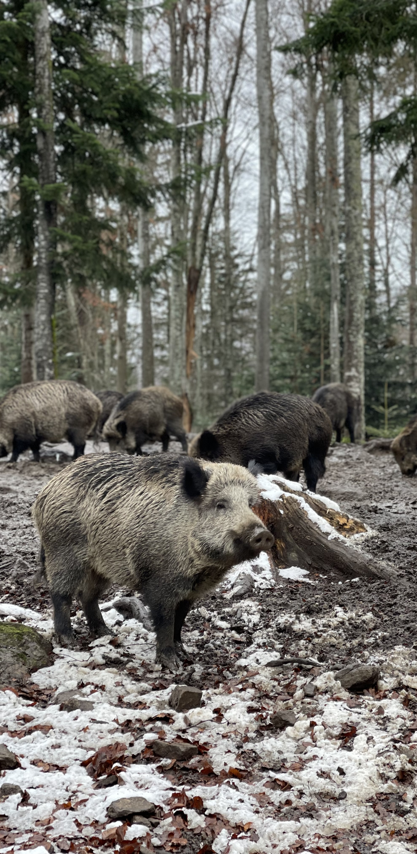
Understanding the compensation policy impact on local resident’s
tolerance towards wild boars in Giant Panda National Park, China
StaBLab First Meeting
Mengxi Kou

Slide 2
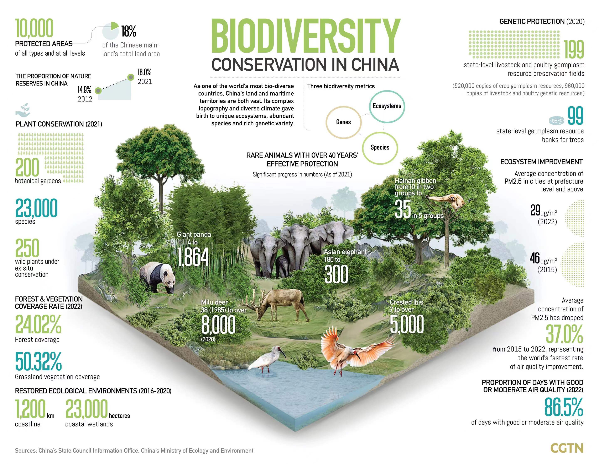
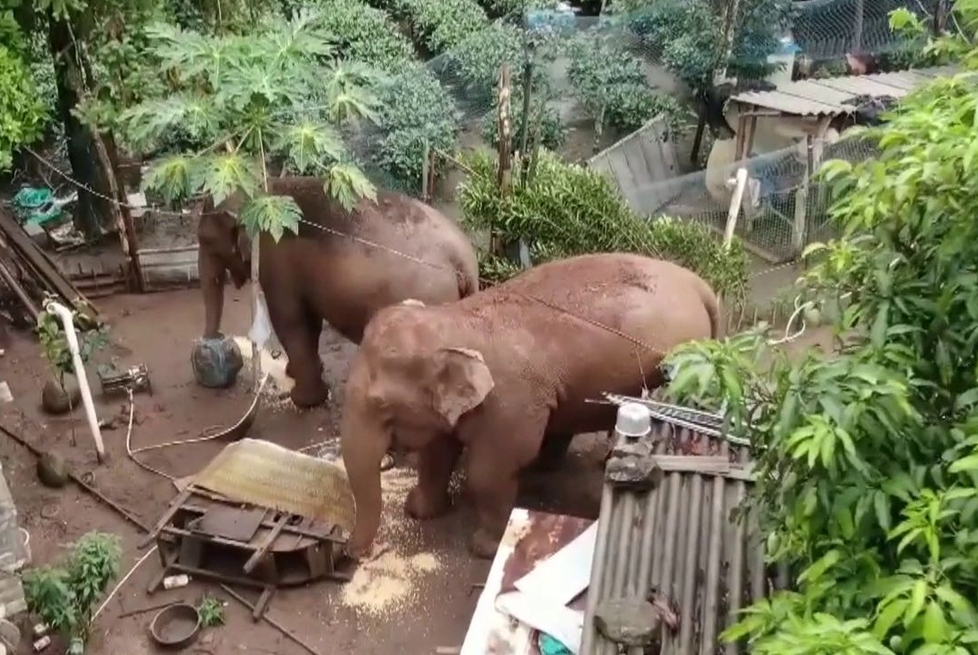
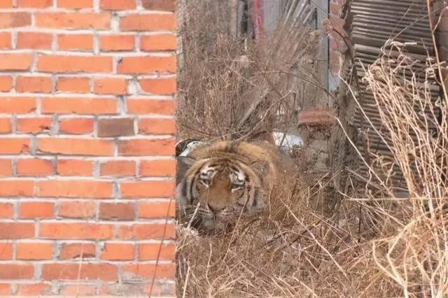
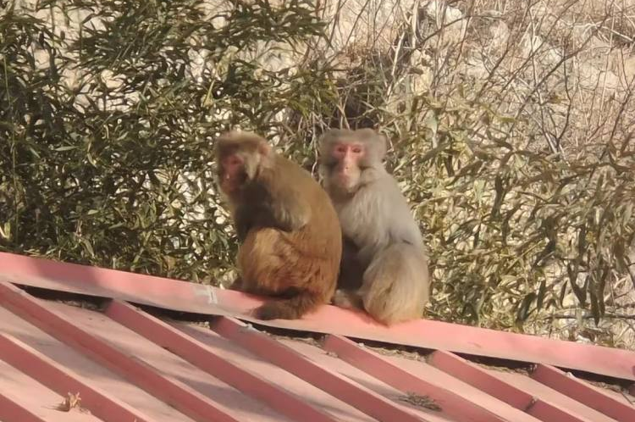
© CCTV.COM
© CCTV.COM
© HONGXIA LIU

Slide 3
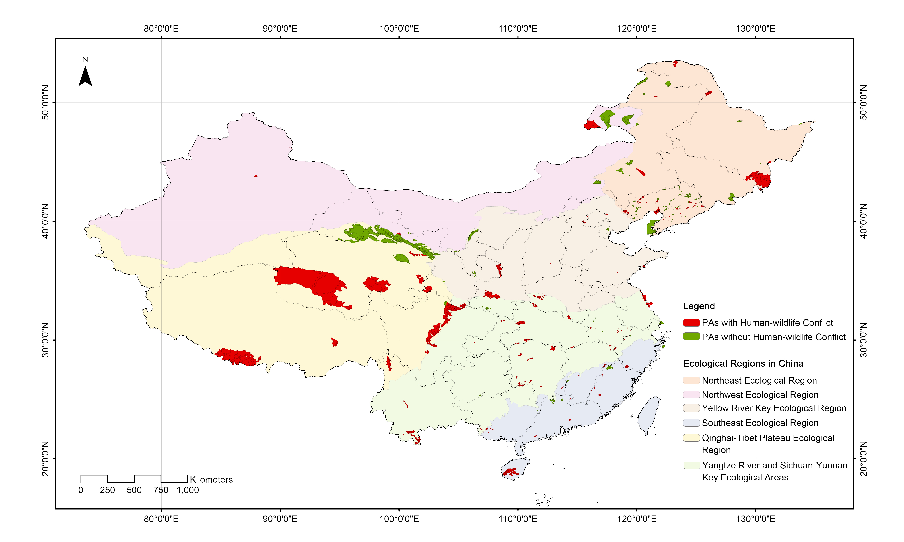
Human-wildlife Conflict in China
Ranger Questionnaire
164 PAs in China
Species ?
Incidents ?
Mitigation ?
Effectiveness ?

Slide 4
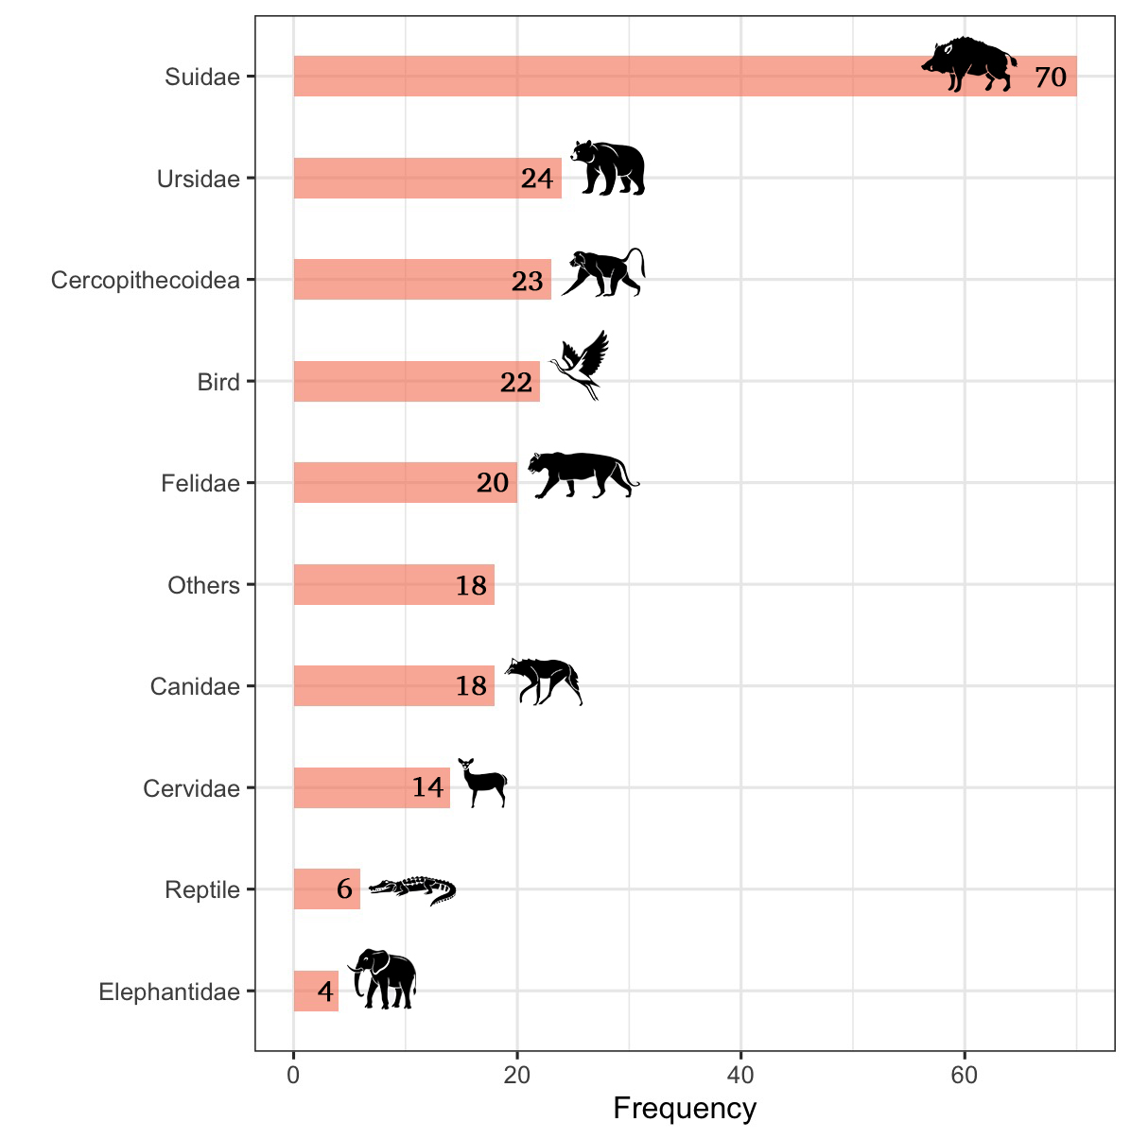
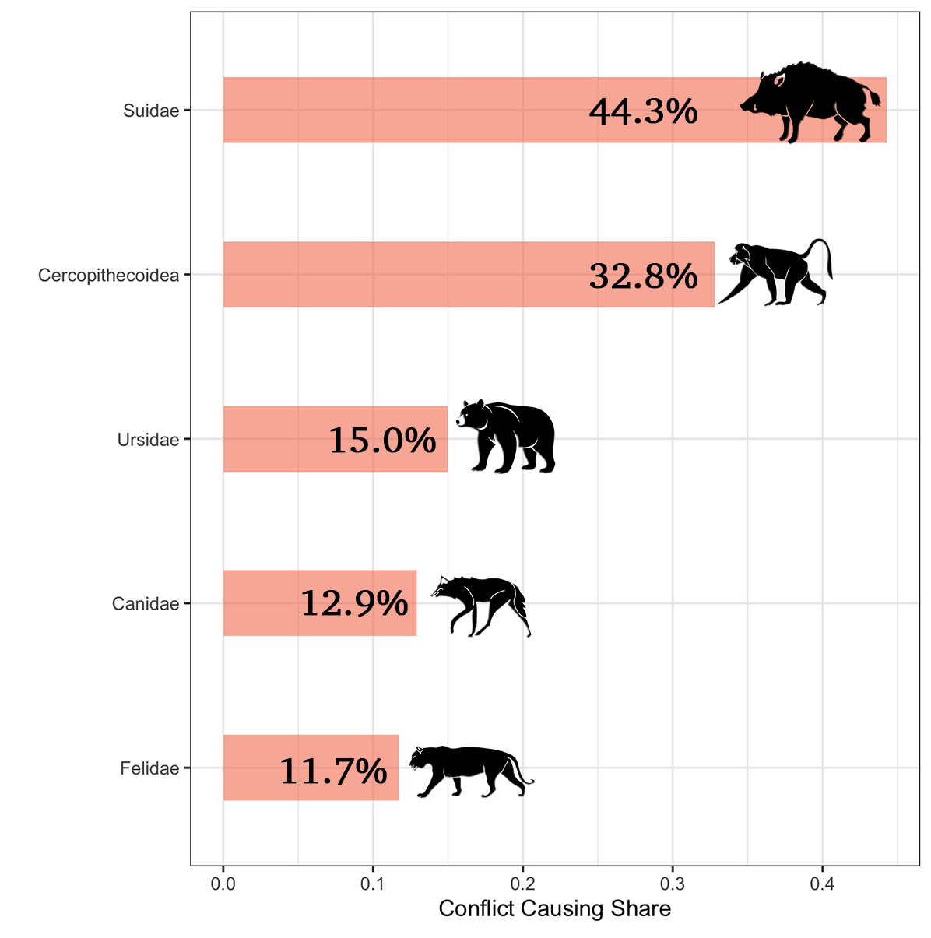
Human-wildlife Conflict in China
Wild boar !!!
Omnivorous species !!!

Slide 5
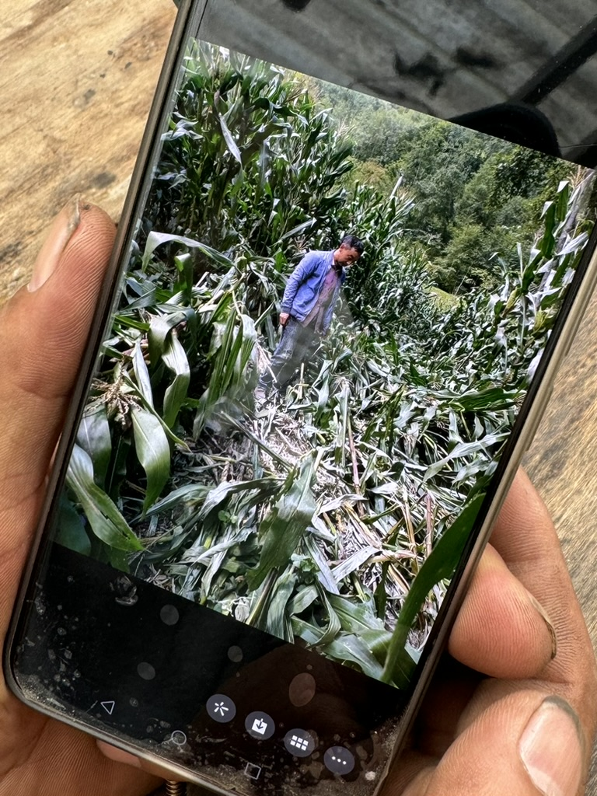
Compensation Policy
While compensation can be effective, its success to increase tolerance to crop damage varies most likely based on farmers’ values and how they perceive administrative challenges (Hemminger et al. 2025 ).
Financial compensation for livestock losses is a key factor in improving human–leopard coexistence (Kichloo et al. 2023).
Social customs, pastoral practices, and the present compensation mechanism were identified as being antithetical to conflict reduction and sustainable pastureland management (Poudel et al. 2022).
Compensation is failing to reconcile conservation and development priorities (Johnson et al. 2018).

Slide 6
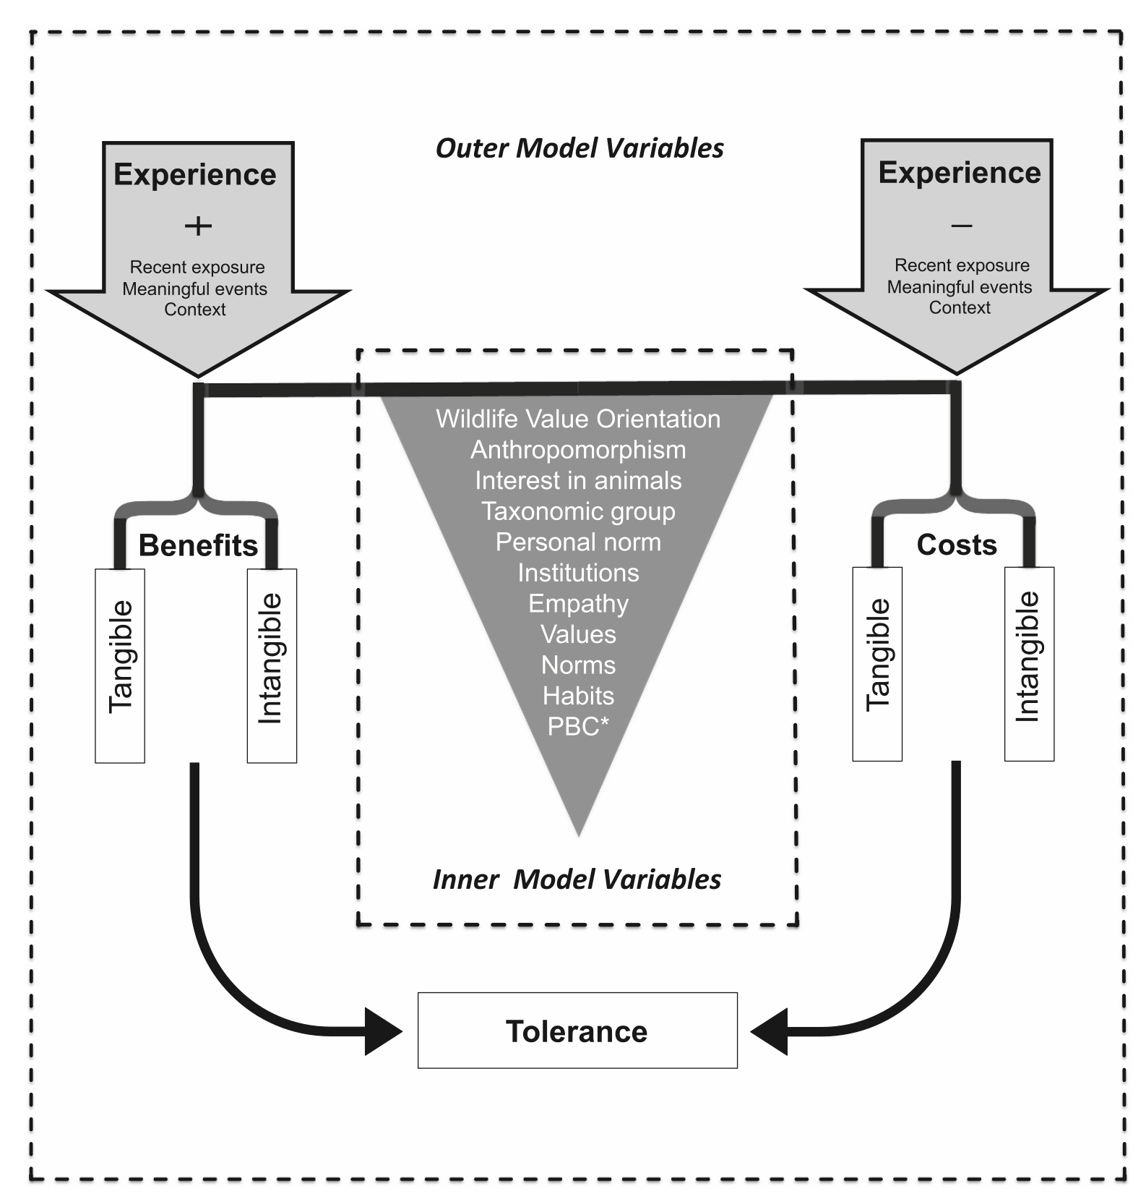
Wildlife Tolerance Model
(WTM)
Outer Model
Inner Model
Policy perspective?
Our aim is to see the relationship between compensation policy and tolerance.
Kansky, R., Kidd, M., & Knight, A. T. (2016). A wildlife tolerance model and case study for understanding human wildlife conflicts. Biological Conservation, 201, 137-145. https://doi.org/10.1016/j.biocon.2016.07.002

Slide 7
Household Questionnaire

Slide 8
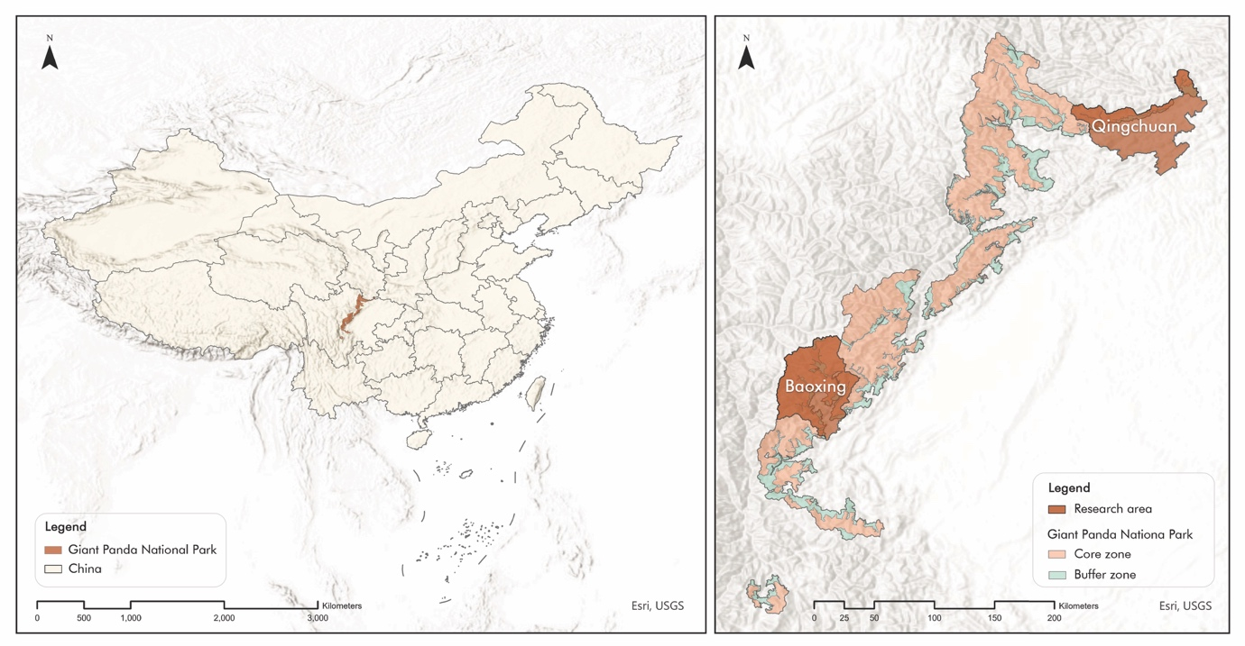
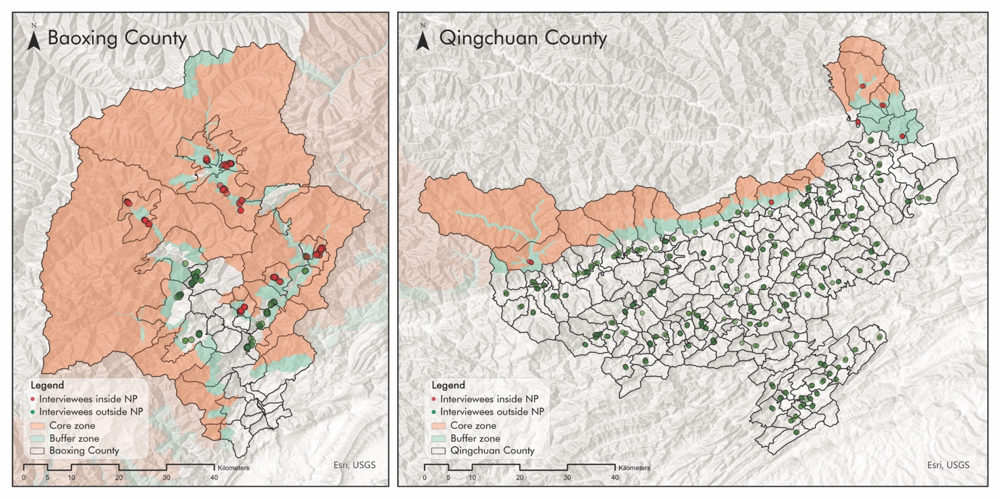
Basic Information
Time period:
Baoxing: 2024.08.15 - 2024.08.31 (n=195)
Qingchuan: 2025.03.10 - 2025.04.10 (n=479)
Target people: Local residents
Interviewer: Staff of Sichuan Province Forestry and Grassland Administration

Slide 9
Sociodemographic Information
 | Baoxing County (n=160) |  | Qingchuan County (n=465) |  | Total (n=625)
 | Number | Percentage (%) | Number | Percentage (%) | Number | Percentage (%)
Age
40's and below | 16 | 10.0% | 68 | 14.6% | 84 | 13.4%
50's | 62 | 38.8% | 177 | 38.1% | 239 | 38.2%
60's | 48 | 30.0% | 138 | 29.7% | 186 | 29.8%
70's and above | 34 | 21.3% | 82 | 17.6% | 116 | 18.6%
Gender
Male | 99 | 61.9% | 336 | 72.3% | 435 | 69.6%
Female | 61 | 38.1% | 129 | 27.7% | 190 | 30.4%
Education
No formal education | 44 | 27.5% | 45 | 9.7% | 89 | 14.2%
Primary school | 63 | 39.4% | 185 | 39.8% | 248 | 39.7%
Middle school | 42 | 26.3% | 179 | 38.5% | 221 | 35.4%
High school | 8 | 5.0% | 41 | 8.8% | 49 | 7.8%
University and above | 3 | 1.9% | 15 | 3.2% | 18 | 2.9%
Household population
1-3 persons | 88 | 55.0% | 247 | 53.1% | 335 | 53.6%
4-6 persons | 65 | 40.6% | 209 | 44.9% | 274 | 43.8%
7 persons and above | 7 | 4.4% | 9 | 1.9% | 16 | 2.6%
Annual Household Income
0 – 10000 RMB | 66 | 41.3% | 124 | 26.7% | 190 | 30.4%
10001 – 20000 RMB | 31 | 19.4% | 107 | 23.0% | 138 | 22.1%
20001 – 30000 RMB | 25 | 15.6% | 89 | 19.1% | 114 | 18.2%
More than 30000 RMB | 38 | 23.8% | 145 | 31.2% | 183 | 29.3%

Slide 10
Sociodemographic Information
 | With Compensation (n=277) |  | Without Compensation (n=348) |  | Total (n=625)
 | Number | Percentage (%) | Number | Percentage (%) | Number | Percentage (%)
Age
40's and below | 33 | 11.9% | 51 | 14.7% | 84 | 13.4%
50's | 112 | 40.4% | 127 | 36.5% | 239 | 38.2%
60's | 94 | 33.9% | 92 | 26.4% | 186 | 29.8%
70's and above | 38 | 13.7% | 78 | 22.4% | 116 | 18.6%
Gender
Male | 199 | 71.8% | 236 | 67.8% | 435 | 69.6%
Female | 78 | 28.2% | 112 | 32.2% | 190 | 30.4%
Education
No formal education | 41 | 14.8% | 48 | 13.8% | 89 | 14.2%
Primary school | 102 | 36.8% | 146 | 42.0% | 248 | 39.7%
Middle school | 100 | 36.1% | 121 | 34.8% | 221 | 35.4%
High school | 25 | 9.0% | 24 | 6.9% | 49 | 7.8%
University and above | 9 | 3.2% | 9 | 2.6% | 18 | 2.9%
Household population
1-3 persons | 152 | 54.9% | 183 | 52.6% | 335 | 53.6%
4-6 persons | 118 | 42.6% | 156 | 44.8% | 274 | 43.8%
7 persons and above | 7 | 2.5% | 9 | 2.6% | 16 | 2.6%
Annual Household Income
0 – 10000 RMB | 79 | 28.5% | 111 | 31.9% | 190 | 30.4%
10001 – 20000 RMB | 63 | 22.7% | 75 | 21.6% | 138 | 22.1%
20001 – 30000 RMB | 52 | 18.8% | 62 | 17.8% | 114 | 18.2%
More than 30000 RMB | 83 | 30.0% | 100 | 28.7% | 183 | 29.3%
Notes:
No big difference!

Slide 11

Basic Description
 | Top 10 words
1 | 讨厌 | nasty
2 | 害怕 | afraid
3 | 吃庄稼 | eat corps
4 | 可恶 | horrid
5 | 厌恶 | disgusted
6 | 凶猛 | ferocious
7 | 糟蹋庄稼 | destroy crops
8 | 可怕 | terrifying
9 | 烦 | annoyed
10 | 吓人 | scary

Slide 12
Compensation Description
 | With Compensation (n=277) |  | Without Compensation (n=348) |  | Total (n=625)
 | Mean | Median | Mean | Median | Mean | Median
TC1: Estimated areas of damaged cropland | 2.86 | 2.00 | 2.45 | 1.10 | 2.63 | 1.50
TC2: Perceived economic loss | 3387.69 | 1700.00 | 4105.26 | 1200.00 | 3787.23 | 1500.00
CA1: Lowest accepted compensation percentage | 0.63 | 0.50 | 0.70 | 0.50 | 0.67 | 0.50
CA2: Expected compensation percentage | 0.76 | 0.80 | 0.72 | 0.80 | 0.74 | 0.80
CA3: Annual insurunce payment | 227.42 | 80.00 | 72.05 | 80.00 | 140.91 | 80.00
Compensation Timeliness | Number | Percentage (%)
Untimely | 180 | 65.0%
Moderate | 58 | 20.9%
Timely | 39 | 14.1%
Compensation Satisfaction | Number | Percentage (%)
Dissatisfied | 207 | 74.7%
Moderate | 46 | 16.6%
Satisfied | 24 | 8.7%

Slide 13
Tolerance Description
 | With Compensation (n=277) |  | Without Compensation (n=348) |  | Total (n=625)
 | Number | Percentage (%) | Number | Percentage (%) | Number | Percentage (%)
IB: Do you agree with that wild boars are an important part of the forest?
Strongly Disagree | 99 | 35.7% | 72 | 20.7% | 171 | 27.4%
Disagree | 94 | 33.9% | 134 | 38.5% | 228 | 36.5%
Neutral | 46 | 16.6% | 62 | 17.8% | 108 | 17.3%
Agree | 36 | 13.0% | 78 | 22.4% | 114 | 18.2%
Strongly Agree | 2 | 0.7% | 2 | 0.6% | 4 | 0.6%
Tolerance1: I support non-lethal management strategies for wild boars (e.g., relocation, fencing)
Strongly Disagree | 66 | 23.8% | 28 | 8.0% | 94 | 15.0%
Disagree | 179 | 64.6% | 248 | 71.3% | 427 | 68.3%
Neutral | 25 | 9.0% | 48 | 13.8% | 73 | 11.7%
Agree | 6 | 2.2% | 23 | 6.6% | 29 | 4.6%
Strongly Agree | 1 | 0.4% | 1 | 0.3% | 2 | 0.3%
Tolerance2: Government should take stricter measures to control the wild boar population
Strongly Disagree | 1 | 0.4% | 0 | 0.0% | 1 | 0.2%
Disagree | 3 | 1.1% | 15 | 4.3% | 18 | 2.9%
Neutral | 5 | 1.8% | 16 | 4.6% | 21 | 3.4%
Agree | 171 | 61.7% | 235 | 67.5% | 406 | 65.0%
Strongly Agree | 97 | 35.0% | 82 | 23.6% | 179 | 28.6%
Tolerance3: Wild boars cause a serious threat to my personal safety
Strongly Disagree | 14 | 5.1% | 4 | 1.1% | 18 | 2.9%
Disagree | 87 | 31.4% | 98 | 28.2% | 185 | 29.6%
Neutral | 53 | 19.1% | 52 | 14.9% | 105 | 16.8%
Agree | 111 | 40.1% | 182 | 52.3% | 293 | 46.9%
Strongly Agree | 12 | 4.3% | 12 | 3.4% | 24 | 3.8%
Tolerance4: I can accept some damage caused by wild boars
Strongly Disagree | 79 | 28.5% | 78 | 22.4% | 157 | 25.1%
Disagree | 93 | 33.6% | 147 | 42.2% | 240 | 38.4%
Neutral | 26 | 9.4% | 48 | 13.8% | 74 | 11.8%
Agree | 77 | 27.8% | 73 | 21.0% | 150 | 24.0%
Strongly Agree | 2 | 0.7% | 2 | 0.6% | 4 | 0.6%

Slide 14
Evaluation Constructs
Evaluation Dimension | Formative Construct | Reflective Construct
Indicator Significance | Outer Weights | Outer Loadings
Collinearity Check | Outer VIF < 3.3 | Generally, not required
Convergent Validity | Not applicable | AVE ≥ 0.5
Internal Consistency | Not applicable | Composite Reliability ≥ 0.7, Alpha ≥ 0.7
Discriminant Validity | Rarely assessed | Fornell-Larcker, HTMT, Cross-Loadings
Significance Testing | t/p values of Outer Weights | t/p values of Outer Loadings
Content Validity | Based on theoretical justification | Can be supported by statistical validation

Slide 15
Question 1: Does compensation participation have the impact on tolerance?
Compensation participation (Yes 1/ No 0)
Other variables are compound variables based on Wildlife Tolerance Model
Hypothesis 1: Compensation participation has negative impact on tolerance.
Wang, W., Wronski, T., & Yang, L. (2024). The Status of Wildlife Damage Compensation in China. Animals (Basel), 14(2). https://doi.org/10.3390/ani14020292
Ravenelle, J., & Nyhus, P. J. (2017). Global patterns and trends in human-wildlife conflict compensation. Conserv Biol, 31(6), 1247-1256. https://doi.org/10.1111/cobi.12948

Slide 16
Model 0 – All Data (n=625)
Conflict Experience
Mitigation Strategy
Cost & Benefit
Tolerance
Conflict Experience - Wild boar
Prevention Effectiveness
Tangible Cost
Tolerance
Occurrence Frequency,
Annual Duration,
Conflict Frequency,
Population Trend
Average Effectiveness
Damage Area,
Perceived economic loss
Killing, Population,
Spatial, Loss
Compensation Participation
Yes / No
Intangible Cost
Conflict Experience - All
General Attitude,
Descriptive Attitude: First, Second, Third.
Conflict-causing Species Number,
Percieved Conflict Severity,
Conflict Duration
Compensation Anticipation
Lowest Accepted Percentage,
Expected Percentage,
Annual Insurance Payment
Intangible Benefit
Gender
Ecological Value
Age
Policy Dependency
Education
Supportive Institute,
Knowledge Obtained Method
Income
Household Asset

Slide 17
Model 0 – All Data (n=625)
Conflict Experience - Wild boar
Prevention Effectiveness
Tangible Cost
Tolerance
Occurrence Frequency,
Annual Duration,
Conflict Frequency,
Population Trend
Average Effectiveness
Damage Area,
Perceived economic loss
Killing, Population,
Spatial, Loss
Compensation Participation
Yes / No
Intangible Cost
Conflict Experience - All
General Attitude,
Descriptive Attitude: First, Second, Third.
Conflict-causing Species Number,
Percieved Conflict Severity,
Conflict Duration
Compensation Anticipation
Lowest Accepted Percentage,
Expected Percentage,
Annual Insurance Payment
Intangible Benefit
Gender
Ecological Value
Age
Policy Support
Education
Supportive Institute,
Knowledge Obtained Method
Income
Household Asset

Slide 18
Model 0 – All Data (n=625) – Measurement Model (GOODNESS-OF-FIT 0.1876 )
Latent variable | Mode | Indicators | Indicator Significance |  | Collinearity Check | Convergent validity | Internal consistency | Discriminant validity | Significance Testing
 |  |  | Outer Weights ≥ 0.2 | Outer Loadings≥ 0.5 | Outer VIF < 3.3 | AVE ≥ 0.5 | Composite reliability ≥ 0.6 | Cross-Loadings | T values of Outer Weights > 1.96 | T values of Outer Loadings > 1.96
Conflict Experience _Wild boar | Formative | CP_WB1: Occurrence Frequency | 0.422 | 0.627 | 1.295 | / | / | Yes | 4.237*** | 6.694***
 |  | CP_WB2: Annual Duration | 0.383 | 0.566 | 1.196 |  |  | Yes | 2.281* | 3.799***
 |  | CP_WB3: Conflict Frequency | 0.093 | 0.167 | 1.178 |  |  | No | 0.532 | 0.890
 |  | CP_WB4: Population Trend | 0.645 | 0.780 | 1.249 |  |  | Yes | 5.204*** | 7.803***
Conflict Experience _All | Formative | CP_A1: Conflict-causing Species Number | 0.706 | 0.811 | 1.459 | / | / | Yes | 3.282** | 3.494***
 |  | CP_A2: Percieved Conflict Severity | 0.527 | 0.581 | 1.363 |  |  | Yes | 1.909 | 2.233*
 |  | CP_A3: Conflict Duration | 0.259 | 0.473 | 1.236 |  |  | Yes | 1.902 | 3.938***
Prevention Effectiveness | Manifest | PE: Average Effectiveness | 1.000 | 1.000 | 1.107 | / | / | Yes | *** | ***
Compensation Participation | Manifest | CE0: Yes/No | 1.000 | 1.000 | 1.330
Compensation Anticipation | Formative | CA1: Lowest Accepted Percentage | 0.049 | 0.043 | 1.054 | / | / | No | 0.210 | 0.211
 |  | CA2: Expected Percentage | -0.106 | -0.047 | 1.084 |  |  | No | -0.521 | -0.243
 |  | CA3:Annual Insurance Payment | 1.000 | 0.993 | 1.126 |  |  | Yes | 5.403*** | 1.229
Policy Support | Formative | PS1: Reported Institute | 0.684 | 0.751 | 1.281 | / | / | Yes | 3.139** | 3.195***
 |  | PS2: Knowledge Obtained Method | 0.664 | 0.733 | 1.333 |  |  | Yes | 3.475*** | 2.884**
Tangible Cost | Formative | TC1: Damage Area | 0.872 | 0.978 | 1.729 | / | / | Yes | 2.751** | 3.760***
 |  | TC2: Perceived economic loss | 0.235 | 0.627 | 1.475 |  |  | Yes | 0.536 | 2.477*
Intangible Cost | Formative | IC1: General Attitude | 0.898 | 0.932 | 1.415 | / | / | Yes | 8.469*** | 2.235*
 |  | IC2_1 | 0.278 | 0.386 | 1.088 |  |  | Yes | 2.983** | 2.042*
 |  | IC2_2 | 0.228 | 0.213 | 1.209 |  |  | Yes | 2.252* | 1.914
 |  | IC2_3 | -0.137 | -0.055 | 1.339 |  |  | No | -0.555 | -0.221
Intangible Benifit | Manifest | IB: Ecological Value | 1.000 | 1.000 | 1.275 | / | / | Yes | *** | ***
Gender | Manifest | Q4_Gender | 1.000 | 1.000 | 1.228 | / | / | Yes | *** | ***
Age | Manifest | Q5_Age | 1.000 | 1.000 | 1.407 | / | / | Yes | *** | ***
Education | Manifest | Q6_Education | 1.000 | 1.000 | 1.372 | / | / | Yes | *** | ***
AnnualIncome | Manifest | Q8_AnnualIncome | 1.000 | 1.000 | 1.231 | / | / | Yes | *** | ***
HouseholdAsset | Manifest | Q14_CropAsset | 1.000 | 1.000 | 1.705 | / | / | Yes | *** | ***
Tolerance 0.2307 | Reflective | Tol1: Killing | 0.479 | 0.787 | 1.571 | 0.412 | 0.679 | Yes | 7.315*** | 16.920***
 |  | Tol2: Population | 0.486 | 0.834 | 1.593 |  |  | Yes | 10.225*** | 23.951***
 |  | Tol3: Spatial | 0.117 | 0.130 | 1.223 |  |  | No | 1.023 | 0.930
 |  | Tol4: Loss | 0.362 | 0.562 | 1.271 |  |  | Yes | 5.172*** | 7.519***
Deleted variables: 1) Reflective: outer loading < 0.5 & t value < 1.96; 2) Formative: outer weights < 0.2 or VIF > 3.3 & t value < 1.96

Slide 19
Model 0 – All Data (n=625) – Measurement Model (GOODNESS-OF-FIT 0.2065 )
Latent variable | Mode | Indicators | Indicator Significance |  | Collinearity Check | Convergent validity | Internal consistency | Discriminant validity | Significance Testing
 |  |  | Outer Weights ≥ 0.2 | Outer Loadings≥ 0.5 | Outer VIF < 3.3 | AVE ≥ 0.5 | Composite reliability ≥ 0.6 | Cross-Loadings | T values of Outer Weights > 1.96 | T values of Outer Loadings > 1.96
Conflict Experience _Wild boar | Formative | CP_WB1: Occurrence Frequency | 0.430 | 0.622 | 1.261 | / | / | Yes | 4.447*** | 7.318***
 |  | CP_WB2: Annual Duration | 0.396 | 0.584 | 1.185 |  |  | Yes | 2.538* | 4.201***
 |  | CP_WB3: Conflict Frequency
 |  | CP_WB4: Population Trend | 0.643 | 0.779 | 1.234 |  |  | Yes | 5.270*** | 8.048***
Conflict Experience _All | Formative | CP_A1: Conflict-causing Species Number | 0.736 | 0.835 | 1.433 | / | / | Yes | 3.813*** | 5.154***
 |  | CP_A2: Percieved Conflict Severity | 0.494 | 0.549 | 1.335 |  |  | Yes | 2.148* | 2.387*
 |  | CP_A3: Conflict Duration | 0.245 | 0.466 | 1.181 |  |  | Yes | 2.059* | 4.799***
Prevention Effectiveness | Manifest | PE: Average Effectiveness | 1.000 | 1.000 | 1.093 | / | / | Yes | *** | ***
Compensation Participation | Manifest | CE0: Yes/No | 1.000 | 1.000 | 1.30 |  |  |  | *** | ***
Compensation Anticipation | Manifest | CA1: Lowest Accepted Percentage
 |  | CA2: Expected Percentage
 |  | CA3:Annual Insurance Payment | 1.000 | 1.000 | 1.12 |  |  | Yes | *** | ***
Policy Support | Formative | PS1: Reported Institute | 0.664 | 0.733 | 1.261 | / | / | Yes | 3.570*** | 3.962***
 |  | PS2: Knowledge Obtained Method | 0.684 | 0.750 | 1.226 |  |  | Yes | 4.000*** | 3.348***
Tangible Cost | Formative | TC1: Damage Area | 0.853 | 0.972 | 1.706 | / | / | Yes | 2.708** | 3.935***
 |  | TC2: Perceived economic loss | 0.264 | 0.647 | 1.467 |  |  | Yes | 0.613 | 2.609**
Intangible Cost | Formative | IC1: General Attitude | 0.907 | 0.941 | 1.404 | / | / | Yes | 20.200*** | 26.963***
 |  | IC2_1 | 0.283 | 0.390 | 1.084 |  |  | Yes | 3.066** | 3.988***
 |  | IC2_2 | 0.176 | 0.208 | 1.058 |  |  | Yes | 1.660 | 1.908
 |  | IC2_3
Intangible Benifit | Manifest | IB: Ecological Value | 1.000 | 1.000 | 1.251 | / | / | Yes | *** | ***
Gender | Manifest | Q4_Gender | 1.000 | 1.000 | 1.19 | / | / | Yes | *** | ***
Age | Manifest | Q5_Age | 1.000 | 1.000 | 1.39 | / | / | Yes | *** | ***
Education | Manifest | Q6_Education | 1.000 | 1.000 | 1.36 | / | / | Yes | *** | ***
AnnualIncome | Manifest | Q8_AnnualIncome | 1.000 | 1.000 | 1.203 | / | / | Yes | *** | ***
HouseholdAsset | Manifest | Q14_CropAsset | 1.000 | 1.000 | 1.697 | / | / | Yes | *** | ***
Tolerance 0.2255 | Reflective | Tol1: Killing | 0.490 | 0.789 | 1.550 | 0.551 | 0.781 | Yes | 11.162*** | 19.627***
 |  | Tol2: Population | 0.487 | 0.841 | 1.571 |  |  | Yes | 17.088*** | 41.429***
 |  | Tol3: Spatial
 |  | Tol4: Loss | 0.360 | 0.567 | 1.258 |  |  | Yes | 6.316*** | 8.777***
Deleted variables: 1) Reflective: outer loading < 0.5 & t value < 1.96; 2) Formative: outer weights < 0.2 or VIF > 3.3 & t value < 1.96

Slide 20
Model 0 – All Data (n=625) – Measurement Model (GOODNESS-OF-FIT 0.2157 )
Latent variable | Mode | Indicators | Indicator Significance |  | Collinearity Check | Convergent validity | Internal consistency | Discriminant validity | Significance Testing
 |  |  | Outer Weights ≥ 0.2 | Outer Loadings≥ 0.5 | Outer VIF < 3.3 | AVE ≥ 0.5 | Composite reliability ≥ 0.6 | Cross-Loadings | T values of Outer Weights > 1.96 | T values of Outer Loadings > 1.96
Conflict Experience _Wild boar | Formative | CP_WB1: Occurrence Frequency | 0.421 | 0.616 | 1.246 | / | / | Yes | 4.542*** | 7.671***
 |  | CP_WB2: Annual Duration | 0.421 | 0.606 | 1.175 |  |  | Yes | 2.944** | 4.848***
 |  | CP_WB3: Conflict Frequency
 |  | CP_WB4: Population Trend | 0.631 | 0.769 | 1.223 |  |  | Yes | 5.634*** | 8.441***
Conflict Experience _All | Formative | CP_A1: Conflict-causing Species Number | 0.849 | 0.880 | 1.368 | / | / | Yes | 6.021*** | 2.767**
 |  | CP_A2: Percieved Conflict Severity | 0.477 | 0.530 | 1.330 |  |  | Yes | 2.092* | 2.409*
 |  | CP_A3: Conflict Duration
Prevention Effectiveness | Manifest | PE: Average Effectiveness | 1.000 | 1.000 | 1.089 | / | / | Yes | *** | ***
Compensation Participation | Manifest | CE0: Yes/No | 1.000 | 1.000 | 1.299 |  |  |  | *** | ***
Compensation Anticipation | Manifest | CA1: Lowest Accepted Percentage
 |  | CA2: Expected Percentage
 |  | CA3:Annual Insurance Payment | 1.000 | 1.000 | 1.115 |  |  | Yes | *** | ***
Policy Support | Formative | PS1: Reported Institute | 0.650 | 0.720 | 1.245 | / | / | Yes | 4.088*** | 4.932***
 |  | PS2: Knowledge Obtained Method | 0.697 | 0.763 | 1.196 |  |  | Yes | 4.774*** | 5.226***
Tangible Cost | Formative | TC1: Damage Area | 0.869 | 0.977 | 1.702 | / | / | Yes | 2.594** | 5.398***
 |  | TC2: Perceived economic loss | 0.240 | 0.631 | 1.457 |  |  | Yes | 0.567 | 2.586**
Intangible Cost | Manifest | IC1: General Attitude | 1.000 | 1.000 | 1.399 | / | / | Yes | *** | ***
 |  | IC2_1
 |  | IC2_2
 |  | IC2_3
Intangible Benifit | Manifest | IB: Ecological Value | 1.000 | 1.000 | 1.222 | / | / | Yes | *** | ***
Gender | Manifest | Q4_Gender | 1.000 | 1.000 | 1.186 | / | / | Yes | *** | ***
Age | Manifest | Q5_Age | 1.000 | 1.000 | 1.379 | / | / | Yes | *** | ***
Education | Manifest | Q6_Education | 1.000 | 1.000 | 1.363 | / | / | Yes | *** | ***
AnnualIncome | Manifest | Q8_AnnualIncome | 1.000 | 1.000 | 1.199 | / | / | Yes | *** | ***
HouseholdAsset | Manifest | Q14_CropAsset | 1.000 | 1.000 | 1.695 | / | / | Yes | *** | ***
Tolerance 0.2070 | Reflective | Tol1: Killing | 0.488 | 0.790 | 1.523 | 0.551 | 0.781 | Yes | 10.942*** | 22.006***
 |  | Tol2: Population | 0.495 | 0.845 | 1.565 |  |  | Yes | 17.308*** | 41.220***
 |  | Tol3: Spatial
 |  | Tol4: Loss | 0.350 | 0.559 | 1.226 |  |  | Yes | 5.564*** | 7.840***
Deleted variables: 1) Reflective: outer loading < 0.5 & t value < 1.96; 2) Formative: outer weights < 0.2 or VIF > 3.3 & t value < 1.96

Slide 21
Model 0 – All Data (n=625) : Structure Model
Path |  |  | Original | Mean.Boot | Std.Error | perc.025 | perc.975 | T value | Tips
ConflictExp_WB | -> | Prevention_Effectiveness | -0.043 | -0.034 | 0.045 | -0.125 | 0.060 | -0.950
ConflictExp_WB | -> | Compensation_Participation | 0.108 | 0.114 | 0.041 | 0.033 | 0.191 | 2.626** | When human-wild boar conflict is more frequent, people prefer to join in the compensation policy.
ConflictExp_WB | -> | Compensation_Anticipation | 0.099 | 0.110 | 0.024 | 0.065 | 0.157 | 4.093*** | When human-wild boar conflict is more frequent, people prefer to spend more in the insurance.
ConflictExp_WB | -> | Policy_Support | -0.033 | -0.038 | 0.055 | -0.143 | 0.062 | -0.606
ConflictExp_WB | -> | Tangible_Costs | 0.200 | 0.207 | 0.071 | 0.079 | 0.337 | 2.820** | When human-wild boar conflict is more frequent, people feel more tangible cost.
ConflictExp_WB | -> | Intangible_Costs | 0.181 | 0.182 | 0.056 | 0.068 | 0.284 | 3.214** | When human-wild boar conflict is more frequent, people feel more intangible cost.
ConflictExp_WB | -> | Intangible_Benefits | -0.133 | -0.135 | 0.048 | -0.227 | -0.038 | -2.793** | When human-wild boar conflict is more frequent, people feel less intangible benefits.
ConflictExp_WB | -> | Tolerance | -0.046 | -0.050 | 0.045 | -0.139 | 0.029 | -1.027
ConflictExp_A | -> | Prevention_Effectiveness | 0.143 | 0.133 | 0.065 | -0.084 | 0.220 | 2.216*
ConflictExp_A | -> | Compensation_Participation | 0.284 | 0.269 | 0.094 | -0.060 | 0.359 | 3.025**
ConflictExp_A | -> | Compensation_Anticipation | 0.154 | 0.178 | 0.100 | -0.073 | 0.354 | 1.545
ConflictExp_A | -> | Policy_Support | -0.237 | -0.229 | 0.118 | -0.359 | 0.187 | -2.008*
ConflictExp_A | -> | Tangible_Costs | 0.023 | 0.017 | 0.068 | -0.112 | 0.156 | 0.345
ConflictExp_A | -> | Intangible_Costs | 0.133 | 0.115 | 0.109 | -0.089 | 0.326 | 1.223
ConflictExp_A | -> | Intangible_Benefits | -0.118 | -0.106 | 0.059 | -0.204 | 0.050 | -2.006*
ConflictExp_A | -> | Tolerance | -0.058 | -0.058 | 0.046 | -0.146 | 0.033 | -1.268
Prevention_Effectiveness | -> | Tangible_Costs | 0.044 | 0.048 | 0.039 | -0.050 | 0.114 | 1.124
Prevention_Effectiveness | -> | Intangible_Costs | -0.082 | -0.080 | 0.042 | -0.156 | 0.004 | -1.986
Prevention_Effectiveness | -> | Intangible_Benefits | 0.059 | 0.055 | 0.039 | -0.025 | 0.123 | 1.516
Prevention_Effectiveness | -> | Tolerance | 0.116 | 0.115 | 0.038 | 0.039 | 0.184 | 3.011** | When prevention is more effective, people show higher tolerance to wild boars.
Compensation_Participation | -> | Tangible_Costs | -0.008 | -0.002 | 0.057 | -0.106 | 0.113 | -0.144
Compensation_Participation | -> | Intangible_Costs | 0.063 | 0.069 | 0.039 | -0.004 | 0.150 | 1.617
Compensation_Participation | -> | Intangible_Benefits | -0.066 | -0.067 | 0.040 | -0.141 | 0.015 | -1.661
Compensation_Participation | -> | Tolerance | -0.115 | -0.113 | 0.035 | -0.188 | -0.042 | -3.309*** | When people join in the compensation policy, they show lower tolerance to wild boars.
Compensation_Anticipation | -> | Tangible_Costs | 0.020 | 0.039 | 0.068 | -0.051 | 0.200 | 0.294
Compensation_Anticipation | -> | Intangible_Costs | -0.053 | -0.037 | 0.049 | -0.116 | 0.060 | -1.089
Compensation_Anticipation | -> | Intangible_Benefits | -0.049 | -0.059 | 0.025 | -0.114 | -0.017 | -1.998* | When people prefer to spend more in the insurance, they feel less intangible benefits.
Compensation_Anticipation | -> | Tolerance | -0.012 | -0.029 | 0.047 | -0.136 | 0.032 | -0.254
Policy_Support | -> | Tangible_Costs | 0.061 | 0.054 | 0.056 | -0.080 | 0.153 | 1.095
Policy_Support | -> | Intangible_Costs | 0.180 | 0.172 | 0.050 | 0.076 | 0.260 | 3.604*** | When people seek for more policy support, they feel more intangible costs.
Policy_Support | -> | Intangible_Benefits | 0.118 | 0.114 | 0.039 | 0.035 | 0.192 | 3.011** | When people seek for more policy support, they feel more intangible benefits.
Policy_Support | -> | Tolerance | -0.073 | -0.074 | 0.047 | -0.164 | 0.017 | -1.551
Tangible_Costs | -> | Tolerance | 0.031 | 0.038 | 0.040 | -0.038 | 0.116 | 0.766
Intangible_Costs | -> | Tolerance | -0.279 | -0.281 | 0.045 | -0.358 | -0.184 | -6.208*** | When people feel more intangible costs, they show lower tolerance to wild boars.
Intangible_Benefits | -> | Tolerance | 0.185 | 0.181 | 0.036 | 0.106 | 0.246 | 5.098*** | When people feel more intangible benefits, they show higher tolerance to wild boars.
Gender | -> | Tolerance | -0.047 | -0.046 | 0.043 | -0.120 | 0.041 | -1.105
Age | -> | Tolerance | -0.061 | -0.061 | 0.041 | -0.136 | 0.018 | -1.475
Education | -> | Tolerance | -0.012 | -0.017 | 0.046 | -0.116 | 0.060 | -0.261
AnnualIncome | -> | Tolerance | 0.006 | 0.016 | 0.040 | -0.063 | 0.093 | 0.139
HouseholdAsset | -> | Tolerance | 0.010 | 0.009 | 0.037 | -0.070 | 0.079 | 0.277

Slide 22
Model 0 – All Data (n=625)
-0.13
0.18
0.20
-0.12
Conflict Experience - Wild boar
Prevention Effectiveness
0.12
Tangible Cost
Tolerance
Occurrence Frequency,
Annual Duration,
Conflict Frequency,
Population Trend
0.10
Damage Area,
Perceived economic loss
Killing, Population,
Spatial, Loss
Average Effectiveness
-0.28
0.10
Compensation Participation
Yes / No
Intangible Cost
Conflict Experience - All
0.18
0.19
General Attitude,
Descriptive Attitude: First, Second, Third.
Conflict-causing Species Number,
Percieved Conflict Severity,
Conflict Duration
Compensation Anticipation
-0.05
Lowest Accepted Percentage,
Expected Percentage,
Annual Insurance Payment
Intangible Benefit
Gender
0.12
Ecological Value
Age
Policy Support
Education
Supportive Institute,
Knowledge Obtained Method
Income
Household Asset

Slide 23
Model 0 – All Data (n=625)
Conclusion:
1. Compensation Participation → Tolerance （β = -0.115，t = -3.309）
The people who participate the compensation policy have the lower tolerance to wild boars. (Support the hypothesis)
Conflict Experience - Wild boar→ Compensation Participation (β = 0.108，t = 2.626)
When people perceived more frequent human-wild boar conflict, they prefer to join in the compensation policy.
Compensation Participation → Intangible Benefits / Costs (Not Significant!)
Compensation Participation have no impact on intangible benefits and costs.
Intangible Benefits → Tolerance (β = 0.185，t = 5.098) & Intangible Costs → Tolerance (β = -0.279，t = -6.208)
These two paths illustrate that intangible benefits and costs are the ley factors of tolerance, and compensation policy is almost entirely uninvolved in shaping meaning, values, and attitudes.

Slide 24
Question 2: When people have compensation experience, is intangible cost the most important factor of tolerance?
Excluded the variables having no significant paths in the model (Conflict Experience – All, Gender, Age, Education, Income and Household Assessment)
Hypothesis 2: Yes, intangible cost is the most important factor of tolerance.
Based on the result of the first model

Slide 25
Model 1 - with compensation (n=277)
Conflict Experience
Mitigation Strategy
Cost & Benefit
Tolerance
Conflict Experience - Wild boar
Prevention Effectiveness
Tangible Cost
Tolerance
Occurrence Frequency,
Annual Duration,
Conflict Frequency,
Population Trend
Average Effectiveness
Damage Area,
Perceived economic loss
Killing, Population,
Spatial, Loss
Intangible Cost
General Attitude,
Descriptive Attitude: First, Second, Third.
Compensation Anticipation
Lowest Accepted Percentage,
Expected Percentage,
Annual Insurance Payment
Intangible Benefit
Ecological Value
Policy Support
Supportive Institute,
Knowledge Obtained Method

Slide 26
Model 1 - with compensation (n=277)
Conflict Experience - Wild boar
Prevention Effectiveness
Tangible Cost
Tolerance
Occurrence Frequency,
Annual Duration,
Conflict Frequency,
Population Trend
Average Effectiveness
Damage Area,
Perceived economic loss
Killing, Population,
Spatial, Loss
Intangible Cost
General Attitude,
Descriptive Attitude: First, Second, Third.
Compensation Anticipation
Lowest Accepted Percentage,
Expected Percentage,
Annual Insurance Payment
Intangible Benefit
Ecological Value
Policy Support
Supportive Institute,
Knowledge Obtained Method

Slide 27
Model 1 - with compensation (n=277) - Measurement Model (GOODNESS-OF-FIT 0.18)
Latent variable | Mode | Indicators | Indicator Significance |  | Collinearity Check | Convergent validity | Internal consistency | Discriminant validity | Significance Testing
 |  |  | Outer Weights ≥ 0.2 | Outer Loadings≥ 0.5 | Outer VIF < 3.3 | AVE ≥ 0.5 | Composite reliability ≥ 0.6 | Cross-Loadings | T values of Outer Weights > 1.96 | T values of Outer Loadings > 1.96
Conflict Experience _Wild boar | Formative | CP_WB1: Occurrence Frequency | 0.034 | 0.037 | 1.144 | / | / | No | 0.184 | 0.242
 |  | CP_WB2: Annual Duration | 0.567 | 0.693 | 1.165 |  |  | Yes | 1.761 | 1.145
 |  | CP_WB3: Conflict Frequency | -0.569 | -0.597 | 1.209 |  |  | Yes | -1.307 | -1.121
 |  | CP_WB4: Population Trend | 0.470 | 0.568 | 1.193 |  |  | Yes | 1.440 | 0.890
Conflict Experience _All | Formative | CP_A1: Conflict-causing Species Number
 |  | CP_A2: Percieved Conflict Severity
 |  | CP_A3: Conflict Duration
Prevention Effectiveness | Manifest | PE: Average Effectiveness | 1.000 | 1.000 | 1.147 | / | / | Yes | *** | ***
Compensation Experience | Formative | CE1: Timeliness
 |  | CE2: Satisfaction
Compensation Anticipation | Formative | CA1: Lowest Accepted Percentage | 0.240 | 0.257 | 1.046 | / | / | Yes | 0.645 | 0.835
 |  | CA2: Expected Percentage | -0.304 | -0.289 | 1.086 |  |  | Yes | -0.633 | -0.617
 |  | CA3:Annual Insurance Payment | 0.926 | 0.918 | 1.094 |  |  | Yes | 2.130* | 1.376
Policy Support | Formative | PS1: Reported Institute | 0.497 | 0.678 | 1.277 | / | / | Yes | 2.888** | 4.316***
 |  | PS2: Knowledge Obtained Method | 0.757 | 0.876 | 1.439 |  |  | Yes | 6.158*** | 7.892***
Tangible Cost | Formative | TC1: Damage Area | -0.880 | 0.322 | 1.459 | / | / | Yes | -0.930 | 0.702
 |  | TC2: Perceived economic loss | 1.099 | -0.652 | 1.542 |  |  | Yes | 1.163 | -1.062
Intangible Cost | Formative | IC1: General Attitude | 0.750 | 0.809 | 1.221 | / | / | Yes | 2.421* | 1.546
 |  | IC2_1 | 0.341 | 0.417 | 1.143 |  |  | Yes | 1.983* | 1.693
 |  | IC2_2 | 0.098 | 0.246 | 1.180 |  |  | Yes | 0.539 | 1.576
 |  | IC2_3 | 0.440 | 0.52 | 1.449 |  |  | Yes | 0.809 | 1.141
Intangible Benifit | Manifest | IB: Ecological Value | 1.000 | 1.00 | 1.394 | / | / | Yes | *** | ***
Gender | Manifest | Q4_Gender
Age | Manifest | Q5_Age
Education | Manifest | Q6_Education
AnnualIncome | Manifest | Q8_AnnualIncome
HouseholdAsset | Manifest | Q14_CropAsset
Tolerance 0.2160 | Reflective | Tol1: Killing | 0.284 | 0.51 | 1.543 | 0.326 | 0.66 | Yes | 1.202 | 2.040*
 |  | Tol2: Population | 0.281 | 0.52 | 1.501 |  |  | Yes | 1.479 | 2.223*
 |  | Tol3: Spatial | 0.616 | 0.63 | 1.230 |  |  | Yes | 2.789** | 1.780
 |  | Tol4: Loss | 0.524 | 0.61 | 1.231 |  |  | Yes | 2.817** | 2.153*
Deleted variables: 1) Reflective: outer loading < 0.5 & t value < 1.96; 2) Formative: outer weights < 0.2 or VIF > 3.3 & t value < 1.96

Slide 28
Model 1.1 - with compensation (n=277) - Measurement Model (GOODNESS-OF-FIT 0.2064)
Latent variable | Mode | Indicators | Indicator Significance |  | Collinearity Check | Convergent validity | Internal consistency | Discriminant validity | Significance Testing
 |  |  | Outer Weights ≥ 0.2 | Outer Loadings≥ 0.5 | Outer VIF < 3.3 | AVE ≥ 0.5 | Composite reliability ≥ 0.6 | Cross-Loadings | T values of Outer Weights > 1.96 | T values of Outer Loadings > 1.96
Conflict Experience _Wild boar | Formative | CP_WB1: Occurrence Frequency
 |  | CP_WB2: Annual Duration | 0.690 | 0.801 | 1.147 |  |  | Yes | 4.423*** | 4.855***
 |  | CP_WB3: Conflict Frequency
 |  | CP_WB4: Population Trend | 0.609 | 0.734 | 1.171 |  |  | Yes | 3.669*** | 4.893***
Conflict Experience _All | Formative | CP_A1: Conflict-causing Species Number
 |  | CP_A2: Percieved Conflict Severity
 |  | CP_A3: Conflict Duration
Prevention Effectiveness | Manifest | PE: Average Effectiveness | 1.000 | 1.000 | 1.111 | / | / | Yes | *** | ***
Compensation Experience | Formative | CE1: Timeliness
 |  | CE2: Satisfaction
Compensation Anticipation | Manifest | CA1: Lowest Accepted Percentage
 |  | CA2: Expected Percentage
 |  | CA3:Annual Insurance Payment | 1.000 | 1.000 | 1.063 |  |  | Yes | *** | ***
Policy Support | Formative | PS1: Reported Institute | 0.510 | 0.688 | 1.217 | / | / | Yes | 3.723*** | 5.548***
 |  | PS2: Knowledge Obtained Method | 0.747 | 0.869 | 1.341 |  |  | Yes | 6.917*** | 12.205***
Tangible Cost | Manifest | TC1: Damage Area
 |  | TC2: Perceived economic loss | 1.000 | 1.000 | 1.104 |  |  | Yes | *** | ***
Intangible Cost | Formative | IC1: General Attitude | 0.671 | 0.740 | 1.183 | / | / | Yes | 3.106** | 3.260**
 |  | IC2_1 | 0.343 | 0.401 | 1.090 |  |  | Yes | 2.333* | 2.728**
 |  | IC2_2
 |  | IC2_3 | 0.584 | 0.626 | 1.296 |  |  | Yes | 1.819 | 1.938
Intangible Benifit | Manifest | IB: Ecological Value | 1.000 | 1.000 | 1.354 | / | / | Yes | *** | ***
Gender | Manifest | Q4_Gender
Age | Manifest | Q5_Age
Education | Manifest | Q6_Education
AnnualIncome | Manifest | Q8_AnnualIncome
HouseholdAsset | Manifest | Q14_CropAsset
Tolerance 0.2173 | Reflective | Tol1: Killing | 0.223 | 0.328 | 1.184 | 0.353 | 0.632 | Yes | 0.736 | 1.022
 |  | Tol2: Population
 |  | Tol3: Spatial | 0.697 | 0.715 | 1.166 |  |  | Yes | 4.556*** | 4.931***
 |  | Tol4: Loss | 0.644 | 0.664 | 1.157 |  |  | Yes | 4.600*** | 5.443***
Deleted variables: 1) Reflective: outer loading < 0.5 & t value < 1.96; 2) Formative: outer weights < 0.2 or VIF > 3.3 & t value < 1.96

Slide 29
Model 1.2 - with compensation (n=277) - Measurement Model (GOODNESS-OF-FIT 0.2177)
Latent variable | Mode | Indicators | Indicator Significance |  | Collinearity Check | Convergent validity | Internal consistency | Discriminant validity | Significance Testing
 |  |  | Outer Weights ≥ 0.2 | Outer Loadings≥ 0.5 | Outer VIF < 3.3 | AVE ≥ 0.5 | Composite reliability ≥ 0.6 | Cross-Loadings | T values of Outer Weights > 1.96 | T values of Outer Loadings > 1.96
Conflict Experience _Wild boar | Formative | CP_WB1: Occurrence Frequency
 |  | CP_WB2: Annual Duration | 0.629 | 0.751 | 1.135 |  |  | Yes | 4.193*** | 5.777***
 |  | CP_WB3: Conflict Frequency
 |  | CP_WB4: Population Trend | 0.672 | 0.785 | 1.160 |  |  | Yes | 4.634*** | 6.709***
Conflict Experience _All | Formative | CP_A1: Conflict-causing Species Number
 |  | CP_A2: Percieved Conflict Severity
 |  | CP_A3: Conflict Duration
Prevention Effectiveness | Manifest | PE: Average Effectiveness | 1.000 | 1.000 | 1.096 | / | / | Yes | *** | ***
Compensation Experience | Formative | CE1: Timeliness
 |  | CE2: Satisfaction
Compensation Anticipation | Manifest | CA1: Lowest Accepted Percentage
 |  | CA2: Expected Percentage
 |  | CA3:Annual Insurance Payment | 1.000 | 1.000 | 1.057 |  |  | Yes | *** | ***
Policy Support | Formative | PS1: Reported Institute | 0.531 | 0.705 | 1.170 | / | / | Yes | 4.425*** | 6.779***
 |  | PS2: Knowledge Obtained Method | 0.730 | 0.857 | 1.265 |  |  | Yes | 7.381*** | 12.260***
Tangible Cost | Manifest | TC1: Damage Area
 |  | TC2: Perceived economic loss | 1.000 | 1.000 | 1.089 |  |  | Yes | *** | ***
Intangible Cost | Manifest | IC1: General Attitude | 1.000 | 1.000 | 1.171 | / | / | Yes | *** | ***
 |  | IC2_1
 |  | IC2_2
 |  | IC2_3
Intangible Benifit | Manifest | IB: Ecological Value | 1.000 | 1.000 | 1.215 | / | / | Yes | *** | ***
Gender | Manifest | Q4_Gender
Age | Manifest | Q5_Age
Education | Manifest | Q6_Education
AnnualIncome | Manifest | Q8_AnnualIncome
HouseholdAsset | Manifest | Q14_CropAsset
Tolerance 0.2086 | Reflective | Tol1: Killing |  |  |  | 0.501 | 0.668
 |  | Tol2: Population
 |  | Tol3: Spatial | 0.701 | 0.703 | 1.141 |  |  | Yes | 6.551*** | 6.333***
 |  | Tol4: Loss | 0.711 | 0.713 | 1.145 |  |  | Yes | 6.771*** | 6.482***
Deleted variables: 1) Reflective: outer loading < 0.5 & t value < 1.96; 2) Formative: outer weights < 0.2 or VIF > 3.3 & t value < 1.96

Slide 30
Model 1.2 - with compensation (n=277) : Structure Model
Path |  |  | Original | Mean.Boot | Std.Error | perc.025 | perc.975 | T value | Tips
ConflictExp_WB | -> | Prevention_Effectiveness | 0.012 | 0.0147 | 0.0644 | -0.1112 | 0.1301 | 0.186
ConflictExp_WB | -> | Compensation_Anticipation | 0.1389 | 0.1579 | 0.0411 | 0.0952 | 0.2464 | 3.380*** | When human-wild boar conflict is more frequent, people prefer to spend more in the insurance.
ConflictExp_WB | -> | Policy_Support | -0.2462 | -0.2517 | 0.0612 | -0.3638 | -0.1299 | -4.023*** | When human-wild boar conflict is more frequent, people seek for less policy support.
ConflictExp_WB | -> | Tangible_Costs | 0.1997 | 0.1989 | 0.0737 | 0.0651 | 0.3442 | 2.710** | When human-wild boar conflict is more frequent, people feel more tangible cost.
ConflictExp_WB | -> | Intangible_Costs | 0.1098 | 0.1053 | 0.0719 | -0.0515 | 0.2378 | 1.527
ConflictExp_WB | -> | Intangible_Benefits | -0.2608 | -0.2547 | 0.0562 | -0.3681 | -0.141 | -4.641*** | When human-wild boar conflict is more frequent, people feel less intangible benefits.
ConflictExp_WB | -> | Tolerance | 0.0388 | 0.038 | 0.061 | -0.0833 | 0.1588 | 0.636
Prevention_Effectiveness | -> | Tangible_Costs | 0.1232 | 0.1188 | 0.0491 | 0.0149 | 0.2163 | 2.509* | When prevention is more effective, people show higher tolerance to wild boars.
Prevention_Effectiveness | -> | Intangible_Costs | -0.2089 | -0.206 | 0.0537 | -0.3046 | -0.101 | -3.890*** | When prevention is more effective, people feel less intangible costs.
Prevention_Effectiveness | -> | Intangible_Benefits | 0.0361 | 0.0362 | 0.0621 | -0.0836 | 0.1554 | 0.581
Prevention_Effectiveness | -> | Tolerance | 0.0927 | 0.0899 | 0.0664 | -0.0408 | 0.2162 | 1.396
Compensation_Anticipation | -> | Tangible_Costs | -0.0326 | -0.0204 | 0.0382 | -0.086 | 0.0667 | -0.853
Compensation_Anticipation | -> | Intangible_Costs | -0.0483 | -0.0171 | 0.0701 | -0.1285 | 0.1144 | -0.689
Compensation_Anticipation | -> | Intangible_Benefits | -0.0706 | -0.0853 | 0.031 | -0.1575 | -0.0366 | -2.277* | When people prefer to spend more in the insurance, they feel less intangible benefits.
Compensation_Anticipation | -> | Tolerance | -0.0263 | -0.0184 | 0.0509 | -0.1115 | 0.0958 | -0.517
Policy_Support | -> | Tangible_Costs | -0.0494 | -0.0453 | 0.0652 | -0.1651 | 0.088 | -0.758
Policy_Support | -> | Intangible_Costs | 0.1721 | 0.1807 | 0.0601 | 0.0649 | 0.2986 | 2.864** | When people seek for more policy support, they feel more intangible costs.
Policy_Support | -> | Intangible_Benefits | 0.1924 | 0.1889 | 0.0572 | 0.0759 | 0.2984 | 3.364*** | When people seek for more policy support, they feel more intangible benefits.
Policy_Support | -> | Tolerance | -0.3488 | -0.3516 | 0.0592 | -0.4708 | -0.2273 | -5.892*** | When people seek for more policy support, they show lower tolerance to wild boars.
Tangible_Costs | -> | Tolerance | 0.0716 | 0.0667 | 0.0564 | -0.0476 | 0.173 | 1.270
Intangible_Costs | -> | Tolerance | -0.1777 | -0.1767 | 0.0573 | -0.2792 | -0.0674 | -3.101** | When people feel more intangible costs, they show lower tolerance to wild boars.
Intangible_Benefits | -> | Tolerance | 0.1465 | 0.1507 | 0.0598 | 0.0285 | 0.2751 | 2.450* | When people feel more intangible benefits, they show higher tolerance to wild boars.

Slide 31
Model 1 - with compensation (n=277)
-0.26
0.20
-0.35
Conflict Experience - Wild boar
Prevention Effectiveness
0.12
Tangible Cost
Tolerance
Occurrence Frequency,
Annual Duration,
Conflict Frequency,
Population Trend
Average Effectiveness
Damage Area,
Perceived economic loss
-0.18
Killing, Population,
Spatial, Loss
-0.21
0.14
Intangible Cost
0.17
General Attitude,
Descriptive Attitude: First, Second, Third.
0.15
-0.25
Compensation Anticipation
-0.07
Lowest Accepted Percentage,
Expected Percentage,
Annual Insurance Payment
Intangible Benefit
Ecological Value
0.19
Policy Dependency
Supportive Institute,
Knowledge Obtained Method

Slide 32
Model 1 - with compensation (n=277)
Conclusion:
1. Conflict Experience - Wild boar → Policy Support (β = -0.246，t = -4.023)
Repeated exposure to conflict under a compensation regime may erode confidence in governance rather than reinforcing it.
Policy Support → Tolerance (β = -0.349，t = -5.892)
Among people who have experienced compensation, those who rely on policy support are actually less tolerant of wild boars.
(Against the hypothesis, policy support is the most important factor.)
Compensation Anticipation → Intangible Benefits (β = -0.071，t = -2.277)
The more compensation is expected, the harder it is to maintain the recognition of the positive ecological value of wild boars.
Intangible Benefits → Tolerance (β = 0.147，t = 2.450) & Intangible Costs → Tolerance (β = -0.178，t = -3.101)
Compensation does not remove the role of meanings, but it weakens their autonomy.

Slide 33
Question 3: When people have no compensation experience, is intangible cost the most important factor of tolerance?
Excluded the variables having no significant paths in the model (Conflict Experience – All, Gender, Age, Education, Income and Household Assessment)
Hypothesis 2: Yes, intangible cost is the most important factor of tolerance.
Based on the result of the first model

Slide 34
Model 2 - without compensation (n=348)
Conflict Experience
Mitigation Strategy
Cost & Benefit
Tolerance
Conflict Experience - Wild boar
Prevention Effectiveness
Tangible Cost
Tolerance
Occurrence Frequency,
Annual Duration,
Conflict Frequency,
Population Trend
Average Effectiveness
Damage Area,
Perceived economic loss
Killing, Population,
Spatial, Loss
Intangible Cost
General Attitude,
Descriptive Attitude: First, Second, Third.
Compensation Anticipation
Lowest Accepted Percentage,
Expected Percentage,
Annual Insurance Payment
Intangible Benefit
Ecological Value
Policy Support
Supportive Institute,
Knowledge Obtained Method

Slide 35
Model 2 - without compensation (n=348)
Conflict Experience - Wild boar
Prevention Effectiveness
Tangible Cost
Tolerance
Occurrence Frequency,
Annual Duration,
Conflict Frequency,
Population Trend
Average Effectiveness
Damage Area,
Perceived economic loss
Killing, Population,
Spatial, Loss
Intangible Cost
General Attitude,
Descriptive Attitude: First, Second, Third.
Compensation Anticipation
Lowest Accepted Percentage,
Expected Percentage,
Annual Insurance Payment
Intangible Benefit
Ecological Value
Policy Support
Supportive Institute,
Knowledge Obtained Method

Slide 36
Model 2 - without compensation (n=348) - Measurement Model (GOODNESS-OF-FIT 0.1950)
Latent variable | Mode | Indicators | Indicator Significance |  | Collinearity Check | Convergent validity | Internal consistency | Discriminant validity | Significance Testing
 |  |  | Outer Weights ≥ 0.2 | Outer Loadings≥ 0.5 | Outer VIF < 3.3 | AVE ≥ 0.5 | Composite reliability ≥ 0.6 | Cross-Loadings | T values of Outer Weights > 1.96 | T values of Outer Loadings > 1.96
Conflict Experience _Wild boar | Formative | CP_WB1: Occurrence Frequency | 0.407 | 0.711 | 1.355 | / | / | Yes | 2.593** | 6.403***
 |  | CP_WB2: Annual Duration | 0.340 | 0.512 | 1.300 |  |  | Yes | 1.178 | 2.152*
 |  | CP_WB3: Conflict Frequency | 0.412 | 0.526 | 1.174 |  |  | Yes | 3.172** | 3.759***
 |  | CP_WB4: Population Trend | 0.494 | 0.647 | 1.210 |  |  | Yes | 2.433* | 3.216**
Conflict Experience _All | Formative | CP_A1: Conflict-causing Species Number
 |  | CP_A2: Percieved Conflict Severity
 |  | CP_A3: Conflict Duration
Prevention Effectiveness | Manifest | PE: Average Effectiveness | 1.000 | 1.000 | 1.103 | / | / | Yes | *** | ***
Compensation Experience | Formative | CE1: Timeliness
 |  | CE2: Satisfaction
Compensation Anticipation | Formative | CA1: Lowest Accepted Percentage | -0.013 | -0.017 | 1.085 | / | / | No | -0.050 | -0.068
 |  | CA2: Expected Percentage | -0.241 | 0.134 | 1.298 |  |  | Yes | -1.090 | 0.731
 |  | CA3:Annual Insurance Payment | 1.060 | 0.974 | 1.478 |  |  | Yes | 4.044*** | 1.604
Policy Support | Formative | PS1: Reported Institute | 0.129 | 0.062 | 1.066 | / | / | No | 0.331 | 0.202
 |  | PS2: Knowledge Obtained Method | 1.000 | 0.992 | 1.150 |  |  | Yes | 4.369*** | 1.113
Tangible Cost | Formative | TC1: Damage Area | 1.080 | 0.987 | 1.714 | / | / | Yes | 3.225** | 4.368***
 |  | TC2: Perceived economic loss | -0.185 | 0.359 | 1.463 |  |  | Yes | -0.389 | 1.304
Intangible Cost | Formative | IC1: General Attitude | 0.912 | 0.942 | 1.518 | / | / | Yes | 14.113*** | 3.501***
 |  | IC2_1 | 0.215 | 0.330 | 1.104 |  |  | Yes | 2.148* | 2.248*
 |  | IC2_2 | 0.166 | 0.265 | 1.257 |  |  | Yes | 1.324 | 1.977*
 |  | IC2_3 | 0.140 | 0.189 | 1.295 |  |  | No | 1.009 | 1.235
Intangible Benifit | Manifest | IB: Ecological Value | 1.000 | 1.000 | 1.192 | / | / | Yes | *** | ***
Gender | Manifest | Q4_Gender
Age | Manifest | Q5_Age
Education | Manifest | Q6_Education
AnnualIncome | Manifest | Q8_AnnualIncome
HouseholdAsset | Manifest | Q14_CropAsset
Tolerance 0.2597 | Reflective | Tol1: Killing | 0.413 | 0.747 | 1.493 | 0.428 | 0.704 | Yes | 8.929*** | 13.755***
 |  | Tol2: Population | 0.470 | 0.832 | 1.640 |  |  | Yes | 13.280*** | 27.723***
 |  | Tol3: Spatial | 0.114 | 0.136 | 1.193 |  |  | No | 1.172 | 0.968
 |  | Tol4: Loss | 0.427 | 0.667 | 1.365 |  |  | Yes | 6.574*** | 9.322***
Deleted variables: 1) Reflective: outer loading < 0.5 & t value < 1.96; 2) Formative: outer weights < 0.2 or VIF > 3.3 & t value < 1.96

Slide 37
Model 2.1 - without compensation (n=348) - Measurement Model (GOODNESS-OF-FIT 0.2117)
Latent variable | Mode | Indicators | Indicator Significance |  | Collinearity Check | Convergent validity | Internal consistency | Discriminant validity | Significance Testing
 |  |  | Outer Weights ≥ 0.2 | Outer Loadings≥ 0.5 | Outer VIF < 3.3 | AVE ≥ 0.5 | Composite reliability ≥ 0.6 | Cross-Loadings | T values of Outer Weights > 1.96 | T values of Outer Loadings > 1.96
Conflict Experience _Wild boar | Formative | CP_WB1: Occurrence Frequency | 0.457 | 0.750 | 1.307 | / | / | Yes | 2.968** | 6.882***
 |  | CP_WB2: Annual Duration | 0.368 | 0.548 | 1.240 |  |  | Yes | 1.410 | 2.525*
 |  | CP_WB3: Conflict Frequency | 0.400 | 0.520 | 1.135 |  |  | Yes | 3.704*** | 4.368***
 |  | CP_WB4: Population Trend | 0.422 | 0.588 | 1.155 |  |  | Yes | 2.233* | 3.142**
Conflict Experience _All | Formative | CP_A1: Conflict-causing Species Number
 |  | CP_A2: Percieved Conflict Severity
 |  | CP_A3: Conflict Duration
Prevention Effectiveness | Manifest | PE: Average Effectiveness | 1.000 | 1.000 | 1.094 | / | / | Yes | *** | ***
Compensation Experience | Formative | CE1: Timeliness
 |  | CE2: Satisfaction
Compensation Anticipation | Formative | CA1: Lowest Accepted Percentage
 |  | CA2: Expected Percentage | -0.283 | 0.095 | 1.223 |  |  | No | -1.258 | 0.606
 |  | CA3:Annual Insurance Payment | 1.065 | 0.964 | 1.449 |  |  | Yes | 6.574*** | 1.172
Policy Support | Manifest | PS1: Reported Institute
 |  | PS2: Knowledge Obtained Method | 1.000 | 1.000 | 1.073 |  |  | Yes | *** | ***
Tangible Cost | Manifest | TC1: Damage Area | 1.000 | 1.000 | 1.344 | / | / | Yes | *** | ***
 |  | TC2: Perceived economic loss
Intangible Cost | Formative | IC1: General Attitude | 0.946 | 0.974 | 1.502 | / | / | Yes | 23.591*** | 34.403***
 |  | IC2_1 | 0.230 | 0.344 | 1.102 |  |  | Yes | 2.212* | 3.103**
 |  | IC2_2
 |  | IC2_3
Intangible Benifit | Manifest | IB: Ecological Value | 1.000 | 1.000 | 1.170 | / | / | Yes | *** | ***
Gender | Manifest | Q4_Gender
Age | Manifest | Q5_Age
Education | Manifest | Q6_Education
AnnualIncome | Manifest | Q8_AnnualIncome
HouseholdAsset | Manifest | Q14_CropAsset
Tolerance 0.2493 | Reflective | Tol1: Killing | 0.404 | 0.728 | 1.453 | 0.570 | 0.798 | Yes | 8.840*** | 12.815***
 |  | Tol2: Population | 0.466 | 0.830 | 1.609 |  |  | Yes | 13.429*** | 26.672***
 |  | Tol3: Spatial
 |  | Tol4: Loss | 0.455 | 0.702 | 1.321 |  |  | Yes | 7.362*** | 13.784***
Deleted variables: 1) Reflective: outer loading < 0.5 & t value < 1.96; 2) Formative: outer weights < 0.2 or VIF > 3.3 & t value < 1.96

Slide 38
Model 2.2 - without compensation (n=348) - Measurement Model (GOODNESS-OF-FIT 0.2052)
Latent variable | Mode | Indicators | Indicator Significance |  | Collinearity Check | Convergent validity | Internal consistency | Discriminant validity | Significance Testing
 |  |  | Outer Weights ≥ 0.2 | Outer Loadings≥ 0.5 | Outer VIF < 3.3 | AVE ≥ 0.5 | Composite reliability ≥ 0.6 | Cross-Loadings | T values of Outer Weights > 1.96 | T values of Outer Loadings > 1.96
Conflict Experience _Wild boar | Formative | CP_WB1: Occurrence Frequency | 0.441 | 0.739 | 1.290 | / | / | Yes | 3.24** | 7.828***
 |  | CP_WB2: Annual Duration | 0.370 | 0.546 | 1.236 |  |  | Yes | 1.535 | 2.690**
 |  | CP_WB3: Conflict Frequency | 0.419 | 0.535 | 1.133 |  |  | Yes | 4.029*** | 4.777***
 |  | CP_WB4: Population Trend | 0.423 | 0.587 | 1.145 |  |  | Yes | 2.518* | 3.558***
Conflict Experience _All | Formative | CP_A1: Conflict-causing Species Number
 |  | CP_A2: Percieved Conflict Severity
 |  | CP_A3: Conflict Duration
Prevention Effectiveness | Manifest | PE: Average Effectiveness | 1.000 | 1.000 | 1.085 | / | / | Yes | *** | ***
Compensation Experience | Formative | CE1: Timeliness
 |  | CE2: Satisfaction
Compensation Anticipation | Manifest | CA1: Lowest Accepted Percentage
 |  | CA2: Expected Percentage
 |  | CA3:Annual Insurance Payment | 1.000 | 1.000 | 1.266 |  |  | Yes | *** | ***
Policy Support | Manifest | PS1: Reported Institute
 |  | PS2: Knowledge Obtained Method | 1.000 | 1.000 | 1.069 |  |  | Yes | *** | ***
Tangible Cost | Manifest | TC1: Damage Area | 1.000 | 1.000 | 1.342 | / | / | Yes | *** | ***
 |  | TC2: Perceived economic loss
Intangible Cost | Manifest | IC1: General Attitude | 1.000 | 1.000 | 1.462 | / | / | Yes | *** | ***
 |  | IC2_1
 |  | IC2_2
 |  | IC2_3
Intangible Benifit | Manifest | IB: Ecological Value | 1.000 | 1.000 | 1.135 | / | / | Yes | *** | ***
Gender | Manifest | Q4_Gender
Age | Manifest | Q5_Age
Education | Manifest | Q6_Education
AnnualIncome | Manifest | Q8_AnnualIncome
HouseholdAsset | Manifest | Q14_CropAsset
Tolerance 0.2342 | Reflective | Tol1: Killing | 0.394 | 0.719 | 1.435 | 0.569 | 0.798 | Yes | 7.462*** | 11.748***
 |  | Tol2: Population | 0.465 | 0.828 | 1.601 |  |  | Yes | 12.917*** | 28.356***
 |  | Tol3: Spatial
 |  | Tol4: Loss | 0.466 | 0.711 | 1.320 |  |  | Yes | 7.577*** | 13.647***
Deleted variables: 1) Reflective: outer loading < 0.5 & t value < 1.96; 2) Formative: outer weights < 0.2 or VIF > 3.3 & t value < 1.96

Slide 39
Model 2.2 - without compensation (n=348) : Structure Model
Path |  |  | Original | Mean.Boot | Std.Error | perc.025 | perc.975 | T value | Tips
ConflictExp_WB | -> | Prevention_Effectiveness | 0.035 | 0.041 | 0.062 | -0.076 | 0.163 | 0.572
ConflictExp_WB | -> | Compensation_Anticipation | 0.200 | 0.212 | 0.061 | 0.107 | 0.350 | 3.283** | When human-wild boar conflict is more frequent, people prefer to spend more in the insurance.
ConflictExp_WB | -> | Policy_Support | 0.091 | 0.087 | 0.061 | -0.032 | 0.203 | 1.504
ConflictExp_WB | -> | Tangible_Costs | 0.171 | 0.200 | 0.079 | 0.062 | 0.365 | 2.172* | When human-wild boar conflict is more frequent, people feel more tangible cost.
ConflictExp_WB | -> | Intangible_Costs | 0.334 | 0.328 | 0.078 | 0.146 | 0.444 | 4.277*** | When human-wild boar conflict is more frequent, people feel more intangible cost.
ConflictExp_WB | -> | Intangible_Benefits | -0.120 | -0.126 | 0.057 | -0.231 | -0.008 | -2.105* | When human-wild boar conflict is more frequent, people feel less intangible benefits.
ConflictExp_WB | -> | Tolerance | -0.079 | -0.083 | 0.063 | -0.202 | 0.042 | -1.255
Prevention_Effectiveness | -> | Tangible_Costs | 0.062 | 0.060 | 0.044 | -0.027 | 0.140 | 1.408
Prevention_Effectiveness | -> | Intangible_Costs | -0.019 | -0.024 | 0.055 | -0.130 | 0.077 | -0.350
Prevention_Effectiveness | -> | Intangible_Benefits | 0.070 | 0.072 | 0.051 | -0.029 | 0.175 | 1.369
Prevention_Effectiveness | -> | Tolerance | 0.110 | 0.114 | 0.057 | 0.012 | 0.233 | 1.920 | When prevention is more effective, people show higher tolerance to wild boars.
Compensation_Anticipation | -> | Tangible_Costs | 0.361 | 0.329 | 0.161 | 0.031 | 0.614 | 2.248* | When people prefer to spend more in the insurance, they feel more tangible costs.
Compensation_Anticipation | -> | Intangible_Costs | 0.003 | 0.001 | 0.032 | -0.064 | 0.061 | 0.089
Compensation_Anticipation | -> | Intangible_Benefits | -0.092 | -0.089 | 0.057 | -0.190 | 0.030 | -1.620
Compensation_Anticipation | -> | Tolerance | 0.076 | 0.072 | 0.063 | -0.040 | 0.206 | 1.203
Policy_Support | -> | Tangible_Costs | 0.041 | 0.040 | 0.048 | -0.056 | 0.134 | 0.852
Policy_Support | -> | Intangible_Costs | 0.137 | 0.137 | 0.051 | 0.042 | 0.235 | 2.708** | When people seek for more policy support, they feel more intangible costs.
Policy_Support | -> | Intangible_Benefits | 0.045 | 0.040 | 0.054 | -0.066 | 0.140 | 0.820
Policy_Support | -> | Tolerance | -0.005 | -0.013 | 0.053 | -0.116 | 0.100 | -0.102
Tangible_Costs | -> | Tolerance | 0.036 | 0.041 | 0.038 | -0.037 | 0.118 | 0.937
Intangible_Costs | -> | Tolerance | -0.350 | -0.353 | 0.060 | -0.462 | -0.235 | -5.799*** | When people feel more intangible costs, they show lower tolerance to wild boars.
Intangible_Benefits | -> | Tolerance | 0.213 | 0.209 | 0.048 | 0.115 | 0.295 | 4.410*** | When people feel more intangible benefits, they show higher tolerance to wild boars.

Slide 40
Model 2 - without compensation (n=348)
-0.12
0.33
0.17
0.11
Conflict Experience - Wild boar
Prevention Effectiveness
Tangible Cost
Tolerance
Occurrence Frequency,
Annual Duration,
Conflict Frequency,
Population Trend
Average Effectiveness
Damage Area,
Perceived economic loss
-0.35
Killing, Population,
Spatial, Loss
0.20
0.36
Intangible Cost
General Attitude,
Descriptive Attitude: First, Second, Third.
0.21
Compensation Anticipation
0.14
Lowest Accepted Percentage,
Expected Percentage,
Annual Insurance Payment
Intangible Benefit
Ecological Value
Policy Dependency
Supportive Institute,
Knowledge Obtained Method

Slide 41
Model 2 - without compensation (n=348)
Conclusion:
1. Conflict Experience - Wild boar → Intangible Cost (β = 0.334，t = 4.277)
The more frequent the conflict, the more anxious people become.
Conflict Experience - Wild boar → Intangible Benefit (β = -0.120，t = -2.105)
The more frequent the conflict, the less benefits people perceive.
3. Policy Support → Intangible Cost (β = 0.137，t = 2.708)
Those who seek policy support often feel more powerless, anxious, and uneasy.
4. Intangible Benefits → Tolerance (β = 0.213，t = 4.410) & Intangible Costs → Tolerance (β = - 0.350，t = -5.799)
Tolerance toward wild boars is primarily shaped by intangible dimensions of human–wildlife interactions, rather than by direct conflict exposure or economic considerations.
(Support the hypothesis, intangible cost is the most important factor.)

Slide 42
Conclusion
Conceptual comparison of tolerance formation mechanisms across three analytical models
Dimension | Full Sample Model | With Compensation Experience | Without Compensation Experience
Primary analytical focus | Overall tolerance formation under mixed institutional exposure | Tolerance formation under compensation-based governance | Baseline tolerance formation without institutional intervention
Direct effect of conflict on tolerance | Not significant | Not significant | Not significant
Core mediating mechanisms | Intangible costs and intangible benefits | Policy support (governance-related perceptions) | Intangible costs and intangible benefits
Dominant pathway to tolerance | Mixed meaning–institution pathway | Governance-framed pathway | Meaning-driven pathway
Role of tangible (economic) costs | Not significant | Not significant | Not significant
Compensation-related variable | Compensation experience (Yes/No) | Compensation anticipation (institutionalized expectation) | Compensation anticipation (psychological expectation)
Effect of compensation on tolerance | Negative (direct effect) | Indirectly negative via policy support | Not applicable
Policy support → tolerance | Weak or inconsistent | Strong negative effect | Not significant
Interpretation of policy support | Mixed governance perception | Expression of governance fatigue and institutional disillusionment | Signal of vulnerability
Intangible benefits → tolerance | Positive and significant | Positive and significant | Positive and significant
Intangible costs → tolerance | Negative and significant | Negative and significant | Negative and significant
Conceptual implication | Compensation modifies tolerance mechanisms | Compensation reshapes conflict narratives and responsibility attribution | Tolerance emerges from lived meanings

