Slide 1
Sentiment Analysis applying
Large Language Model
21125017 - 21125019 - 21125042 - 21125055

Slide 2
What is Sentiment Analysis?
A subset of NLP that analyzes and classifies emotional tone in text, speech,...
Example:
Đồ ăn ở đây rất ngon.
→ a positive review
Tôi rất thích đi học.
→ positive, enjoyment, excitement, etc.

Slide 3
Some challenges in SA
Challenge #1: Understanding human language.
Ex:
Hôm nay tôi ngủ được tận 5 tiếng. Quá đã!
→ sarcasm.
Tôi không nghĩ trời sẽ hết mưa đâu.
→ negation (today it might rain).

Slide 4
Some challenges in SA
Challenge #2: Understanding context.
Ex (we only classifies the sentence “Nothing!”):
I like nothing about this. Nothing!
→ negative
Nothing could go wrong with this. Nothing!
→ positive

Slide 5
Some challenges in SA
Challenge #3: Recognizing multiple sentiments associating with multiple aspects.
Ex:
Đồ ăn ở đây rất ngon, nhưng giá quá mắc.
→ positive about the food, but negative about the price

Slide 6
Why use SA?
Posts, reviews on social media, shopping sites,…
→ invaluable source of insight on public sentiment (towards a topic).
→ help businesses understand customers, enhance their products, …

Slide 7
Why use SA?
Use-cases:
Product designers: determine which features resonate with customers.
Retail orgs: determine which product is likely to sell well.
Investors: identify market trends in online conversations.
Politicians: sample voters attitude on important issues.

Slide 8
Dataset: Vietnamese Students’ Feedback Corpus
Source: Van Nguyen, Kiet, et al. "UIT-VSFC: Vietnamese students’ feedback corpus for sentiment analysis.", 2018.
Lang: Vietnamese
~16,000 human-annotated sentences.
Labels: positive (>45%), negative (>45%), neutral (<5%)
Data splits (7:1:2)
 | Train | Validation | Test
Num. | 11426 | 1583 | 3166

Slide 9
Dataset: “neutral” label
“Neutral” sentences can be ambiguous: some could be more positive or negative
Ex: thầy có hơi đi trễ chút xíu
→ quite negative to some people
Ex: giảng viên rất đảm bảo giờ lên lớp
→ positive to some people
⇒ Roughly 3-5% of “neutral” labels in dataset is ambiguous

Slide 10
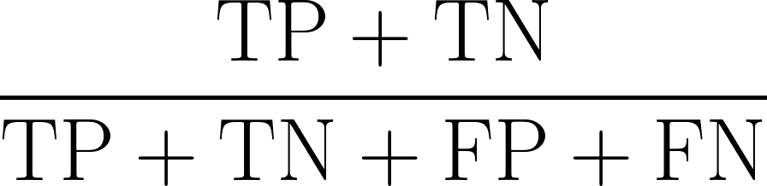
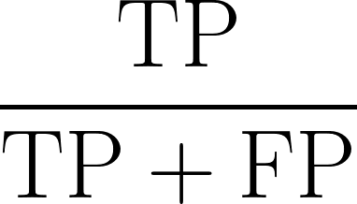
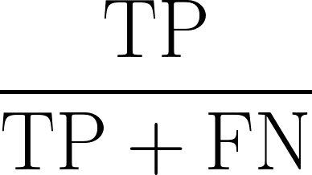
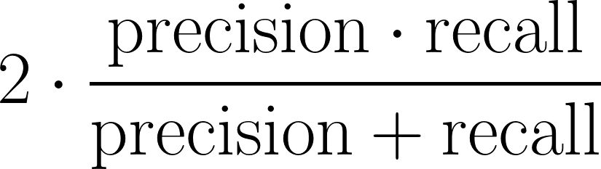
Evaluation metrics
Accuracy
Precision
Recall
F1-score
TP: True Positive
TN: True Negative
FP: False Positive
FN: False Negative

Slide 11
Related work
Since 2000, opinion mining and aspect-level opinion mining have been attracting attention of researchers, developers and have been applied widely in real-life.

Slide 12

International work

Slide 13
Sentiment Analysis: Capturing Favorability Using Natural Language Processing
Task definition: Find sentiment expressions for a given subject and determine the polarity of the sentiments.
Training corpus: Wall Street Journal articles from the Penn Treebank Project
Methods: semantic analysis with a syntactic parser and sentiment lexicon
Evaluation: 94.3% precision, 28.6% recall (Benchmark Corpus) and 94.5% precision, 24% recall (Open Test Corpus).

Slide 14
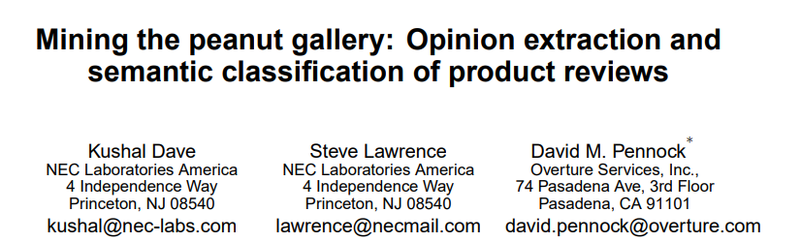
International work

Slide 15
Mining the Peanut Gallery: Opinion Extraction and Semantic Classification of Product Reviews
Training corpora: C|net and Amazon
Evaluation:
The results of thresholding schemes on baseline performance is 82.6% highest.
The results of tests using Naive Bayes with Laplace is 87.0%

Slide 16
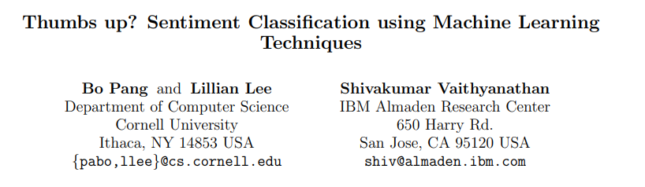
International work

Slide 17
Thumbs up? Sentiment Classification using Machine Learning Techniques
Methods: Compare Naive Bayes classification, Maximum Entropy classification, and Support Vector Machines.
Data source: The Internet Movie Database (IMDb) archive of the rec.arts.movies.reviews.newsgroup
Evaluation:
The baseline results ranged from 50% to 69%.
The best performance for different settings ranged from 77.4% to 82.9%.

Slide 18
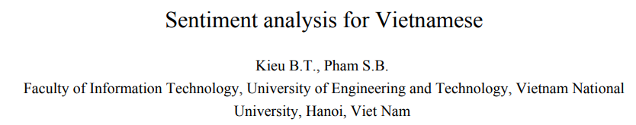
Vietnamese work

Slide 19
Sentiment analysis for Vietnamese
Corpus: Of computer products reviews
The first work to analyze sentiment at sentence level in Vietnamese

Slide 20
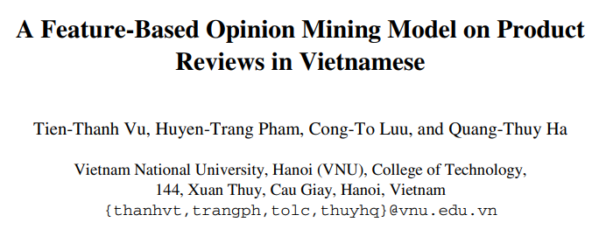
Vietnamese work

Slide 21
A Feature-Based Opinion Mining Model on Product Reviews in Vietnamese
Explicit/Implicit feature-words and opinion-words were extracted.
Synonym feature words were grouped into a feature.
Customers’ opinion orientations and summarization on features were determined by using VietSentiWordNet and suitable formulas.

Slide 22
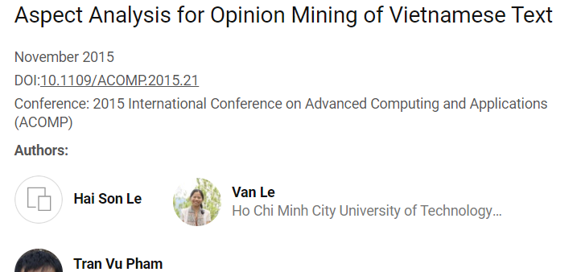
Vietnamese work

Slide 23
Aspect Analysis for Opinion Mining of Vietnamese Text
Results: Semi-supervised learning GK-LDA has better performance than the traditional topic modeling LDA
Aspect inference: use dictionary-based method
=> extract noun-phrases for obtaining better performance than just extract word seeds or use a complete sentence to infer aspects

Slide 24
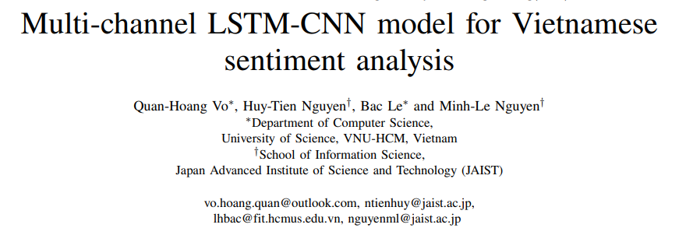
Vietnamese work

Slide 25
Multi-channel LSTM-CNN model for Vietnamese sentiment analysis
A multi-channel LSTM-CNN model for Vietnamese sentiment analysis: integrate the advantages of CNN and LSTM into one model
=> outperform the individual models: CNN, LSTM on Vietnamese datasets.
A Vietnamese sentiment (VS) corpus containing 17,500 reviews from Vietnamese e-commercial sites

Slide 26
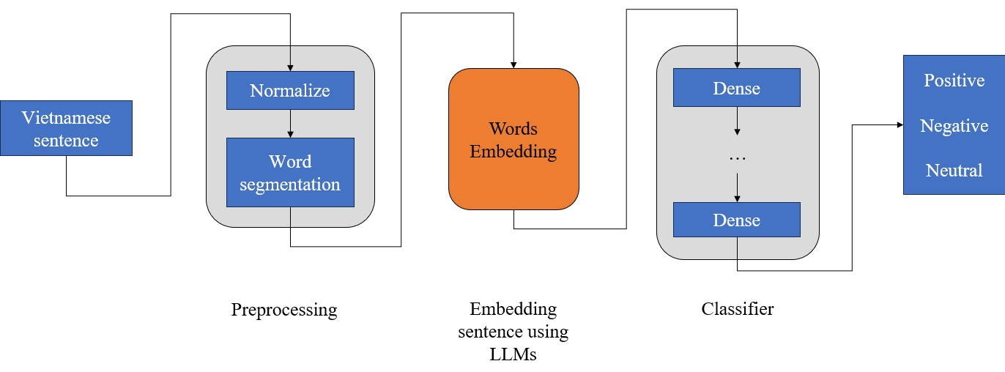
Our approach

Slide 27
PREPROCESSING
Normalization
Undertheseanlp
VnCoreNLP
Pre-tokenization
Tokenization
Sentencepiece

Slide 28
Normalization
Vietnamese Text Normalization tool from undertheseanlp contains rules for normalizing Vietnamese text, including character normalization, syllable normalization, and word normalization.
Ex: xẩy ra/xảy ra, bẩy/bảy, xẩy ra/xảy ra, gẫy tay/gãy tay
Word segmentation: VnCoreNLP helps to pre-process the pre-training data (including Vietnamese tone normalization and words segmentation).
Ex: Ông Nguyễn Khắc Chúc đang làm việc tại Đại học Quốc gia Hà Nội.
Ông Nguyễn_Khắc_Chúc đang làm_việc tại Đại_học Quốc_gia Hà_Nội .

Slide 29
Pre-tokenization
Tokenizer cannot work on the raw text. Instead, we first need to break the texts into smaller entities, such as words.
Ex: “Bạn có khỏe không?” → [“Bạn”, “có”, “khỏe”, “không”, “?”]
Pre-tokenization involves separation based on whitespace and punctuation. Other tokenizers may have different rules for this step.
Ex: “Bạn có khỏe không?” → [“Bạn”, “Ġcó”, “Ġkhỏe”, “Ġkhông”, “?”]

Slide 30
Tokenization
SentencePiece is introduced by Taku Kudo in the paper “SentencePiece: A simple and language independent subword tokenizer and detokenizer for Neural Text Processing”
Treat the input as a raw input stream, then use the BPE or unigram algorithm to construct the appropriate vocabulary.
ALBERT, XLNet, Marian, and T5.

Slide 31
Transformers
Encoder
Decoder
1
2

Slide 32
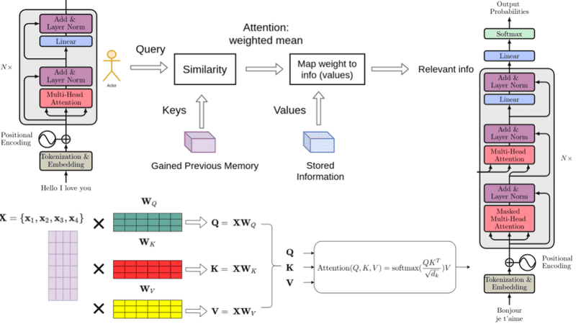
Encoder

Slide 33
Embedding
Word embeddings are a way to represent words as vectors in a multi-dimensional space, typically in high-dimensional numerical form
Vector operations can be performed on word embeddings.
Example:
king = [0.1 0.05 0.2 .... 150 such number]
king - men + women = queen

Slide 34
Embedding
bkai-foundation-models/vietnamese-llama2-7b-40GB
Pretrained model is built upon Meta's Llama-2, by Hanoi University of Science and Technology
SentencePiece was used to further train a Vietnamese tokenizer with a vocabulary size of 20K.
The new tokenizer significantly improves when encoding Vietnamese text

Slide 35
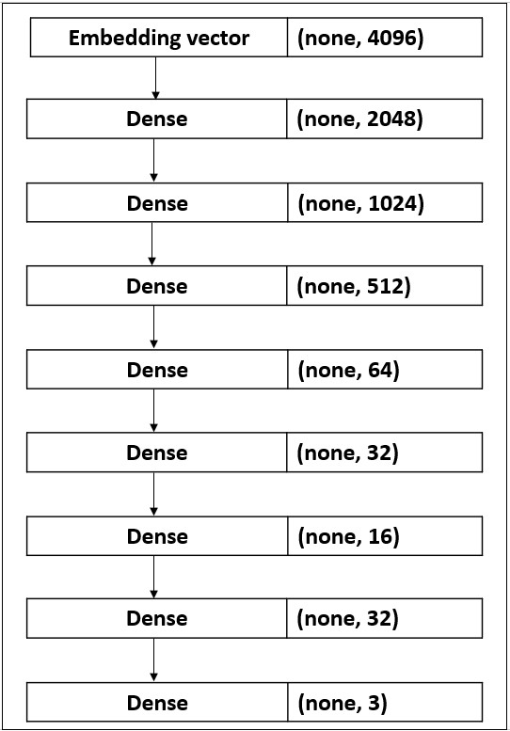
Classifier

Slide 36
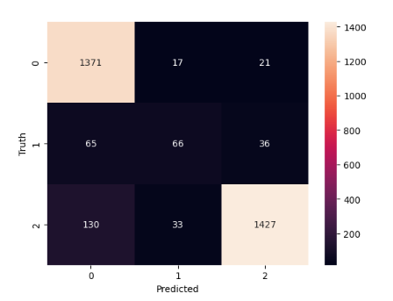
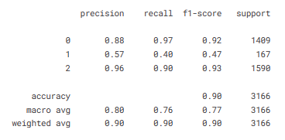
Result
0 - positive, 1 - neutral, 2 - negative

Slide 37
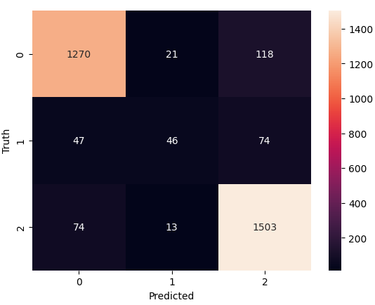
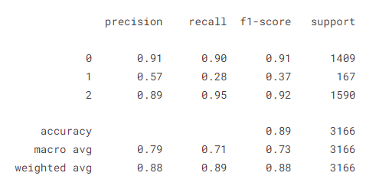
Result with processing
0 - positive, 1 - neutral, 2 - negative

Slide 38
Comments
Overall accuracy is high (weighted avg. = 90%, “positive” labels = 92%, “negative” labels = 93%)
Accuracy of ”neutral” label is only at 47%
→ Uneven dataset, only 4.5% are “neutral”
→ 3-5% of “neutral” sentences are ambiguous
Further preprocessing did not yield better results (weighted avg. = 88%)
→ Llama2 already pre-processes internally
→ Our attempt might be overreaching

Slide 39
Compare
We compare our model with the Bi-LSTM model (using Word2Vec) from the paper “Deep Learning versus Traditional Classifiers on Vietnamese Students’ Feedback Corpus” by Phu et al.
In that paper, the overall micro-average scores are:
Precision: 90.8%
Recall: 93.4%
Balanced F1: 92.0%
The micro-average scores of our model are as follows:
Precision: 90.46%
Recall: 90.46%
Balanced F1: 90.46%
It could be seen that our model’s results are slightly lower than those of the Bi-LSTM model.

Slide 40
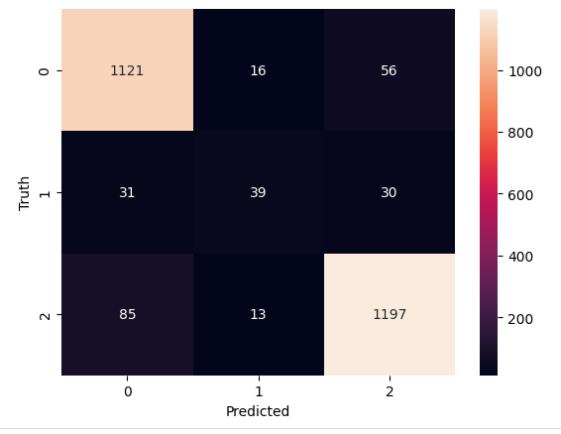
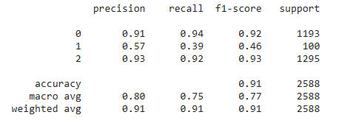
Bidirectional - CNN model

Slide 41
Incorrect prediction
Input: “Thầy cô dạy hay đưa em vào giấc ngủ ngàn thu”
→ Actual output: Positive
→ Expected output: Negative
Input: “Em đạt điểm mười môn học”
→ Actual output: Neutral
→ Expected output: Positive
Input: “Kiến thức thầy dạy như nước đổ lên đầu em”
→ Actual output: Neutral
→ Expected output: Negative

Slide 42
Limitation
The model currently struggles with cases involving neutral emotions.
The imbalance of labels in the corpus, feedbacks whose sentiment is neutral are often misclassified by our models.
Sarcastic comments are still challenges to our models.
The model has not fully analyzed the meaning of the context, the results are still limited.

Slide 43
Future work
Collect more feedbacks that are neutral to increase the balance of labels in our corpus.
Expand the corpus to include more feedbacks from other educational institutions.
Fine-tune Llama2 better and integrate it with Bidirectional-CNN to increase the overall model’s performance.

Slide 44
Thanks for listening

