Slide 1
REVIEW

Slide 2
original / əˈrɪdʒɪnəl / adjective existing or happening first, before other people or things :
- The land was returned to its original owner.
- The original plan was to fly out to New York.

Slide 3
now ( also ˈnow that ) conjunction because of something or as a result of something :
- Now that we know each other a little better, we get along fine.
- I’m going to relax now the school year is over.

Slide 4
crave / kreɪv / verb to have an extremely strong desire for something :
- an insecure child who craves attention

Slide 5
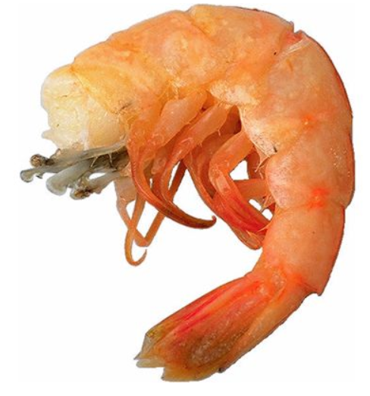
shrimp / ʃrɪmp / noun a small sea creature that you can eat, which has ten legs and a soft shell SYN prawn British English

Slide 6
reasonable / ˈriːzənəbəl / adjective reasonable prices are not too high SYN fair : good food at a reasonable price

Slide 7
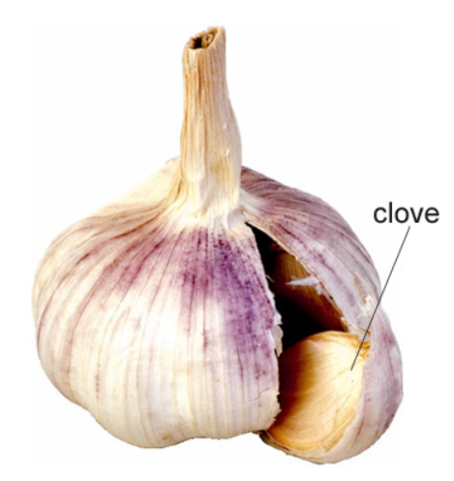
garlic / ˈɡɑːlɪk / noun a plant like a small onion, used in cooking to give a strong taste :
- Add a crushed clove of garlic (= single section of it ) .

Slide 8
express post/mail a system that delivers letters and packages very quickly

Slide 9
seal / siːl / verb to close an envelope, package etc by using something sticky to hold its edges in place :
- He wrote the address and sealed the envelope.

Slide 10
confidential / ˌkɒnfəˈdenʃəl / adjective spoken or written in secret and intended to be kept secret :
0 Doctors are required to keep patients’ records completely confidential .

Slide 11
rush noun a situation in which you need to hurry : do something in a rush (= do something quickly because you need to hurry )
I had to do my homework in a rush because I was late. be in a rush
I’m sorry, I can’t talk now – I’m in a rush.

Slide 12
settle in ( also settle into something ) phrasal verb to become comfortable in and accustomed to a new location, environment, or circumstance.
- How’s your new home? Are you settling in OK?
- It takes a few months to settle into life at college.

Slide 13
raise noun American English an increase in the money you earn SYN rise British English

Slide 14
jewellery British English , jewelry American English / ˈdʒuːəlri / noun small things that you wear for decoration, such as rings or necklaces
- She wears a lot of gold jewelry.

Slide 15
insure / ɪnˈʃʊə / verb
1 to buy insurance so that you will receive money if something bad happens to you, your family, your possessions etc :
- Have you insured the contents of your home? insure (something/somebody) against loss/damage/theft/sickness etc
- It is wise to insure your property against storm damage.
2 to provide insurance for something or someone :
- Many companies won’t insure young drivers.

Slide 16
tracking / ˈtrækɪŋ / noun the act or process of following something or someone

Slide 17
expense / ɪkˈspens / noun the amount of money that you spend on something :
- He borrowed £150,000 and used the money for legal expenses.
- Conference rooms were equipped at great expense.

Slide 18
crew / kruː / noun all the people who work on a ship or plane :
- The plane crashed, killing two of the crew and four passengers. crew of
- He joined the crew of a large fishing boat.
- a crew member

Slide 19
beverage / ˈbevərɪdʒ / noun formal a hot or cold drink :
- alcoholic beverages
- the Food and Beverage Manager

Slide 20
head verb ( also be headed ) to go or travel towards a particular place, especially in a deliberate way head for/towards/back etc
- The ship was heading for Cuba.
Where are you guys headed?

Slide 21
ˈwake-up ˌcall noun a telephone call that someone makes to you, especially at a hotel, to wake you up in the morning SYN alarm call

Slide 22
postpone / pəʊsˈpəʊn / verb to change the date or time of a planned event or action to a later one SYN put back OPP bring forward :
- The match had to be postponed until next week. postpone doing something
- They’ve decided to postpone having a family for a while.

Slide 23
crucial / ˈkruːʃəl / adjective something that is crucial is extremely important, because everything else depends on it SYN vital crucial to
- This aid money is crucial to the government’s economic policies.

Slide 24
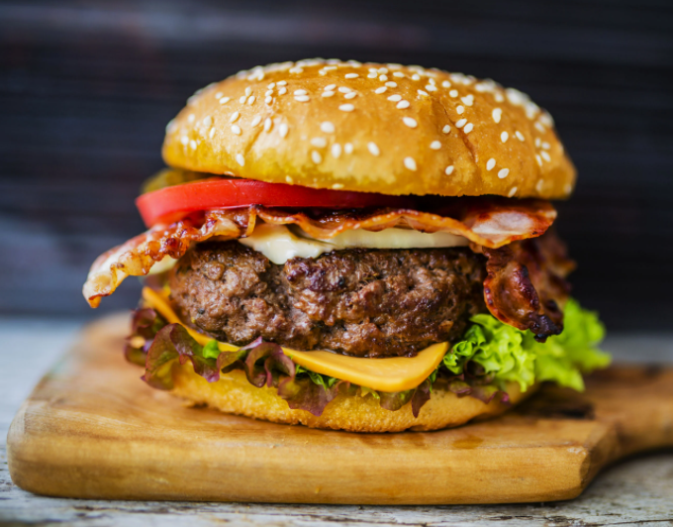
burger / ˈbɜːɡə / noun a flat round piece of finely cut beef, which is cooked and eaten, or one of these served in a bread bun SYN hamburger

Slide 25
starve / stɑːv / verb be starving ( also be starved American English ) to be very hungry :
- You must be starving!

Slide 26
luncheon / ˈlʌntʃən / noun formal lunch

Slide 27
packet / ˈpækət, ˈpækɪt / noun ( meeting, conference…) several documents provided as a set, giving information about something:
- Our bookkeeping training packet includes everything you need to get started

Slide 28
turn out phrasal verb to happen in a particular way, or to have a particular result, especially one that you did not expect turn out well/badly/fine etc
- It was a difficult time, but eventually things turned out all right.
- To my surprise, it turned out that I was wrong.

Slide 29
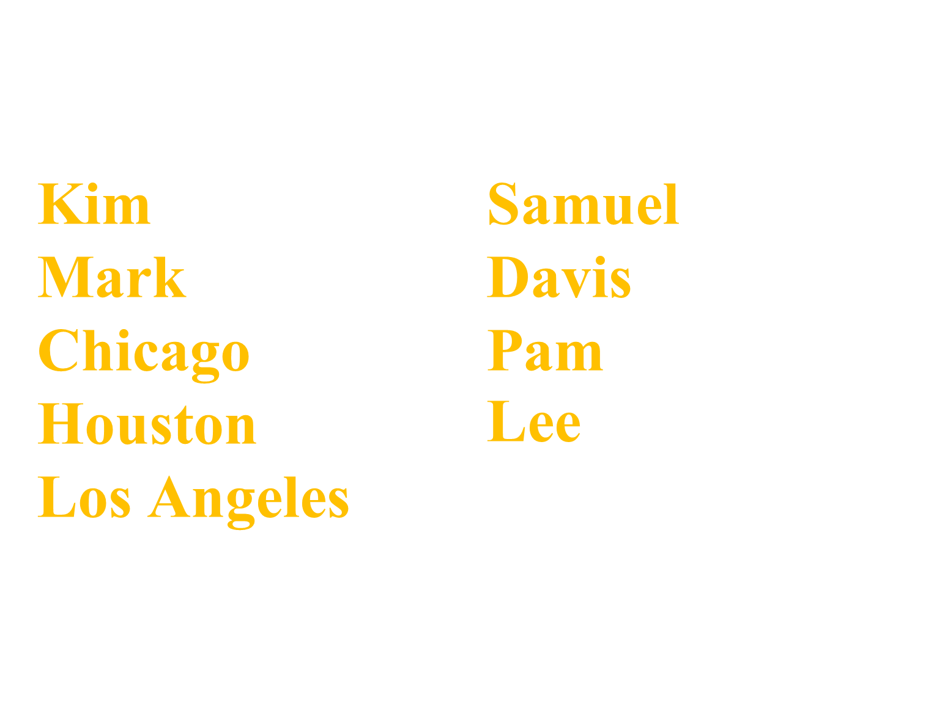

Slide 30
THANK YOU

