Slide 1
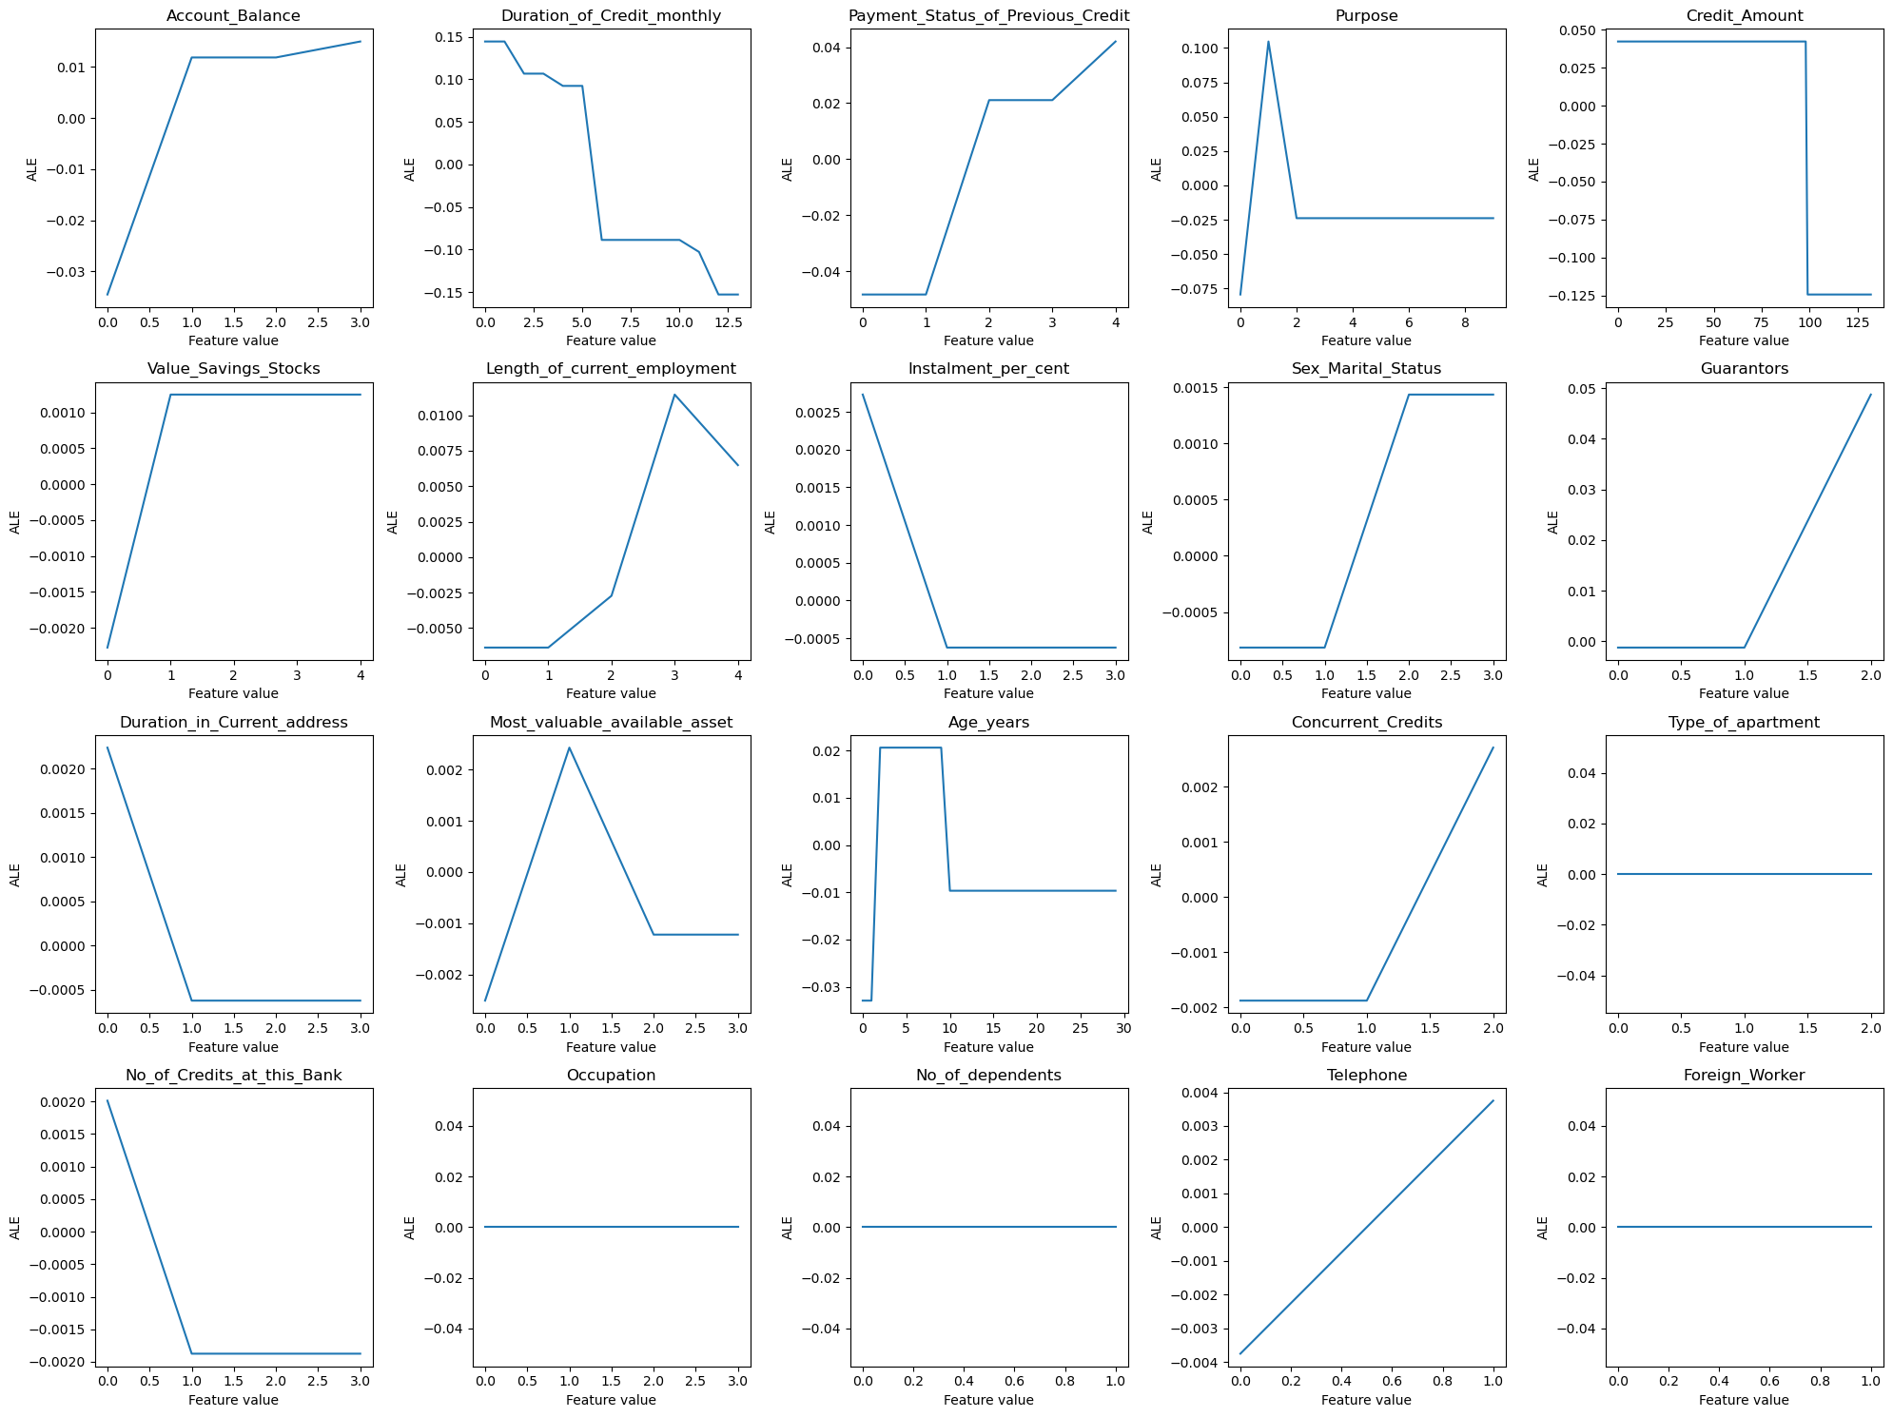
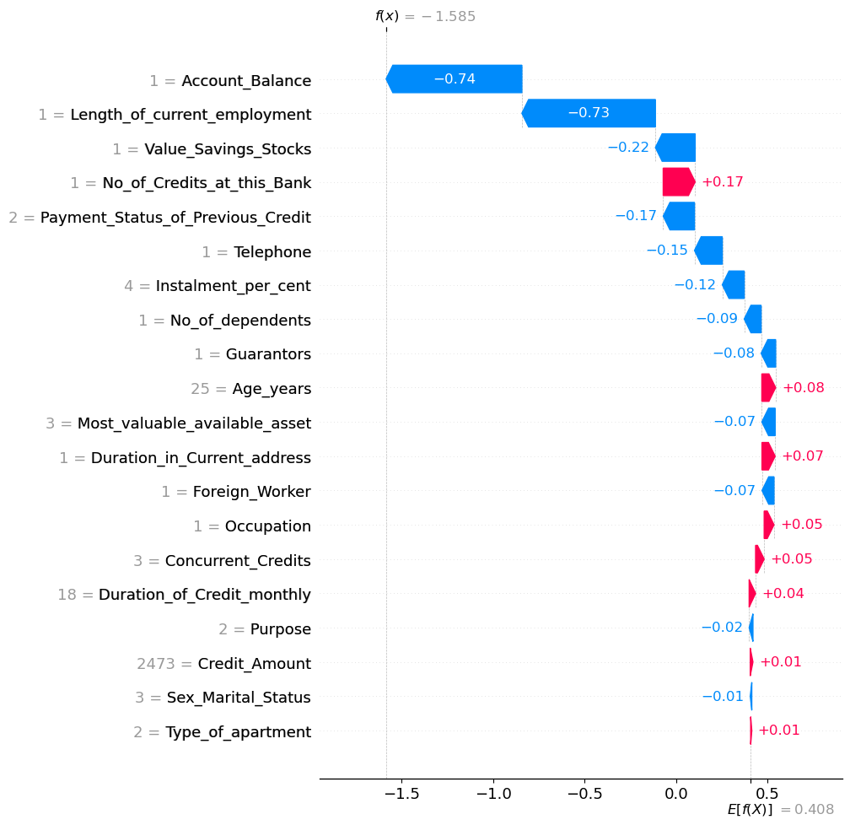
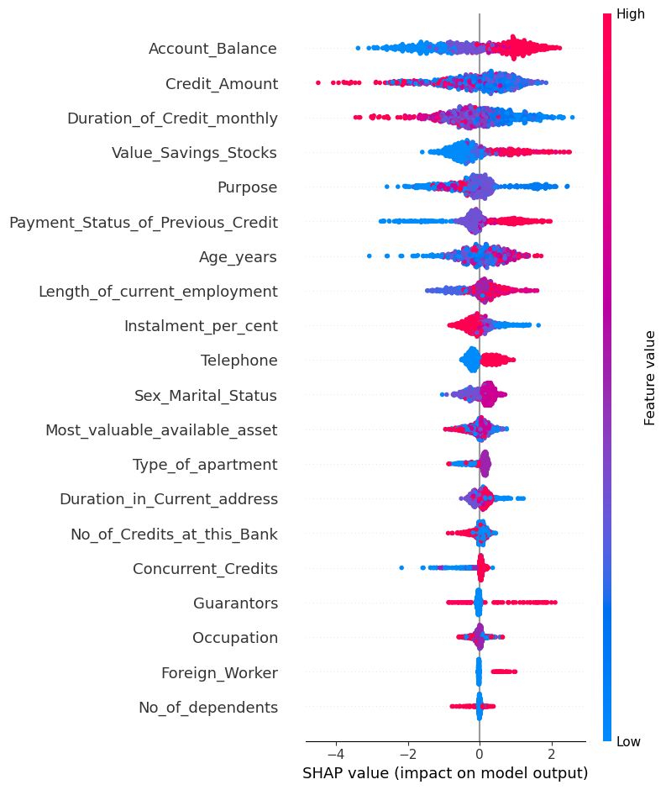
Predicting Creditworthiness with Artificial Neural Networks and XGBoost: An Explainability Approach using SHAP and ALE
DUC TUNG BUI
RAIKA HOORSUN
17.01.2025
‹#›

Slide 2

Agenda
Predicting Creditworthiness with Artificial Neural Networks and XGBoost: An Explainability Approach using SHAP and ALE
Motivation & Goal
Dataset
Preprocessing
ANN Methodology
XGBoost Methodology
SHAP Methodology
ALE Methodology
Model Design & Performance
SHAP Interpretations
ALE Interpretations

Slide 3




Motivation & Goal
Predicting Creditworthiness with Artificial Neural Networks and XGBoost: An Explainability Approach using SHAP and ALE
Increasing need for accurate creditability prediction
Emerging techniques in Machine Learning
Addressing model transparency and trust
Potential for improved financial decision-making
Financial institutions require reliable models to assess credit risk effectively
Traditional methods may lack precision, leading to potential financial losses
cutting-edge algorithms with proven success in predictive tasks
Exploring these techniques can enhance prediction accuracy and decision-making
Understanding the decision-making process of models is crucial
This study aims to provide clear explanations of how models arrive at their predictions
By harnessing advanced models, institutions can make better-informed decisions
goal is to reduce default rates and improve financial stability

Slide 4

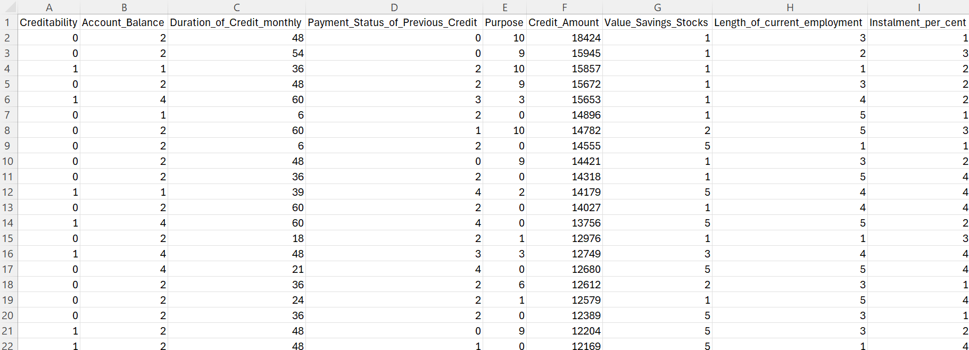
Predicting Creditworthiness with Artificial Neural Networks and XGBoost: An Explainability Approach using SHAP and ALE
GERMAN CREDIT DATA
Designed to analyze influences
Binary target variable ‚creditability‘
🡪 1 or 0
Building classification models
20 features (numerical and categorical)

Slide 5
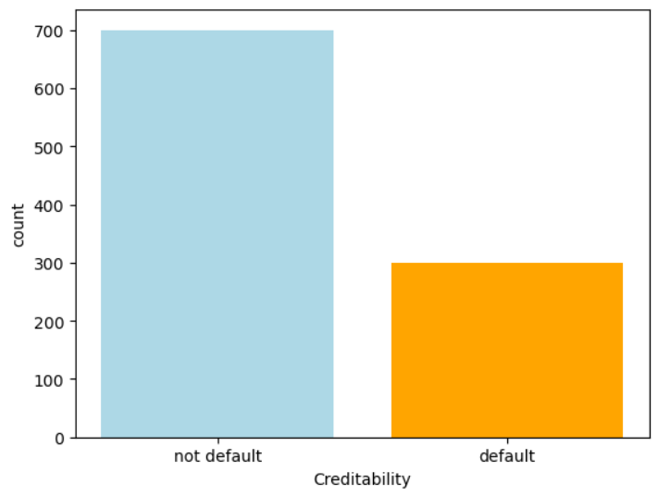
Data Preprocessing
Data Preprocessing
Explanation of ANN & XGBoost for creditability prediction
Use Package StandardScaler()
🡪 Input features ~ N(0, 1)
🡪 Features are on similar scale
700 Not Default
300 Default
Imbalanced Data
🡪 Class Weights method

Slide 6

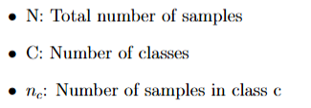






Data Preprocessing
Data Preprocessing
Explanation of ANN & XGBoost for creditability prediction
Class Weights Method: assign higher weights to minority classes and lower weights to majority classes in the loss function
Formula
In our study

Slide 7
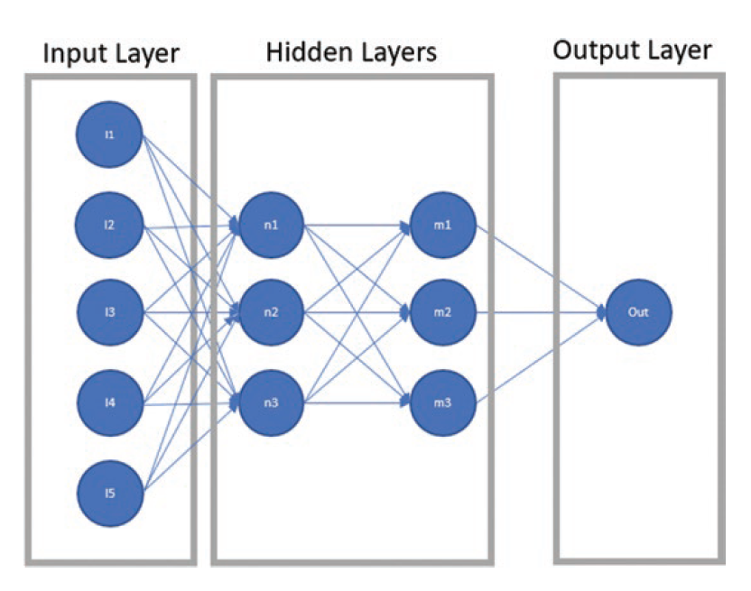
Artificial neural network (ANN)
Methodology
Explanation of ANN & XGBoost for creditability prediction
Inspired by the human brain, neural networks are computational models composed of interconnected nodes (neurons)
Used to recognize patterns and model complex relationships in data
Capable of learning from large datasets and improving performance over time
Model performance: Accuracy, F-1 score
Explainable AI with Python, Gianfagna

Slide 8
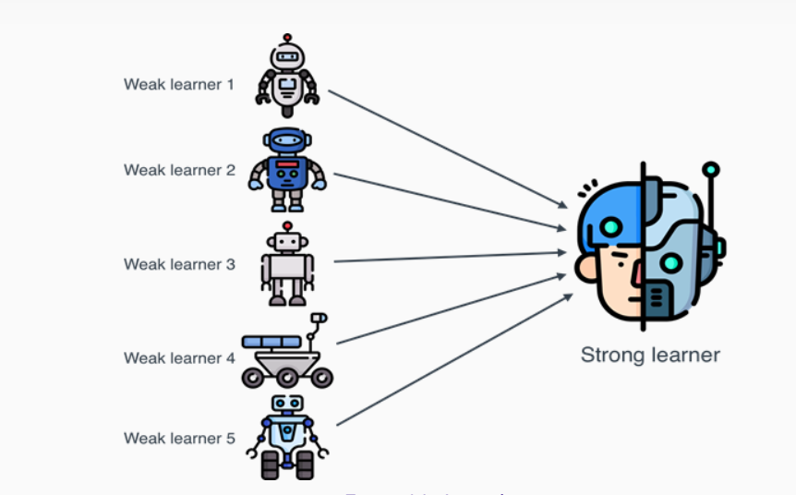
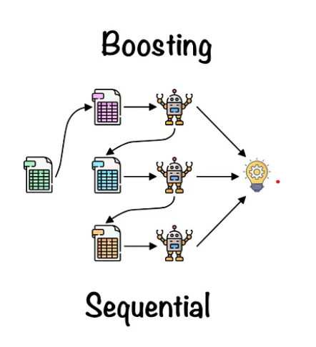
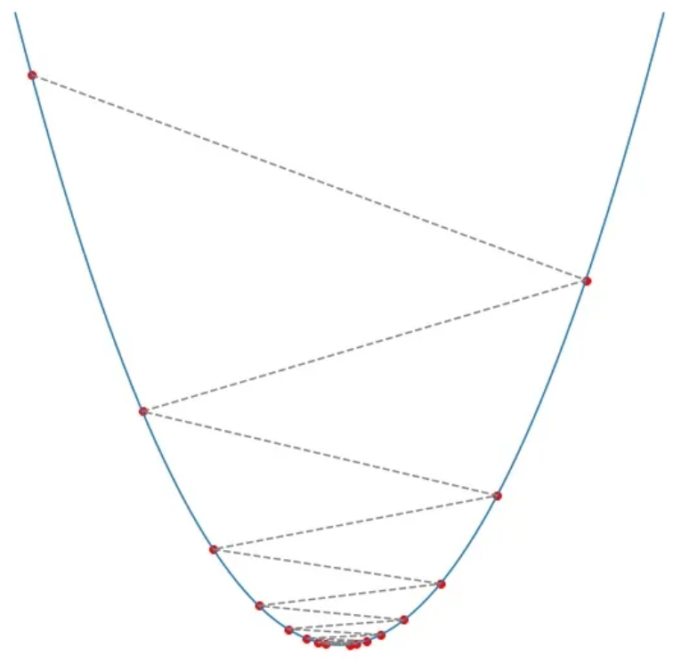
EL, Boosting & Gradient Descent
Methodology
Explanation of ANN & XGBoost for creditability prediction
Ensemble Learning
Boosting
Gradient Descent
Train different models („learners“) to solve the same problem
Combine „learners“ to improve performance
Train sequentially models
Each new model attempts to correct errors made b the previous model
Attempts to minimize a loss function of model
Iteratively adjusts the model parameters in the direction of the negative gradient
https://encord.com/blog/what-is-ensemble-learning/
https://medium.com/@roshmitadey/bagging-v-s-boosting-be765c970fd1
https://bdtechtalks.com/2023/07/31/what-is-gradient-descent/

Slide 9
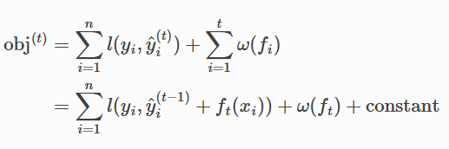
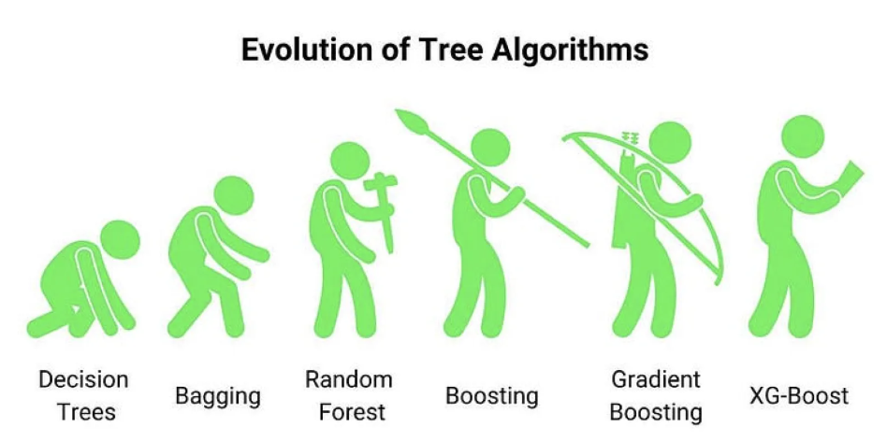
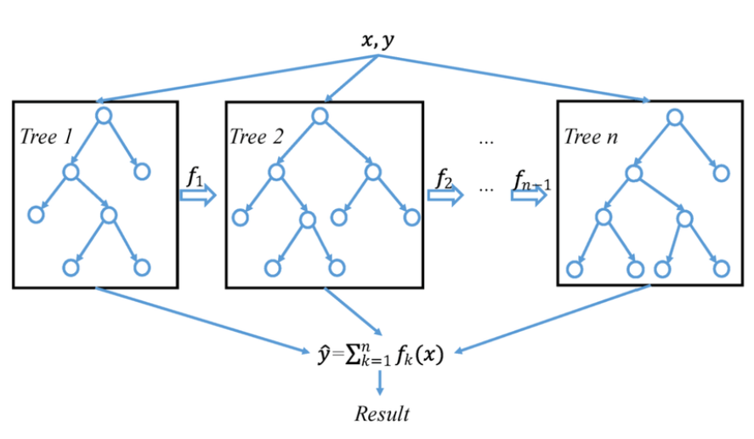
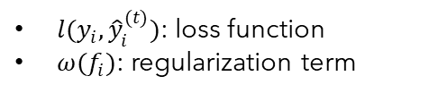
XGBoost
Methodology
Explanation of ANN & XGBoost for creditability prediction
XGBoost
eXtreme Gradient Boosting
Ensemble method
Based on the principles of gradient boosting
Primarily uses decision trees as base learners
Builds an ensemble of trees in a sequential manner
Each new tree aims to correct the errors made by the previous trees
Mathematical formula
https://aiml.com/what-is-xgboost-and-how-does-it-improve-upon-standard-gbm/
https://www.researchgate.net/figure/A-general-architecture-of-XGBoost_fig3_335483097

Slide 10
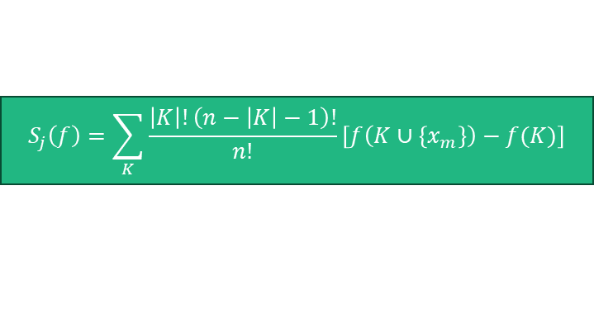
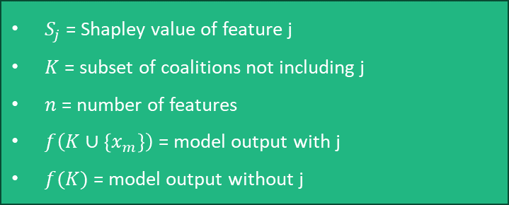
SHAP
Methodology
Explanation of ANN & XGBoost for creditability prediction
Understanding SHAP: Explaining Machine Learning Models
Mathematical Foundations of SHAP
SHapley Additive exPlanations
Provides interpretability for ML models using game theory
Assigns each feature a value representing its contribution to the model‘s prediction
Enhances trust and transparency in ML applications
Offers consistent and accurate local explanations
Originating from cooperative game theory
Distributes the total prediction value fairly among all features

Slide 11
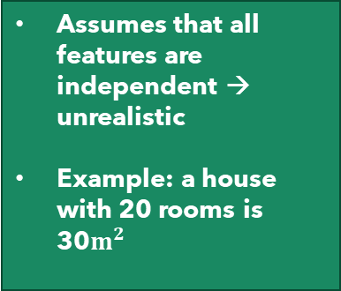
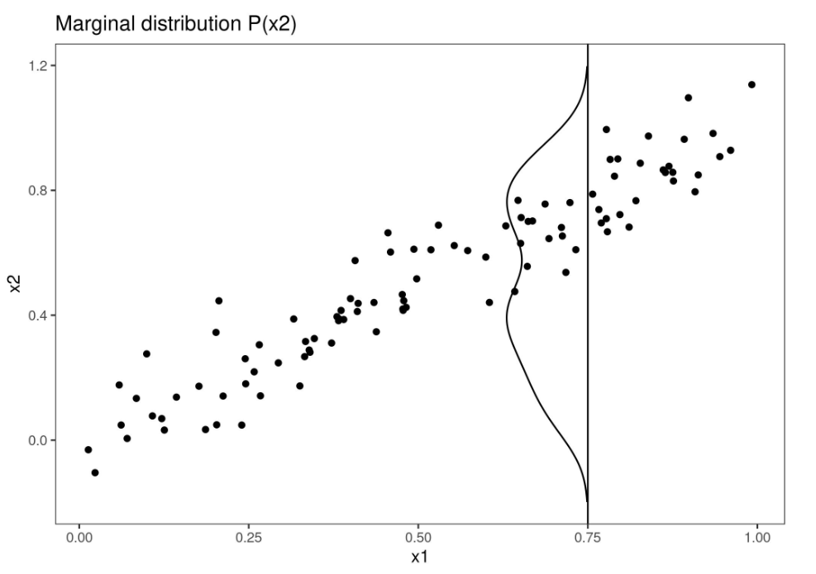
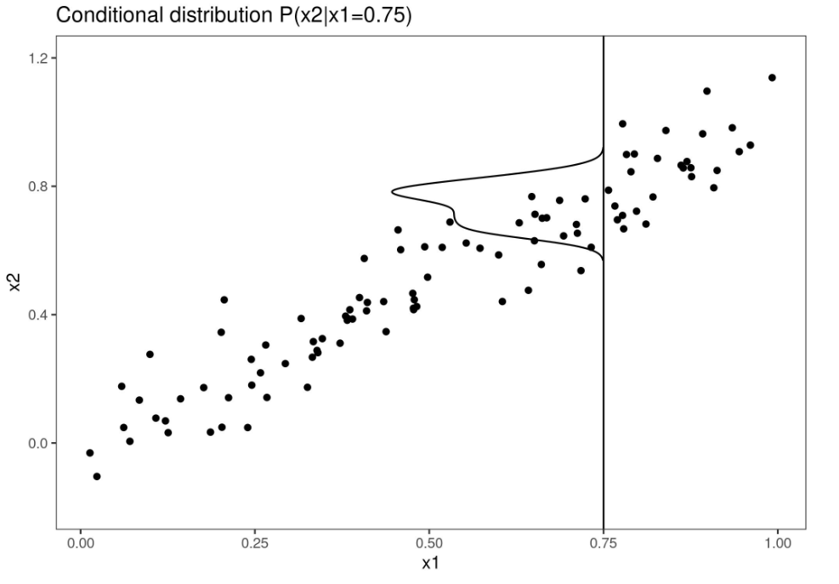
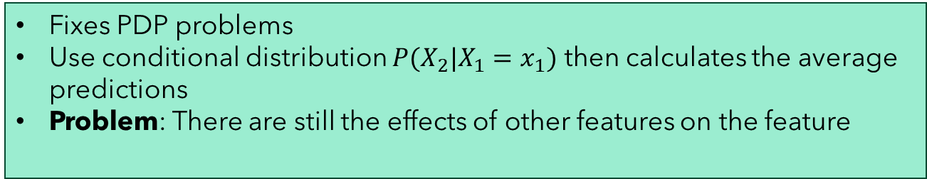
PDP & M-Plot
Methodology
Explanation of ANN & XGBoost for creditability prediction
Partial Dependence Plot (PDP)
Problem of PDP
Vary the value of one or more features
… while keeping other features constant
… then averaging the resulting predictions
Marginal Plot (M-Plot)

Slide 12
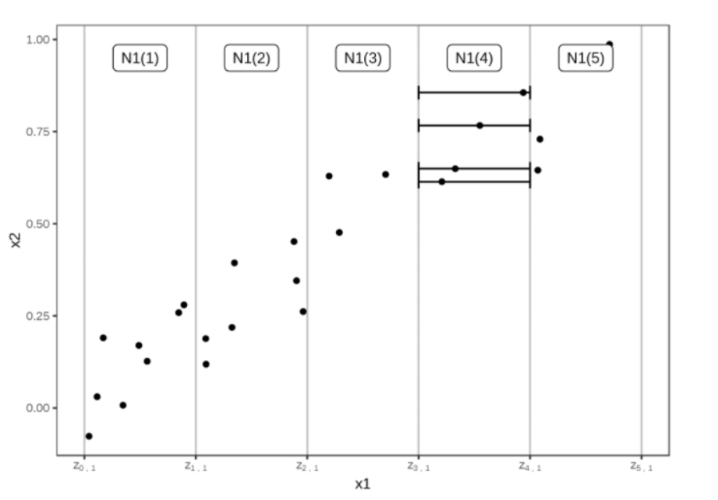
ALE
Methodology
Explanation of ANN & XGBoost for creditability prediction
Accumulated Local Effects Plot (ALE)
Fixes both PDP and M-Plot problems
Calculates the differences in predictions instead of averages
Focuses on local effects by examining how small changes in a feature value impact the model‘s predictions
https://christophm.github.io/interpretable-ml-book/ale.html

Slide 13





ALE
Methodology
Explanation of ANN & XGBoost for creditability prediction
Mathematical formulas of ALE
1. Calculates local effects within each interval
2. Averages the local effects for each interval
3. Accumulates the local effects across all intervals
4. Centers the ALE values

Slide 14
ALE Value Explanation
Methodology
Explanation of ANN & XGBoost for creditability prediction
ALE > 0: the feature increases the likelihood of the predicted outcome.
ALE < 0: the feature decreases the likelihood of the predicted outcome
ALE = 0: the feature has no effect on the prediction

Slide 15

Neural Network Model
Predicting Creditworthiness with Artificial Neural Networks and XGBoost: An Explainability Approach using SHAP and ALE
Input layer
Hidden layer
Output layer
128 samples per batch
100 epochs
Adam optimizer
Training Process
Forward Pass
Loss Calculation
Backpropagation
Weight Updates
40 neurons each
ReLU
Sigmoid

Slide 16
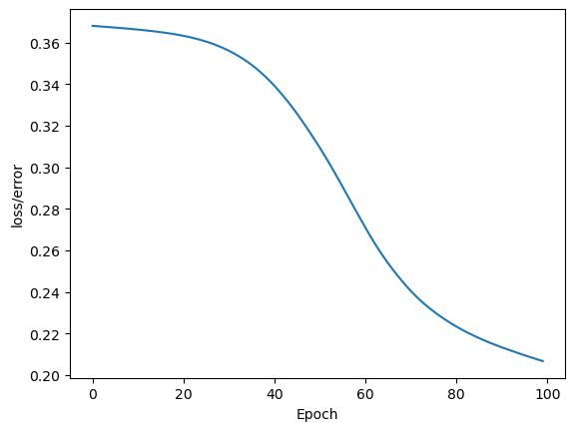


Performance
Predicting Creditworthiness with Artificial Neural Networks and XGBoost: An Explainability Approach using SHAP and ALE
XGBoost performance
ANN performance
Training Loss Curve
Training Data
xx.yy% accuracy
xx.yy% F1-score
Test Data
73.5% accuracy
81.00% F1-score
Training Data
77.5% accuracy
82.92% F1-score
Test Data
75.5% accuracy
80.93% F1-score

Slide 17
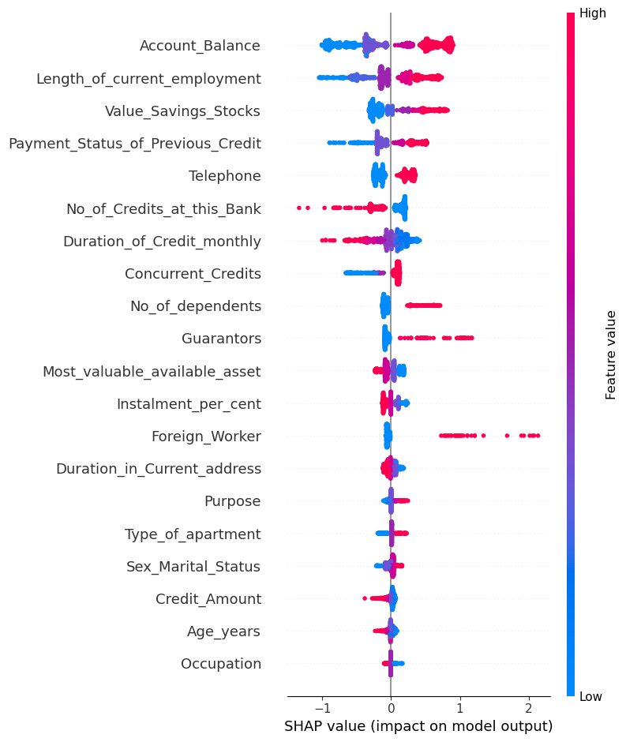
SHAP Summary Plot
Predicting Creditworthiness with Artificial Neural Networks and XGBoost: An Explainability Approach using SHAP and ALE
SHAP interpretation for ANN model
SHAP interpretation for XGBoost model

Slide 18
SHAP Waterfall Plot
Predicting Creditworthiness with Artificial Neural Networks and XGBoost: An Explainability Approach using SHAP and ALE
Base value = average model output across all observations
Positive and negative contributions
EXAMPLE
Base value = 0.408
Model output = -1.585
Threshold 0.5
0.17 < 0.5 🡪 ‚no credit received‘

Slide 19
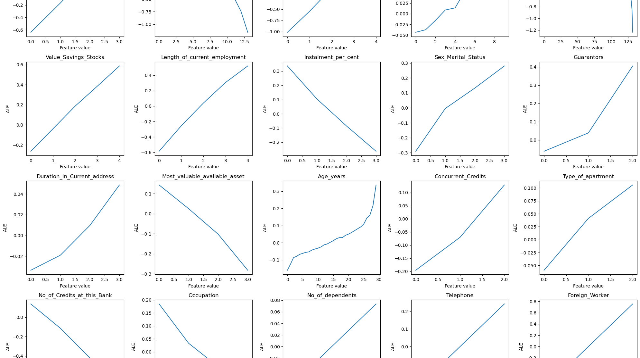
Explain ALE Plot for ANN

Slide 20
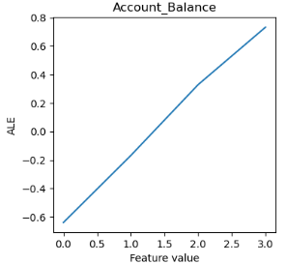
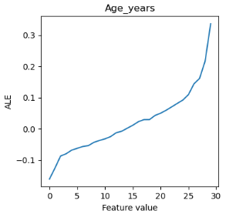
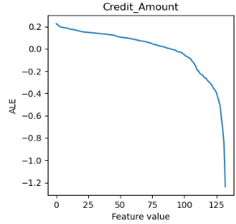
Account_Balance: [1, 2, 3, 4]
Increasing of account balance
🡪 ALE value increases
🡪 Risk of default decreases
Age_years: [19-75]
Increasing of Age
🡪 ALE value increases
🡪 Risk of default decreases
Credit_Amount
Increasing of credit amount
ALE value decreases
Risk of default decreases

Slide 21
Explain ALE Plot for XGBoost

Slide 22
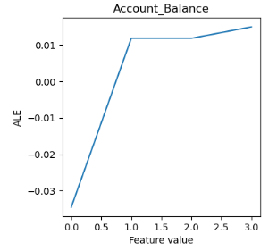
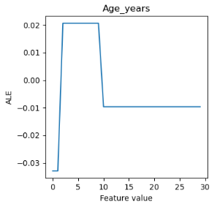
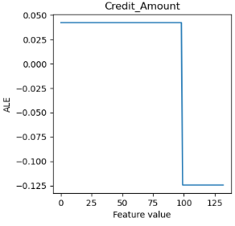
Account_Balance: [1, 2, 3, 4]
Increasing of account balance
🡪 ALE value increases
🡪 Risk of default decreases
Age_years: [19-75]
Young : ALE < 0 🡪 higher likelihood to default
Older: ALE > 0 🡪 lower likelihood to default
Credit_Amount
Increasing of credit amount
ALE value decreases
Risk of default decreases

Slide 23
Thank you for your attention!

