Slide 1
Passerelles numériques
Chapter0: Configuration
A Gateway for Life

Slide 2
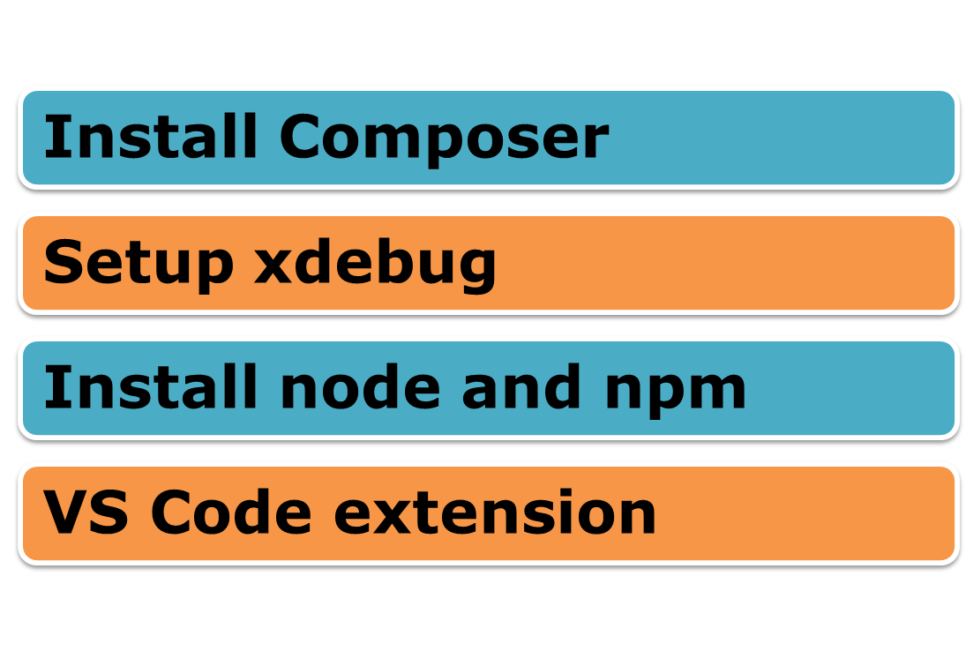
Content

Slide 3
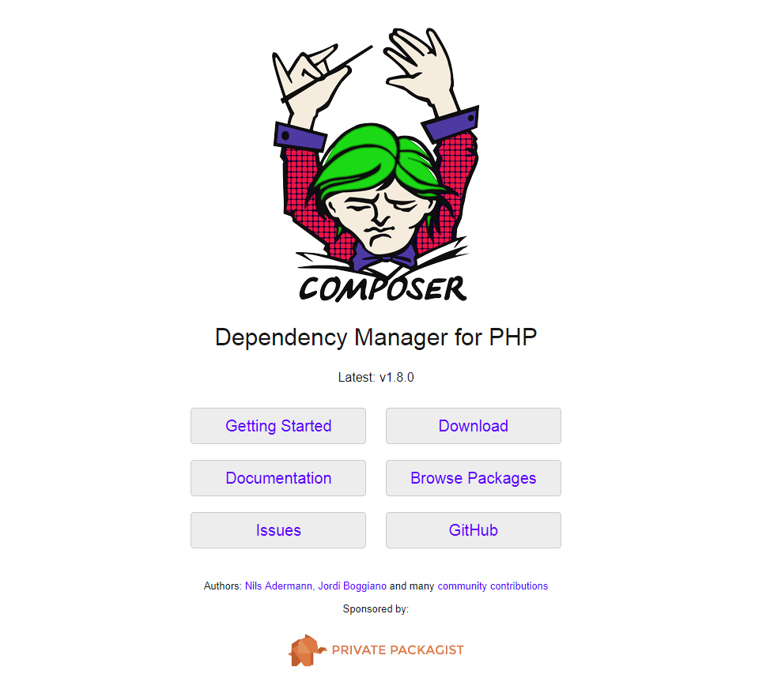
Install Composer
Notes:
Got to: https://getcomposer.org/
Then click on button download.

Slide 4
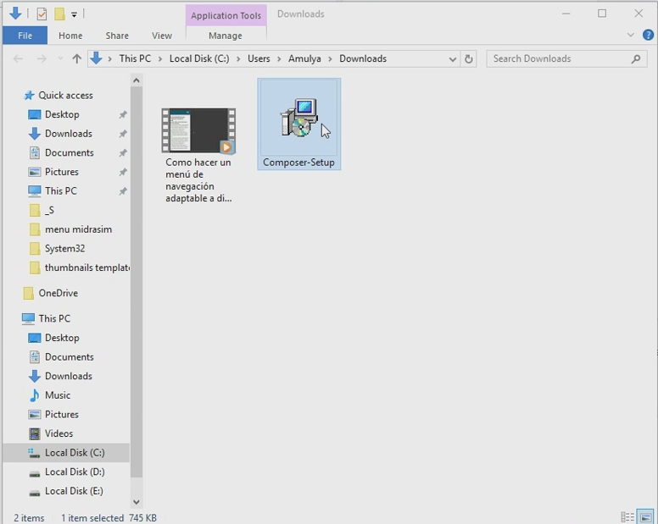
Install Composer

Slide 5
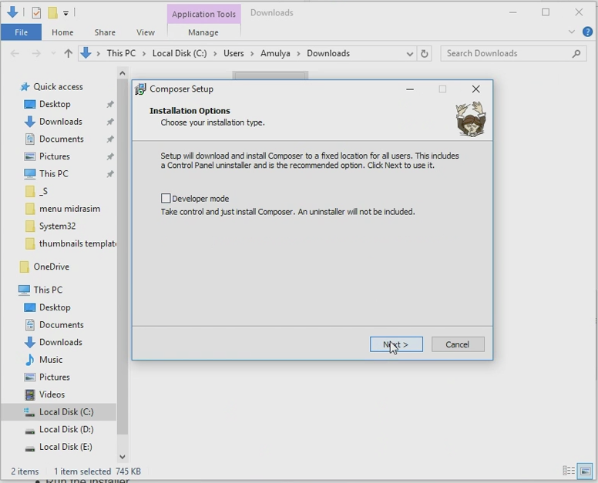
Install Composer

Slide 6
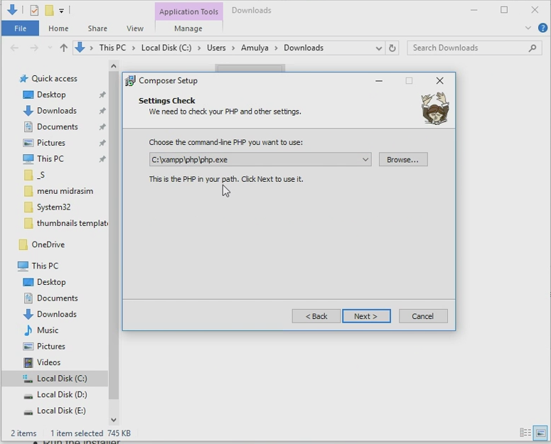
Install Composer

Slide 7
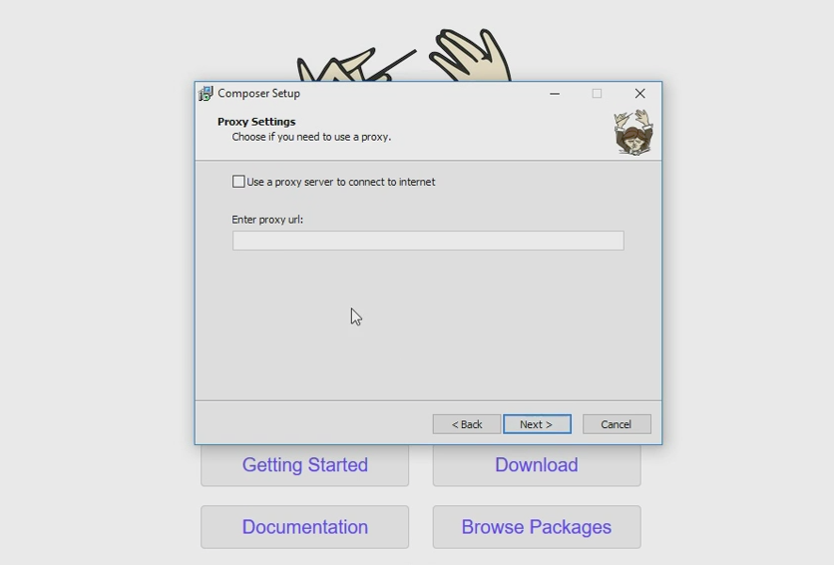
Install Composer

Slide 8
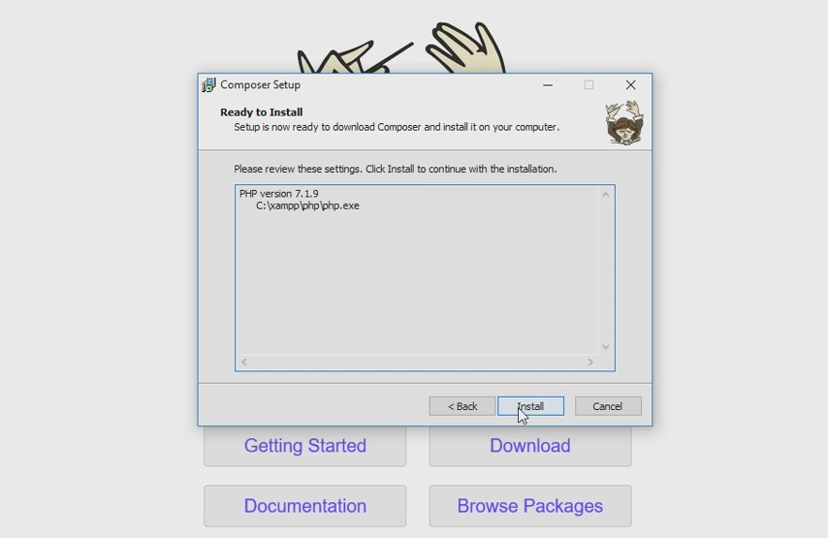
Install Composer

Slide 9
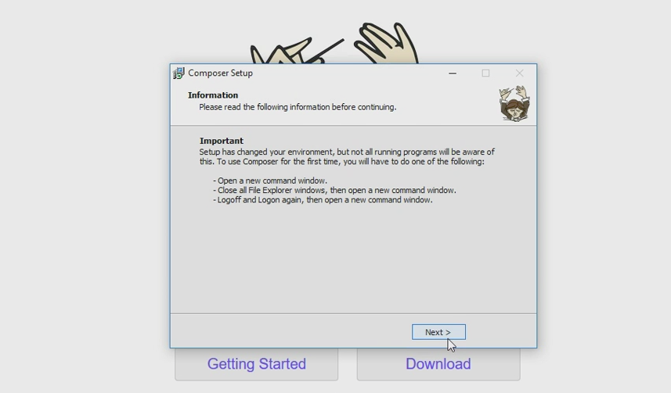
Install Composer

Slide 10
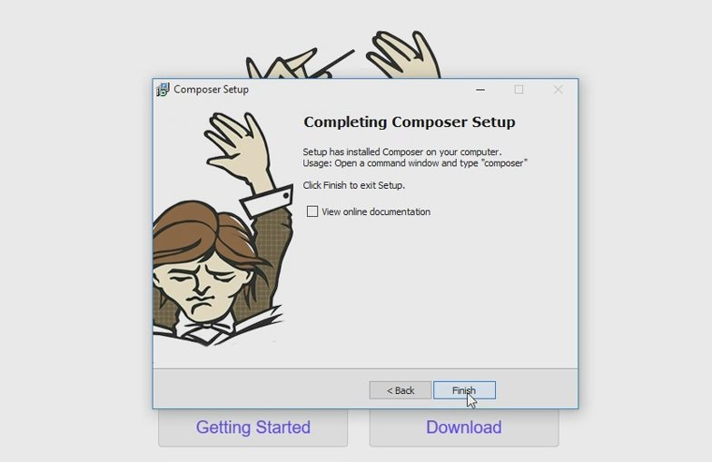
Install Composer

Slide 11
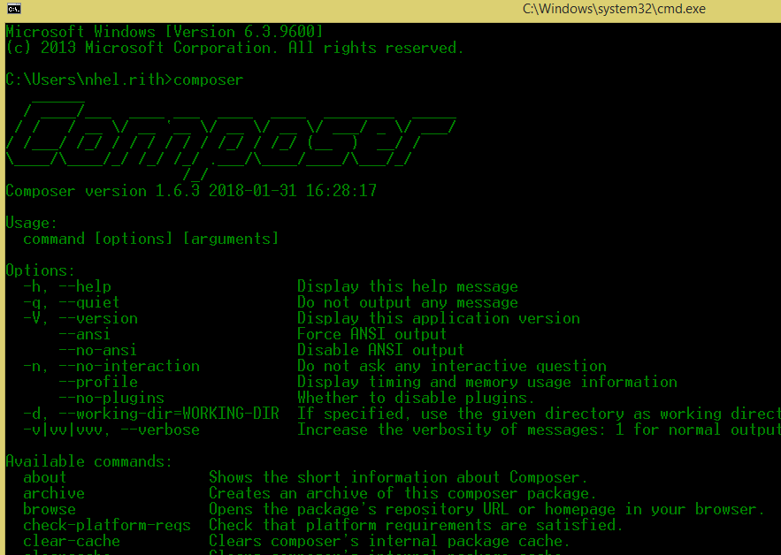
Check Composer

Slide 12

Setup xdebug

Slide 13
Setup xdebug
  Go to the url below:
  https://xdebug.org/download.php
  After go to this url, then download the fill .dll that fit to your php version and the bit of your pc.
  Ex: My PC is 64bit and My php Version is 7.1 so I download one file is:
  php_xdebug-2.7.0beta1-7.1-vc14-nts-x86_64.dll
Notes:
This is the url to download the xdebug that fit to the php version of your pc.

Slide 14
Setup xdebug
After you download the file, then copy that fill to put in
  C:\xampp\php\ext

Slide 15
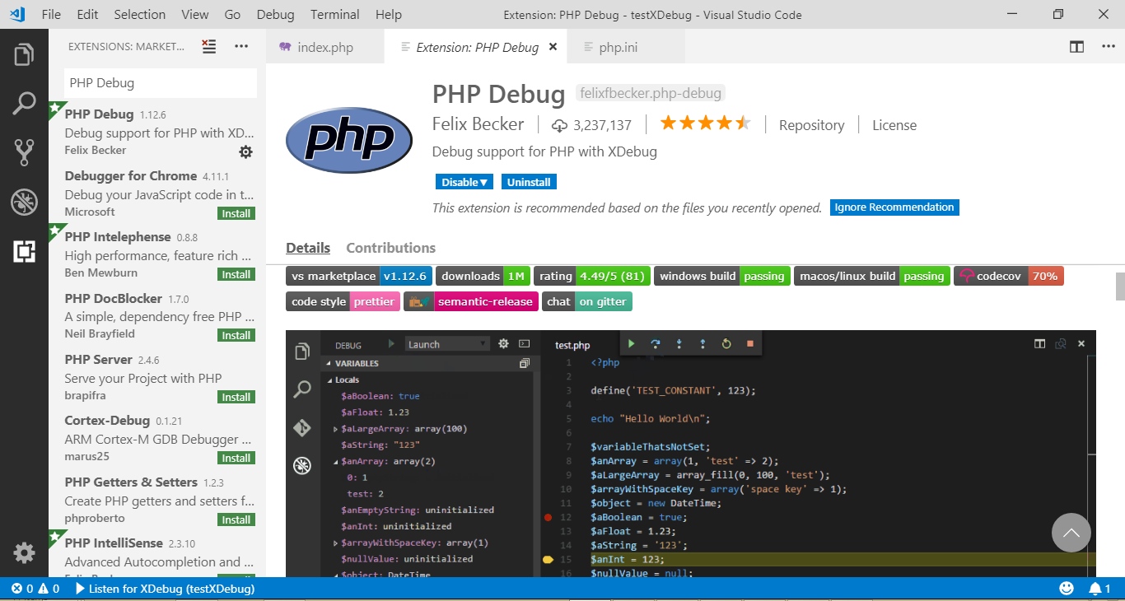
Setup xdebug
In VsCode, Install one extension call PHP Debug

Slide 16
Setup xdebug
Add this line to your php.ini
zend_extension = "C:/xampp/php/ext/php_xdebug-2.7.0beta1-7.1-vc14-nts-x86_64.dll"
xdebug.remote_enable = 1
xdebug.remote_autostart = 1
After adding the line above then restart the service of your xampp or warmp.

Slide 17
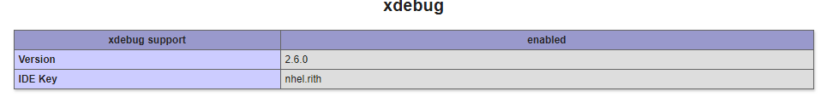
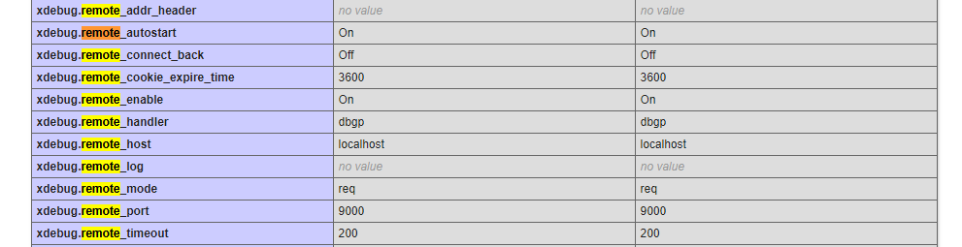
Test xdebug Working or not
Create one project Call testXDebug
In this project create one file index.php
  Add phpinfo(); into the file
After that run the project, and check for some information as picture below.

Slide 18
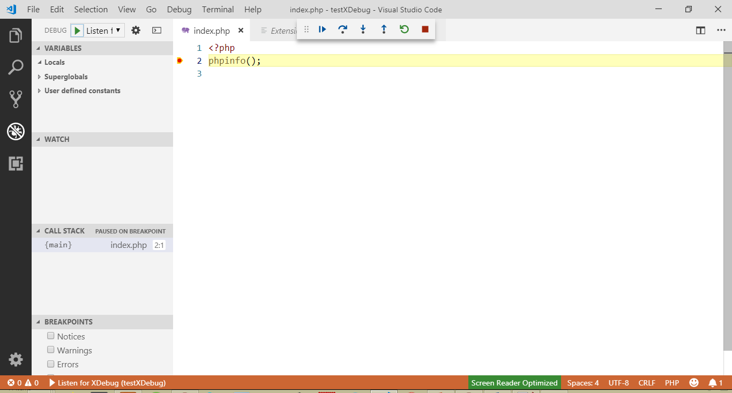

Slide 19
Install Node & NPM
Go to this location:
  Y:\03. COMMON\01.Teachers\Rith.Nhel
  Copy one file call node-v10.13.0-x64.msi
  And install it.

Slide 20
Q&A

