Slide 1
Trial tracker status. Manual user guide.
PRB TE
Update : 02-Feb-2015

Slide 2
Trial Tracker status V1.2
What is Trial tracker status ? Trial tracker status is a test time / yield / Pass fail code tracker / Summary system.
Feature support:
Summary by process (Function / SRST / Final / Featuring test) and by MTYPE
Summary percent completion, yield , test time, PFCode each process.
Test time summary: min, max , average, 95% completion.
Error code ratio.
All data from PID 6400, 6600, 68800 and 9000.
Report summary by email to owner every day morning.
Report System error to owner and admin.
User guide.
How to access to System ?
Home Page
How to execute Tracker condition ?
How to create new Tracker condition ?

Slide 3
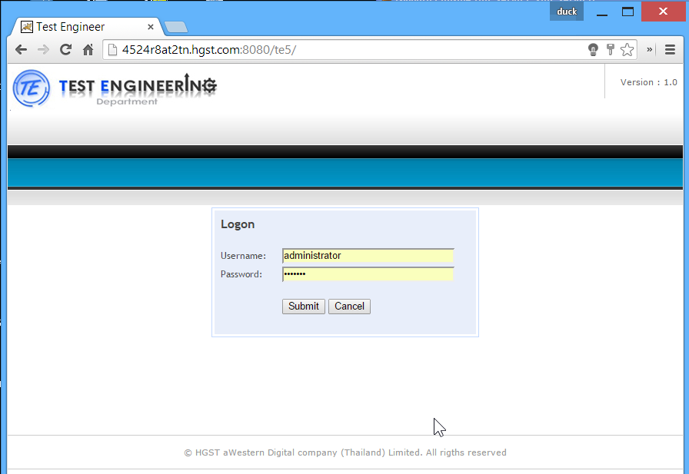
Manual User guide.
Host name : http://4524r8at2tn.hgst.com:8080/te5/
User name : administrator
Password : zaq1wsx
Home

Slide 4
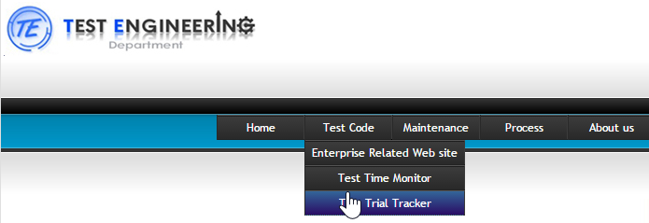
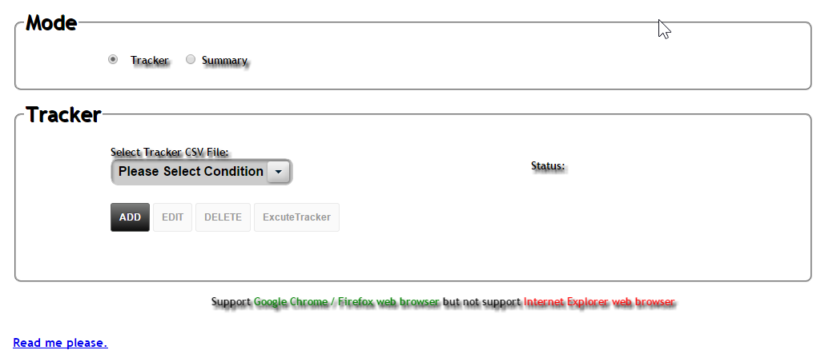
Home page of Trial tracker system.
1
2
3
Tracker Subject selection
Action button
User Guide
Home

Slide 5
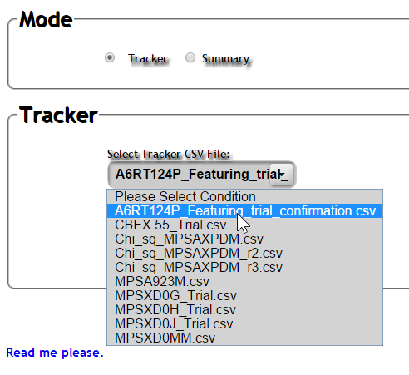
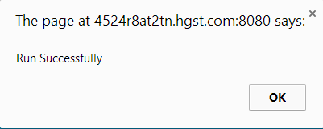
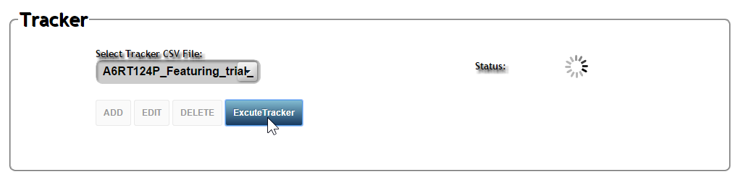
How to execute Tracker ?
Click [Select Tracker CSV file.]
1
Select condition.
2
4
Finish.
3
Click ExecuteTracker.
Home

Slide 6
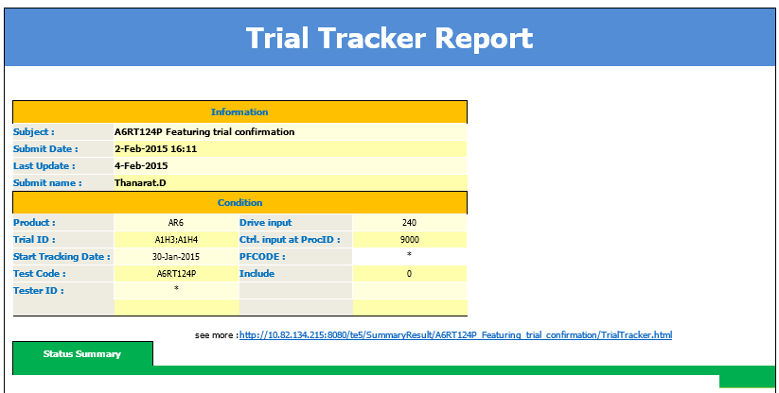
How to execute Tracker ?
Result in your email.
5
Home

Slide 7
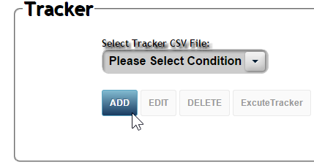
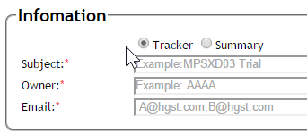
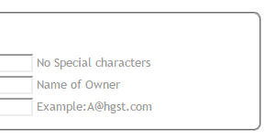
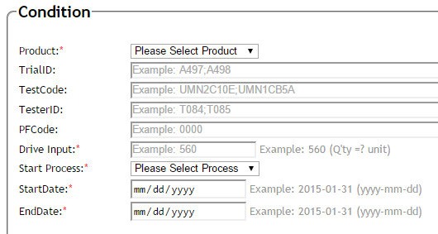
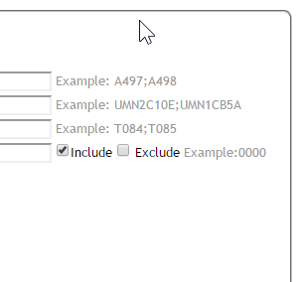
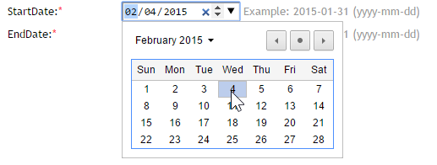

How to create new tracker condition?
Click Tracker
2
1
Click
A@a.com ; B@b.com
Fill Information
3
Fill Condition
Field Date for Google Chrome.
***
Field Date for Firefox.
***
Home

Slide 8
Thank you. Any question please contract Piyanan.K

