Slide 1

Go Fun Go And Run

Slide 2
Introduction
Teenagers today frequently struggle to find a good hangout spot, which leads to canceled plans and unhappiness. In order to assist people in creating hangouts that suit their needs and budget, It takes into account various factors like money, location, and number of people.

Slide 3
What we offer ?
Ducks Row addressed the problem of planning a hangout with friends or alone, taking into account the user's budget and preferences. The method takes into account the following factors:
The amount of money the user has available
The places the user would like to visit
The distance between the places the user would like to visit
The number of people the user is with

Slide 4
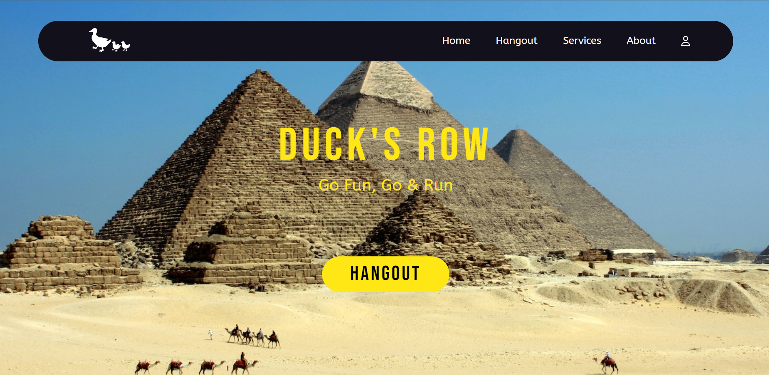
Home Page
The user interface is welcoming and simple to use, which is something we ensure.
The homepage includes a lovely floating navbar with links to the website's primary pages. And a brief of the main website’s features as well as a way to get in touch with the development team

Slide 5
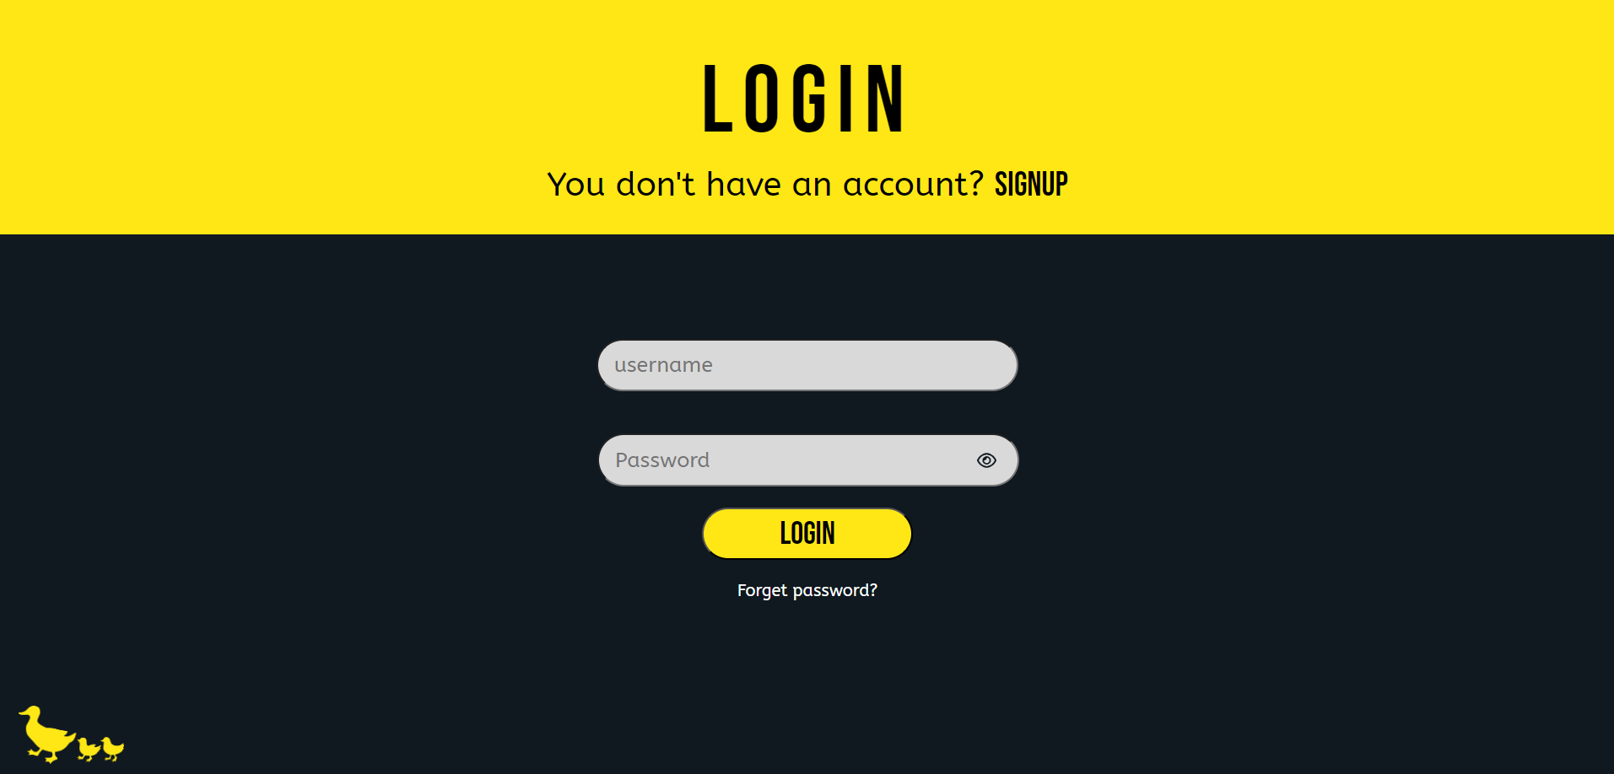
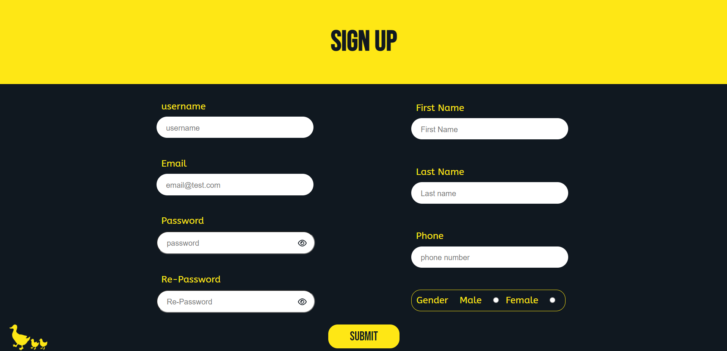
Registration and login form
We created a registration form with the user's basic information. such as his name, gender, or email. For user trust, we additionally created a secured form from the SQL injection and encrypted the password.

Slide 6
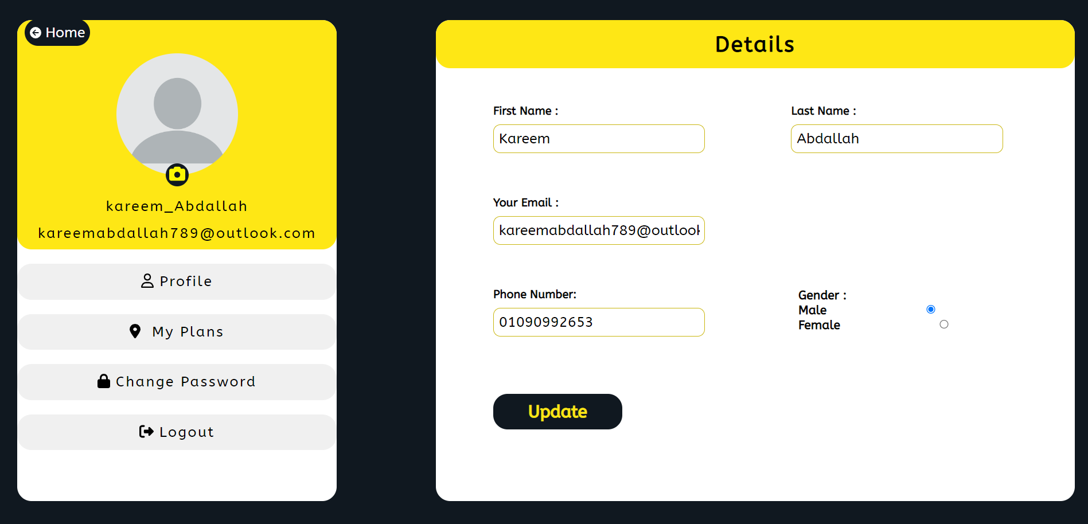
Profile Page
We made a profile page to see your plan that you made and manage your data, put a profile photo, or change your password

Slide 7
Updates!? Sure
The future work of the project includes the following:
Improving the accuracy of the recommendations by incorporating more data about the places the project recommends.
Allowing users to specify more detailed preferences, such as the type of food they would like to eat or the activities they would like to do.
Integrating with transportation apps to provide users with more information about how to get to the places they are planning to visit.

Slide 8
Updates!? Sure
In addition to the above, the project team also plans to explore the following future work:
Developing a mobile app version of the website.
Creating a community forum where users can share their hangout experiences and recommendations.
Partnering with businesses to offer discounts and promotions to users of the website.

Slide 9
Thank You
Kareem Abdallah
Abdallah Gamal
Abdelrahman Ahmed
Abdelrahman Sherif
Omar Eid

