Slide 1

OOP #2

Slide 2


?

Slide 3
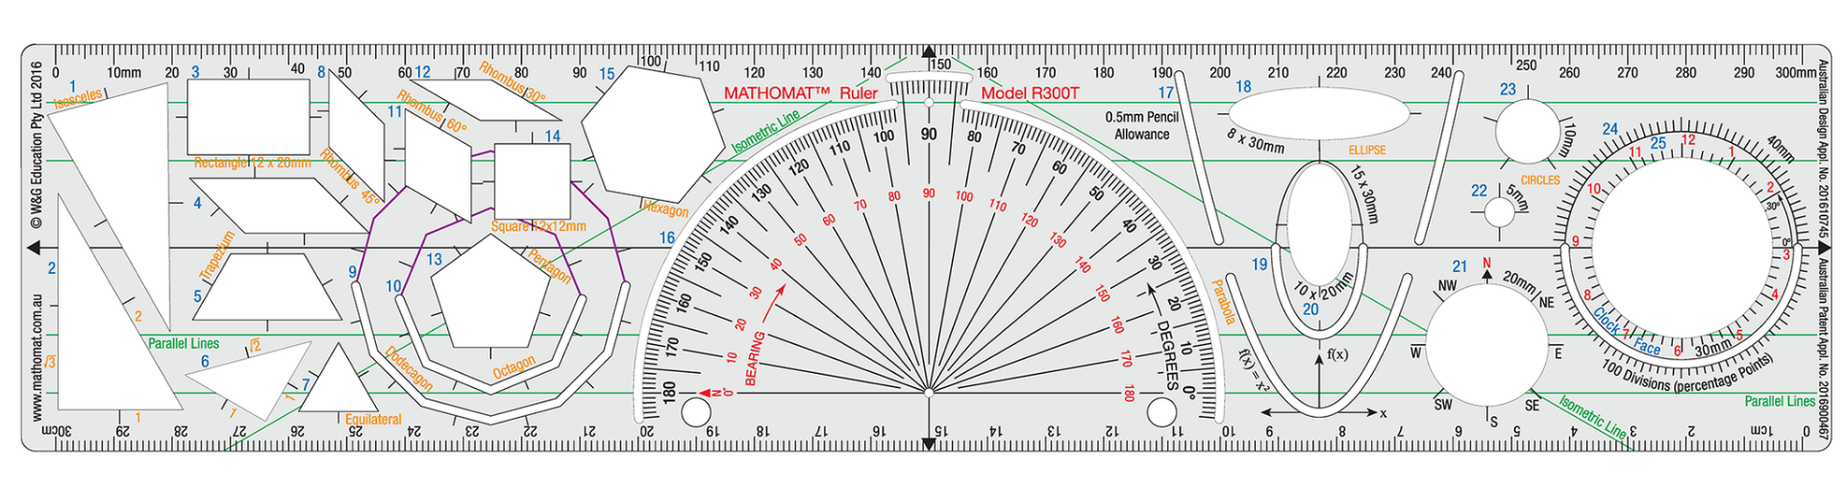
Template --> Instance
Class --> Object

Slide 4
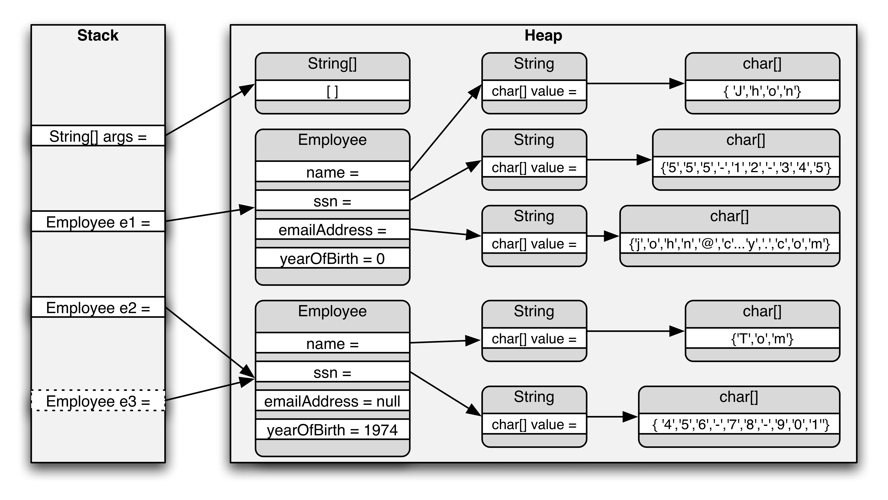

Slide 5



Slide 6
class Duck
{
string _name;
Duck(string name)
{
_name = name;
}
}
Field
Constructor
var duck = new Duck("Quack the great")

Slide 7
class Duck
{
private string _name;
public Duck(string name)
{
_name = name;
}
}
Black box
White box

Slide 8
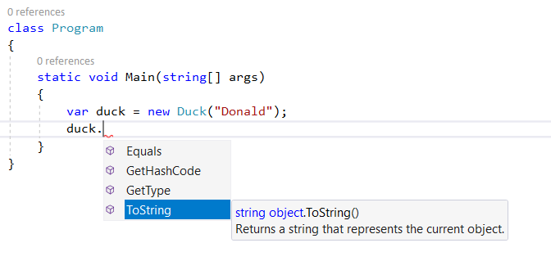
Public contract

Slide 9
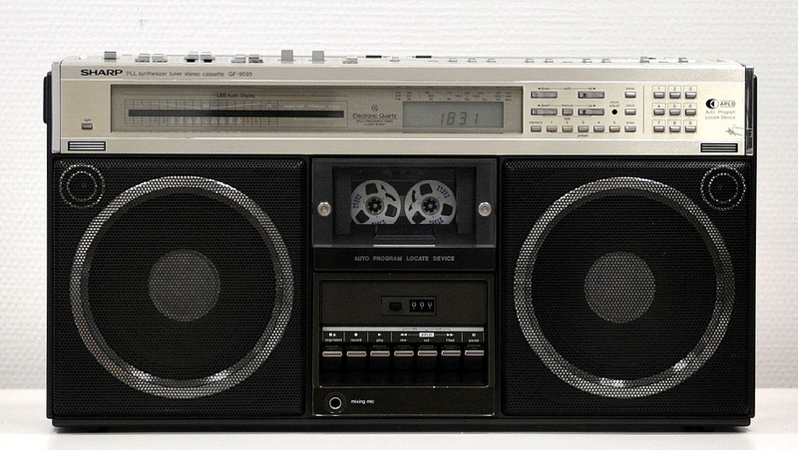

Slide 10
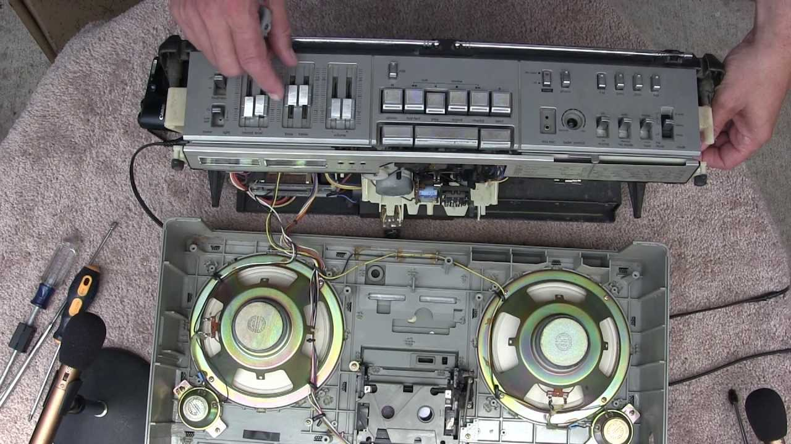

Slide 11
public class Duck
{
private string _name;
public Duck(string name)
{
_name = name;
}
public string GetName()
{
return _name;
}
public void SetName(string name)
{
_name = name;
}
}
Method
Method

Slide 12
public class Duck
{
private string _firstName;
private string _lastName;
public Duck(string firstName, string lastName)
{
_firstName = firstName;
_lastName = lastName;
}
public string FullName
{
get
{
return _firstName + " " + _lastName;
}
}
}
Property

Slide 13
public class Duck
{
public string FirstName { get; set; }
public string LastName { get; set; }
public string FullName
{
get
{
return FirstName + " " + LastName;
}
}
}
var duck = new Duck();
duck.FirstName = "Donald";
duck.LastName = "Trump";

Slide 14
public class Duck
{
public string FirstName { get; set; }
public string LastName { get; set; }
public string FullName
{
get
{
return FirstName + " " + FirstName;
}
}
}
static void WhatsMyName()
{
var duck = new Duck();
var DucK = new Duck();
var dUCk = duck;
duck.FirstName = "Donald";
DucK.LastName = "Trump";
duck.FirstName = "Don";
DucK.LastName = "Rump";
DucK.LastName = dUCk.FirstName;
duck = dUCk;
dUCk = new Duck();
dUCk.LastName = "Duke";
DucK.FirstName = "Rambo";
dUCk.LastName = "McDuck";
duck.LastName = dUCk.FirstName;
Console.WriteLine(duck.FullName);
}

