Slide 1

ReSTLess
Macro-Social Turn in Labour Market Inequality: An Open Database and A Toolkit of Unpaid Labour
Kick-off Meeting, 12th November 2025
Valeria Pulignano (PI), Milena Franke (Post-Doc), Bart Meuleman (PI-collaborator)
KU Leuven – Centre for Sociological Research

Slide 2

Objective
To enable ERC-funded ideas to progress on the path from ground-breaking research towards innovation.

Slide 3
Objective
ERC PoC ReSTLess (2025-2027) establishes a clear pathway from research (ERC AdG ResPectMe 2019-2025) to innovation by instigating a ‘macro-social turn’ on labour market inequality due to unpaid labour

Slide 4
Two stages
To harness the utility of the ResPecTMe unpaid labour survey module along time, material, immaterial dimensions which caters to;
  Eurofound & ILO by an Open cross-national harmonised database along 3 dimensions;
  Eurofound & ILO & ETUI (Research) by policy recommendations based upon the monitoring of shifts in labour market inequality due to unpaid labour;
To develop a Toolkit of unpaid labour will cater to:
  ETUI, to train unions, workers representatives on bargaining about working time reduction.
  SOLIDAR to empower workers by raising awareness on unpaid labour across formal/informal work settings

Slide 5
From Ground-breaking Research towards Innovation: What & Whom
Objective 1: Open Database
To develop the Open harmonised cross-national database (OD) based upon the time, material, immaterial dimensions of the survey module of unpaid labour.
Objective 2: Macro-social turn
To analyse socio-demographic, occupational differences at individual level of unpaid dimensions & connect those to macro-level labour market, welfare variables per studied country.
Objective 3: Toolkit
To create a Toolkit of unpaid labour consisting of train-the-trainer materials & learning nuggets. (animated video, audio, text) on unpaid labour time & relationship with work-life conflict;
Objective 4: Knowledge transfer & innovation
To transfer knowledge from OD to useful policy (recommendations) and innovation (toolkit) by involving end-users into the testing & validation phases.
End Users: Eurofound & ILO;
Possible: ETUI (Research) & Leeds University
End Users: ETUI (Education/Research), SOLIDAR; Possible: Eurofound, ILO

Slide 6
Eurofound & ILO involvement
Making the database open & survey module ready to be deployed (Month 1-7) & Technical Report (TR) & Policy Report (M5-12)
Developing the harmonised cross-national database (KU Leuven) (M1-6)
Making the database open and available (Eurofound & ILO through data repository archive, e.g., UK data service, Gesis, Sodha or website) (M6-7)
Developing the multi-group LC analysis (macro social turn) (KU Leuven) (M7-12)
Developing & Making publicly open the methodologies (i.e., Technical report) & survey module through website, publication, webinars (KUL with Eurofound (webinar TR)/ILO) (M8-12)
Developing Policy report on macro social turn to disseminate to stakeholders (KU Leuven with ILO (webinar or workshop)/Eurofound) (M5-12)
Objective 1: Open Database
To develop the Open harmonised cross-national database (OD) based upon the time, material, immaterial dimensions of the survey module of unpaid labour.
Objective 2: Macro-social turn
To analyse socio-demographic, occupational differences at individual level of unpaid dimensions & connect those to macro-level labour market, welfare variables per studied country.
End Users: Eurofound & ILO

Slide 7
ETUI (Education/Research), SOLIDAR
Objective 3: Toolkit
To create a Toolkit of unpaid labour consisting of train-the-trainer materials & learning nuggets. (animated video, audio, text) on unpaid labour time & relationship with work-life conflict;
Objective 4: Knowledge transfer & innovation
To transfer knowledge from OD to useful policy (recommendations) and innovation (toolkit) by involving end-users into the testing & validation phases.
Develop the train-the-trainer as part of the Toolkit (Month 9-12) & Learning Nuggets (Month 12-15)
Developing a Toolkit (train-the-trainer materials - text/brochure - & learning nuggets of unpaid labour), multi-group LC analysis; (KU Leuven with ETUI, SOLIDAR) (M8-12)
Developing Learning Nuggets (KU Leuven with SOLIDAR who will make sure LN reach a broad range of workers in formal/informal work settings) (M12-15)
End Users: ETUI (Education/Research), SOLIDAR

Slide 8
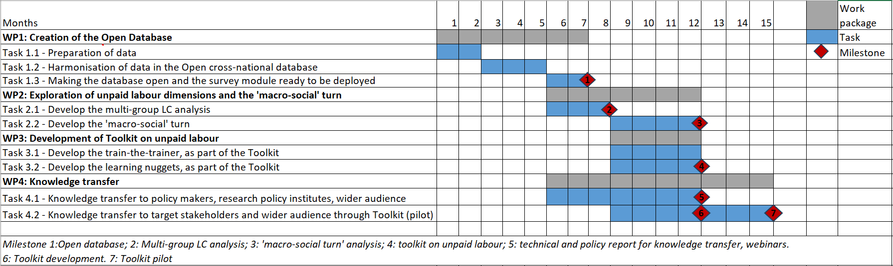
The process: What, When, How

Slide 9
Technical report to the open database
Open database: measurement of unpaid labour, socio-demographic and job-related characteristics, and related variables (work-life balance, feeling stigmatized…) across countries (FR, SE, NL, UK)
Technical report:
  Methods: survey development, sampling, ethical considerations
  Detailed codebook
  Validation of the measurement of unpaid labour (different dimensions)
Technical report ResPectMe: https://zenodo.org/records/15180621

Slide 10
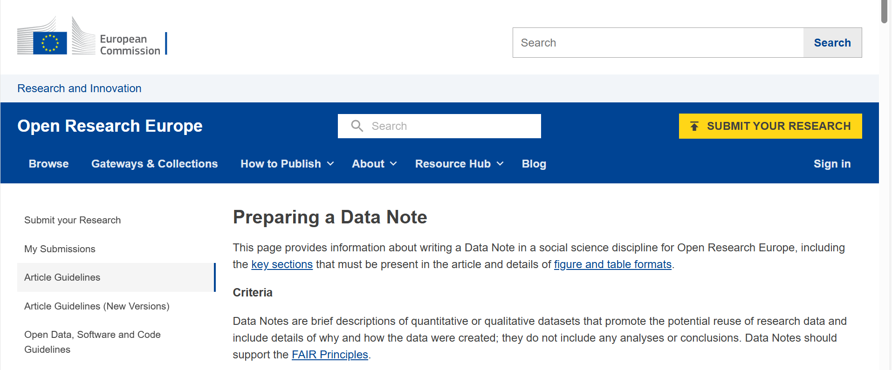
Technical report to the open database
Data not to be published via Open Research Europe
https://open-research-europe.ec.europa.eu/for-authors/article-guidelines/social-sciences/data-notes

Slide 11
Unpaid Labour Dimensions
Unpaid Time
Waiting
Communication
Administrative work
Traveling
Maintenance
Networking
Preparation
Training
Unpaid Material
Transportation
Safety equipment
Clothing/ accessories Computer
Phone
Internet
Gifts or rewards for clients
Working space
Unpaid Immaterial
Expressing untrue feelings
Pretending feelings
Hiding true feelings
Express feelings to others (customers/ employers/ colleagues)
Notes:
Unpaid time – latent class analysis done
Class 1 ‘no unpaid tasks’ 79% of sample
Class 2 ‘partially unpaid tasks’ 11,35% of sample
Class 3 ‘unpaid tasks’ 9,65% of sample
Emotional labour → principal Component Analysis shows 1 component (Cronbach’s alpha 0,815)
Emotional labour – factor analysis done

Slide 12
ResPecTMe survey module & EWCS
Work intensification & Work extensification (Unpaid Time & Effort) & Unpaid Tasks
More Items in ResPecTMe survey module TBD relevance for EWCS
  Emotional labour
  Motives to do unpaid labour: punishment/ future reward
  Recognition of work
Notes:
We also include unpaid overtime, next to tasks
Unpaid tasks: potential to explore linkages with technology and job automation or with competences/ skills (in EWCS)
Emotional labour: EWCS also contains a question on ‘your job requires you to hide your feelings’ → Respectme includes more items
Motives:
1. Unpaid work is part of my job
2. There is no one to perform the tasks for my job instead of me
3. Doing unpaid work can help with my career (e.g., promotion, increase in wage, bonus, finding a better job, etc.)
4. Doing unpaid work is seen favourably by colleagues, clients, or employers
5. Doing unpaid work is an act of care or kindness towards people I work with (e.g., colleagues, clients)
6. Not doing unpaid work would make me feel guilty
7. Not doing unpaid work is seen badly by colleagues, clients, or employers
8. Not doing unpaid work might harm my career (e.g., promotion, finding better job in the future, wage, losing clients)
Recognition:
Already in EWCS:
Question on discrimination
you have the feeling of doing useful work
your job gives you the feeling of work well done
In Respectme:
1. My job gives me the feeling of work well done
2. I feel like I do useful work
3. I feel like my job is being recognized
4. I feel appreciated in society because of my job
5. Considering all my efforts and achievements in my job, I feel I get paid appropriately
6. My job offers good prospects for career advancement
7. I might lose my job in the next 6 months
8. If I were to lose or quit my current job, it would be easy for me to find a job of a similar salary
Others think less of people in a similar job to mine
People who work in a similar job to mine feel we’re not as good as others
Others discriminate against me because of my job

Slide 13
Q&A – Phase 1: Eurofound/ILO
  ACTIVITIES
  Making the database open and available (Eurofound & ILO through data repository archive, e.g., UK data service, Gesis, Sodha or website) (M6-7)
  Developing & Making publicly open the methodologies (i.e., Technical report) & survey module through website, publication, webinars (KUL with Eurofound (webinar TR)/ILO) (M8-12)
  Developing a Policy report on macro social turn to disseminate to stakeholders (KU Leuven with ILO (webinar or workshop)/Eurofound) (M5-12)
Q&A
Harmonized cross-national database (March-April 2026),
  Country specific variables (e.g., educational level) & variables which cannot be harmonized (e.g., they are not included due to survey limitations)
  Format & technicalities
Webinars/workshops
  When and how

Slide 14
Q&A – Phase 2: ETUI (Education)/SOLIDAR
  ACTIVITIES
  Developing a Toolkit (train-the-trainer materials - text/brochure - & learning nuggets of unpaid labour), multi-group LC analysis; (KU Leuven with ETUI, SOLIDAR) (M8-12)
  Developing Learning Nuggets (KU Leuven with SOLIDAR who will make sure LN reach a broad range of workers in formal/informal work settings) (M12-15)
Q&A
  Working methods Toolkit (train-the-trainer) & dissemination training representatives – How
  Dissemination (learning nuggets) – How

