Slide 1
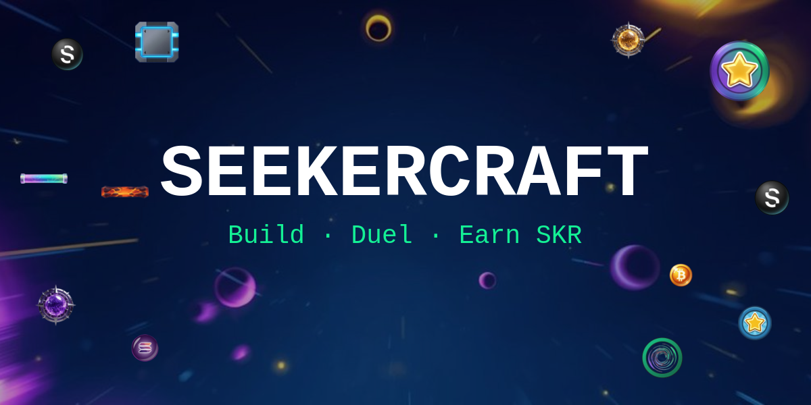
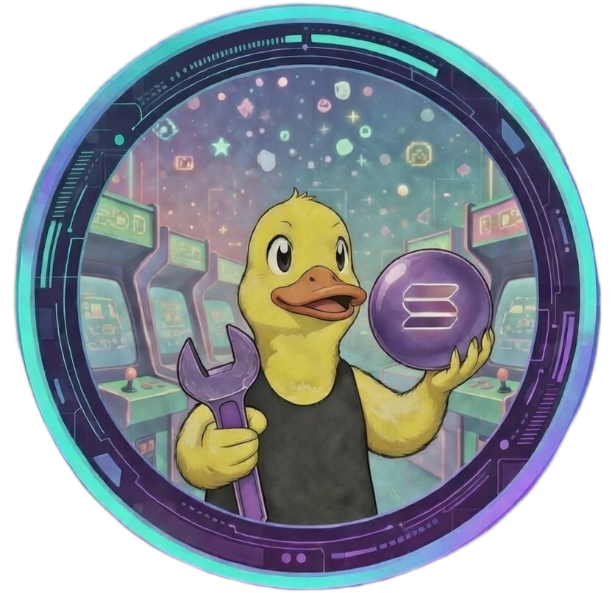
SEEKERCRAFT
Shoot. Build. Conquer.
A Peggle-style physics game built natively for Solana Mobile
with full SKR token integration & on-chain payments.
Solana Mobile | Expo / React Native | Firebase Realtime DB | SKR Token | 60fps Worklet Physics

Slide 2
THE PROBLEM
Mobile gaming on Solana is missing something real
Games are built for devs, not players
No tools for community content
Most crypto games funnel rewards back to the dev.
The community that plays and creates sees little benefit.
Mobile crypto gaming has no real way for players
to create, share, and monetize their own levels.
No real player-to-player competition
SKR token has no gaming home
No ranked duels, no shared challenges, no social layer.
Players exist in isolation with nothing to compete for.
No fun, casual way to use SKR on Seeker.
Token utility stays theoretical rather than playful.

Slide 3




THE SOLUTION
SeekerCraft: every interaction is Solana-native
PLAY
BUILD
COMPETE
EARN
TIP
Addictive Peggle-style
ball physics
Create & publish levels
for the community
PvP duels with
on-chain score submission
160+ achievements
with on-chain unlocks
Reward creators
with SKR tokens (90%)

Slide 4
HOW IT WORKS
Simple to pick up, deep to master
1
Connect Wallet
2
Aim & Shoot
3
Hit Gold Pegs
Tap to connect your Solana wallet
via Mobile Wallet Adapter
Drag to aim, release to fire
your ball into the peg grid
Clear all golden SKR pegs
to win the level
4
Use Power-Ups
5
Epic Slow-Mo
6
Score & Rank
Multiball, Fireball, Slow Bucket,
Long Shot, Vortex
Cinematic zoom on the last
SKR peg, Peggle 2 style
Build combos up to 10x,
climb the global leaderboard

Slide 5

KEY FEATURES
LEVEL EDITOR
COMMUNITY
• 12x16 grid with 7 unique peg types
• Browse & play other players' levels
• Curves, vortexes, teleporters, moving walls
• Rate levels 1-5 stars with live feed
• 10 SKR upload fee to reduce spam
• Global leaderboard (all-time + weekly)
• Cloud sync: edit offline, publish anytime
• Real-time activity & donation feed
PVP DUELS
160+ ACHIEVEMENTS
• Challenge any player on the leaderboard
• 7 categories: Player, Score, Creator, Duel...
• Both play same level, highest score wins
• On-chain unlock for 0.50 SOL (permanent)
• On-chain score submission via Firebase
• Rarity tiers: Common, Rare, Epic, Legendary
• Win/Draw/Loss record tracked per player
• Donation & Social milestones included

Slide 6

SKR TOKEN INTEGRATION
SeekerCraft deeply integrates the SKR (Seeker) token
DONATIONS
ON-CHAIN TX
GAME REWARDS
• Tip level creators with SKR tokens
• SPL token transfers via MWA
• Golden SKR pegs = win condition
• 90% goes to creator / 10% dev fund
• Auto-creates Associated Token Accounts
• SKR balance shown in rankings
• Preset amounts: $0.50 / $5 / $15
• Real-time SKR balance checks
• Donation milestones unlock achievements
• Custom SKR amount supported
• Full TX preview before signing
• 10 SKR upload fee to reduce spam

Slide 7
TECH STACK
Mobile-native, production-ready architecture
FRONTEND
RENDERING
Expo / React Native (expo-router)
@shopify/react-native-skia, Canvas GPU rendering
PHYSICS
WALLET
react-native-reanimated worklets, 60fps, no JS bridge
@solana-mobile/mobile-wallet-adapter-protocol-web3js
BLOCKCHAIN
BACKEND
@solana/web3.js + @solana/spl-token, SOL and SPL transfers
Firebase Realtime Database: levels, scores, activity, duels
AUDIO
SECURITY
expo-audio: 5 music tracks + 8 SFX, fever music system
dotenv + expo-constants, zero hardcoded keys in source
All on-chain: SOL transfers | SKR SPL transfers | ComputeBudgetProgram priority fees | Full MWA authorize / sign / confirm

Slide 8
MOBILE-FIRST DESIGN
Built exclusively for Seeker / Solana Mobile
Touch Controls
7 Languages
Drag to aim, release to fire. Zero buttons needed.
EN / FR / DE / ES / ZH / JA / KO, fully localized
Haptic Feedback
Neon Visual FX
Every peg hit, combo, achievement triggers vibration
Sparkle particles, screen shake, combo overlays, confetti
Portrait UI
Offline + Cloud
Candy Crush style, fully optimized for one-hand play
Edit levels offline, auto-sync to Firebase on publish
Cinematic Slow-Mo
4 Music Tracks
Peggle 2-style zoom on the last golden SKR peg
Alternating BGM with fever mode & ding combo system

Slide 9
TRACTION & NUMBERS
Built by a solo developer in ~3 months
160+
7
Achievements
across 7 categories
Peg types + curves
+ teleporters + walls
8
5
Sound effects +
5 music tracks
Power-up types:
Multiball, Fireball...
7
1
Languages
fully supported
Solo developer
~3 months to ship

Slide 10
ROADMAP
Q1 2026 [ NOW ]
Q2 2026
Q3 2026
Q4 2026
• Hackathon submission
• Tournament mode
• Multiplayer real-time mode
• DAO governance
• Solana dApp Store listing
• Level packs (curated collections)
• NFT level ownership
• Creator monetization dashboard
• Community beta launch
• Enhanced SKR rewards system
• Cross-platform web version
• Seasonal events & limited achievements

Slide 11
TEAM
DuckerForge
Solo Developer & Game Designer
Full-stack mobile developer specializing in
React Native, Solana, and game physics.
github.com/DuckerForge | X: @SeekerCraftApp

Slide 12
SeekerCraft brings real gaming to Solana Mobile.
Play. Build. Compete. Earn. Tip.
All on-chain. All on Seeker.
github.com/DuckerForge/SeekerCraftApp

