Slide 1
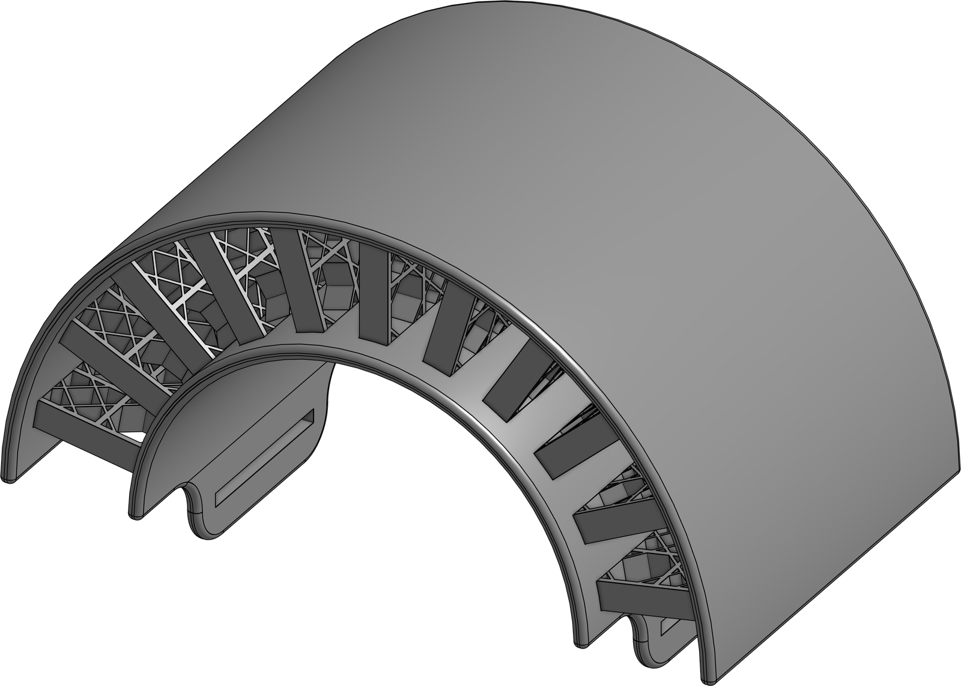



Teaching Armor to Feel Its Own Damage
VBR RESEARCH CAMP 2026
Bio-inspired, self-sensing 3D-printed armor
Lattices modeled on the deep-sea glass sponge and the mantis shrimp, printed in conductive carbon-black PLA and TPU.
VBR Mechanical Engineering Team · Emmet, Raina, Jayden, Jaycen & Peggy

Slide 2

Dr. Yang Yang & the Yang Lab
MEET OUR MENTOR
BACKGROUND
Ph.D. in Physics & Bioengineering, Wuhan University and UCLA (2015)
Postdoc at the USC Center for Advanced Manufacturing
75+ peer-reviewed papers, including Science Advances and Nature Communications
RECENT AWARDS
NSF CAREER Award (2025)
ASME Rising Star in Mechanical Engineering (2025)
SME Outstanding Young Manufacturing Engineer (2022)
THE LAB · BIOINSPIRED 3D PRINTING
Bioinspired structures
Nacre, lobster-claw and cuttlebone-inspired armor
Robotics & wearables
Star-nose-inspired stretchable skin sensors
Biomedical
3D-printed bone implants, painless microneedles
Environmental
Water-repelling surfaces inspired by Salvinia leaves
Dr. Yang Yang
Associate Professor of Mechanical Engineering, San Diego State University
Where our project comes from: the lab's nacre-inspired 3D-printed armor that senses its own damage (Yang et al., Science Advances, 2019)

Slide 3
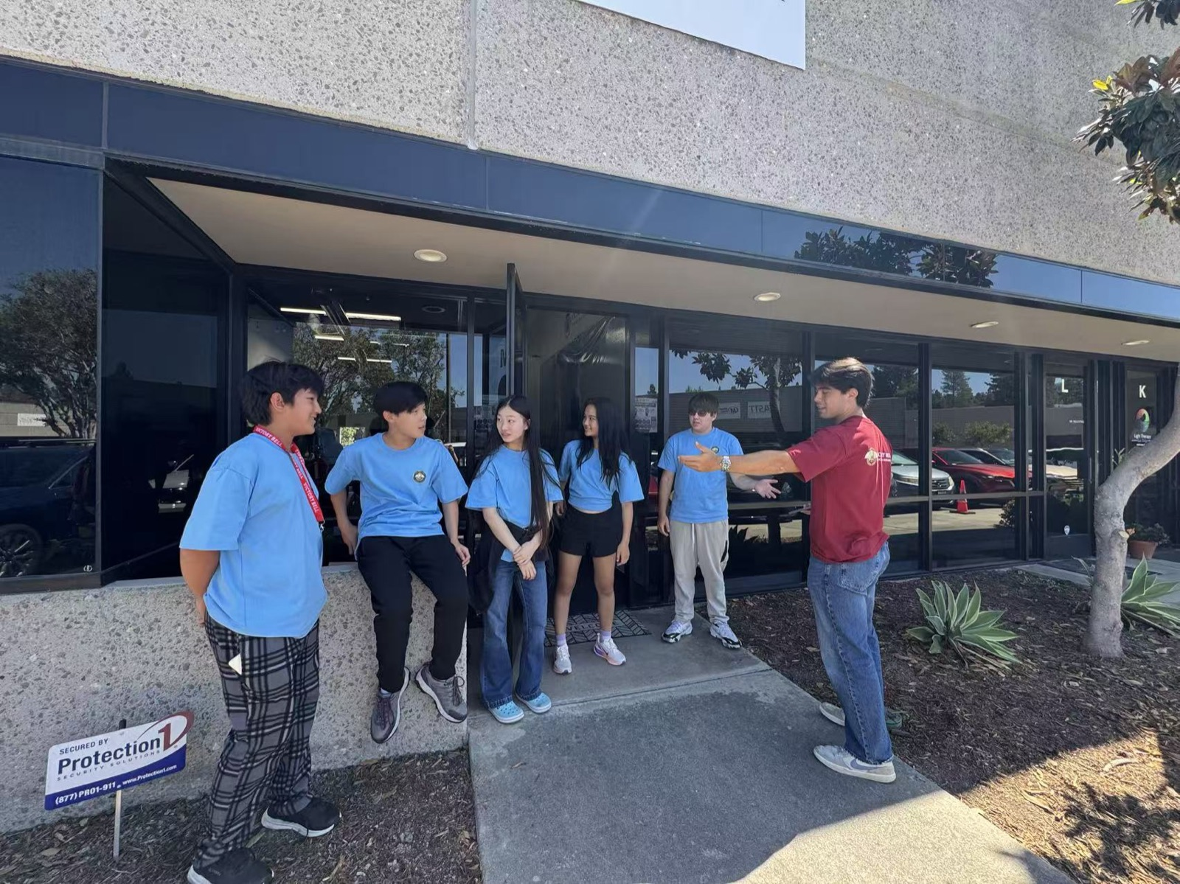
Meet the Team
THE RESEARCHERS
VBR MECHANICAL ENGINEERING TEAM
Emmet
Raina
Jayden
Jaycen
Peggy
Teaching assistant: Preston
HOW WE WORKED
Everyone designed, printed, tested and wrote
Roles rotated: experiments, data, analysis, slides
Daily check-ins with Dr. Yang and our TA

Slide 4
What We'll Cover
ROADMAP
02
04
01
03
Design Process & Methods
Conclusion & Takeaways
Research & Ideas
Testing & Results
CAD, 3D printing and the test rig
Lessons, real-world uses and what’s next
The problem, piezoresistance and nature’s designs
Four rounds of crush tests, simulations and the shrimp arches

Slide 5
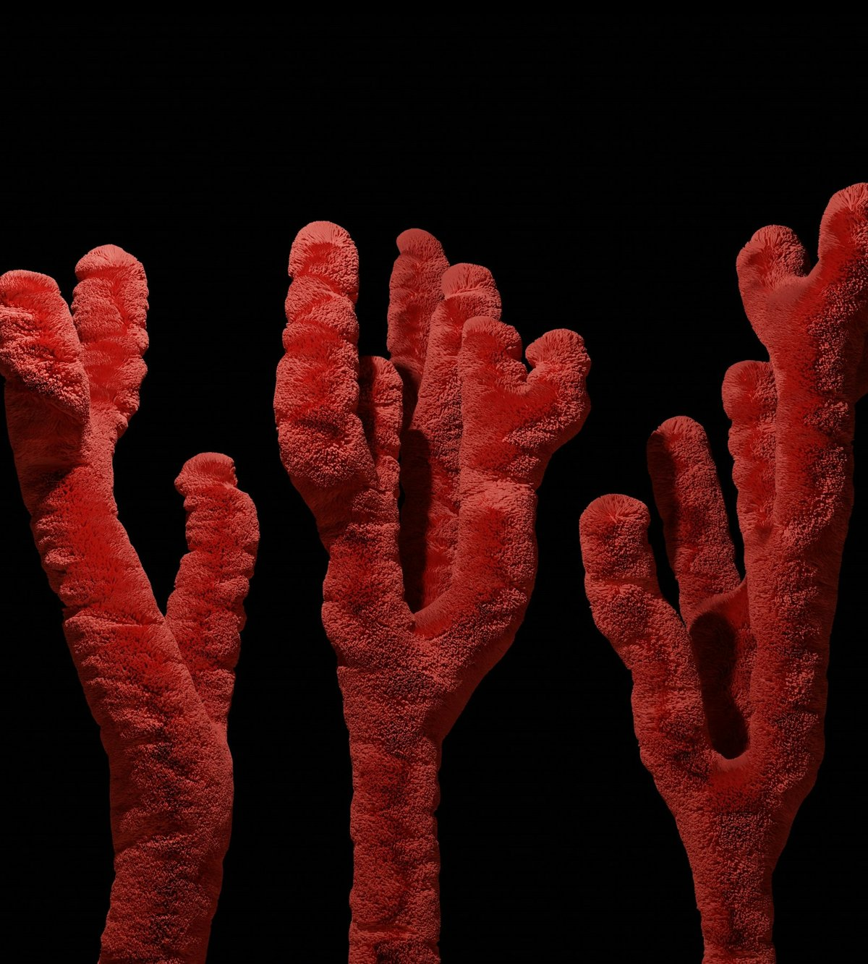
Research & Ideas
01
The problem: hidden damage
How plastic can sense
Nature’s blueprints
Why armor needs to feel, and what nature taught us
Photo: Yassine Ait Tahit / Unsplash

Slide 6
Hidden Damage
THE PROBLEM
Today's armor (Kevlar, Dyneema)
Excellent against bullets, weaker against large impacts
Repeated hits cause internal micro-cracks
Damage is often invisible from the outside
Inspection needs infrared thermography or acoustic emission: large, costly equipment
Self-sensing armor
The armor itself is the sensor
Cracks change its electrical resistance
Can be read with a simple multimeter
3D printed, so it can be customized to the wearer
Can we build armor whose electrical signal reveals how much damage it has absorbed?

Slide 7
How Can Plastic Feel?
PIEZORESISTANCE
Conductive filament is plastic loaded with carbon-black particles. Touching particles form a network of tiny electrical pathways.
Intact: pathways connected
Cracked: pathways broken
load
multimeter
multimeter
Low resistance
Resistance RISES ▲
carbon-black particle
electric current path
Like a city's road grid: close a few streets (cracks) and traffic (current) must detour. Longer detours mean higher resistance.

Slide 8
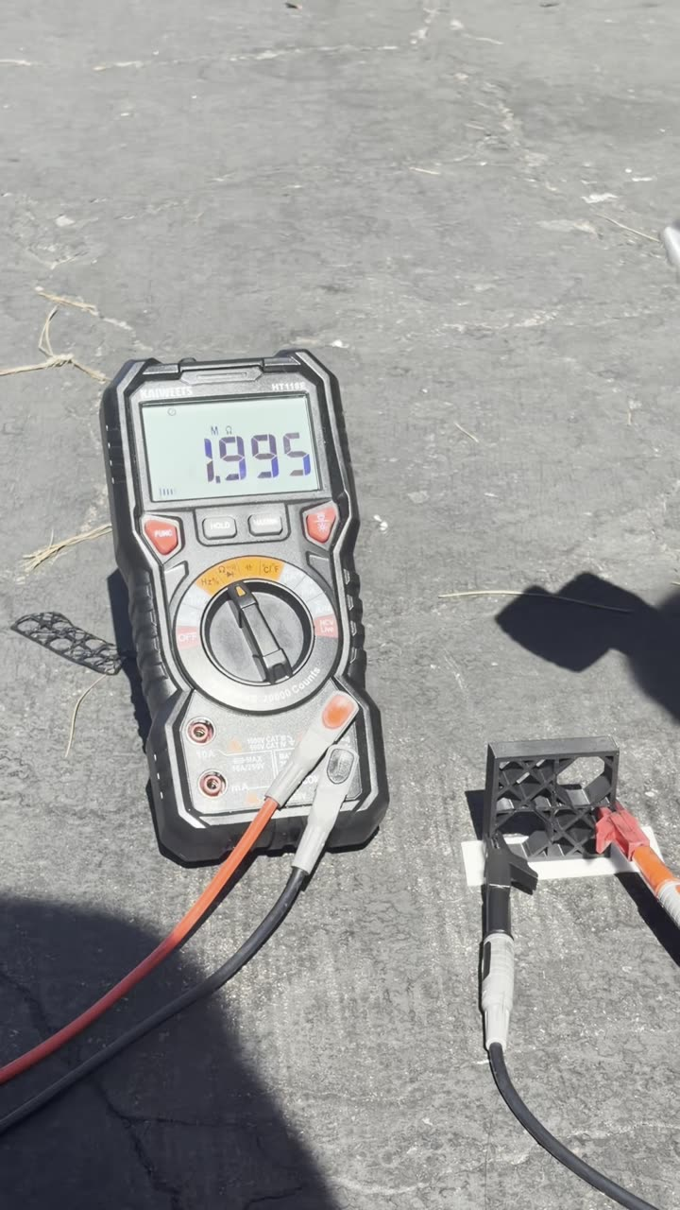
Seeing It Happen
LIVE DEMO
A printed lattice, a multimeter and a hammer
Each strike cracks more of the carbon pathways inside the lattice
The meter reading climbs from about 2.0 to 4.2, roughly doubling
No lab equipment: just the printed part, two clips and a meter
That climbing number is the whole idea: the damage shows up as resistance.

Slide 9
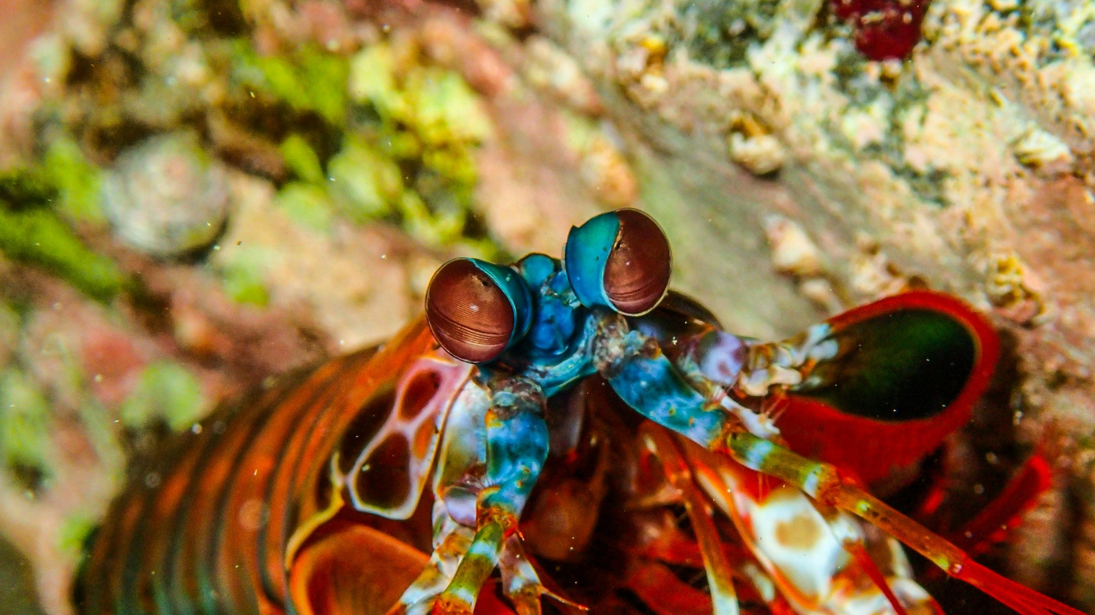
The Mantis Shrimp
NATURE'S IMPACT EXPERT
Its hammer-shaped club strikes at up to 23 m/s, hard enough to crack snail shells, and survives thousands of blows without shattering.
It inspired our flexible, arched TPU designs.
Photo: Nichika Sakurai / Unsplash

Slide 10
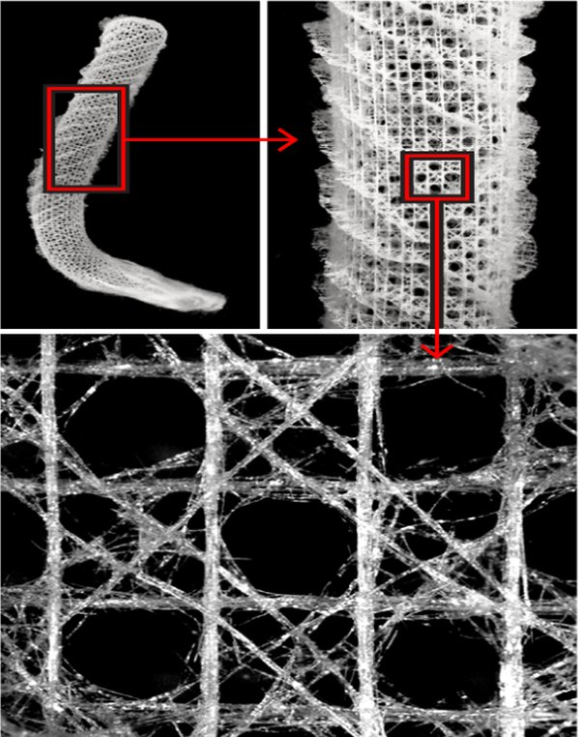
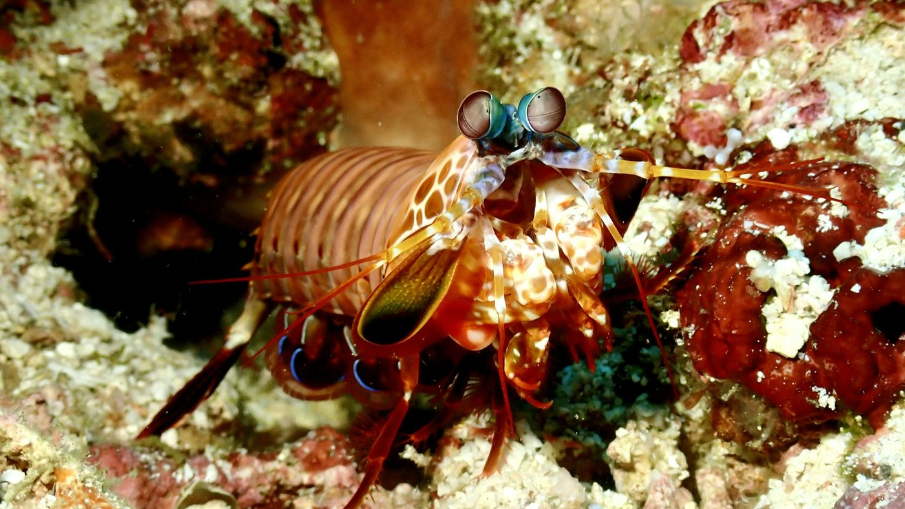
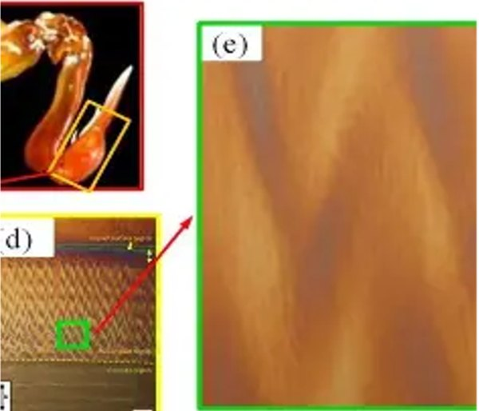
Borrowing From Nature
NATURE'S BLUEPRINTS
Glass sponge
Nature
Bioinspired
Mantis shrimp club
Photo: Claus Giering / Unsplash
Deep-sea glass sponge → rigid lattice with diagonal cross-bracing
Mantis shrimp dactyl club → arched, energy-absorbing “bumps”
Natural-structure images as reproduced in the paper from the cited literature.

Slide 11
Two Materials, Two Jobs
CONDUCTIVE FILAMENTS
Both filaments conduct electricity, but they behave very differently under load.
CB-PLA
Rigid · carbon-black polylactic acid
Higher conductivity and stiffness
Cracks show up as resistance changes
Used for the glass sponge lattices
CB-TPU
Flexible · carbon-black thermoplastic polyurethane
Bends and springs back
Absorbs shock and vibration
Used for the mantis shrimp arches
Rigid layers to sense damage, flexible layers to soak up impact.

Slide 12
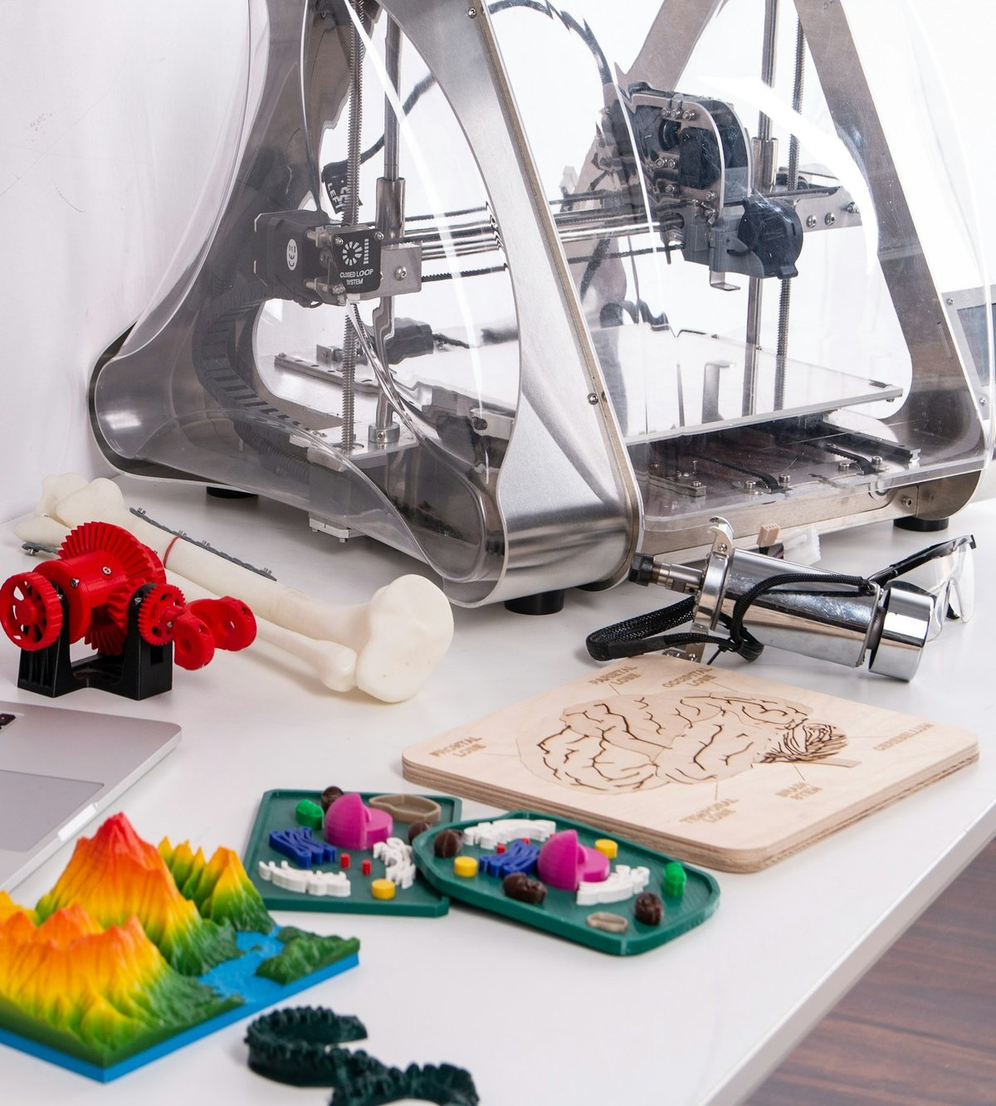
Design Process & Methods
02
Designing the models
From CAD to printed part
The compression rig
From CAD models to conductive prints and a test rig
Photo: ZMorph All-in-One 3D Printers / Unsplash

Slide 13
Designing the Models
ONSHAPE CAD
Global variables let us change strut thickness and cell spacing without redrawing.
One bump
Two bumps
3 × 4 grid
Sponge · 1.0 mm
Sponge · 1.5 mm
Three bumps
Four bumps
Five bumps
Control grid
3 × 4 grid · 44 × 44 × 5 mm · 2.0 mm walls
Glass sponge
Same footprint plus diagonal cross-bracing
Mantis shrimp
1 to 5 swept arches · 25 × 15 × 5 mm

Slide 14
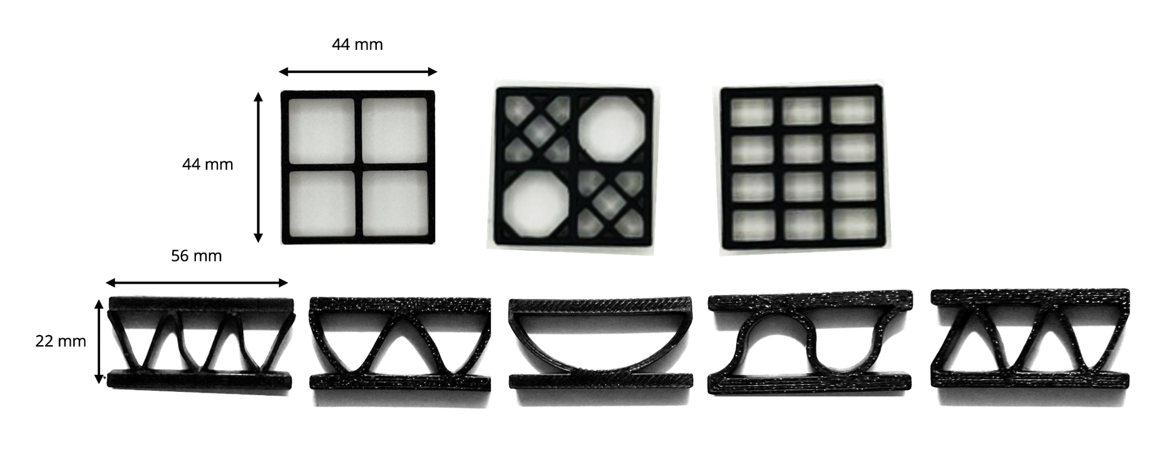
From CAD to Printed Part
FABRICATION
PRINT SETTINGS
Bambu Lab A1 and H2C, sliced in Bambu Studio
0.4 mm nozzle, 15% gyroid infill
Horizontal vs. vertical orientation tested
TAMING FLEXIBLE TPU
Kept dry and loaded without the PTFE tube
Idler screws loosened 1.5 turns, filament hand-fed
WHAT WENT WRONG
Stringing on small features
0.75 mm lattice was too fine for the nozzle: only the frame printed

Slide 15
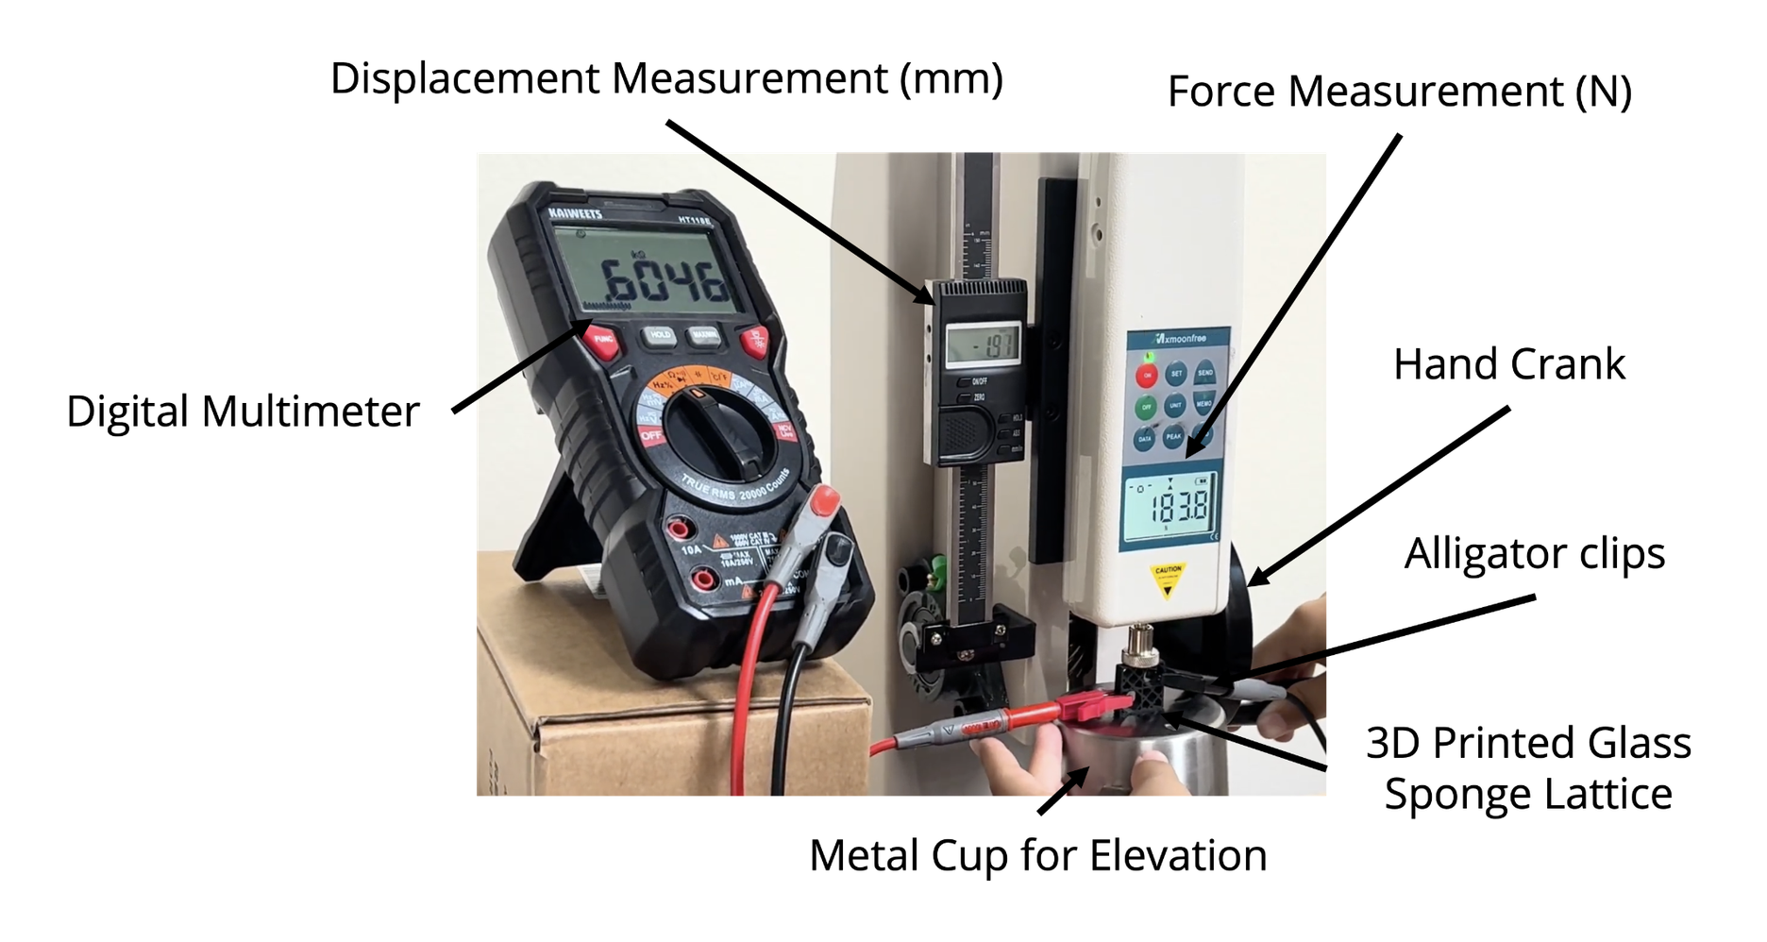
Squeeze and Measure
THE TEST RIG
THE RIG
Hand-cranked stand with a 500 N force gauge
16 mm cylindrical tip presses the sample
Digital scale tracks displacement
Multimeter with alligator clips reads resistance
THE METHOD
Every model tested 3 times, results averaged
FreeCAD finite element analysis to predict stress and failure points
Force and resistance are recorded at the same time as each model is crushed.

Slide 16
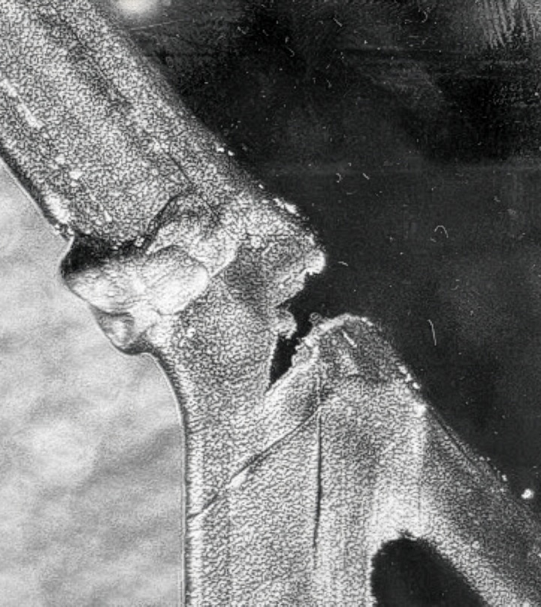
Testing & Results
03
Line thickness and spacing
The final design, ten times
Mantis shrimp arches
Four rounds of crush tests, plus simulations

Slide 17
Four Rounds of Refinement
GLASS SPONGE LATTICE · CB-PLA
Each round kept the winner from the last and changed one variable.
ROUND 1
ROUND 1.5
ROUND 2
ROUND 3
Line thickness
Double-check
Line spacing
Final design
Plain grid vs. 1.0 to 2.5 mm diagonal lines
Added 0.75, 0.9 and 1.25 mm
Offsets from −1.0 to +1.0 mm
1.0 mm lines + 0.5 mm offset, 10 runs + FEA
1.0 mm
1.0 mm
+0.5 mm
425.50 N
456.73 N avg
still on top
493.73 N avg
average peak
Mantis shrimp arches (CB-TPU): 1 to 5 bumps, same 25 × 15 × 5 mm size. Two bumps won at 131.67 N.

Slide 18
Round 1: Line Thickness
RESULTS · GLASS SPONGE LATTICE
1.0 mm diagonal lines were both the strongest and the most sensitive.
1.0 mm: 456.73 N vs. 309.37 N for the plain grid, about 48% stronger
Biggest signal: 0.57 kΩ; thick 2.5 mm lines likely masked the micro-cracks (0.07 kΩ)

Slide 19
Round 1.5: Is 1.0 mm Really Best?
RESULTS · DOUBLE-CHECK
Thinner and in-between lines were added to make sure we hadn’t missed a better option.
1.0 mm stays on top at 456.73 N, with the largest resistance change (0.57 kΩ)
0.75 mm collapsed at 165.7 N: too fine for a 0.4 mm nozzle, so only the outer frame printed

Slide 20
Round 2: Line Spacing
RESULTS · SPACING OFFSETS
Strength and sensitivity pull in opposite directions.
+0.5 mm offset: strongest at 493.73 N, but the smallest resistance change (0.21 kΩ)
+1.0 mm offset: biggest signal at 1.09 kΩ, but wider gaps made weak points (465.40 N)

Slide 21
Round 3: The Final Design
RESULTS · TEN RUNS
1.0 mm lines with a +0.5 mm offset, compressed ten times.
━ 10 individual runs ━ Average
Average curve peaks at 425.50 N; resistance averages a peak of 0.76 kΩ
Ten runs show how much real prints vary, even with identical settings

Slide 22
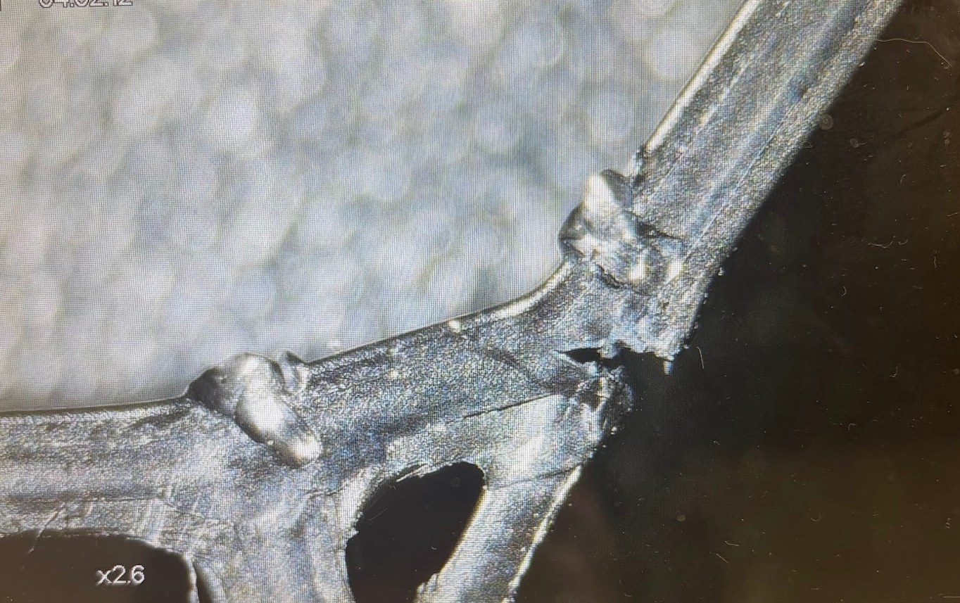
Microscopic Cracks
UNDER THE MICROSCOPE
Hairline cracks form where struts meet
Under stress, cracks form, some invisible to the naked eye. Each one breaks part of the carbon network, which is what shifts the resistance.
Magnified ×2.6. The circle marks a crack at a joint.
3 mm

Slide 23
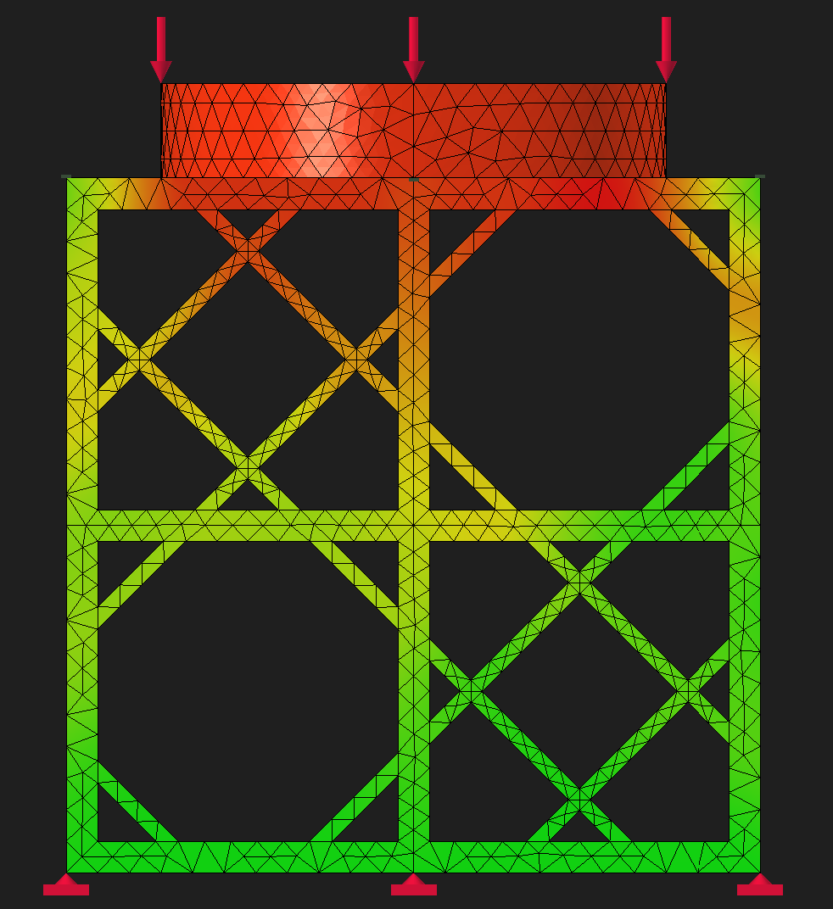
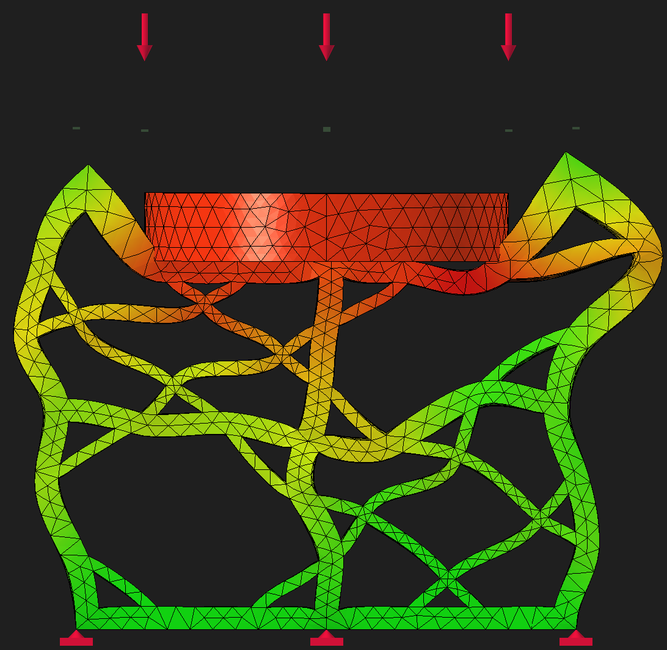
Simulating the Load
FINITE ELEMENT ANALYSIS · GLASS SPONGE
500 N static load
FreeCAD simulation of the final design, pressed through a 16 mm head to match the real rig. Before loading (left) and fully loaded (right).
16 mm
22 mm
Simulated deformation was compared with what we saw in the physical tests.
0%
100%

Slide 24
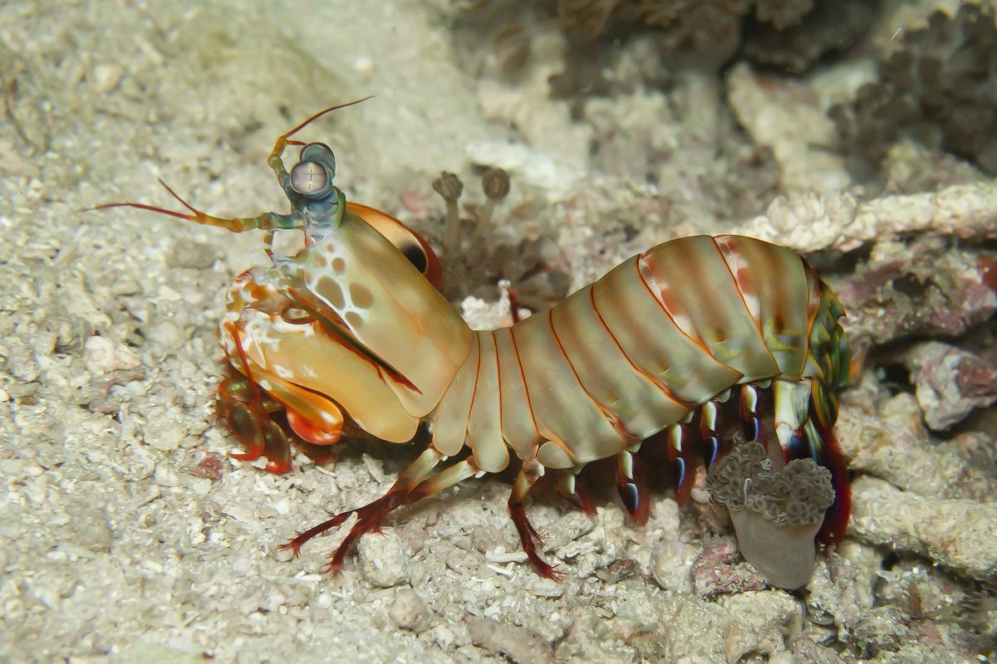
The Mantis Shrimp Arches
RESULTS · CB-TPU
In flexible TPU, two wide arches beat five narrow ones.
Photo: Heidi Bruce / Unsplash
Two bumps: 131.67 N peak. Wider arches likely spread the load better
Four bumps: 92.33 N. Tight arches buckled locally

Slide 25
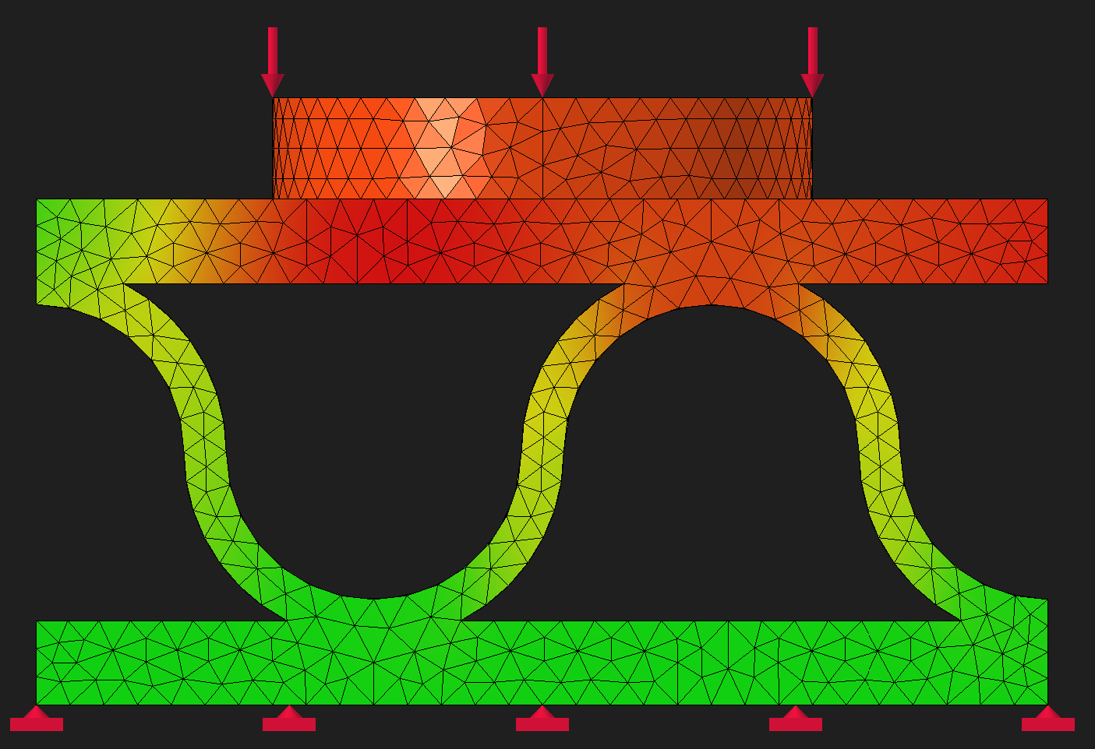
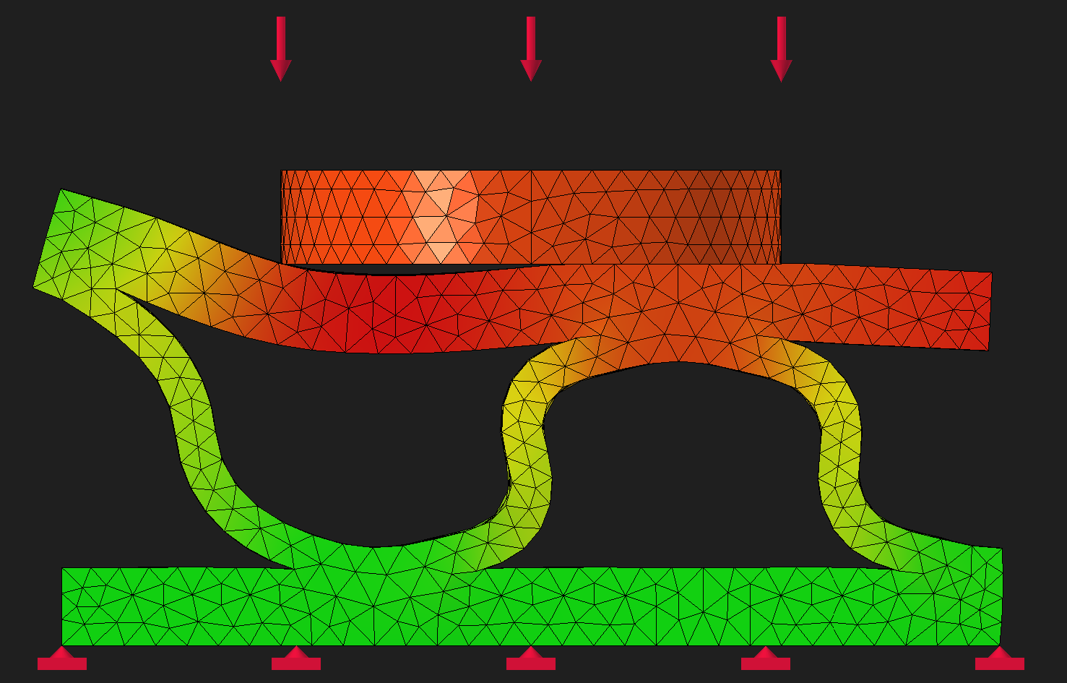
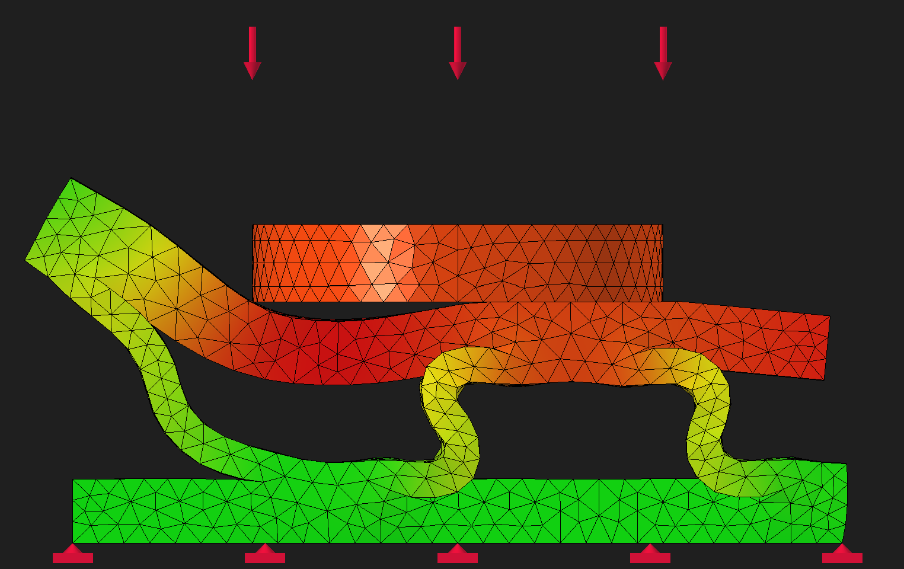
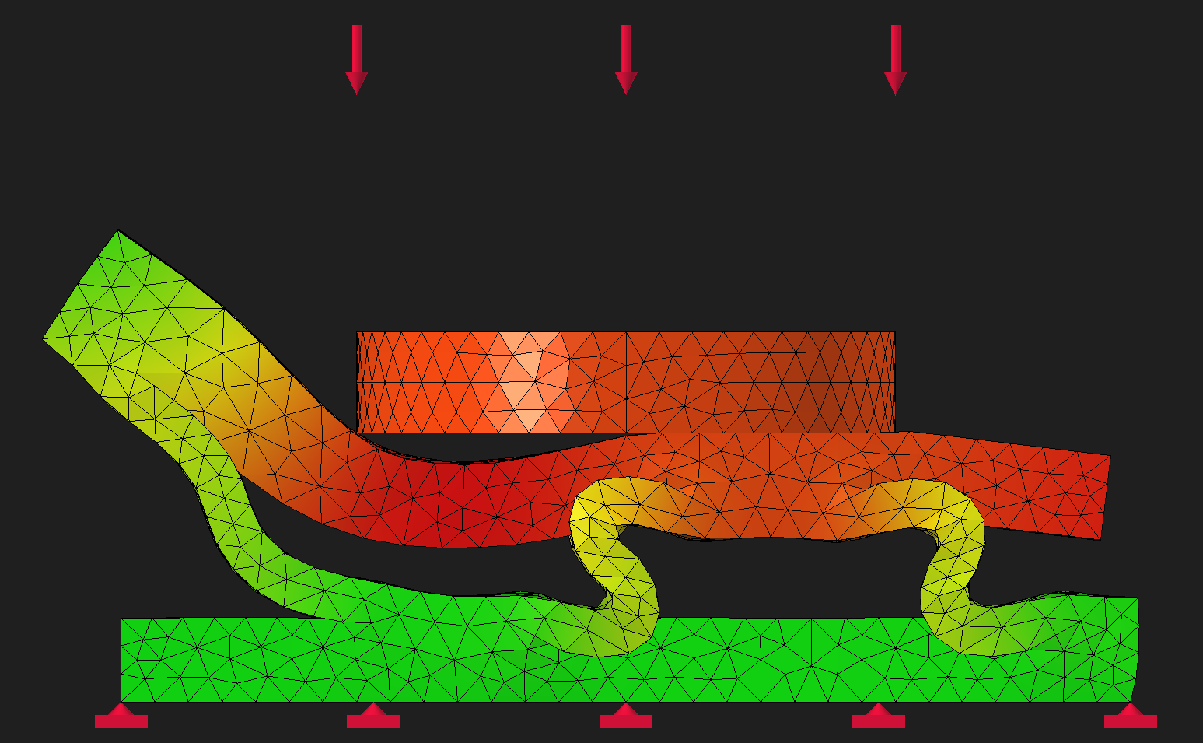
Simulating the Arches
FINITE ELEMENT ANALYSIS · 500 N CONSTANT FORCE
0%
50%
The arches bend instead of snapping
Frames at 0, 50, 75 and 100% of a 500 N load on the two-bump TPU design: the arches flex and flatten as the load grows.
75%
100%

Slide 26
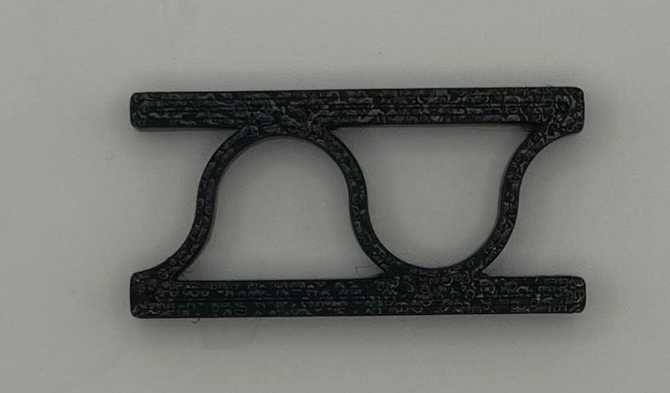
Final Result: The Two-Bump Arch
MANTIS SHRIMP · CB-TPU
Average of 3 trials
“It was squishy, so it could actually absorb force, but not too squishy that it can actually withstand stuff.”

Slide 27
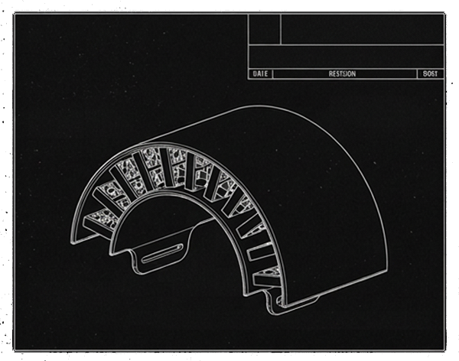
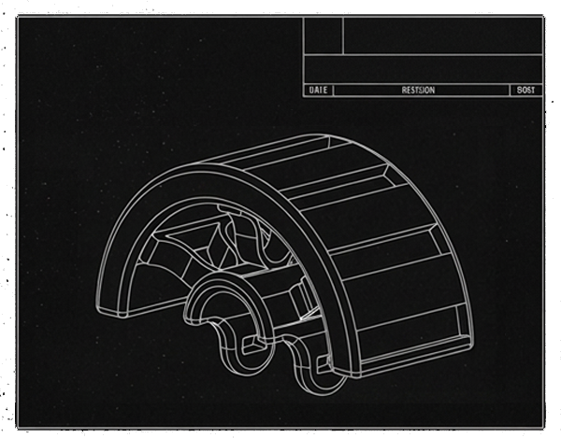
Our Final Prototype
GLASS SPONGE
MATERIAL: PLA
PUTTING IT TOGETHER
We tested our results by building a piece of armor from the data we collected.
Two models:
All PLA, using the finalized glass sponge design
A PLA and TPU mix, using the two-bump arch design
MANTIS SHRIMP
MATERIAL: PLA/TPU MIX

Slide 28
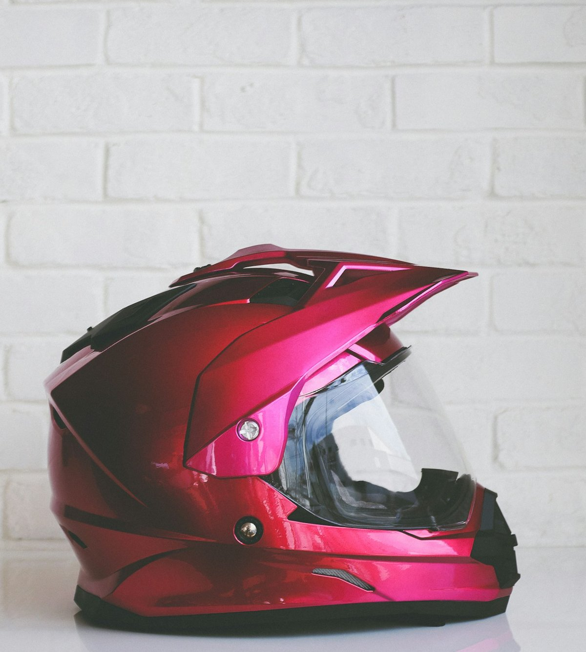
Conclusion & Takeaways
04
Lessons learned
Real-life applications
Why this matters
What we learned and where it could go
Photo: Quilia / Unsplash

Slide 29
Lessons Learned
REFLECTION
What got in the way
500 N gauge limit: the strongest models couldn't be broken
Hand-cranked loading, so the rate varied between trials
Testing software deleted several finished datasets
Identical prints gave different resistance readings
What's next
Try other materials: PETG and ABS
Motorized, automated loading for consistent tests
Aim: next-generation body armor, sports safety gear and medical prosthetics

Slide 30
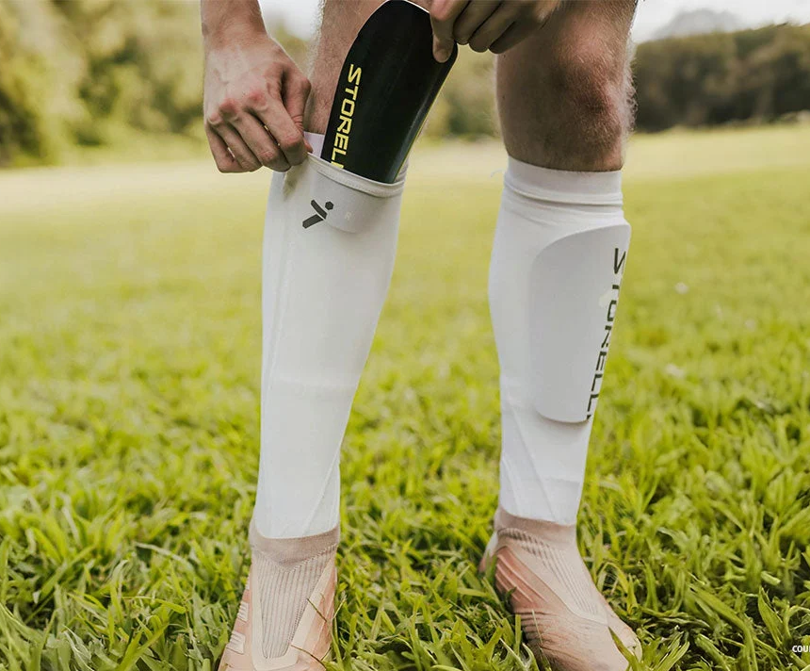
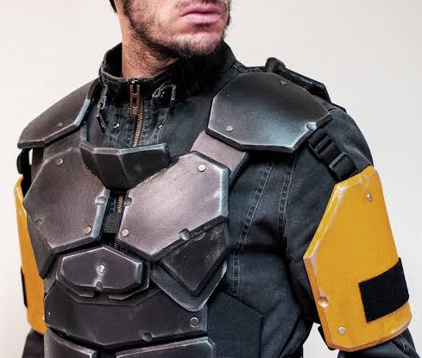
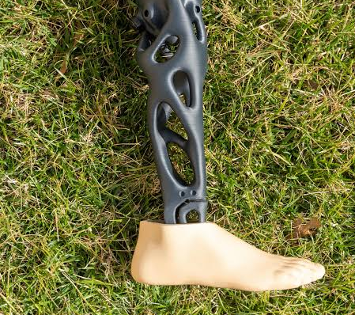
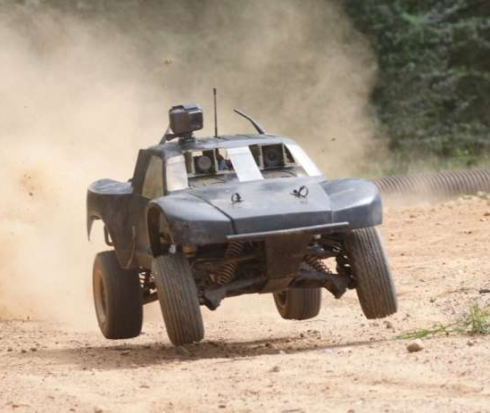
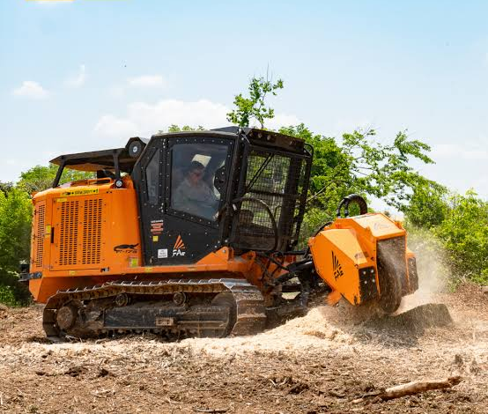
Real-Life Applications
WHERE IT COULD GO
Sports
Shin guards
Helmets
Elbow and shoulder pads
Military & law enforcement
Armor
Protective vests
Medical
Stronger, durable prosthetics
Monitor movement, detect falls
Transportation
Monitor stress and damage during vehicle operation
Machines
Better protection against outside elements

Slide 31




Why This Matters
IMPACT
Built-in health check
Armor that reports its own damage, without lab equipment
Light and custom-fit
3D printing makes complex lattices practical and lets armor be shaped to the wearer
Beyond the battlefield
Sports safety gear and medical prosthetics could use the same idea
Nature as engineer
Sponges and shrimp solved strength-per-weight long ago. We can borrow their designs

Slide 32
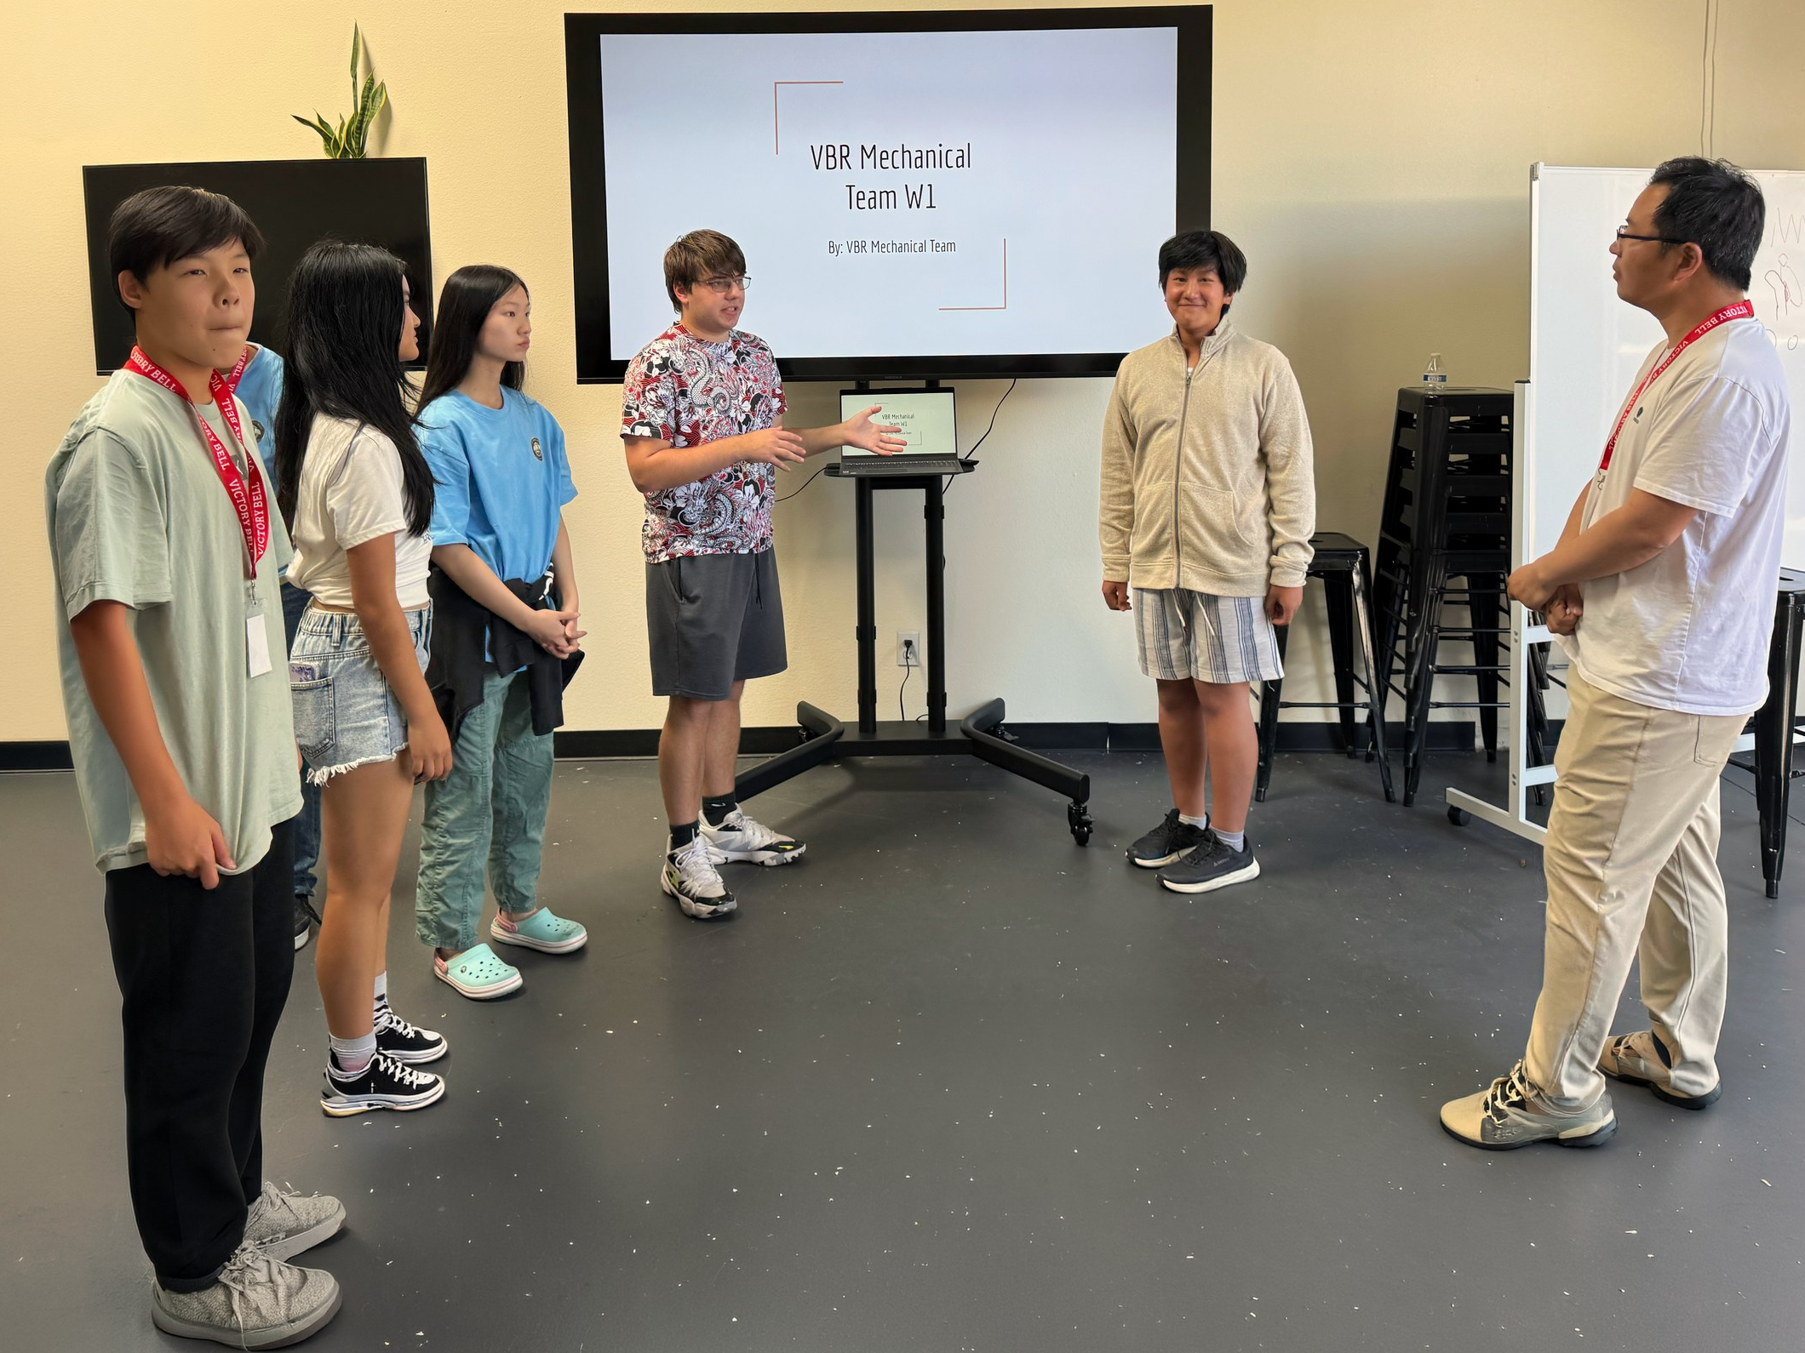
Behind the Research
VBR RESEARCH CAMP
A TYPICAL DAY
About an hour of instruction from Dr. Yang
Small teams run experiments with teaching assistants
Roles rotate: experiments, data, analysis, slides
Dr. Yang checks in with every group
Around 4 PM, each team reviews results and slides with him
GUEST SEMINARS
Stanford, UW–Madison and USC researchers on multi-material 3D printing, adaptive materials and ultrasound
SCHEDULE
3 weeks of in-person labs and experiments
6 weeks of paper writing for publication
Notes:
[Sources]
Image: AI-generated conceptual research-lab illustration, created for this slide. Does not depict the actual camp, lab or named participants.
[/Sources]

Slide 33
What We Found
SUMMARY
456.73 N
493.73 N
0.57 kΩ
131.67 N
1.0 mm lines were strongest in Round 1, about 48% stronger than a plain grid
A +0.5 mm spacing offset made the strongest lattice of all
1.0 mm also gave the biggest resistance change in Round 1
Two wide TPU arches carried the most load
3D-printed, bio-inspired lattices in conductive plastic can carry real loads and signal stress through changes in their own resistance.
Strength and sensitivity trade off, so designs must balance both.

Slide 34
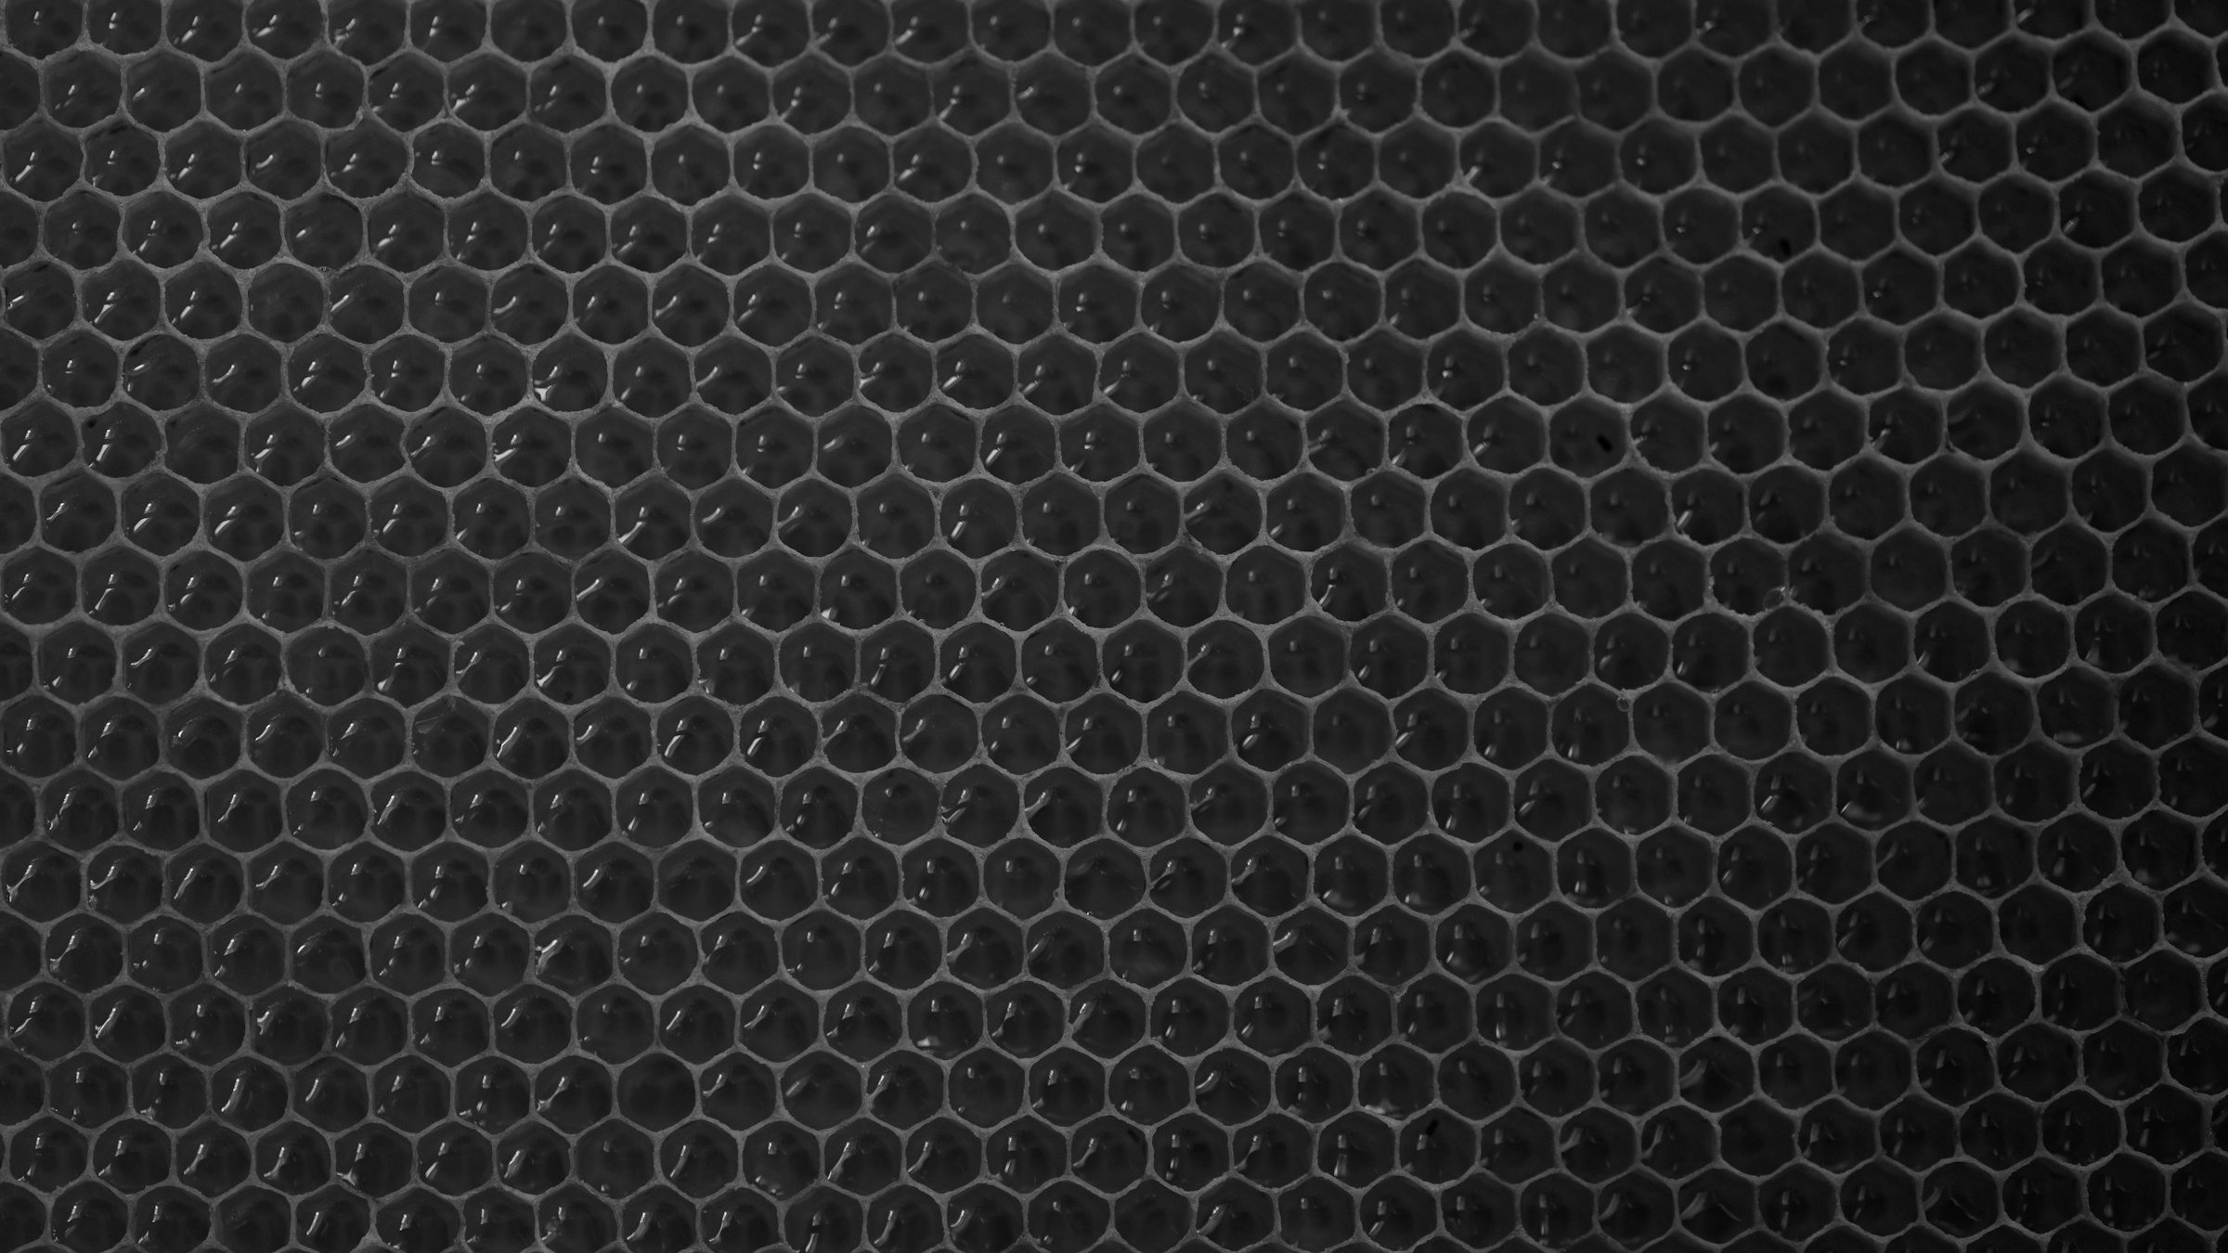
Thank You
VBR MECHANICAL ENGINEERING TEAM
Questions?
Emmet · Raina · Jayden · Jaycen · Peggy
With thanks to Dr. Yang Yang, our TA Preston, and Victory Bell Education & Research
Photo: Victoria Druc / Unsplash

