Slide 1


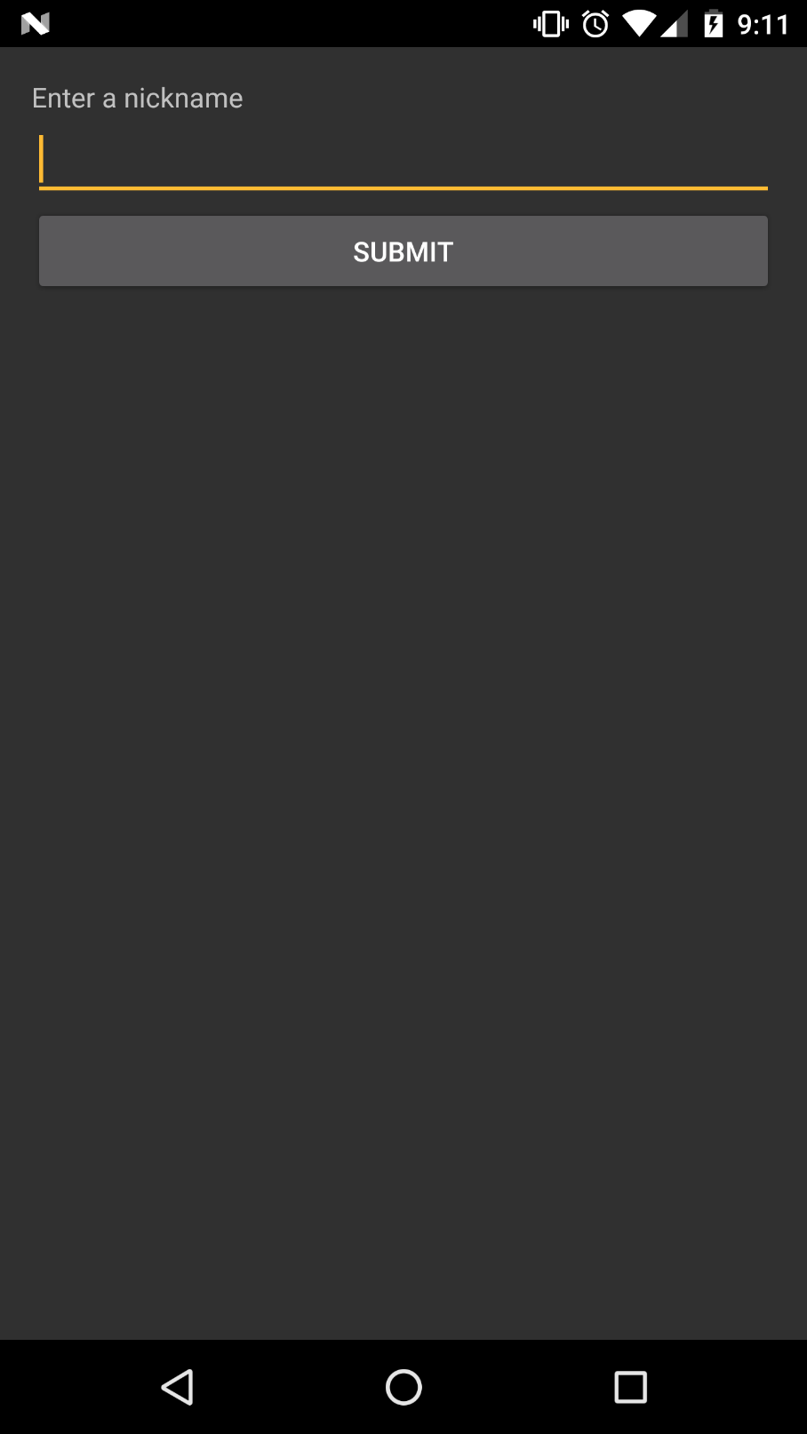
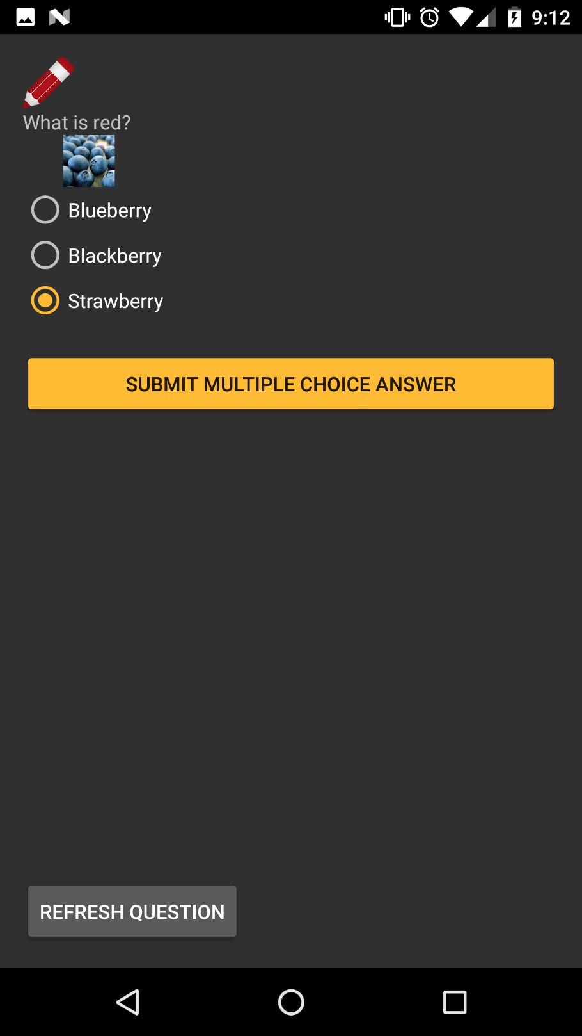
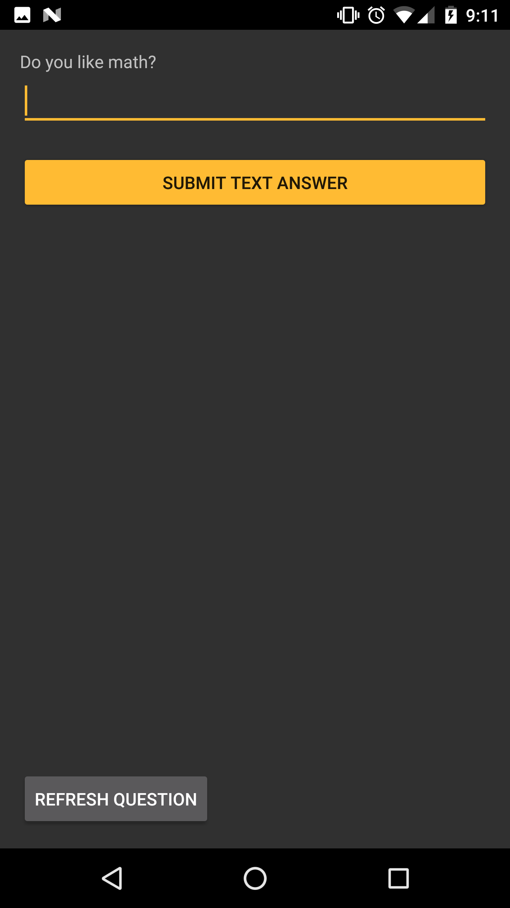
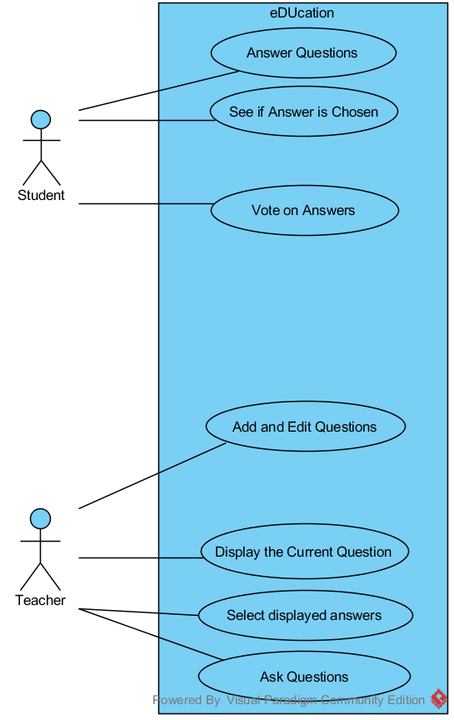
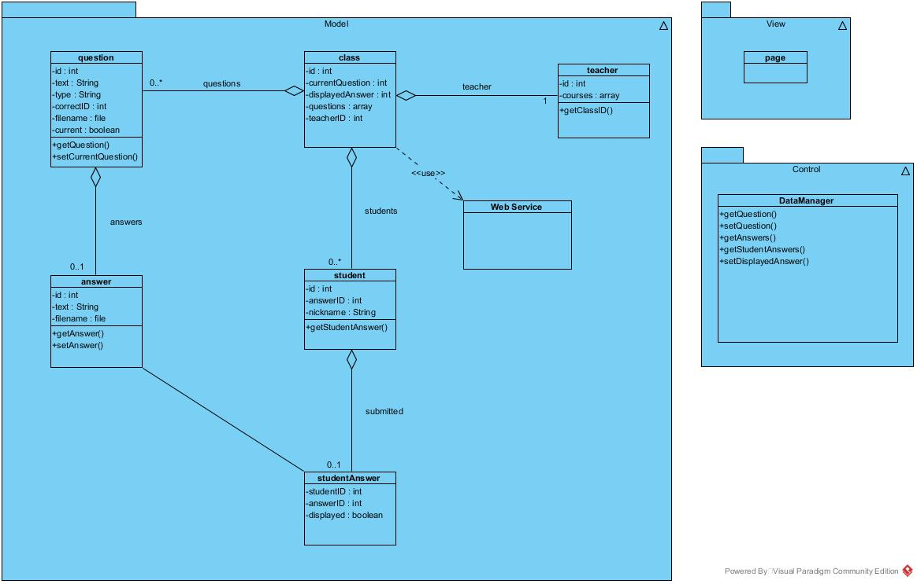
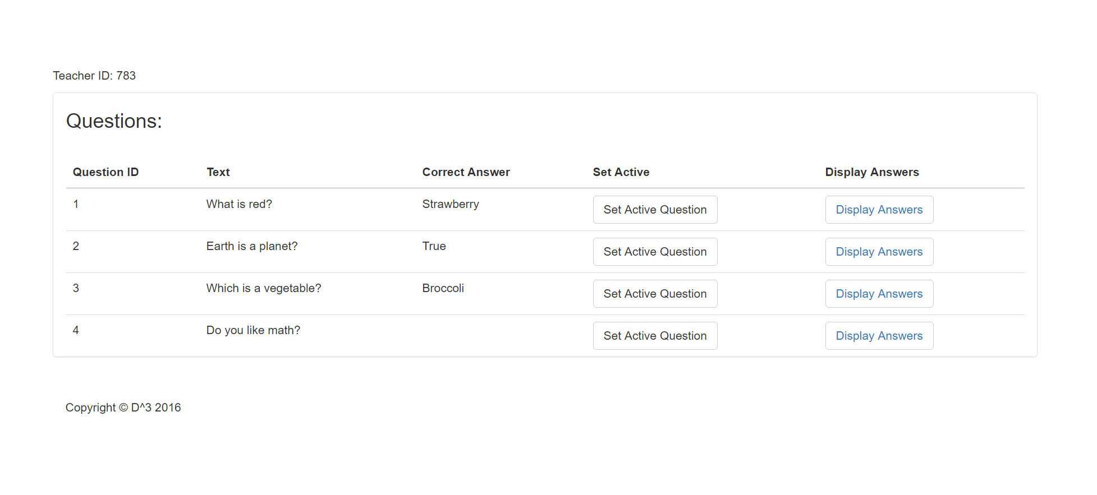
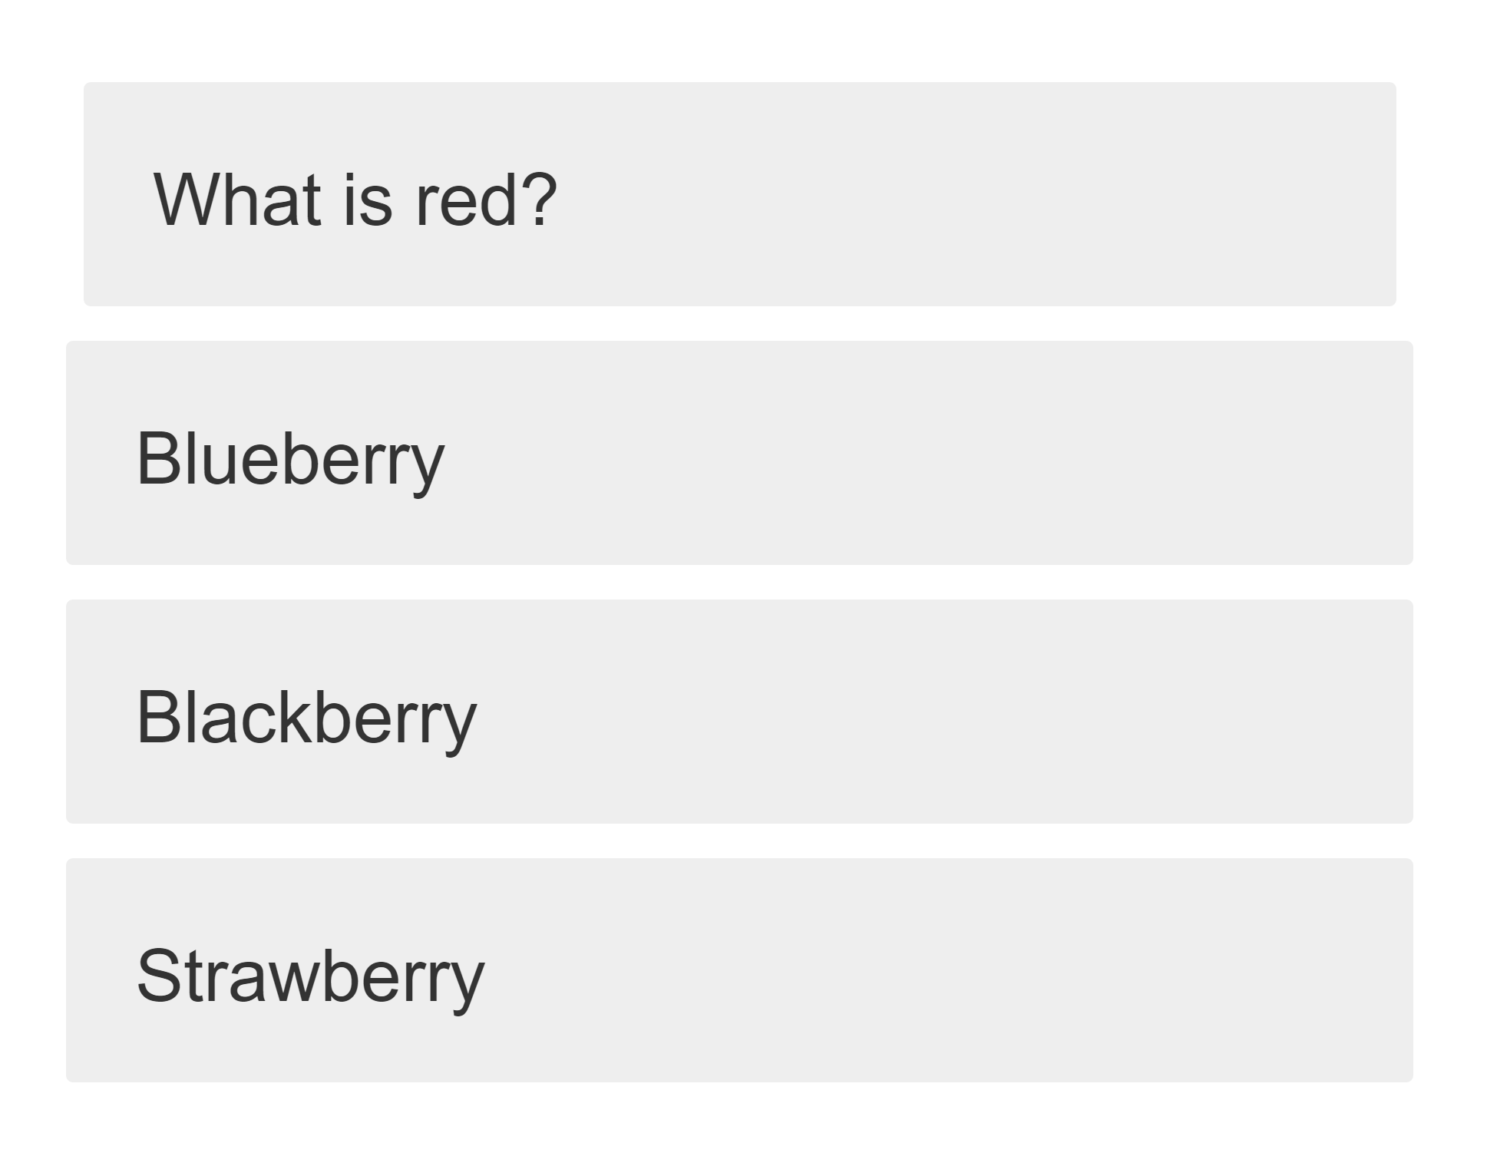
eDUcation
Kyle Martin, Josh Harrold, Zachary Green, Amelia Merritt | Mentor: Dr. Scott Sigman | Clients: Dr. Ioana Popescu, Dr. Keith Coates
Purpose
App Design
Design
Engage students using their own technology in classroom environments
Promote discussion of concepts rather than giving quizzes with no feedback
Students learn from other students
Development Process
Pedal development process
Separated into three sprints
Each sprint has four stages: Inception, Elaboration, Construction, and Transition
Developers go through six workflows each stage: Requirements, Analysis, Design, Implementation, Test, and Presentation
Selecting Questions
Phone App Technologies
o iOS
Swift, xCode
o Android
Android Studio
Application and Web Development
Java, Eclipse, HTML
Web Server Scripting
PHP web server
MySQL
Future Direction
Drawing and submitting graph problems
Organization based on teacher and classes
Sustainable design that removes unneeded data from database

