Slide 1


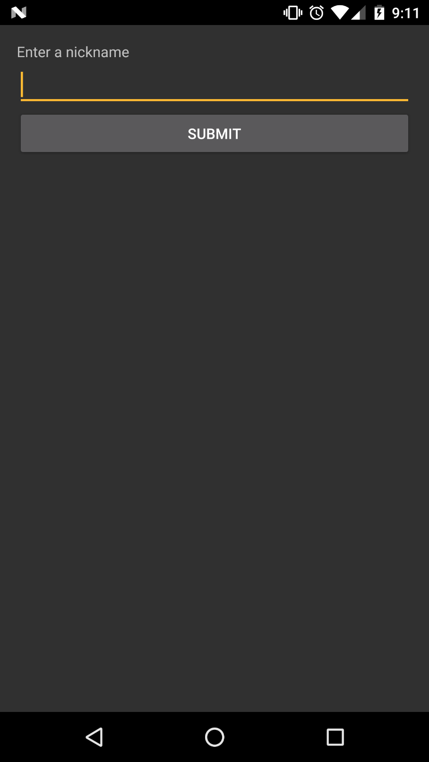
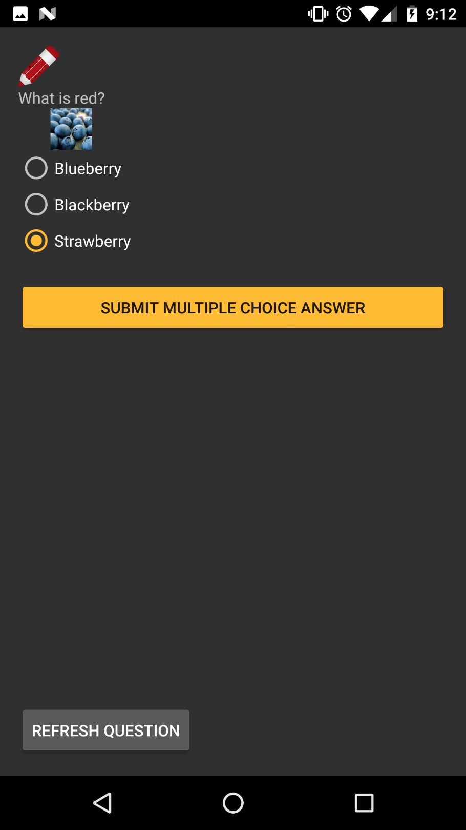
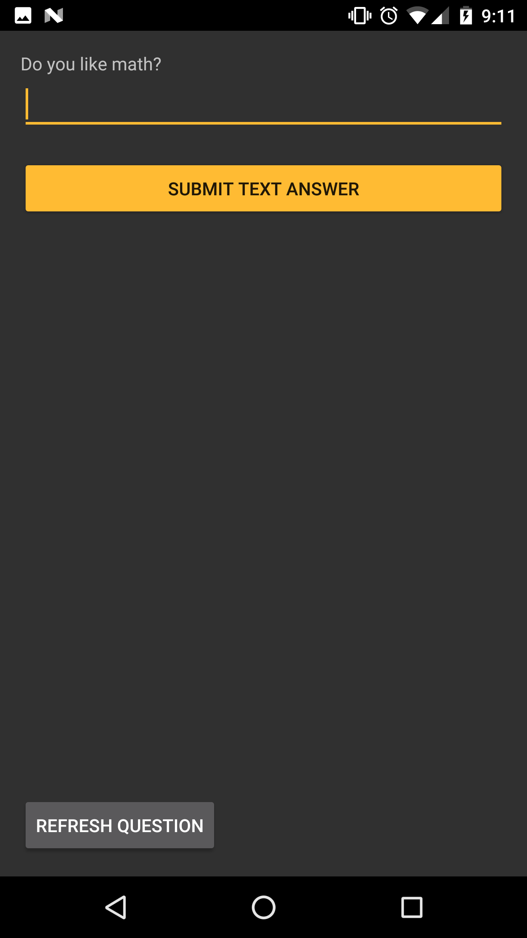
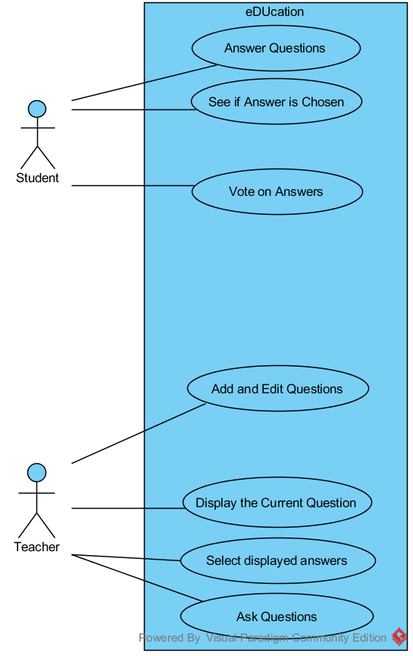
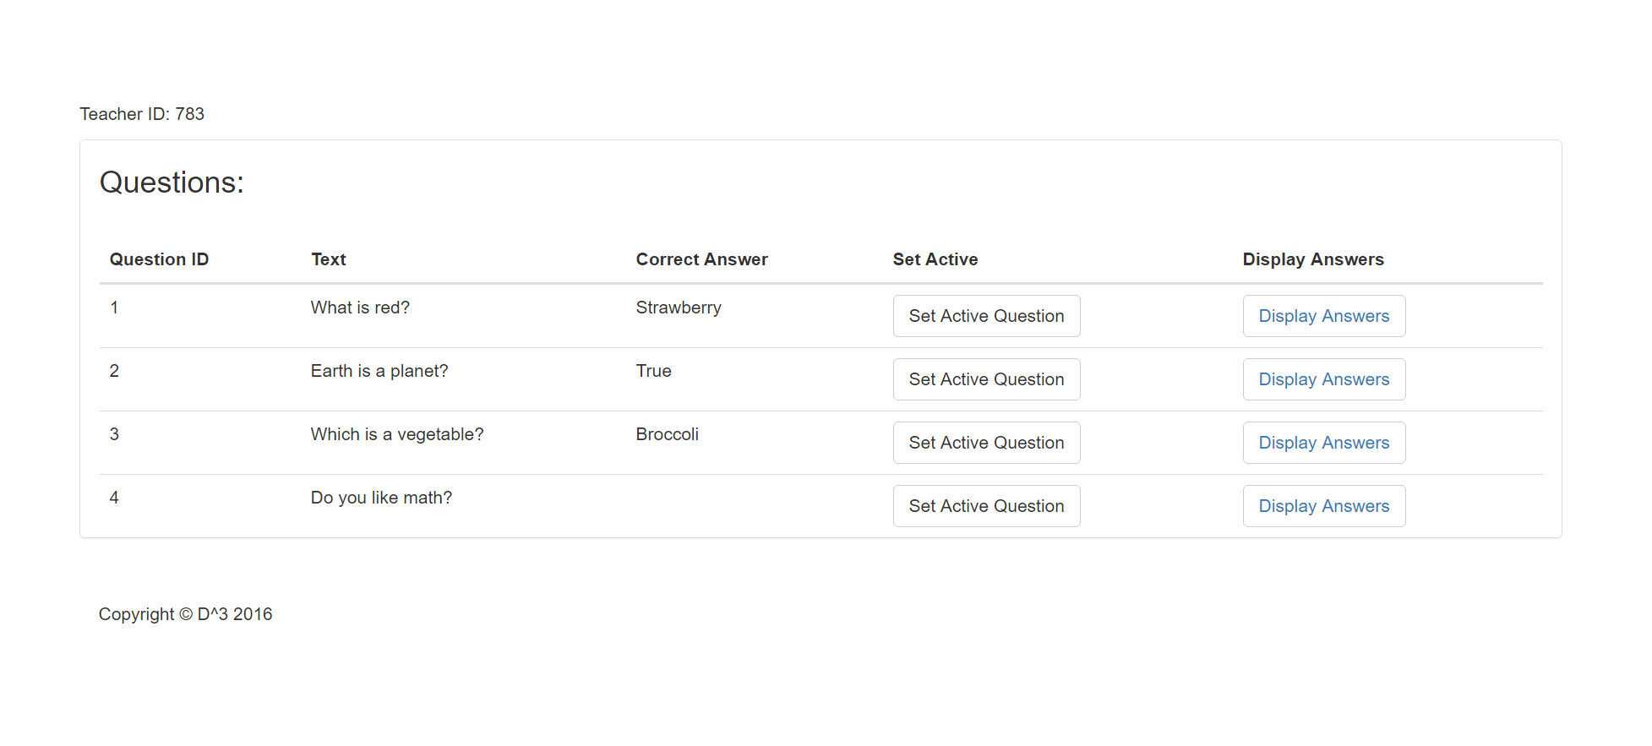
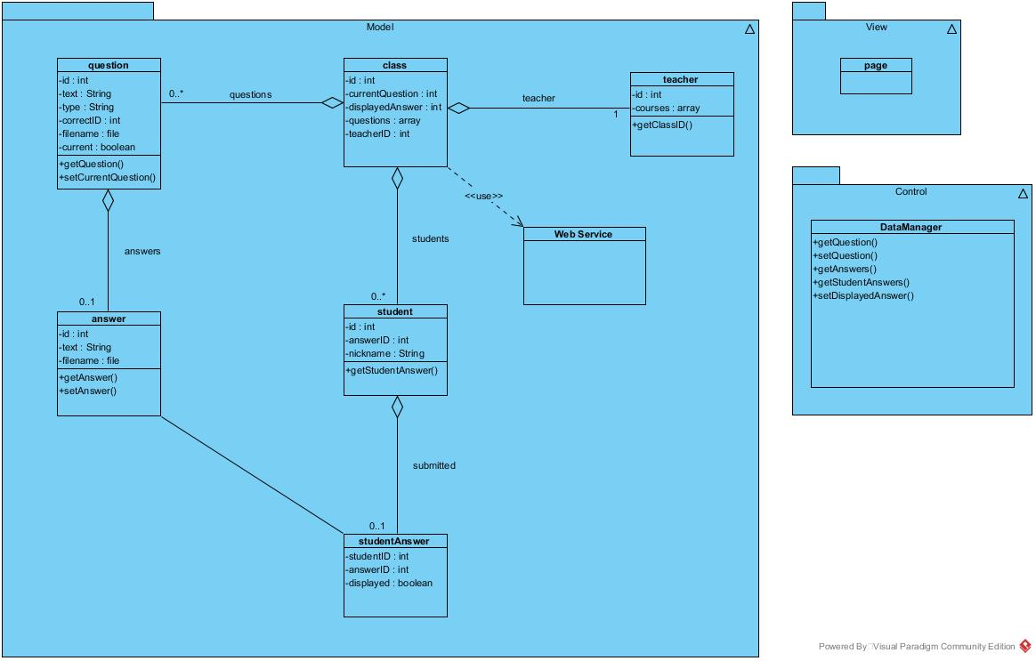
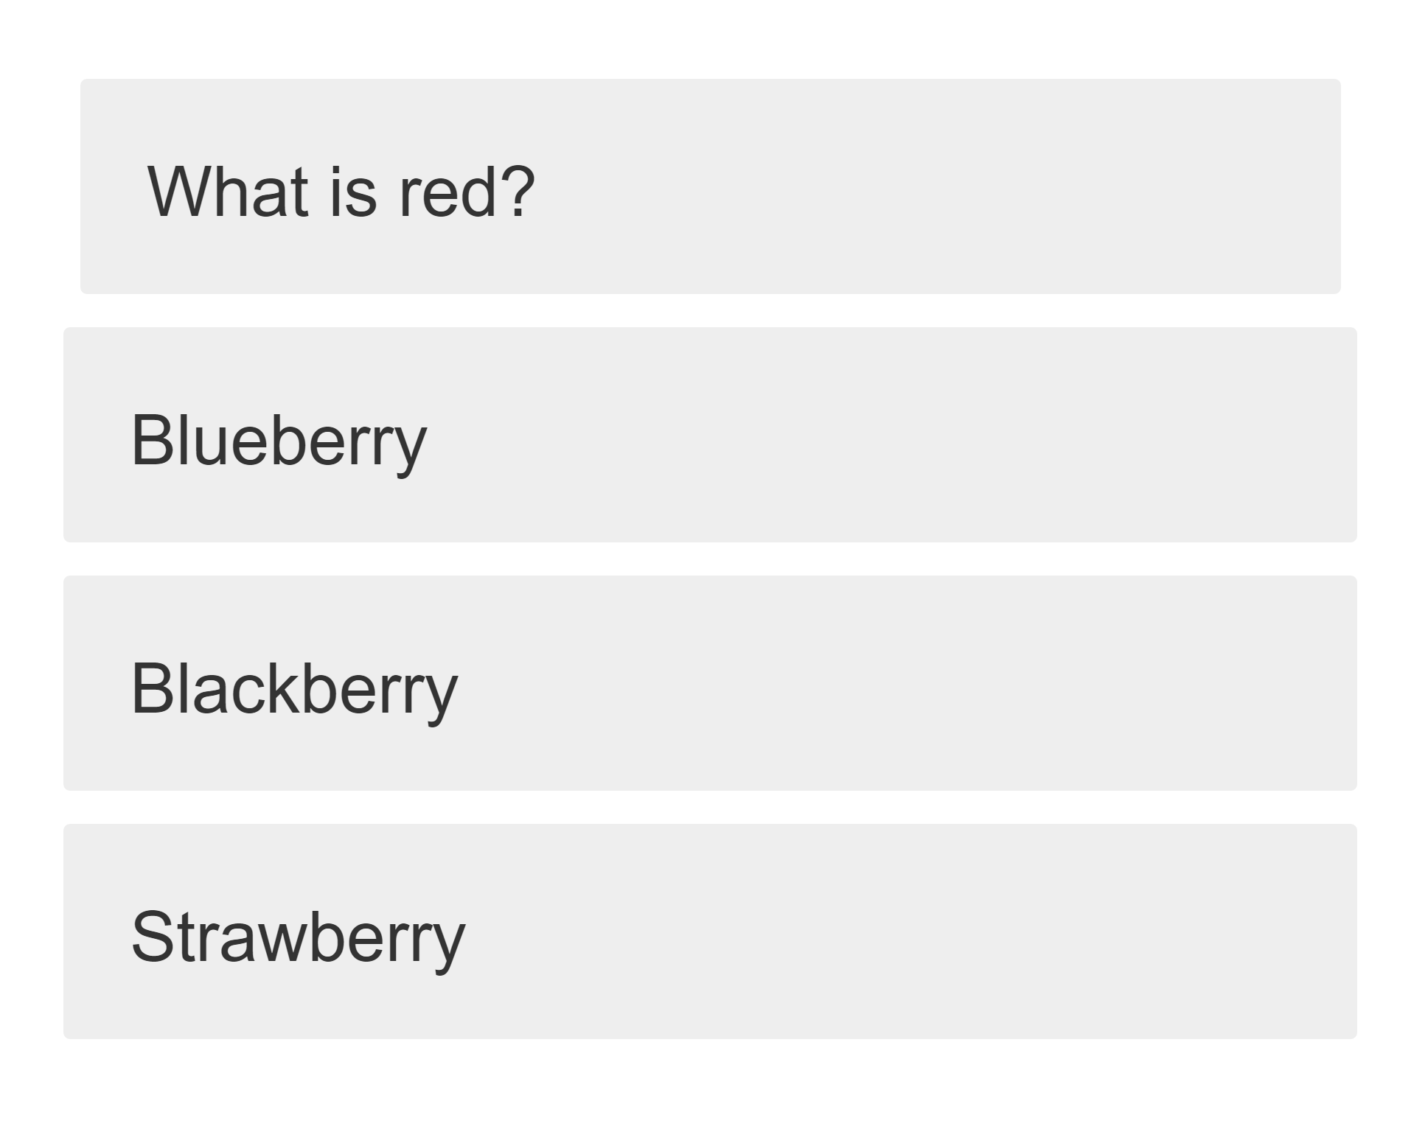
eDUcation
Kyle Martin, Josh Harrold, Zachary Green, Amelia Merritt | Mentor: Dr. Scott Sigman | Clients: Dr. Ioana Popescu, Dr. Keith Coates
App Design
Purpose
Development Process
Engage students using their own technology in classroom environments
Promote discussion of concepts rather than giving quizzes with no feedback
Students learn from other students
Design
Selecting Questions
Future Direction
Drawing and submitting graph problems
Organization based on teacher and classes
Sustainable design that removes unneeded data from database

