Slide 1


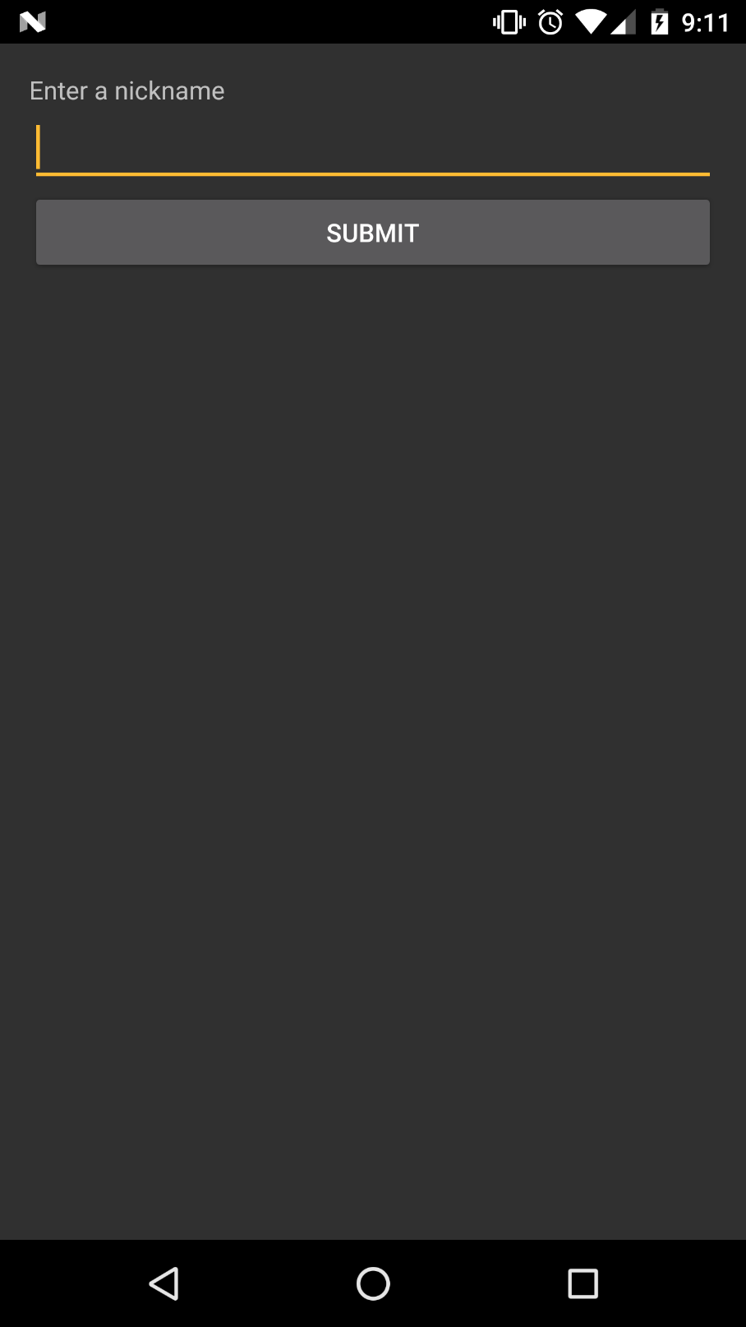
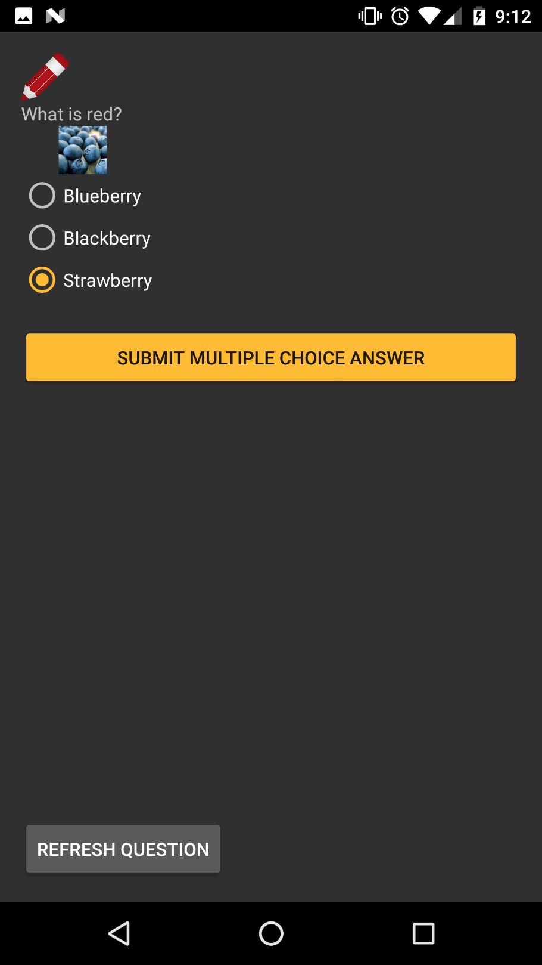
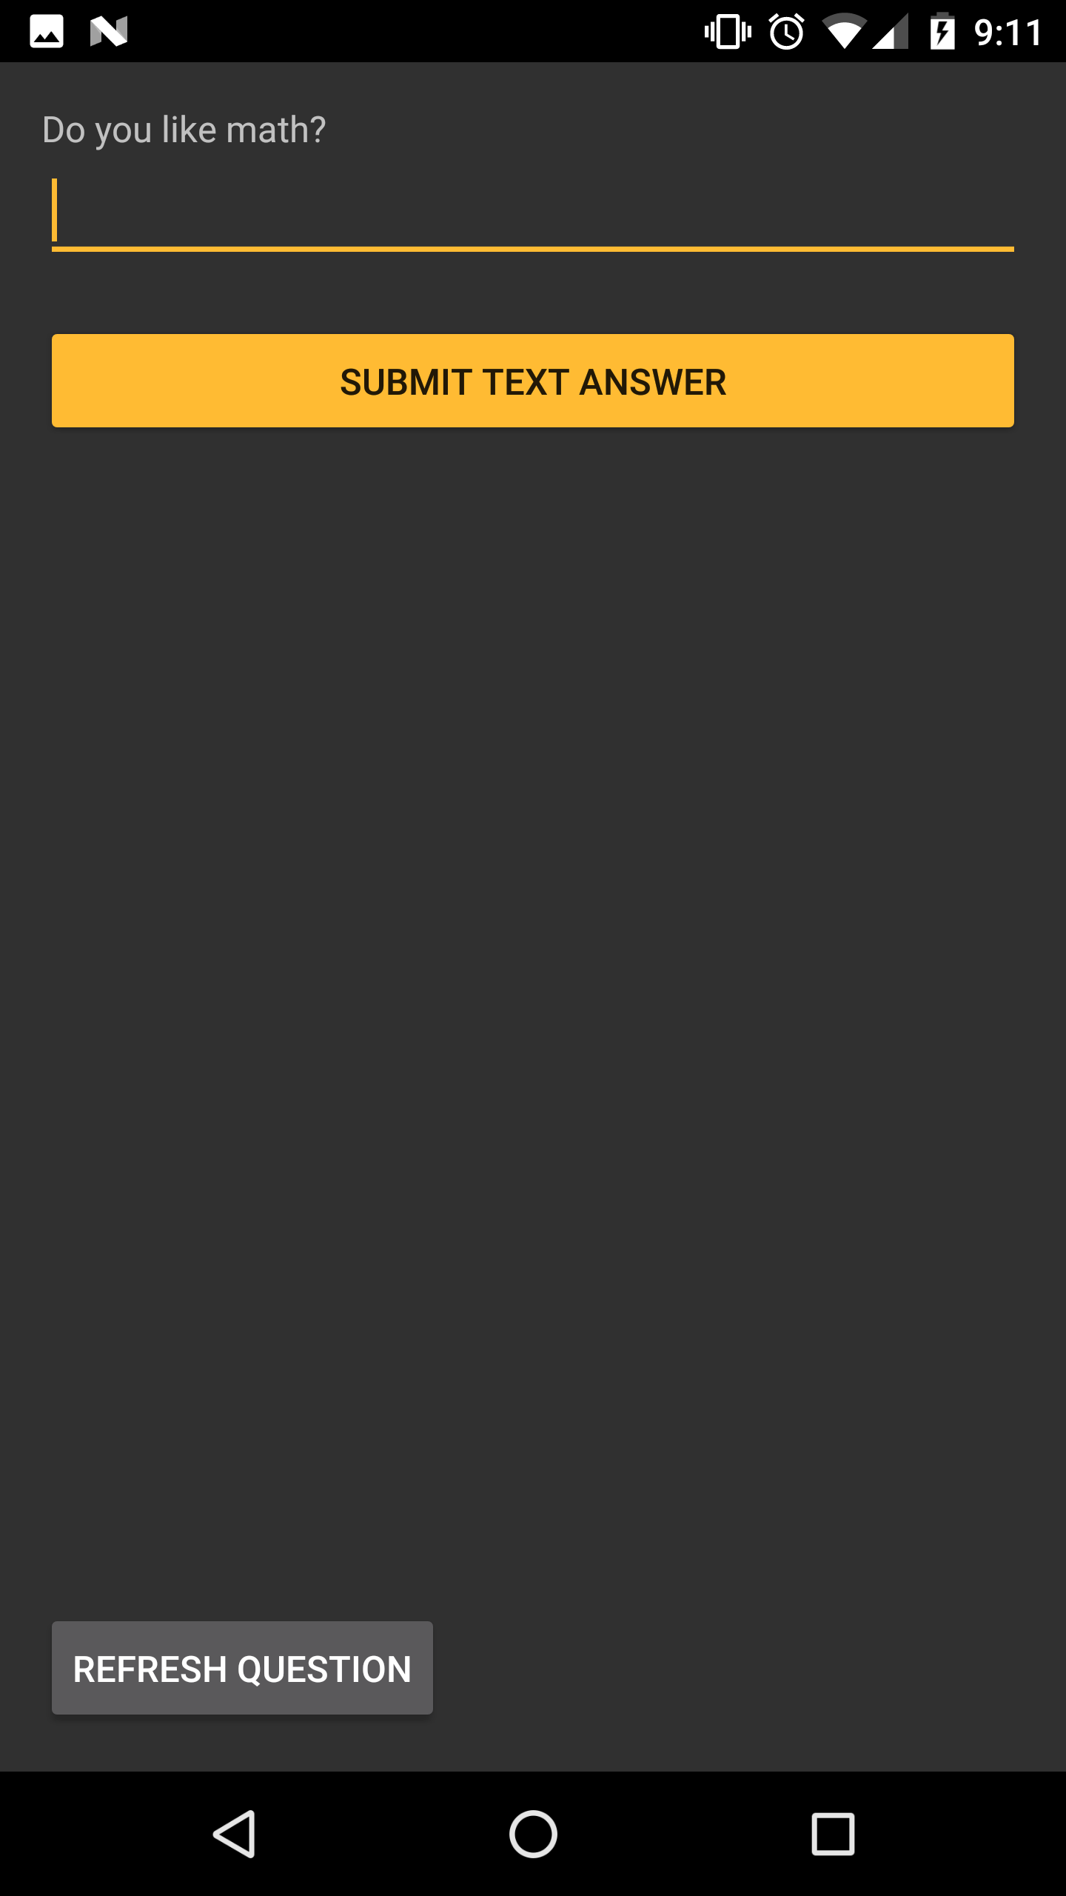
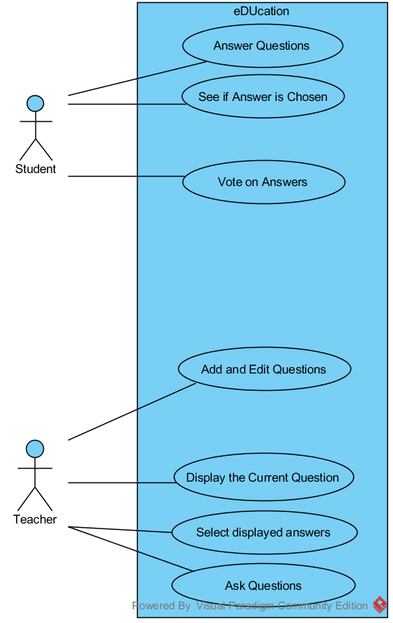
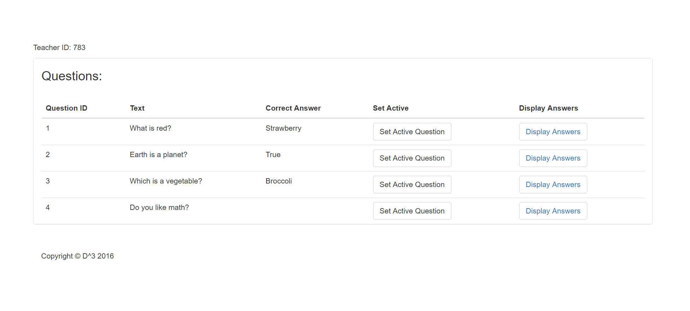
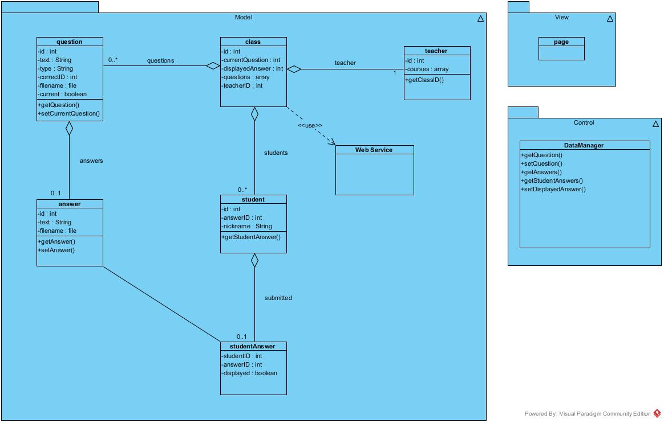
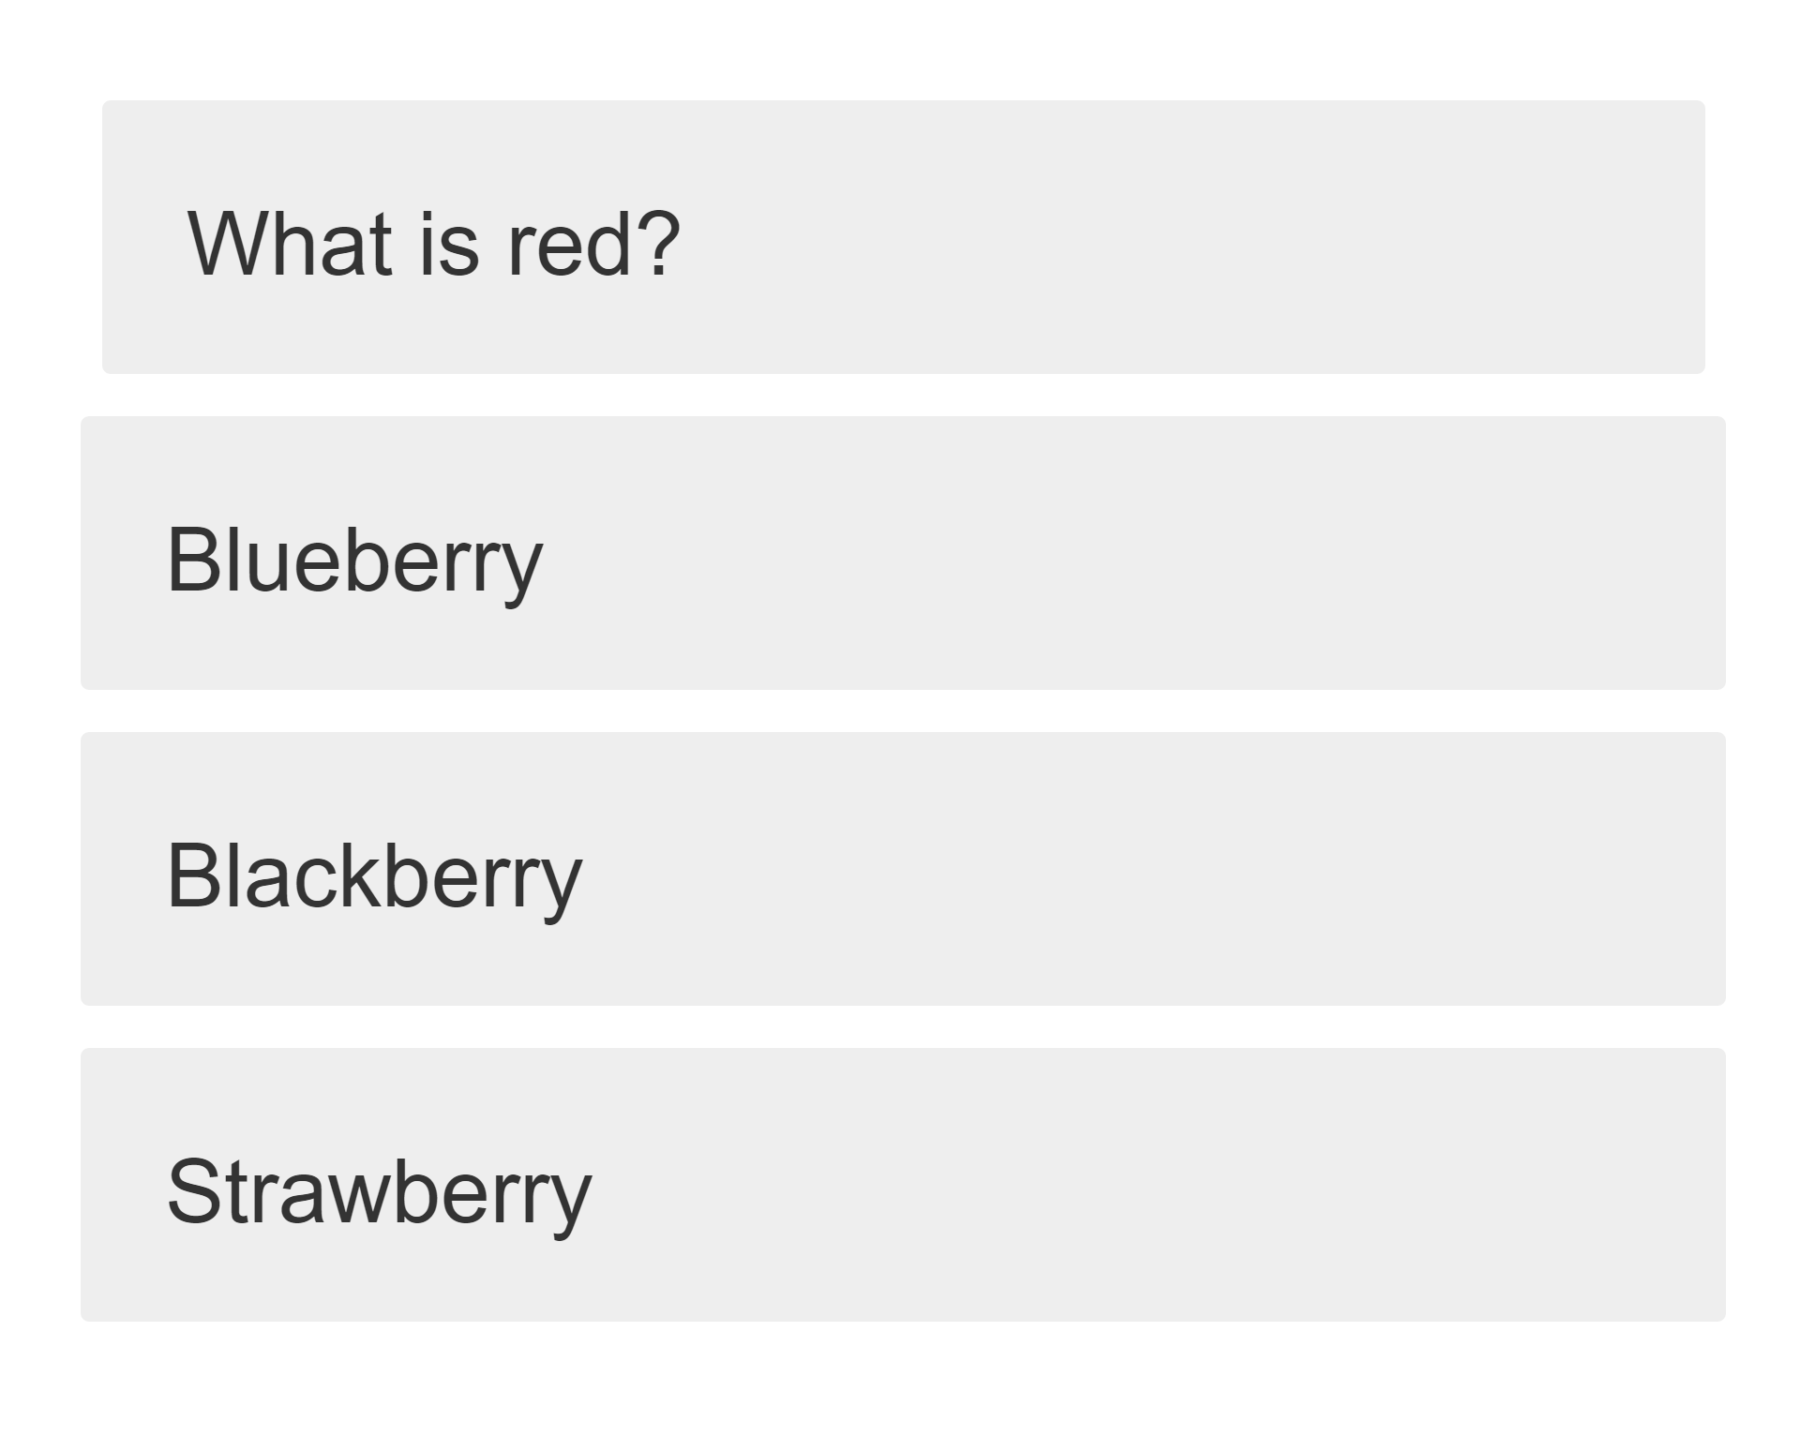
eDUcation
Kyle Martin, Josh Harrold, Zachary Green, Amelia Merritt | Mentor: Dr. Scott Sigman | Clients: Dr. Ioana Popescu, Dr. Keith Coates
Purpose
App Design
Development Process
Engage students using their own technology in classroom environments
Promote discussion of concepts rather than giving quizzes with no feedback
Students learn from other students
Future Direction
Design
Selecting Questions
Acknowledgements

