Slide 1
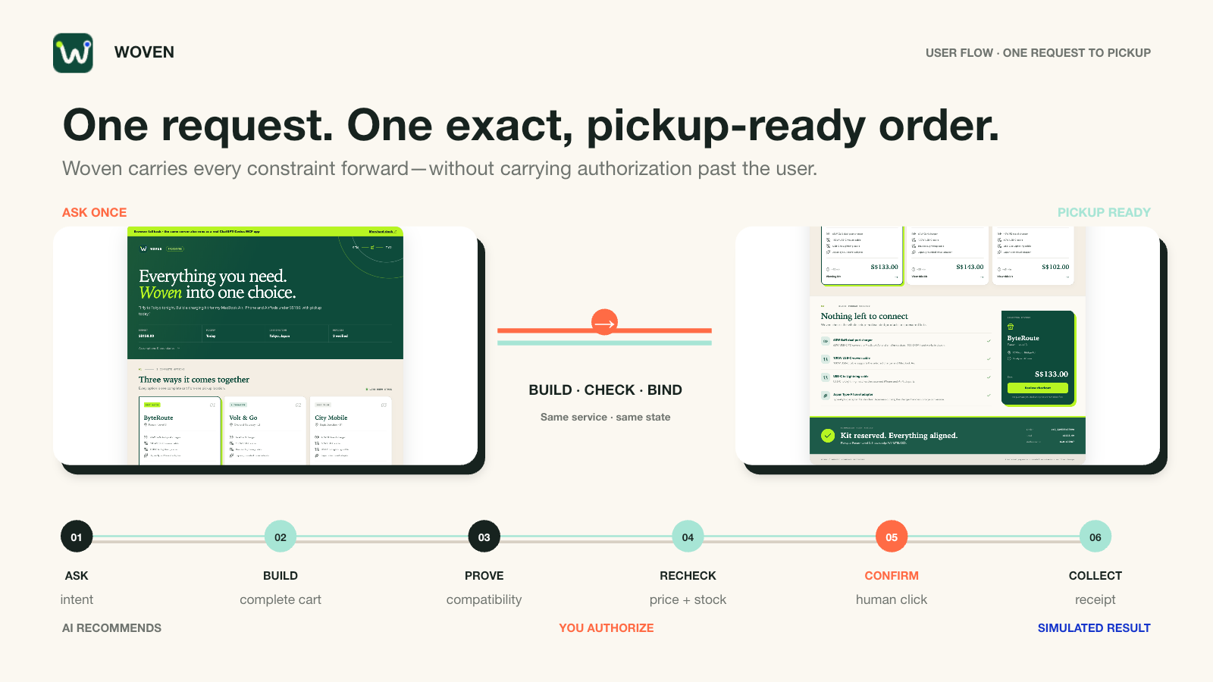
Notes:
[Sources]
- docs/assets/screenshots/buyer-overview.png
- docs/assets/screenshots/order-success.png
- docs/PRD.md
[/Sources]

Slide 2
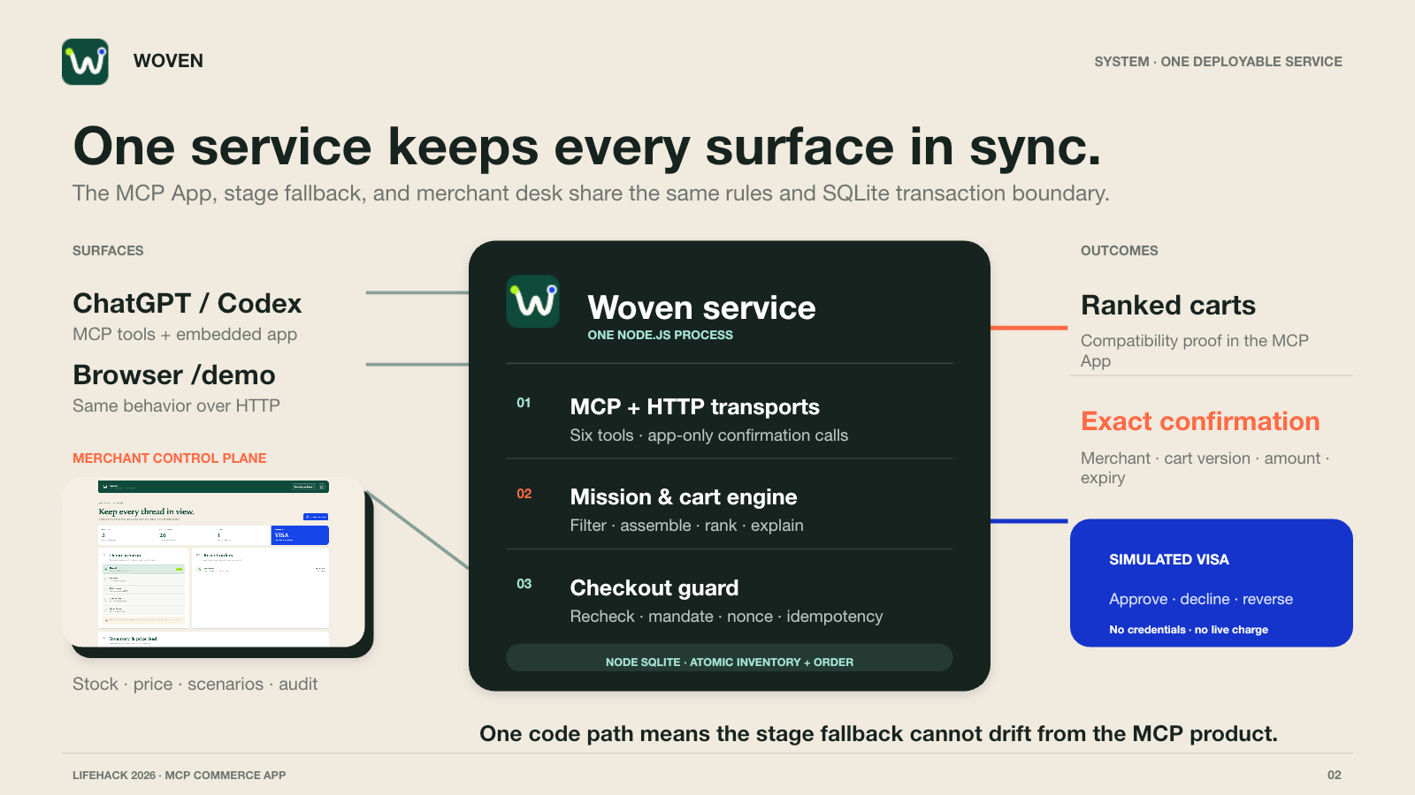
Notes:
[Sources]
- docs/architecture.md
- docs/HANDOVER.md
- docs/assets/screenshots/merchant-dashboard.png
[/Sources]

Slide 3
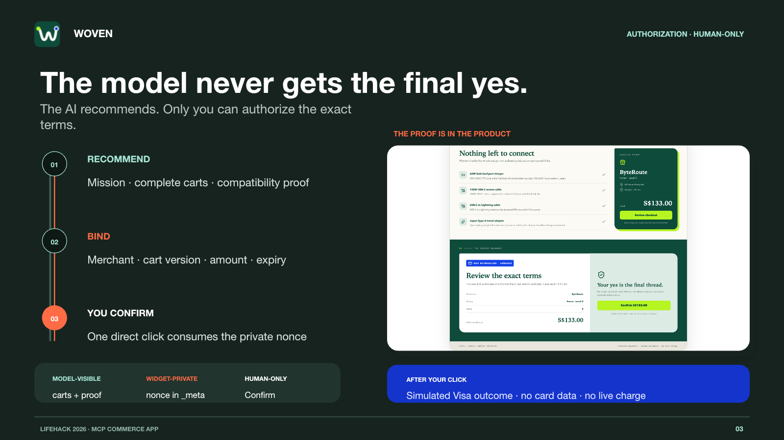
Notes:
[Sources]
- docs/architecture.md
- docs/assets/screenshots/checkout-confirmation.png
- test/store.test.ts
[/Sources]

