Slide 1

WOVEN / CHATGPT SHOPPING APP
Shopping should start
and finish with
one request.
Everything works together.
Ask once.
Review once.
Confirm once.
WORKING MCP APP · SEEDED DEMO DATA
WOVEN / LIFEHACK 2026
01
Notes:
TIME 0:00–0:12
NARRATIVE JOB
Establish that shopping should start and finish in the conversation where the need was expressed.
SAY
“We already ask ChatGPT what to buy. But actually buying still means opening tabs, checking compatibility, finding stock, and rebuilding everything at checkout. We built Woven to finish that process.”
STAGE CUE
Hold this slide for the full opening. The Flightpath hero is illustrative brand artwork; the working product proof begins on slide 3.
TRANSITION
“The hard part is not finding a product. It is completing the whole mission.”
[Sources]
- script.md — 0:00–0:12 opening
- docs/assets/brand/woven-hero-flightpath.png
- docs/BRAND_GUIDE.md — Product promise and visual system

Slide 2
THE FRICTION
Search gives you links. Buying still takes work.
Rebuild the cart at checkout.
01
Compare products
You still open tabs and evaluate individual options.
02
Check compatibility
One wrong cable or adapter breaks the whole kit.
03
Find one store
Everything must be available today at one pickup location.
WOVEN / LIFEHACK 2026
02
Notes:
TIME 0:12–0:30
NARRATIVE JOB
Make the unfinished work after search concrete.
SAY
“Imagine flying tonight and needing a charger for three devices. Search can recommend individual products, but it does not guarantee that everything works together, fits your budget, is available today, and can be collected from one place.”
POINT TO
Compare products. Check compatibility. Find one store. The user still has to rebuild the cart at checkout.
TRANSITION
“Woven resolves those constraints together.”
[Sources]
- script.md — 0:12–0:30 problem framing
- docs/PRD.md — Primary persona and canonical mission
- README.md — Product search versus Woven

Slide 3
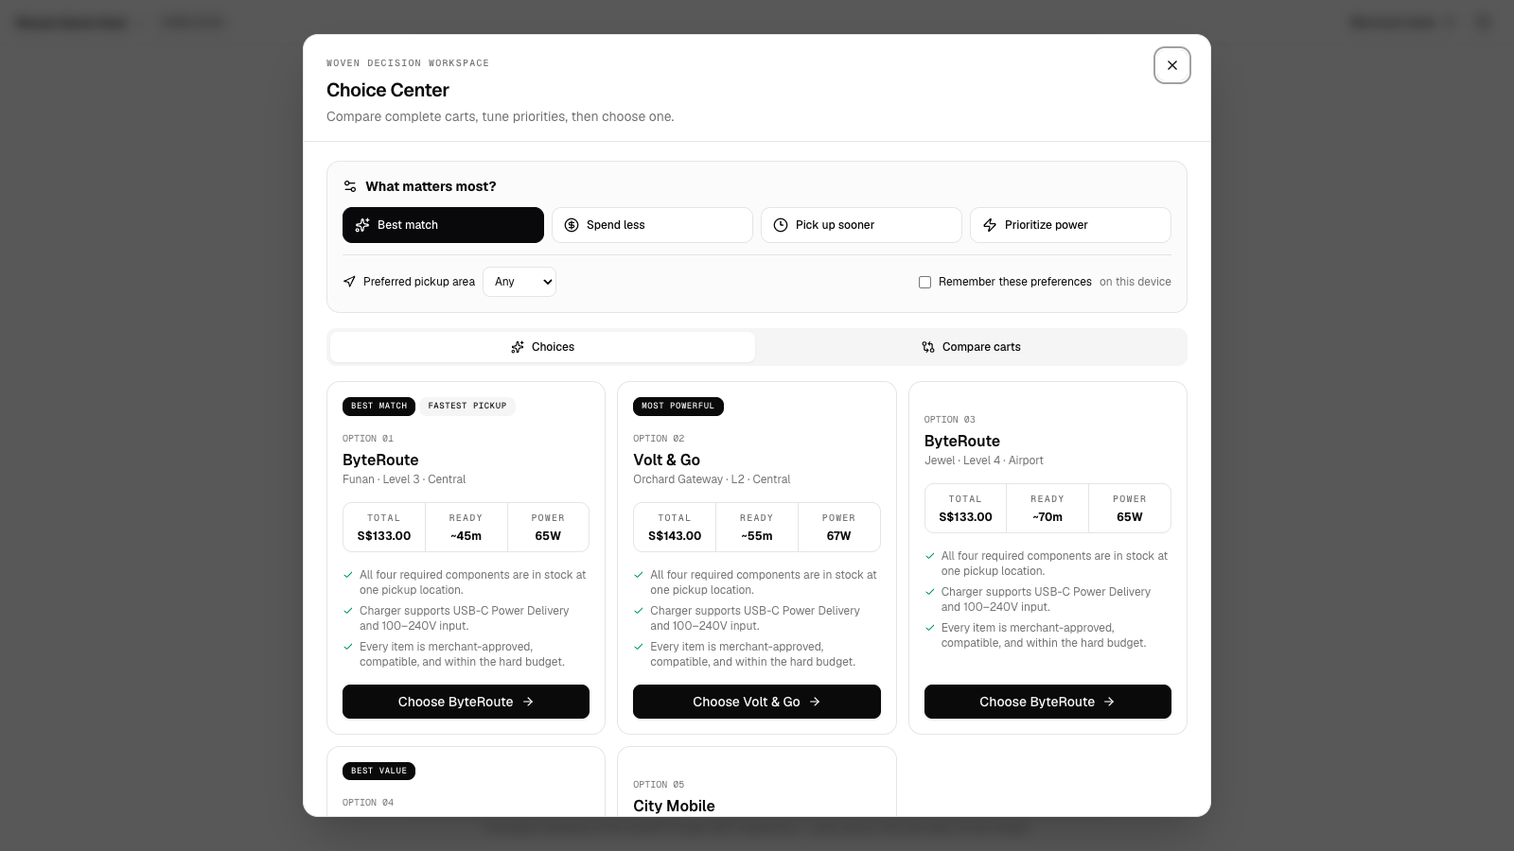
THE COMPLETE CART
Woven returns a complete cart—not another list.
1
merchant and pickup point
4
compatible components
S$133
under budget · pickup today
WOVEN / LIFEHACK 2026
03
Notes:
TIME 0:30–0:48
NARRATIVE JOB
Reveal Woven’s cart-level difference before switching to the product.
SAY
“Woven understands the complete request, eliminates incompatible combinations, and creates five ready-to-buy choices in one comparison workspace. Every cart comes from one merchant and one location, with an explanation of why every component works.”
POINT TO
Compare priorities and pickup areas. One merchant and pickup point. Four compatible components. S$133 total. Pickup today.
TRANSITION
“Let me show you.”
[Sources]
- script.md — 0:30–0:48 product reveal
- docs/assets/screenshots/buyer-overview.png
- docs/PRD.md — Complete-cart requirements

Slide 4
LIVE DEMONSTRATION
Ask once. Let the result prove the value.
“I fly to Tokyo tonight. Build a charging kit for my MacBook Air, iPhone and AirPods under S$150, with pickup today.”
DESTINATION
Tokyo
DEVICES
MacBook · iPhone · AirPods
BUDGET
S$150 hard cap
DEADLINE
Pickup today
5 complete choices. 1 natural sentence.
WOVEN / LIFEHACK 2026
04
Notes:
TIME 0:48–1:30
NARRATIVE JOB
Hand off to the working MCP App or the /demo fallback and let the result prove the value.
ENTER OR REVEAL
“I fly to Tokyo tonight. Build a charging kit for my MacBook Air, iPhone and AirPods under S$150, with pickup today.”
DEMO ACTIONS
1. Open the five-choice Choice Center.
2. Compare carts, rerank by pickup or value, and return to Best match.
3. Select ByteRoute, point to “Why this works,” make the approved cable swap, and show the pickup planner.
SAY
“Woven returned five complete choices—not loose product links. I can compare exact carts, change priorities, and make only merchant-approved compatible swaps without rebuilding the request.”
STAGE GUARDRAIL
If the MCP host fails, move immediately to /demo; it uses the same backend.
[Sources]
- script.md — 0:48–1:30 live demo
- docs/HANDOVER.md — Canonical demo and fallback
- docs/PRD.md — Canonical story and cart constraints

Slide 5
THE TRUST BOUNDARY
The AI recommends. The user authorizes.
Identity is the next integration.
01
Verify identity
PLANNED — server-enforced before checkout; not in the live demo.
02
Review exact terms
WORKING — merchant, items, pickup, total and expiry.
03
Confirm once
WORKING — one click, then simulated Visa authorization.
WOVEN / LIFEHACK 2026
05
Notes:
TIME 1:30–2:15
NARRATIVE JOB
Draw the authorization boundary: the AI recommends; the user authorizes the exact purchase.
WORKING DEMO ACTIONS — USE NOW
1. Click Review checkout.
2. Show the exact merchant, items, pickup location, total, cart version, and expiry.
3. Pause before clicking Confirm S$133.00.
4. Confirm and show the simulated Visa result and exact signed receipt.
SAY
“Woven rechecks price and stock, then creates an exact ten-minute checkout preview. The AI recommended this cart, but it cannot approve it. Only one direct click can confirm the displayed terms.”
“Only after that click does Woven return a simulated Visa result and a server-verifiable receipt. No card details enter Woven, and no live charge occurs.”
TRUTH BOUNDARY
Identity verification is planned and not in the live build. Do not show a static identity mock as verification.
TRANSITION
“The same controls are visible on the merchant side.”
[Sources]
- script.md — Working checkout block and target identity block
- docs/architecture.md — Confirmation boundary, mandate binding, and receipt signing
- docs/PRD.md — Truth and safety constraints

Slide 6
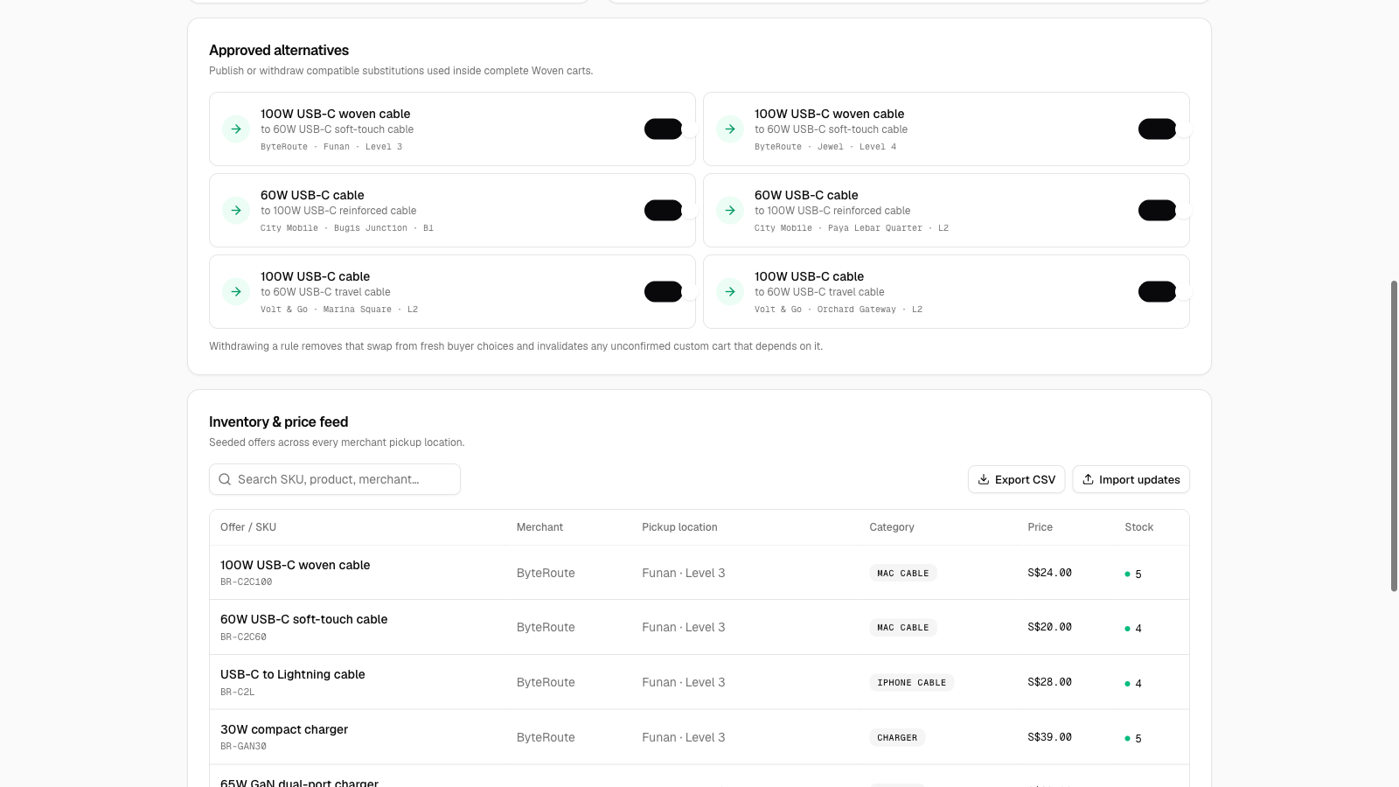
MERCHANT CONTROL
Merchants control what the AI can sell.
ALTERNATIVES
Publish compatible swaps
PRICE + STOCK
Invalidate stale buyer carts
ORDERS
Receive exact confirmed orders
AUDIT
Inspect every action
SEEDED DEMO DATA · WORKING CONTROL DESK
DECLINE + REVERSAL SCENARIOS · NO LIVE RAIL
WOVEN / LIFEHACK 2026
06
Notes:
TIME 2:15–2:35
NARRATIVE JOB
Prove that merchants control what the AI may offer and can test recovery live.
DEMO ACTIONS
Open the Merchant Desk. Show approved alternatives, inventory and price controls, confirmed orders, the audit trail, and the stockout, price-change, decline, and reversal scenarios.
SAY
“Merchants publish compatible alternatives, control price and stock, and see exact confirmed orders. Withdrawing a swap invalidates dependent unconfirmed carts, so Woven rebuilds fresh choices instead of silently substituting.”
TRUTH BOUNDARY
Call the current values seeded demo data. Do not imply a production merchant integration or live payment rail.
TRANSITION
“That brings us back to why this belongs inside ChatGPT.”
[Sources]
- script.md — 2:15–2:35 merchant operations
- docs/assets/screenshots/merchant-dashboard.png
- docs/architecture.md — Merchant state and recovery paths

Slide 7
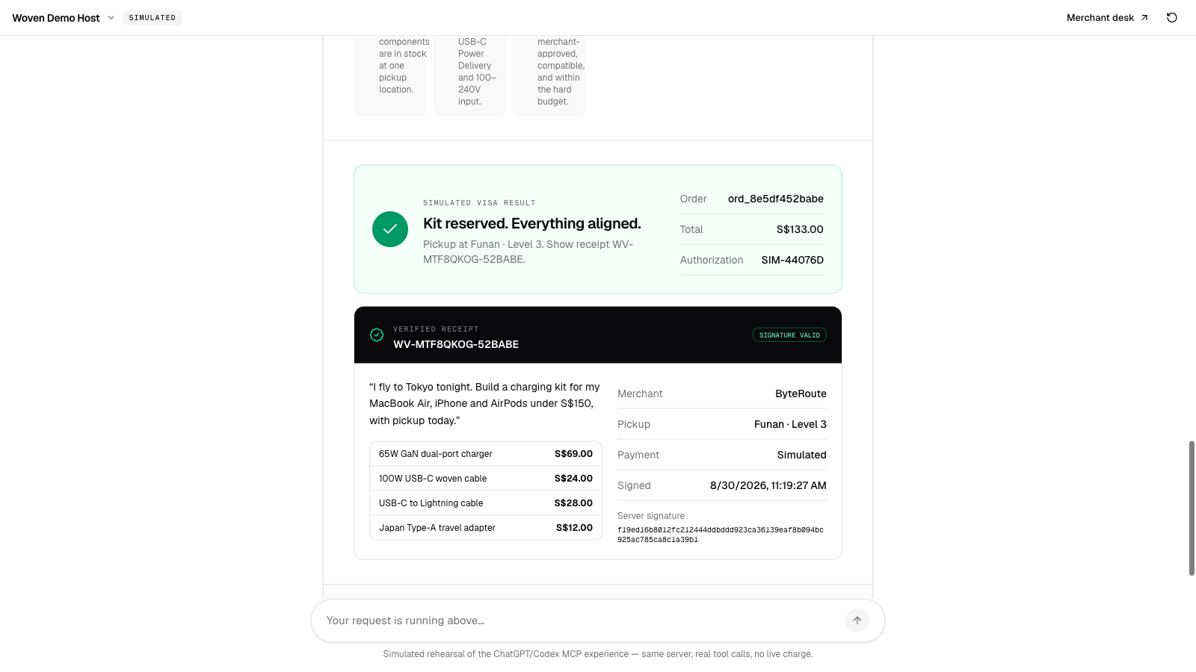
THE TAKEAWAY
The checkout belongs
where the request
begins.
Ask once. Review once. Confirm once.
ChatGPT understands.
Woven builds the right cart.
The user controls authorization.
IDENTITY PLANNED · VISA SIMULATED · RECEIPT VERIFIED
WOVEN / LIFEHACK 2026
07
Notes:
TIME 2:35–3:00
NARRATIVE JOB
Resolve the opening thesis and land the memorable close.
SAY
“Why ChatGPT? Because that is where the user’s request already exists. Woven turns that conversation into comparable merchant actions, an exact checkout, and a signed receipt without asking the user to start again.”
“This prototype uses seeded inventory and a simulated Visa authorization; no live charge occurs. Our next trust step is the connector-style demo identity check.”
“Woven makes shopping through AI simple enough to use—and controlled enough to trust.”
CLOSE
Ask once. Review once. Confirm once.
STAGE CUE
End the three-minute pitch here. Slides 8–11 are Q&A backups only.
[Sources]
- script.md — 2:35–3:00 closing
- docs/assets/screenshots/order-success.png
- docs/DEVPOST_SUBMISSION.md — Three-minute judge demo

Slide 8
BACKUP · WHAT IS REAL
The working prototype already completes the core journey.
01
02
03
Cart engine
Checkout control
Merchant operations
Five ranked complete carts. Compare · preferences · safe swaps.
Expiring exact terms. Direct confirmation · signed receipt.
Alternatives · inventory · scenarios. Orders · audit trail.
MCP APP + REACT UI · SEEDED DATA · SIMULATED PAYMENT
WOVEN / LIFEHACK 2026
08
Notes:
USE IN Q&A — WHAT IS REAL
The working prototype includes the MCP App and browser fallback, five ranked complete carts, comparison and preference controls, compatible merchant-approved swaps, pickup planning, stale-cart recovery, exact expiring checkout terms, direct confirmation, idempotency, signed receipts, merchant controls, failure scenarios, and an audit trail.
JUDGE ANSWER
“The core journey is working end to end with seeded demo inventory and a simulated payment boundary. The primary product is the MCP App; /demo is the same backend over HTTP for stage reliability.”
[Sources]
- README.md — Implemented surfaces and workflow
- docs/PRD.md — Acceptance criteria
- docs/architecture.md — State machine and controls

Slide 9
BACKUP · WHAT IS SIMULATED
The prototype never claims live identity, inventory or payments.
01
02
03
Demo data
Identity direction
Visa response
Seeded merchant inventory and pickup estimates.
Connector-style check is planned and not in the live demo.
Simulated approval, decline and reversal · no live charge.
NO VISA ACCOUNT · NO PAYMENT CREDENTIALS · NO PARTNERSHIP CLAIM
WOVEN / LIFEHACK 2026
09
Notes:
USE IN Q&A — WHAT IS SIMULATED
Inventory and pickup estimates are seeded. Identity verification is a planned product direction, not a live feature. Visa approval, decline, and reversal are simulated. No Visa account is accessed, no payment credentials are collected, and no live charge or partnership is claimed.
JUDGE ANSWER
“The trust boundary is explicit: the working product binds exact terms and requires direct confirmation; identity is next, and the payment rail is clearly simulated.”
[Sources]
- README.md — Prototype boundary
- script.md — Truth guardrails
- docs/PRD.md — Non-goals

Slide 10
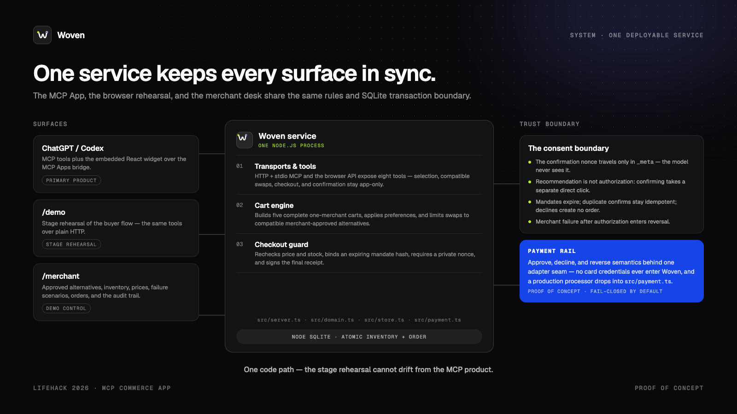
Notes:
USE IN TECHNICAL Q&A — ARCHITECTURE
The ChatGPT or Codex host invokes Woven’s MCP tools. One Node.js service owns cart construction, checkout mandate binding, confirmation, order state, merchant operations, and the simulated Visa adapter. The browser demo is a second transport over the same backend, not a separate product.
POINT TO
MCP and HTTP transports. Mission and cart engine. Checkout guard. Node SQLite atomic inventory and order transaction. Simulated Visa boundary.
[Sources]
- docs/assets/devpost/woven-architecture.png
- docs/architecture.md — System architecture and trust boundaries
- docs/HANDOVER.md — One-service product invariant

Slide 11
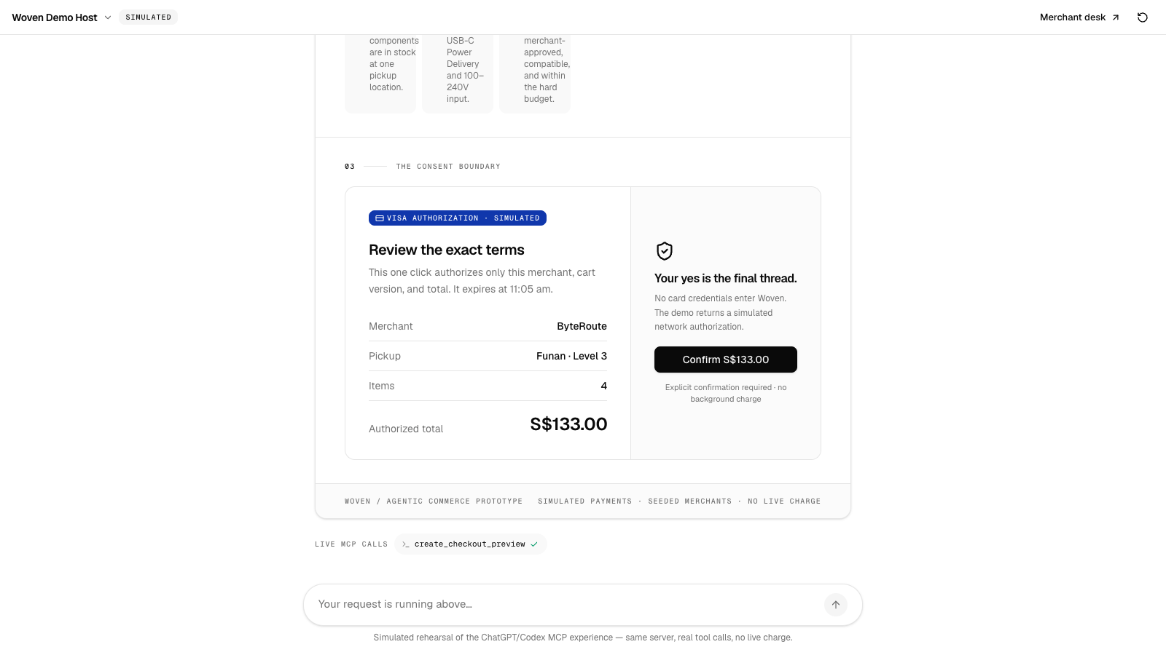
BACKUP · TRUST CONTROLS
Trust is enforced at the purchase boundary.
Exact terms are bound.
Only the user confirms.
IDENTITY · PLANNED / NOT LIVE
Price + stock rechecked · mandate expires · private nonce Idempotent order · simulated reversal
WOVEN / LIFEHACK 2026
11
Notes:
USE IN TRUST AND SAFETY Q&A
Current controls bind merchant, cart version, amount, expiry, nonce, and idempotency key; recheck price and stock; keep the confirmation nonce outside model-visible tool arguments; and simulate reversal after downstream merchant failure. Identity is a planned pre-checkout control and is not implemented.
JUDGE ANSWER
“The model never gets the final yes. It can recommend, but only the widget receives the private confirmation value, and only a direct user action can consume it for the exact displayed terms.”
[Sources]
- docs/assets/devpost/woven-trust-boundary.png
- docs/architecture.md — Mandate, nonce, idempotency, and reversal state machine
- docs/PRD.md — Trust requirements

