Slide 1
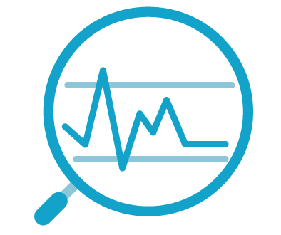
Introduction to Python
Programming for Data Science
Topic 1

Slide 2
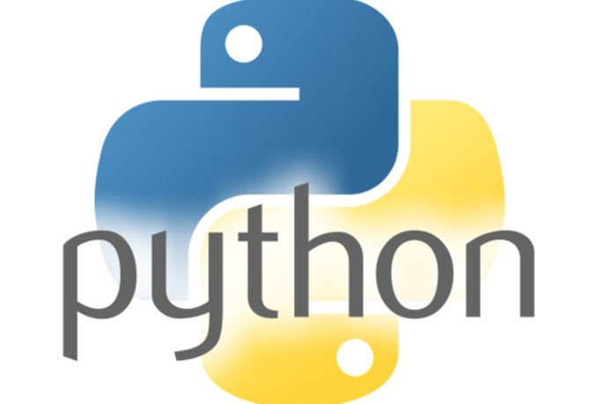
Topics we will cover
Some Python Basics
What is Data Science and why we need it
Intro to Python
Install Anaconda Python
Running Python programs with Jupyter Notebook

Slide 3
Topics we will cover
Some Python Basics
Perform simple console input and output in Python
Inserting comments into your Python code
Using import and calling imported functions
Work with simple data types such as numbers, strings
Use assignment, arithmetic, comparison and logical operators
Implement flow control using if-else statements
Implement loop control using for and while statements
Use Python list, tuple, dictionary object
Define Python functions

Slide 4
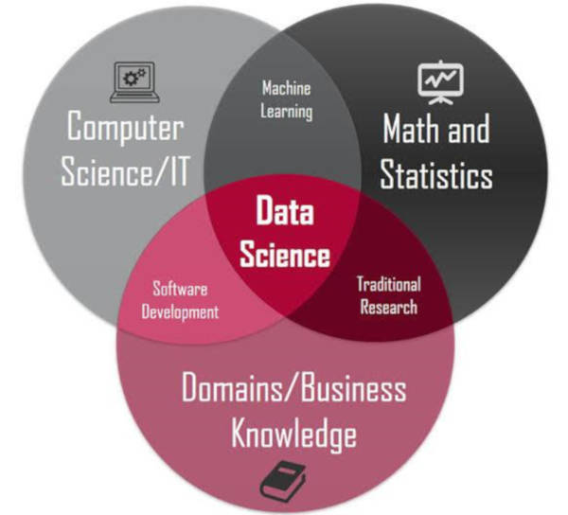
What Is Data Science
Data Science
Data Science is a field of Big data that evaluates massive complex data and gives significant insights about the data.
This field has been dominating most of the industries today and has become the fuel for industries.

Slide 5

What Data Science Can Do
Data Science
Financial Fraud Detection
Tax evasion costs the U.S. government $458 billion a year, so IRS has modernized its fraud-detection protocols in the digital age.
The agency generates taxpayer profiles by analysing big data, such as social media data, emailing analysis, electronic patterns and more.
Based on these profiles, it can forecast individual tax returns. Anyone with big difference between forecast and actual will be audited.

Slide 6

What Data Science Can Do
Data Science
Health Care
Google developed a tool LYNA for identifying breast cancer tumors that transfer to nearby lymph nodes.
Data science and big data has been applied to new drug discovery and development.
Data science helps to analyze the reaction of genes to various medications. Big data technologies can also reduce the processing time for genome sequencing significantly.

Slide 7

What Data Science Can Do
Data Science
Road Transportation
UPS uses data science to optimize package transport from drop-off to delivery. Its latest platform, Network Planning Tools (NPT), incorporates AI to crack challenging logistics puzzles, such as how packages should be rerouted around bad weather or service bottlenecks.
According to a company forecast, the platform could save UPS $100 to $200 million in 2020

Slide 8

What Data Science Can Do
Data Science
Marketing and E-commerce
Instagram uses data science to target its sponsored posts, which hawk everything from trendy sneakers to movie websites.
The company’s data scientists pull data from Instagram as well as its owner, Facebook, which has exhaustive web-tracking infrastructure and detailed information on many users, including age and education.
From there, the team creates AI that convert users’ likes and comments, their usage of other apps and their web history into predictions about the products they might buy.

Slide 9
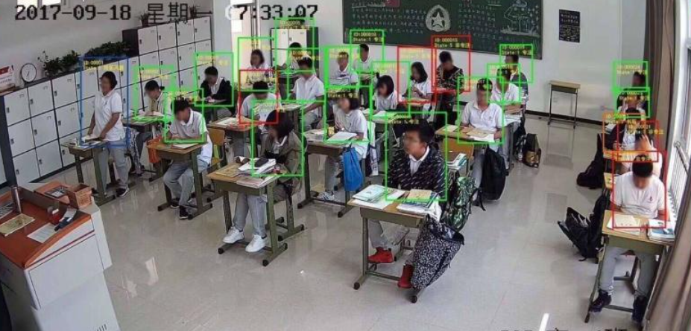
What Data Science Can Do
Data Science
Banking: auto credit card approval.
Manufacturing: Optimize energy consumption and improve production efficiency.
Education: Monitor student performance in class.

Slide 10
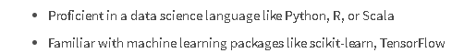

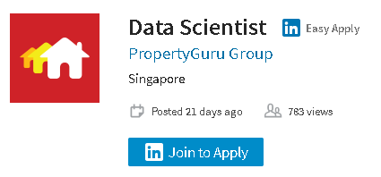


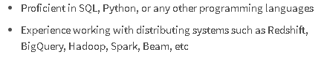
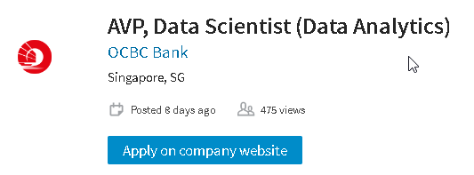
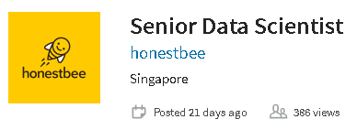
Data Science jobs - what's needed?
Why Programming for Data Science
https://sg.linkedin.com/jobs/data-science-jobs

Slide 11

Brief History of Python
Intro to Python
Python is a widely used high-level programming language created by Guido van Rossum and first released in 1991.
Python 2.0 released in Oct 2000, followed by Python 3.0 in 2008
Latest version of Python, version 3.9 released in Oct 2020
Creator of Python

Slide 12

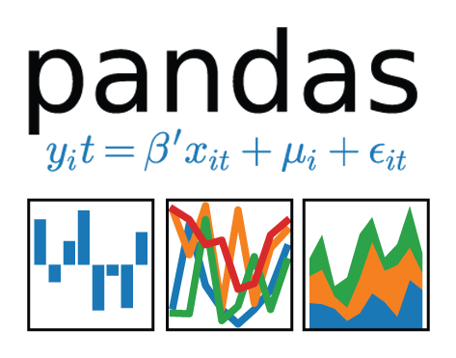
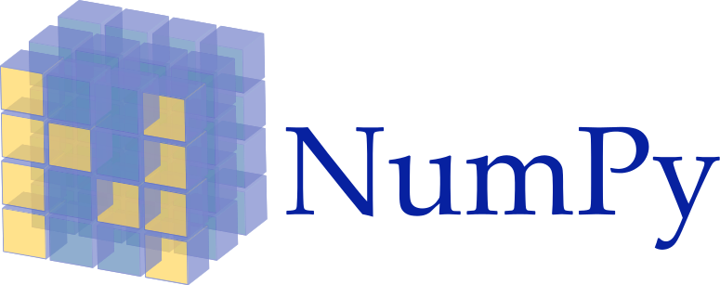
Why Python for Data Science?
Why Python for Data Science?
Python is a great tool for data manipulation, visualization and analysis!
Flexible general programming language
Easy to learn and work with
Has many math / science libraries that makes working with data much easier

Slide 13

Anaconda
Install Anaconda for this module
Python can be run on many operating systems : Windows, Linux, Mac etc
For this module, we will install the Anaconda Individual Edition
Anaconda is a free Python distribution that comes with most of the data science Python packages we need to write data analysis programs
Includes modules such as NumPy, Pandas, Matplotlib
https://www.anaconda.com/products/individual

Slide 14

Jupyter Notebook
Write and run Python programs with Jupyter Notebook
In this module, you will be largely using the Anaconda Jupyter Notebook to write and run your Python code
The Jupyter Notebook App is a web-based application that allows you to edit and run Python programs via your favourite browser.
Refer to Practical 00 to setup the Anaconda Jupyter Notebook environment for the rest of the Labs.
Practical 00

Slide 15

DEMO
Run Python code via Jupyter Notebook

Slide 16
Python Inputs and Outputs (1)
Python Inputs and Outputs
To output to the console, use the print() function
To get input from the console, use the input() function
Ask user for name and print out his name
name = input("What's your name?")
print('Hello' + name)
Ask user for length of square and print out area and perimeter
The input() function automatically interprets all entries as strings
To convert them to numbers, use the int() or float() function
To convert numbers to string, use the str() function
length = int(input("Enter length: "))
breadth = int(input("Enter breadth:"))
print('Area:' + str(length*breadth))
#Another way to print using f-string
print(f'Area: {length*breadth}')
Notes:
@@@

Slide 17

Python Inputs and Outputs (2)
https://docs.python.org/3/library/string.html#formatspec
Python Inputs and Outputs
https://docs.python.org/3/library/string.html#formatstrings
Use f-string to specify decimal precision
weight = float(input("Enter your weight: "))
height = float(input("Enter your height: "))
bmi = weight/(height*height)
print(f'Your bmi is {bmi}')
print(f'Your bmi is {bmi:.2f}')
print(f'Your Height is {height}, weight is {weight} and BMI is {bmi:.4f}')
Ask user for his weight and height
then calculate and print out his BMI
Notes:
@@@

Slide 18
Inserting comments into Python code
Inserting comments into Python code
Sometimes, you may want to insert comments into your Python code
Start comments with a # symbol
Example to show how you insert comments in Python code
# This example shows you how to write a comment
# The code below prompts the user to enter his current age
# and automatically computes the year he was born
age = int(input('Enter your age this year: '))
year_of_birth = 2020 - age
print(f"You were born in the year {year_of_birth} ")
Practical 01 Section 2

Slide 19
Using import (1)
Import libraries in Python
Sometimes, we need to use a function that is not in the default Python library
To use such functions, we use the import keyword to ask the Python interpreter to let us use it
In the example below, we want to generate a random number using the randint() function from the random library.
import random
secret_number = random.randint(1,100)
print(secret_number)
Example to show how you can generate random number using the random.randint() function by first importing the random library

Slide 20
Using import (2)
Some Python Basics
Another example to show how you can get the current time using datetime.now() function which is available only if you import datetime library
# This example shows you how to do an import
# as well as how to format a datetime
from datetime import datetime now = datetime.now() print(f'Today is {now:%d-%b-%Y %H:%M}')
Notes:
@@@

Slide 21
Using import (3)
Import libraries in Python
In the example below, we want to print two messages "Hello" and "Hello again"
However, we want to wait for 5 seconds after the first message, before printing the second
To do this, we can import the sleep function from the time library as shown below
This example shows how delays can be introduced in your program by using sleep() function from time library
from time import sleep
print("Hello")
sleep(5)
print("Hello again")

Slide 22
Using import (4)
Import libraries in Python
Here's another example that uses the time() function from the time library to calculate the time elapsed between two timings
Calculate duration between two times
from time import time
print('Enter your name in the quickest amount of time:')
start = time() # Store the current time
name = input()
reaction_time = time() - start # Calculate how much time has passed
print(f'You took {reaction_time:.2f} seconds')
Notes:
@@@

Slide 23
Using import (5)
Import libraries in Python
This example shows how you calculate the number of years, months and days between two dates by using two libraries: datetime and dateutil
from datetime import datetime
from dateutil import relativedelta as rdelta
date_of_birth = "17-08-1973" # in string format
date_of_birth = datetime.strptime(date_of_birth, '%d-%m-%Y') # datetime format
today = datetime.now() # this is in datetime format
# Calculate diff
rd = rdelta.relativedelta(today,date_of_birth)
print(f"You were born on {date_of_birth:%d-%b-%Y}“)
print(f"{rd.years} years, {rd.months} months and {rd.days} days since you were born")

Slide 24
Working with numeric data types (1)
Standard Data Types
Python has 3 numeric types: integers (int), floating point numbers (float) and complex numbers
Integers are whole numbers while floating point numbers have decimal points
x = 2
y = 8
z = 3.459
print(x*y) # product of x and y → output: 16
print(x/y) # quotient of x and y → output: 0.25
print(x % y) # remainder of x divided by y → output: 2
print(x**y) # x to the power of y → output: 256
print(round(z,1)) # z rounded to 1 decimal place → output: 3.5
Performing simple arithmetic operations on numeric data types
https://docs.python.org/3.6/library/functions.html#int

Slide 25
Working with numeric data types (2)
Standard Data Types
Besides the standard functions, you can apply several additional mathematical functions from the math library to numeric data types as shown below
import math
x = 349.4378
print(math.isnan(x)) # returns True if x is NOT a number
print(math.ceil(x)) # round x upwards → output: 350
print(math.floor(x)) # round x downwards → output: 349
print(math.sqrt(x)) # square root of x → output: 18.693255468216336
Example to show how you use functions from the math library
Practical 01 Section 4

Slide 26
Working with strings
Standard Data Types
Python has a built-in string class with many handy features
String literals can be enclosed by either double or single quotes
Creating string objects
s1 = 'hi how are you'
s2 = "I am fine, thank you"
Notes:
@@@

Slide 27
String indexing
Standard Data Types
Individual characters in a string can be accessed via their INDEX
Indexing starts with zero in Python strings
0 | 1 | 2 | 3 | 4 | 5 | 6 | 7 | 8 | 9 | 10 | 11 | 12 | 13
h | i |  | h | o | w |  | a | r | e |  | y | o | u
s = 'hi how are you'
print(s[0]) # this extracts the character with index 0 → h
print(s[1]) # this extracts the character with index 1 → i
print(s[3:6]) # this extracts 3 characters from index 3 to index 5 → how
Notes:
@@@

Slide 28
Getting length of a string
Standard Data Types
You can retrieve the length of a string with the len function
0 | 1 | 2 | 3 | 4 | 5 | 6 | 7 | 8 | 9 | 10 | 11 | 12 | 13
h | i |  | h | o | w |  | a | r | e |  | y | o | u
s = 'hi how are you'
print(len(s)) # this prints the length of the string → 14
Notes:
@@@

Slide 29
Repeating a string with *
Standard Data Types
You can repeat a string by multiplying it using the * operator
0 | 1 | 2 | 3 | 4 | 5 | 6 | 7 | 8 | 9 | 10 | 11 | 12 | 13
h | i |  | h | o | w |  | a | r | e |  | y | o | u
s = 'hi how are you'
print(s + ' today') # this concatenates the two strings
print(s*2) # prints s twice
Notes:
@@@

Slide 30
Concatenate two strings
Standard Data Types
You can combine two strings by using the + operator
0 | 1 | 2 | 3 | 4 | 5 | 6 | 7 | 8 | 9 | 10 | 11 | 12 | 13
h | i |  | h | o | w |  | a | r | e |  | y | o | u
s1 = 'hi how are you'
s2 = ' today'
print(s1 + s2) # this concatenates the two strings
0 | 1 | 2 | 3 | 4 | 5 | 6 | 7 | 8 | 9 | 10 | 11 | 12 | 13 | 14 | 15 | 16 | 17 | 18 | 19
h | i |  | h | o | w |  | a | r | e |  | y | o | u |  | t | o | d | a | y
Notes:
@@@

Slide 31
Concatenate string and number
Standard Data Types
This example emphasizes the need to use a conversion function when concatenating a string and a non-string
pi = 3.14
text = 'The value of pi is ' + pi ## This does NOT work because pi is number
text = 'The value of pi is ' + str(pi) ## This is ok
print(text)
Notes:
@@@

Slide 32
Useful methods of the str class
Standard Data Types
Turn all characters uppercase/ lowercase and check if a string is numeric
s = 'hi how are you'
print(s.upper()) # this prints out the string in CAPS
print(s.lower()) # this prints out the string in lowercase
print(s.isnumeric()) # prints true if s is numeric → returns False

Slide 33
Useful methods of the str class
Standard Data Types
Find if a substring exists
0 | 1 | 2 | 3 | 4 | 5 | 6 | 7 | 8 | 9 | 10 | 11 | 12 | 13
h | i |  | h | o | w |  | a | r | e |  | y | o | u
s = 'hi how are you'
print(s.find('ar')) # find 'ar' inside the string,
# if found it returns the first index position of ‘ar’ → returns 7

Slide 34
Useful methods of the str class
Standard Data Types
Splitting a string
0 | 1 | 2 | 3 | 4 | 5 | 6 | 7 | 8 | 9 | 10 | 11 | 12 | 13
h | i |  | h | o | w |  | a | r | e |  | y | o | u
s = 'hi how are you'
words = s.split(sep=' ') # splits s into an array, using space as separator
print(words[2]) → returns are
words[0]
hi
words[1]
how
words[2]
are
words[3]
you
Practical 01 Section 5

Slide 35
Types of Operators in Python
Python operators
Python supports the following types of operators:
Arithmetic Operators
Comparison Operators
Assignment Operators
Logical Operators
Membership Operators
Identity Operators

Slide 36
Arithmetic operators
Python Operators
Assume variable num1 holds 10, variable num2 is 5 and variable num3 is 3
+ | Add num1 and num2 | num1 + num2 = 15
– | Subtract num2 from num1 | num1 - num2 = 5
* | Multiply num1 by num2 | num1 * num2 =50
/ | Divide num1 by num2 | num1 / num2 = 2
% | Get the remainder after dividing num1 by num2 | num1 % num2 = 0
** | num1 to the power of num2 | num1 ** num2 = 10⁵
// | Divide num1 by num3 and discard any decimal points from the answer | num1 // num3 = 3
Notes:
@@@

Slide 37
Assignment operators (1)
Python operators
Python allows you to assign single or multiple variables at one go using the = operator
example_assignment_1.py
counter = 100
name = "John" a = b = c = 1
num1, num2, name = 1, 2, "john"

Slide 38
Comparison operators
Python Operators
Assume variable num1 holds 10, variable num2 is 20
num1=10
num2=20
print(num1==num2)
print(num1!=num2)
== | num1 == num2 | False
!= | num1 != num2 | True
> | num1 > num2 | False
< | num1 < num2 | True
>= | num1 >= num2 | False
<= | num1 <= num2 | True

Slide 39
Logical operators
Python Operators
Assume variable num1 =10, variable num2 = 20
and | num1>=10 and num2>=10 num1>=20 and num2>=20 | True False
or | num1>=20 or num2>=20 num1>20 or num2<10 | True False
not | not num1==num2 not num1<num2 | True False
example_logicaloperators_1.py

Slide 40
Membership operators
Python Operators
Python’s membership operators test for membership in a sequence, such as strings, lists, or tuples.
example_membershipoperators_1.py
a = 5
b = 10
list = [1, 2, 3, 4, 5 ]
print(a in list) # True
print(b in list) # False
print(b not in list) # True

Slide 41
Identity operators
Python Operators
example_identityoperators_1.py
Identity operators compare the memory locations of two objects.
a = 20
b = 20
c = a
d= 30
print( a is b) # True
print(a is not b) # False
print(a is c) # True
print(b is c) # True print(a is d) # False

Slide 42
If-else statements (1)
Flow control - if else statements
Python provides if-else statements to enable conditional programming
input_1 = int(input("Enter number 1:"))
input_2 = int(input("Enter number 2:"))
if input_1==input_2:
print("The two numbers are the same")
else:
print("The two numbers are not the same")
Check if two numbers are equa
Notes:
@@@

Slide 43
If-else statements (2)
Flow control - if else statements
Python provides if-else statements to enable conditional programming
input_1 = input("Enter number 1:")
input_2 = input("Enter number 2:")
if input_1.isnumeric() and input_2.isnumeric() :
num_1 = int(input_1)
num_2 = int(input_2)
sum = num_1 + num_2
print("The sum of {} and {} is {}".format(num_1,num_2,sum))
else:
print("Please enter numeric values only")
example_ifelse_1.py
Notes:
@@@

Slide 44
elif
Flow control - if else statements
You can also add in an unlimited number of elif statements following an if to check for multiple conditions
example_ifelse_2.py
print("Below is our drinks menu:")
print("1.Coke 2.Coffee 3.Juice")
drink = int(input("Enter your choice of drink:"))
if drink==1:
print("Coke is $1.00")
elif drink==2:
print("Coffee is $0.50")
elif drink==3:
print("Juice is $2.00")
else:
print("Sorry, you have entered an invalid choice")
Notes:
@@@

Slide 45
Nested if-else
Flow control - if else statements
number = input("Enter your choice (1-2): ")
staff = input("Are you a staff (Y/N)? ")
if number=="1":
if staff.upper() == "Y":
price = 5*0.9
else:
price = 5*0.95
elif number=="2":
if staff.upper() == "Y":
price = 10*0.8
else:
price = 10
else:
print("You did not enter a valid input")
#exit()
print("Price is ${}".format(price))
You can also nest if-else and elif statements
Practical 01 Section 6

Slide 46
iteration with for and while loops
Loops
We often want computers to repeat some process several times
Programming languages provide structures that enable you to repeat blocks of instructions over and over again
This type of repetition is known as iteration.
There are 2 types of loops in Python:
for loop
while loop
These simple for loop and while loop examples would write "hello world" 5 times:
for counter in range(0,5):
print("hello world")
counter = 0
while counter < 5:
print("hello world")
counter+=1

Slide 47
Using for loop
Loop control - for and while statements
Syntax
for stepper_variable in sequence_variable
something_you_want_to_do
Use the for loop when you know how many times you want to repeat a series of statements
The first line of the for statement is used to state how many times the code should be repeated
A stepper variable is used to count through each iteration of the loop.
This prints even numbers from 2 to 100
for i in range(2,102,2): print(i)
This prints the individual letters in the word Python
for letter in 'Python': # First Example
print('Current Letter :', letter)
Notes:
@@@

Slide 48
while loop (1)
Loop control - for and while statements
The while loop repeatedly executes as long as a given condition is true.
This prints "The count is 1", "The count is 2" etc until 10
count = 1
while count <= 10:
print('The count is: {}'.format(count))
count += 1
print("Good bye!")

Slide 49
while loop (2)
Loop control - for and while statements
password = ""
while password != "secret":
password = input("Please enter the password: ")
if password == "secret":
print("Thank you. You have entered the correct password")
else:
print("Sorry the value entered in incorrect - try again")
Here is an example of a while loop being used to test a password. The password is secret and the code within the loop is executed until the user inputs the correct password.

Slide 50
Python Lists
Sequence Data Types - Python Lists
The Python list class is used to store collections of similar or dissimilar items
Creating a list is as simple as putting different comma-separated values between square brackets
Similar to string indices, list indices start at 0, and lists can be sliced, concatenated and so on.
var1 = 'red‘ # this is not a list
list1 = ['red', 'green', 'blue']
list2 = ['NSDDA1', 'NSDDA2', 2017, 2018]
list3 = [1, 2, 3, 4, 5 ]
list4 = ["a", "b", "c", "d"]

Slide 51
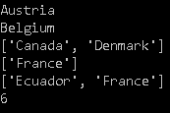
Accessing Values in Lists (1)
Sequence Data Types - Python Lists
To access values in lists, use the square brackets for slicing along with the index or indices to obtain value available at that index
You can get the length of a Python list by using the len() function
countries = ['Austria', 'Belgium', 'Canada', 'Denmark', 'Ecuador', 'France']
print(countries[0]) ## Austria
print(countries[1]) ## Belgium
print(countries[2:4]) ## Canada, Denmark
print(countries[-1:]) ## France
print(countries[-2:]) ## Ecuador, France
print(len(countries)) ## 6
Notes:
How to print the countries in reverse order?
@@@

Slide 52
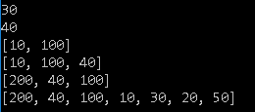
Accessing Values in Lists (2)
Sequence Data Types - Python Lists
Another example to show how you can "slice" lists
list1 = [50,20,30,10,100,40,200]
print(list1[2]) # 3rd element from the front -> 30
print(list1[-2]) # 2nd element from the back -> 40
print(list1[3:5]) # 4th to 5th element -> 10 100
print(list1[-4:-1]) #10 100 40
print(list1[-1:-4:-1]) #200 40 100
print(list1[::-1]) #200 40 100 ...

Slide 53

Iterate through a List (1)
Sequence Data Types - Python Lists
You can use the for loop to iterate through a Python list
colors = ['red', 'green', 'blue', 'yellow', 'magenta', 'cyan']
for color in colors:
print(color)
numbers = [1,2,3,4,5,6,7,8,9,10]
for n in numbers
print(n) # 1,2,3,4,5,6,7,8,9,10
Notes:
@@@

Slide 54
Iterate through a List (2)
Sequence Data Types - Python Lists
colors = ["red car", "green car", "blue", "purple"]
cars = ["Toyota", "Mercedes"]
for i in range(4):
print(colors[i])
fruits = ['banana', 'apple', 'mango', 'pear', 'grape']
for index in range(2,5):
print('Current fruit :', fruits[index]) #mango, pear, grape
Notes:
@@@

Slide 55
Updating Lists
Sequence Data Types - Python Lists
subjects = ['English','Maths','Geography']
## add new item at the back
subjects.append("Physics")
## insert new item at the front
subjects.insert(0, "Chem")
## update value at index 0
subjects[0] = "Chemistry"
## remove at index 1
del(subjects[1])
## removes the last object
subjects.pop()
You can update a list element by giving the slice on the left-hand side of the assignment operator
To add elements in a list, use append() or insert() methods
To remove elements in a list, use del() or pop() methods

Slide 56

+ and * operations on Lists
Sequence Data Types - Python Lists
Lists respond to the + and * operators much like strings, equating to concatenation (+) and repetition (*) as well
The result is a new list
list_1 = [50,20,30,10,100,40,200]
list_2 = [300,65,80]
list_3 = ["apple", "orange","pear"]
print(list_1 + list_2)
print()
print(list_3*2)
print()

Slide 57

Built-in List Functions
Sequence Data Types - Python Lists
Python includes the following list functions
mylist = [50,20,30,10,100,40,200]
mytuple = (50,20,30,10,100,40,100)
print(len(mylist))
print(max(mylist))
print(min(mylist))
print(list(mytuple))
Function | Description
len(list) | Gives total length of the list
max(list) | returns item with the max value from the list
min(list) | returns item with minimum value from the list
list(seq) | Converts tuple from the list

Slide 58
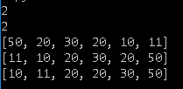
Built-in List Methods
Sequence Data Types - Python Lists
Python includes the following list methods
list1 = [50,20,30,20]
print(list1.count(20))
print(list1.index(30))
list1.extend([10,11])
print(list1)
list1.reverse()
print(list1)
list1.sort()
print(list1)
Function | Description
count(obj) | Returns count of how many times obj occurs in listGives total length of the list
extend(seq) | Appends the contents of seq to list
index(obj) | Returns the lowest index in list that obj appears
reverse() | Reverses objects of list in place
sort([func]) | Sorts objects of list, use compare func if given

Slide 59

Copying lists
Sequence Data Types - Python Lists
Make a copy of a list to another list
Changes to the copy do not affect the original
list1 = [50,20,30,10,100,40,200]
list1copy = list(list1)
list1copy.sort()
print(list1) # list remains the same
print(list1copy) # listcopy is now sorted
Practical 01 Section 9

Slide 60
List Comprehensions (ADVANCED)
Sequence Data Types - Python Lists
Python supports a concept called "list comprehensions"
It eliminates need for loop loops and makes code very concise
It is an advanced concept, so don't worry too much about it if its a little hard to grasp
S = [x**2 for x in range(10)]
print(S) #0 1 4 9 16 25 36 49 64 81
col = ['Red','Green','Blue','Yellow']
info = [[c.upper(), c.lower(), len(c)] for c in col]
print(info)

Slide 61
Working with tuples (1)
Sequence Data Types
A tuple is like a list. The difference is that, it is immutable (cannot be changed)
Tuples use round brackers instead of square brackets
tup1 = ('physics', 'chemistry', 1997, 2000);
tup2 = (1, 2, 3, 4, 5 );
tup3 = "a", "b", "c", "d";
tup4 = (50,) # for tuples with a single value, it is a must to put a comma after first value
print(tup1)
print(tup2[2:4])
print(tup3[-1])
print(len(tup4))
example_tuples_1.py

Slide 62
Dictionaries
Sequence Data Types - Dictionary
phonebook = {}
phonebook["John"] = 93847756
phonebook["Jack"] = 93837726
phonebook["Jill"] = 94766278
print(phonebook)
A dictionary is a data type similar to lists, but works with keys and values instead of indexes
Each value stored in a dictionary can be accessed using a unique key, which is any type of object instead of using its index to address it.
For example, a database of phone numbers could be stored using a dictionary like this
phonebook = {
"John" : 938477566,
"Jack" : 938377264,
"Jill" : 947662781
}
print(phonebook)

Slide 63
Iterating through a dictionary
Sequence Data Types - Dictionary
It is best to think of a dictionary as an unordered set of key: value pairs, with the requirement that the keys are unique (within one dictionary).
The example here shows how you can iterate through a dictionary using its keys
Create a dictionary and iterate through it
tel = {
'Ms Dora': 68706085,
'Ms Eileen': 68704739,
'Mr Calvin':67721917,
'Mr Hu-Shien': 67721922
}
print(tel.keys())
for t in tel: # t is the key
print(t) # print the keys
print(tel[t]) # access via the keys

Slide 64
Iterating through dictionary (items)
Sequence Data Types - Dictionary
You can also use the dict constructor to create the key-value pairs as shown
This example also shows another way to iterate through dictionary by using .items() method
phonebook = { "John" : 938477566, "Jack" : 938377264, "Jill" : 947662781
}
for name, number in phonebook.items(): print(f"{name}: {number}")

Slide 65
Introduction to Functions
Python functions
A function is a block of organized, reusable code that is used to perform a single, related action
Functions provide better modularity for your application and a high degree of code reusing
# The familiar print() function
print("Hello")
# The familiar input() function
num1 = input("Enter number 1: ")
num2 = input("Enter number 2: ")
# The familiar len() function
name = input("Enter your name: ")
print(len(name))
Notes:
@@@

Slide 66
Defining a Python function
Python functions
Function blocks begin with the keyword def followed by the function name and round brackets
The round brackets may enclose input parameters
The code block within every function starts with a colon (:) and is indented
A function may optionally return None, one, or more return values
def printme(string, num_times):
for i in range(num_times):
print(string)
This function accepts two input parameters
Does not return any value
printme('Hello',3)
printme('*****',2)
Notes:
@@@

Slide 67
Defining a Python function
Python functions
from time import sleep
def printme(string, num_times,delay):
for i in range(num_times):
print(string)
sleep(delay)
printme('Hello',10,5)
printme('*****',20,3)
This function accepts thtree input parameters
Does not return any value
Notes:
@@@

Slide 68
Defining a Python function
Python functions
def traffic_light(color):
if color == 'red':
return "Cannot cross"
elif color == 'green':
return "Can cross"
else:
return "Invalid color"
color = "red"
print(traffic_light(color))
color = "green"
print(traffic_light(color))
This function accepts one input parameter
Returns a single string value
Notes:
@@@

Slide 69
Defining a Python function
Python functions
def isDivisibleBy(num1,num2):
if num1 % num2 == 0:
return True
else:
return False
n1 = 180
n2 = 4
print(isDivisiblyBy(n1,n2))
This function accepts two input parameters
Returns a single Boolean value
Notes:
@@@

Slide 70
Defining a Python function
Python functions
def divideList(list, number):
list1 = []
list2 = []
for n in list:
if n<number:
list1.append(n)
elif n> number:
list2.append(n)
return list1, list2
This function accepts two input parameters, first is a list, second is a number
The function iterates through the list elements, and divides up the list
First list -> numbers smaller than number
Second list -> numbers greater than number
Returns both the First and Second List
d = [100,5,11,30,35,16] d1, d2 = divideList(d,20)
print(d1) print(d2)
Practical 01 Section 10

Slide 71
try-except
Exception handling
It is good practice to write Python programs that have exception handling
Python has many built-in exceptions which forces your program to output an error when something in it goes wrong.
try:
number = int(input('Please enter a number: '))
print(number)
except ValueError:
print('You should enter a number')
When these exceptions occur, it causes the current process to stop and passes it to the calling process until it is handled. If not handled, our program will crash
You can handle exceptions using try, except as shown
Handling known error types in Python
ValueError, ZeroDivisionError, TypeError etc are known error type

Slide 72
The End

Slide 73
Some useful Python resources
Links
https://www.tutorialspoint.com/python
http://www.practicepython.org/
https://www.learnpython.org
https://www.w3resource.com/python/python-tutorial.php
https://pythonschool.net/
https://developers.google.com/edu/python/
https://chrisalbon.com/python
http://pbpython.com/
www.pythonforbeginners.com
https://www.programiz.com/python-programming
pythoncentral.io
https://learnpythonthehardway.org
http://codingbat.com/python

Slide 74
Some useful Python resources
Links
https://stackoverflow.com/questions/tagged/python
https://pyformat.info/

Slide 75
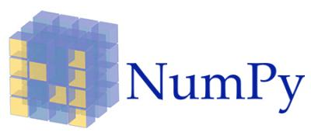
Topic 2
Data Manipulation Using The Numpy Package

Slide 76
Contents
Contents
Intro to Numpy
Creating Numpy arrays
Numpy data types
Inspecting Numpy arrays
Manipulating Array Shapes
Changing array shape
Transpose array
Add/ remove elements
Combine arrays
Split arrays
Converting arrays
Copying Arrays
Sorting Arrays
Subsetting, Slicing and Indexing Numpy arrays
Array Mathematics
Arithmetic operations
Logical operations
Mathematical and Statistical Methods
File I/O on Numpy arrays

Slide 77
Intro to Numpy

Slide 78
What is Numpy?
Intro to Numpy
NumPy (short for numerical Python) is an open source Python library for scientific computing.
It lets you work with arrays and matrices in a natural way
Contains a long list of useful mathematical functions, including some functions for linear algebra, Fourier transformation, and random number generation routines.

Slide 79
Why use NumPy?
Intro to Numpy
NumPy code is much cleaner than regular Python code to accomplish the same tasks. Fewer loops required as operations work directly on arrays and matrices
Has many convenience and mathematical functions that make coding much easier
Underlying algorithms designed with high performance in mind. Large portions of NumPy are written in C. This makes NumPy faster than pure Python code
NumPy's arrays are stored more efficiently than an equivalent data structure in base Python, such as a list of lists. The bigger the array, the more it pays off to use NumPy

Slide 80
A simple application
Intro to Numpy
Imagine that we want to add two vectors called a and b
a = [0,1,4,9,16...] # The vector a holds the squares of integers 0 to n
b = [0,1,8,27,64...] # The vector b holds the cubes of integers 0 to n
def pythonsum(n):
a = list(range(n))
b = list(range(n))
c = [] for i in range(len(a)):
a[i] = i ** 2
b[i] = i ** 3
c.append(a[i] + b[i])
return c
import numpy as np
def numpysum(n):
a = np.arange(n) ** 2
b = np.arange(n) ** 3
c = a + b
return c
Using base Python
Using NumPy
Notes:
def pythonsum1(n):
a=[i**2 for i in range(n)]
b=[i**3 for i in range(n+1)]
#assert len(a) == len(b)
#c=[i + j for i,j in zip(a,b)]
c=[a[i] + b[i] for i in range(0, len(a))]
return c
sum1=pythonsum1(10)
print(sum1)
from time import time
start=time()
sum=pythonsum(100000)
end=time()
print('Time taken 1: {}'.format(end-start))

Slide 81
Numpy Documentation
Intro to Numpy
Official documentation
https://numpy.org/
NumPy Tutorial from W3Schools
https://www.w3schools.com/python/numpy_intro.asp
Notes:
To add

Slide 82
Creating Numpy Arrays

Slide 83
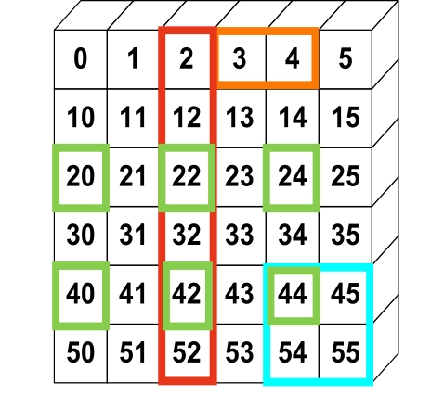
Numpy Array
Intro to Numpy
NumPy provides an N-dimensional array type, the ndarray, which describes a collection of “items” of the same type
The "type" can be any arbitrary structure of bytes and specified using the data type
import numpy as np
# Create a 2-d array (6x6)
a = np.array([(0,1,2,3,4,5),
(10,11,12,13,14,15),
...
(50,51,52,53,54,55)])
print(a[:,2])
[2,12,22,32,42,52]

Slide 84
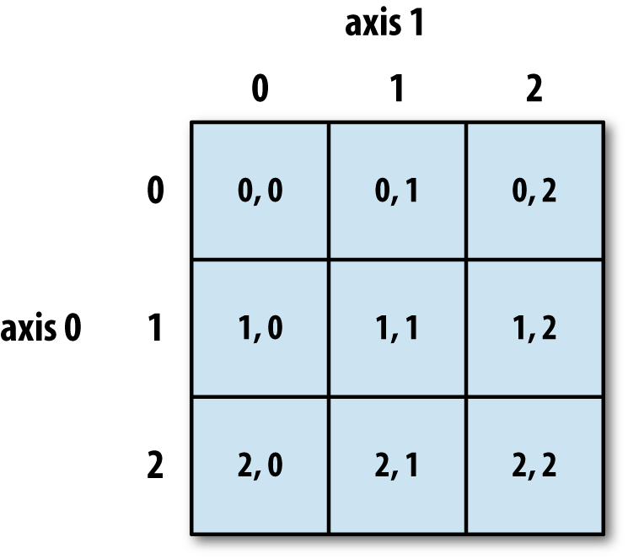
Structure of ndarray
Intro to Numpy
This is an example of a 3x3 ndarray
The size of the array is 9 (i.e. 9 elements inside) and the dimension is 2 (i.e. 2D array)

Slide 85
Using .array() method
Creating Numpy Arrays
import numpy as np
a = np.array([1,2,3]) # Create a 1-d array of integers
b = np.array([(1,2,3),(4,5,6)]) # Create a 2-d array (2x3)
# Create a 1-d array of strings c = np.array(['Apple', 'Orange', 'Pear', 'Durian'])
# Create a 2-d array (2x4) of type float
d = np.array([(1.5,2.5,3.5,4.5),(5.5,6.5,7.5,8.5)],dtype=float)

Slide 86

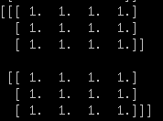
Using zeros() and ones()
Creating Numpy Arrays
import numpy as np
# Create a 3x4 2-d array, with initial value zero
a = np.zeros((3,4))
print(a)
# Create a 2x3x4 3-d array with initial value one
b = np.ones((2,3,4))
print(b)

Slide 87

Using arange()
Creating Numpy Arrays
import numpy as np
# numpy.arange(start,stop,step)
# Create an array that starts from zero and ends at 8
a = np.arange(0,9)
print(a)
# Create array that starts from 10 and ends at 19 with interval 2
c = np.arange(10,20,2)
print(c)
Notes:
https://docs.scipy.org/doc/numpy/reference/generated/numpy.arange.html
@@@

Slide 88
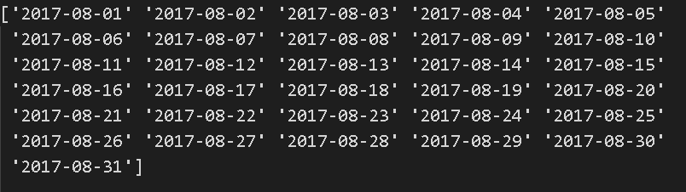
Using arange()
Creating Numpy Arrays
import numpy as np
# Create an array that contains the dates in month of Aug 2017
d = np.arange('2017-08-01','2017-09-01',dtype='datetime64')
print(d)
Notes:
https://docs.scipy.org/doc/numpy/reference/generated/numpy.arange.html

Slide 89
Using linspace()
Creating Numpy Arrays
import numpy as np
# numpy.linspace(start,stop,num)
# Create array that starts with 0 and ends at 2 # with 9 samples in between
d = np.linspace(0,2,9)
print(d)
Notes:
https://docs.scipy.org/doc/numpy/reference/generated/numpy.arange.html
https://docs.scipy.org/doc/numpy/reference/generated/numpy.linspace.html

Slide 90


Using full() and eye()
Creating Numpy Arrays
import numpy as np
# Create a constant array with a specified value # numpy.full(shape, fill_value)
h = 7.0
e = np.full((2,2),h)
print(e)
# Create a 2x2 identity matrix
f = np.eye(2)
print(f)
Notes:
https://docs.scipy.org/doc/numpy/reference/generated/numpy.full.html
https://docs.scipy.org/doc/numpy/reference/generated/numpy.eye.html

Slide 91

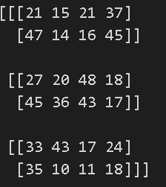
Using random() and randint()
Creating Numpy Arrays
import numpy as np
# Create a 2x2 array with random floats in the interval 0.0 to 1.0 g = np.random.random((2,2))
print(g)
# Create a 3x2x4 array with random numbers # between 10 and 50 (not including 50)
h = np.random.randint(10,50,(3,2,4))
print(h)
Notes:
https://docs.scipy.org/doc/numpy/reference/generated/numpy.random.random.html
https://docs.scipy.org/doc/numpy/reference/generated/numpy.random.randint.html

Slide 92

Using empty()
Creating Numpy Arrays
import numpy as np
# Create a 3x2 empty array
h = np.empty((3,2))
print(h)
Notes:
https://docs.scipy.org/doc/numpy/reference/generated/numpy.random.random.html
https://docs.scipy.org/doc/numpy/reference/generated/numpy.empty.html

Slide 93
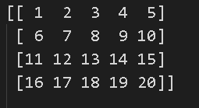
Using reshape()
Creating Numpy Arrays
import numpy as np
# Create 20 numbers from 1 to 20 as a 1-d array
# then reshape this to a 2d array of shape 4x5
a = np.arange(1,21).reshape(4,5)
print(a)

Slide 94
Put different ndarrays into 1 single ndarray
Creating Numpy Arrays
import numpy as np
c1 = np.array([1,2,3,4,5])
c2 = np.arange(2,21,2)
c3 = np.random.randint(1,100,10)
c = np.array([c1,c2,c3])
Practical 2 Section 3

Slide 95
Numpy Data Types
Notes:
https://docs.scipy.org/doc/numpy/reference/arrays.dtypes.html

Slide 96
Numpy Data Types
Data Types
np.int32 | 32-bit integer
np.int64 | 64-bit integer
np.float64 | 64-bit decimal number
np.bool | Boolean type storing TRUE and FALSE values
np.object | Python object type
np.unicode | Fixed-length Unicode string type

Slide 97

Numpy Data Types
Data Types
import numpy as np
a = np.arange(10)
print(f'type(a) is {type(a)}')
print(f'a.dtype is {a.dtype}')

Slide 98
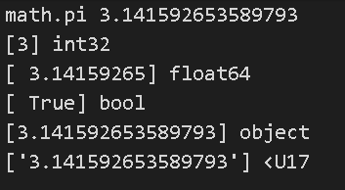
Numpy Data Types
Data Types
import numpy as np
import math
a = np.array([math.pi],dtype=np.int32)
b = np.array([math.pi],dtype=np.float64)
c = np.array([math.pi],dtype=np.bool)
d = np.array([math.pi],dtype=np.object)
e = np.array([math.pi],dtype=np.unicode)

Slide 99
Inspecting your array

Slide 100

shape
Inspecting your array
import numpy as np
# Create 3 arrays with different shapes
a = np.array([1,2,3])
b = np.array([(1,2,3),(4,5,6)])
c = np.array([[(1,2,3,4),(5,6,7,8)], [(9,10,11,12),(13,14,15,16)]])
#shape returns the number of elements in each dimension
print(a.shape)
print(b.shape)
print(c.shape)
(3,)
(2, 3)
(2, 2, 4)
Notes:
The shape of an array is the number of elements in each dimension.

Slide 101
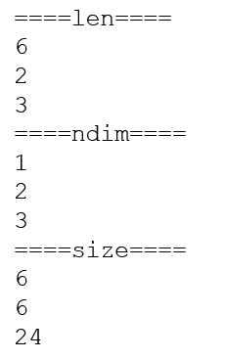
len, ndim, size
Inspecting your array
import numpy as np
# Create 3 arrays with different shapes and sizes
a = np.array([1,2,3,4,5,6])
b = np.array([(1,2,3),(4,5,6)])
c = np.array([[(1,2,3,4),(5,6,7,8)],
[(9,10,11,12),(13,14,15,16)],
[(17,18,19,20),(21,22,23,24)]])
# Size of the first dimension (no of rows)
print('====len====')
print(len(a));print(len(b));print(len(c))
# Number of dimensions
print('====ndim====')
print(a.ndim);print(b.ndim);print(c.ndim)
# Total number of elements across dimensions
print('====size====')
print(a.size);print(b.size); print(c.size)
Practical 2 Section 4

Slide 102
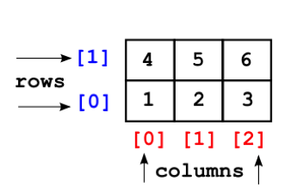
Rows and columns reference
Inspecting your array
Practical 2 Section 4

Slide 103
Functions to manipulate array shapes
Manipulating Array Shapes
CHANGE ARRAY SHAPE
flatten()
reshape()
shape()
resize()
COMBINE ARRAYS
concatenate
ADD/REMOVE ELEMENTS
append()
insert()
delete()
TRANSPOSE ARRAY
transpose

Slide 104
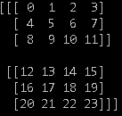
Change array shape - flatten()
Manipulating Array Shapes
Use this function to convert your M-D array to a 1-D array
Return value is a copy of the original array
import numpy as np
b = np.arange(24).reshape(2,3,4) # b= [[[0,1,2,3],[4,5,6,7],[8..],[20,21,22,23]]]
c = b.flatten()
print(b)
print(c) #[ 0 1 2 3 4 5 6 7 8 9 10 11 12 13 14 15 16 17 18 19 20 21 22 23]
c[0] = 100; # change the first value in the copy
print(b)
print(c) #[ 100 1 2 3 4 5 6 7 8 9 10 11 12 13 14 15 16 17 18 19 20 21 22 23]

Slide 105
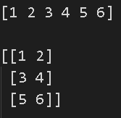
Change array shape - reshape()
Manipulating Array Shapes
reshape gives a new shape to an array without changing its data. It creates a new array and does not modify the original array itself
import numpy
my_array = numpy.array([1,2,3,4,5,6])
print(my_array)
print()
print(numpy.reshape(my_array,(3,2)))
Notes:
What is the difference between reshape(), resize()?
ValueError Traceback (most recent call last) <ipython-input-29-c755319fb958> in <module> 4 print(my_array) 5 print() ----> 6 print(numpy.reshape(my_array,(3,3))) <__array_function__ internals> in reshape(*args, **kwargs) ~\anaconda3\lib\site-packages\numpy\core\fromnumeric.py in reshape(a, newshape, order) 297 [5, 6]]) 298 """ --> 299 return _wrapfunc(a, 'reshape', newshape, order=order) 300 301 ~\anaconda3\lib\site-packages\numpy\core\fromnumeric.py in _wrapfunc(obj, method, *args, **kwds) 56 57 try: ---> 58 return bound(*args, **kwds) 59 except TypeError: 60 # A TypeError occurs if the object does have such a method in its ValueError: cannot reshape array of size 6 into shape (3,3)

Slide 106
shape
Manipulating Array Shapes
The shape attribute an be used to get array dimensions or to change array dimensions
import numpy as np
a= np.array([1, 2, 3, 4, 5])
print(a.shape) #(5,) -> 5 rows and 0 columns
b = np.array([[1, 2],[3, 4],[6,5]])
print(b.shape) #(3, 2) -> 3 rows and 2 columns

Slide 107
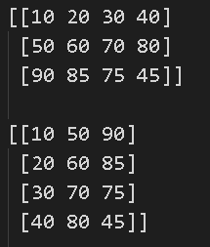
transpose()
Manipulating Array Shapes
The transpose of an array can be obtained by using transpose() method
transpose() is both a library level function and an instance method.
It can be called as numpy.transpose(ndarray) or numpy.ndarray.transpose().
ndarray has an attribute named ‘T’, which returns the transpose of the array.
import numpy as np
x = np.array(([10,20,30,40], [50,60,70,80], [90, 85, 75, 45]))
print(x)
print(x.transpose())
print(np.transpose(x))
print(x.T)

Slide 108
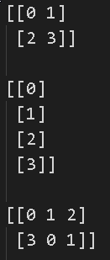
resize()
Manipulating Array Shapes
The resize() method works just like the reshape() function, but modifies the array it operates on:
import numpy as np
a=np.array([[0,1],[2,3]]) #2x2
a = np.resize(a,(4,1))
a = np.resize(a,(2,3)) # not allow in reshape
Practical 2 Section 5

Slide 109

concatenate() - 1-d arrays
Manipulating Array Shapes
Two or more arrays can be concatenated using concatenate() function along an axis
The arrays must have the same shape, except in the dimension corresponding to axis (the first, by default).
numpy.concatenate((a1, a2, ...), axis=0)
import numpy as np
# 1-D array
x = np.arange(5)
y = np.arange(6,10)
z = np.arange(11,15)
print(x);print(y); print(z)
print(np.concatenate((x,y,z)))
Notes:
https://docs.scipy.org/doc/numpy-1.13.0/reference/generated/numpy.concatenate.html
import numpy as np
# 1-D array
x = np.arange(8)
y = np.arange(6,10).reshape(2,2)
z = np.arange(11,15)
print(x);print(y); print(z)
print(np.concatenate((x,y,z)))

Slide 110
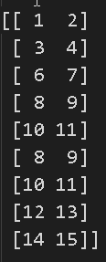

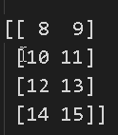
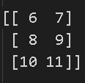
concatenate() 2-d arrays on axis=0
Manipulating Array Shapes
import numpy as np
# Reshaped to 2-D
x = np.arange(1,5).reshape(2,2)
y = np.arange(6,12).reshape(3,2)
z = np.arange(8,16).reshape(4,2)
print(x)
print(y)
print(z)
print(np.concatenate((x,y,z)))
Notes:
https://docs.scipy.org/doc/numpy-1.13.0/reference/generated/numpy.concatenate.html

Slide 111
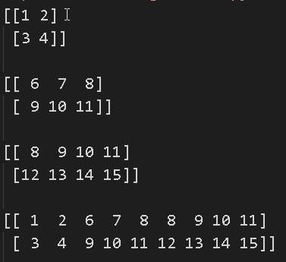
concatenate() - 2-d arrays on axis=1
Manipulating Array Shapes
import numpy as np
x = np.arange(1,5).reshape(2,2)
y = np.arange(6,12).reshape(2,3)
z = np.arange(8,16).reshape(2,4)
print(x)
print(y)
print(z)
print(np.concatenate((x,y,z),axis=1))
Notes:
https://docs.scipy.org/doc/numpy-1.13.0/reference/generated/numpy.concatenate.html

Slide 112
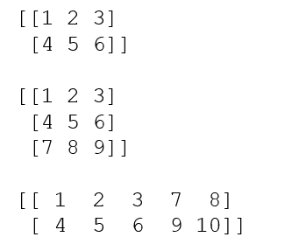
append()
Manipulating Array Shapes
Append values to the end of an array
values must be of the correct shape (the same shape as arr, excluding axis)
If axis is not specified, values can be any shape and will be flattened before use.
import numpy as np
x = np.array([(1,2,3), (4,5,6)])
print(x);print()
x1 = np.append(x, np.array([(7,8,9)]),axis = 0)
x2 = np.append(x, np.array([(7,8), (9,10)]),axis = 1)
print(x1);print()
print(x2);print()
numpy.append(arr, values, axis=None)
Notes:
https://docs.scipy.org/doc/numpy-1.13.0/reference/generated/numpy.append.html
Axis = 0, go down, axis =1 go horizontal

Slide 113
Functions to split arrays
Splitting arrays
split() | This function splits one-dimensional arrays as columns to create a two-dimensional array
hsplit() | This function splits arrays horizontally
vsplit() | This function splits arrays vertically
Notes:
here

Slide 114
split
Splitting arrays
numpy.split(array, indices_or_sections, axis=0)
Split an array into multiple sub-arrays.
import numpy as np
x = np.arange(9.0)
y = np.split(x, 3)
print(x)
print(y)
Notes:
https://docs.scipy.org/doc/numpy-1.13.0/reference/generated/numpy.split.html

Slide 115
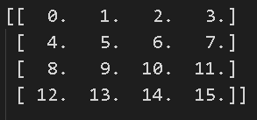
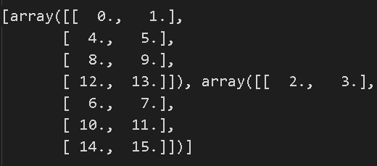
hsplit
Splitting arrays
Split an array into multiple sub-arrays horizontally (column-wise)
Equivalent to split with axis=1, the array is always split along the second axis regardless of the array dimension
import numpy as np
x = np.arange(16.0).reshape(4, 4)
y = np.hsplit(x, 2)
print(x)
print(y)
Notes:
https://docs.scipy.org/doc/numpy-1.13.0/reference/generated/numpy.hsplit.html

Slide 116
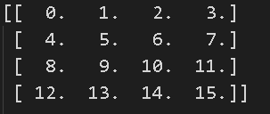
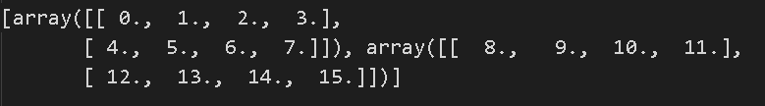
vsplit
Splitting arrays
Split an array into multiple sub-arrays vertically (row-wise)
equivalent to split with axis=0 (default), the array is always split along the first axis regardless of the array dimension
import numpy as np
x = np.arange(16.0).reshape(4, 4)
y = np.vsplit(x, 2)
print(x)
print(y)
Practical 2 Section 6
Notes:
https://docs.scipy.org/doc/numpy-1.13.0/reference/generated/numpy.vsplit.html

Slide 117
Copying arrays

Slide 118

numpy.copy
Copying Arrays
import numpy as np
# Create 2 arrays with different data types, shapes and sizes
a = np.array([10,2,8,4,6,1,5,9,3,7]) b = np.array([("Red","Blue","Yellow"),("Green","Cyan","Magenta")])
npc = np.copy(a)
npc.sort()
print(a)
print(npc)
Practical 2 Section 7

Slide 119
Sorting arrays

Slide 120

Sorting arrays
Sorting Arrays
import numpy as np
# Create 2 arrays with different data types, shapes and sizes
a = np.array([10,2,8,4,6,1,5,9,3,7]) b = np.array([("Red","Blue","Yellow"),("Green","Cyan","Magenta")])
a.sort()
b.sort(axis=1)#column
print(a)
print(b)
Practical 2 Section 8
Notes:
https://docs.scipy.org/doc/numpy/reference/generated/numpy.full.html
https://docs.scipy.org/doc/numpy/reference/generated/numpy.eye.html

Slide 121
Subsetting, Slicing and Indexing

Slide 122
One-dimensional slicing and indexing
Subsetting, Slicing and Indexing
import numpy as np
a = np.arange(9) # a = [0,1,2,3,4,5,6,7,8]
# Select the element at index 2
print(a[2]) # 2
# Select elements from index 0 to 7 with step 2
print(a[:7:2]) # 0 2 4 6
# Select and reverse elements from index 0 to the end
print(a[::-1]) # 8 7 6 5 4 3 2 1

Slide 123
Multi-dimensional Slicing and indexing 1
Subsetting, Slicing and Indexing
import numpy as np
# Create an array with 0 to 23 and reshape it into a 2x3x4 array # Think of it as an Excel workbook with 2 worksheets
# Each worksheet has 3 rows,4 columns
b = np.arange(24).reshape(2,3,4)
print(b)

Slide 124
Multi-dimensional Slicing and indexing 1
Subsetting, Slicing and Indexing
# Select worksheet 2, Row 2, Col 4
print(b[1,1,3]) # 19
# Select both worksheets, Row 1, Col 1
print(b[:,0,0]) # 0 12
# Select first worksheet, all rows and columns
# Method 1
print(b[0])
# Method 2
print(b[0, :, :])
# Method 3, Ellipsis replaces the multiple colons
print(b[0, ...])
Notes:
Stop here

Slide 125
Multi-dimensional Slicing and indexing 2
Subsetting, Slicing and Indexing
# Select first worksheet, second row, all columns
print(b[0,1]) # 4 5 6 7
# Select first worksheet, all rows, second column
print(b[0,:,1]) # 1 5 9
# Select every 2 elements in first worksheet, 2nd row, all cols
print(b[0,1,::2]) # 4 6
# Select all worksheets, all rows, 2nd col
print(b[...,1]) # 1 5 9 13 17 21
# Select 2nd row elements, regardless of worksheet and col
print(b[:,1,:]) # 4 5 6 7 16 17 18 19
# Select 1st worksheet, all rows, last column
print(b[0,:,-1]) #3 7 11

Slide 126
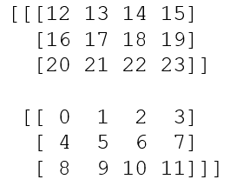
Multi-dimensional Slicing and indexing 3
Subsetting, Slicing and Indexing
# Select first worksheet, all rows, last col, but in reverse
print(b[0,::-1, -1]) # 11 7 3
# Select 1st worksheet, last col, every 2 rows print(b[0,::2,-1]) # 3 11
# Select all worksheets in reverse, all rows, all col
print(b[::-1])

Slide 127
Boolean Indexing
Subsetting, Slicing and Indexing
Boolean indexing lets you indicate if an element should be included
In the example below, we want to create an array with only the even numbers
import numpy as np
a = np.arange(6).reshape(2,3)
b = a % 2 == 0
a = a[b]
print(a)
# 0, 2, 4

Slide 128
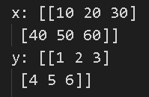
Arithmetic operators
Arithmetic and Logical operations on Arrays
The standard arithmetic operators such as: +, -, *, /, **, % are applied on individual elements, so, the arrays have to be of the same size
import numpy as np
x = np.array(([10,20,30], [40,50,60]))
y = np.array(([1,2,3], [4,5,6]))
print(x) print(y)
print(x+y)
print(x-y)
print(x*y)
print(x/y)
print(x%y)

Slide 129
Logical operators
Arithmetic and Logical operations on Arrays
Similarly, logical operators >, < , == are applied on individual elements, so arrays have to be of same size
import numpy as np
x = np.array(([10,20,30], [40,50,60]))
y = np.array(([1,2,3], [4,5,6]))
print(x) print(y)
print(x>y)
print(x<y)
print(x==y)
Practical 2 Section 10

Slide 130
Mathematical and Statistical Methods
Mathematical and Statistical Methods
sum() | Sum of all the elements in the array or along an axis. Zero-length arrays have sum 0.
mean() | Arithmetic mean. Zero-length arrays have NaN mean.
median()
cumsum() | Return the cumulative sum of the elements along a given axis.
cumprod() | This function stacks one-dimensional arrays as columns to create a two-dimensional array
std, var | Returns the standard deviation, a measure of the spread of a distribution, of the array elements Returns the variance of the array elements, a measure of the spread of a distribution
min,max | Return the minimum, maximum along a given axis
argmin, argmax | Return indices of the minimum, maximum values along the given axis

Slide 131
sum()
Mathematical and Statistical Methods
Sum of all the elements in the array or along an axis
Zero-length arrays have sum 0
numpy.sum(a, axis=None, dtype=None, out=None, keepdims=<class numpy._globals._NoValue>)
import numpy as np
b = np.arange(24).reshape(6,4) # b= [[[0,1,2,3],[4,5,6,7],[8..],[20,21,22,23]]]
print(b.sum()) # 276

Slide 132
mean()
Mathematical and Statistical Methods
Sum of all the elements in the array or along an axis
Zero-length arrays have mean 0
import numpy as np
b = np.arange(24) # b= [0,1,2,3,4,... 23]
print(b.mean()) # 11.5

Slide 133

median()
Mathematical and Statistical Methods
numpy.median(a, axis=None, out=None, overwrite_input=False, keepdims=False)
Compute the median along the specified axis.
Returns the median of the array elements
import numpy as np
a = np.array([[10, 7, 4], [3, 2, 1]])
median = np.median(a)
print(median)
Notes:
https://docs.scipy.org/doc/numpy-1.13.0/reference/generated/numpy.median.html

Slide 134
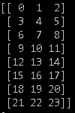


min(), max()
Mathematical and Statistical Methods
ndarray.min(axis=None, out=None, keepdims=False)
ndarray.max(axis=None, out=None, keepdims=False)
import numpy as np
b = np.arange(24).reshape(8,3)
print(b.min())
print(b.min(axis=0))
print(b.min(axis=1))
print(b.max())
print(b.max(axis=0))
print(b.max(axis=1))

Slide 135


argmin(), argmax()
Mathematical and Statistical Methods
numpy.argmin(a, axis=None, out=None)
numpy.argmax(a,axis=None, out=None)
import numpy as np
b = np.arange(24).reshape(8,3)
print(b)
print(b.argmin())
print(b.argmin(axis=0))
print(b.argmin(axis=1))
print(b.argmax())
print(b.argmax(axis=0))
print(b.argmax(axis=1))

Slide 136

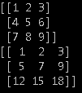
cumsum()
Mathematical and Statistical Methods
Return the cumulative sum of the elements along a given axis
numpy.cumsum(a, axis=None, dtype=None, out=None)
import numpy as np
a = np.array([[1,2,3], [4,5,6]])
print(a)
b = np.cumsum(a)
print(b) # [1 3 6 10 15 21]
c = np.arange(1,10).reshape(3,3)
print(c)
d = np.cumsum(c,axis=0)
print(d)

Slide 137
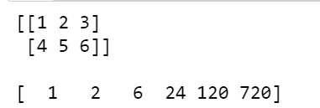
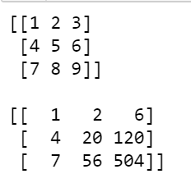
cumprod()
Mathematical and Statistical Methods
Return the cumulative product of the elements along a given axis
numpy.cumprod(a, axis=None, dtype=None, out=None)
import numpy as np
a = np.array([[1,2,3], [4,5,6]])
print(a)
b = np.cumprod(a)
print(b) #[1 2 6 24 120 720]
c = np.arange(1,10).reshape(3,3)
print(c)
d = np.cumprod(c,axis=1)
print(d)

Slide 138
std()
Mathematical and Statistical Methods
Compute the standard deviation along the specified axis
numpy.cumprod(a, axis=None, dtype=None, out=None)
import numpy as np
a = np.array([[1,2,3], [4,5,6]])
print(a)
b = np.std(a)
print(b)
Notes:
https://docs.scipy.org/doc/numpy-1.13.0/reference/generated/numpy.std.html

Slide 139
var()
Mathematical and Statistical Methods
Compute the variance along the specified axis
numpy.var(a, axis=None, dtype=None, out=None, ddof=0)
import numpy as np
a = np.array([[1,2,3], [4,5,6]])
print(np.var(a))
print(np.var(a, axis=0))
print(np.var(a, axis=1))
print(np.var(a, axis=1,dtype=np.float32))
print(np.var(a, axis=1,dtype=np.float64))
Practical 2 Section 11
Notes:
print(np.var(a, axis=1,dtype=np.float32))
print(np.var(a, axis=1,dtype=np.float64))

Slide 140
File Input and Output with Arrays
File Input and Output with Arrays
NumPy is able to save and load data in both text and binary format
Function | Description
load() | Load a Numpy array from disk
save() | Save a Numpy array to a binary file
savez() | Save several arrays into a single file in uncompressed .npz format.
Function | Description
loadtxt(filename) | Load data from a text file. Each row in the text file must have the same number of values.
genfromtxt(filename) | Load data from a text file, with missing values handled as specified.
savetxt(filename) | Save an array to a text file.
Notes:
https://docs.scipy.org/doc/numpy/reference/generated/numpy.save.html
https://docs.scipy.org/doc/numpy/reference/generated/numpy.savez.html
https://docs.scipy.org/doc/numpy/reference/generated/numpy.load.html
https://docs.scipy.org/doc/numpy/reference/generated/numpy.loadtxt.html
https://docs.scipy.org/doc/numpy/reference/generated/numpy.genfromtxt.html
https://docs.scipy.org/doc/numpy/reference/generated/numpy.savetxt.html

Slide 141
Using genfromtxt()
File Input and Output with Arrays
import numpy as np
data = np.genfromtxt("data/coe-results.csv",
delimiter=',',
names=True, dtype=('U7', int, 'U10', int, int, int, int))
print(data)
print(data.shape)
Practical 2 Section 12
Notes:
https://numpy.org/devdocs/user/basics.io.genfromtxt.html

Slide 142
The End

