Slide 1

See what a cloud permission change unlocks, before you deploy it
AttackGraph AI checks a pull request for new routes to admin access, explains them with Amazon Bedrock, and tests the fix.
Scan to try the live demo
attackgraph-ai.vercel.app/demo
Pull-request check
Amazon Bedrock
Synthetic data only
Notes:
AttackGraph AI checks a cloud permission change before it ships. It shows what new access the change creates, explains it with Amazon Bedrock, and tests a fix. Everything here uses synthetic data. Visitors can scan the code to open the live demo on their phone.

Slide 2



One tiny change can unlock admin access
The problem
One line changes
A permission flips from false to true.
snapshots/app-prod.json
1 line changed
"id": "f-ci-pass-deploy-admin"
The risk stays hidden
It lives in what that line connects to.
27 − "state": "false"
27 + "state": "true"
Admin access is now open
The build pipeline can act as an administrator.
To a reviewer, one word changed. It looks harmless.
Notes:
A pull request changes one permission from false to true. In code review it is a one-word edit. The danger is not in the line itself, but in what it connects to: here it lets the build pipeline act as an administrator.

Slide 3

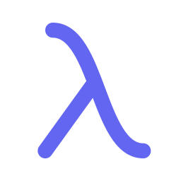
Your build pipeline can now act as admin
In plain words
Entry point
NEW
Lambda function
Protected role
can pass the admin role to
runs as
CI deploy user
Post-build hook
Deployment admin role
What changed
The build pipeline can now start its own code with the admin role's powers.
What is iam:PassRole?
The permission to hand a role to an AWS service. Hand an admin role to code you control, and that code runs as admin.
Notes:
The CI deploy user is the build pipeline. The change lets it pass the deployment admin role to a Lambda function it already creates, invokes and controls. That function then runs as the admin role. iam:PassRole is the permission to hand a role to an AWS service.

Slide 4


The risk hides in the combination
Why reviews miss it
Can pass the admin role to Lambda
NEW: false → true
7 of 7
Can create the post-build hook
already true
Can invoke the function
already true
conditions hold, so the route is open
Controls the function's code
already true
Six were already true. One change completed the set.
AttackGraph AI checks the whole combination, not just the changed line.
Admin role trusts Lambda
already true
All in one AWS account
already true
No unresolved restrictions
already true
Notes:
The route needs seven conditions, all at once. Six were already true before the pull request, and each looks harmless on its own. The pull request flips the seventh. PassRole alone is not enough, which is exactly why a line-by-line review misses it.

Slide 5




Four steps, before anything is deployed
What AttackGraph AI does
STEP 1
STEP 2
STEP 3
STEP 4
Compare
Find routes
Explain
Test the fix
Reads the configuration before and after the change.
Finds every new route to an admin role or sensitive data.
Amazon Bedrock describes the route in plain English.
Removes the new permission on a copy and checks again.
Result: the pull request fails on the exact line that opens the route.
Notes:
Step one compares the current and proposed configuration. Step two finds every new route to a protected role or sensitive data. Step three uses Amazon Bedrock to explain the route in plain English. Step four tests the fix: it removes the new permission on a copy and reruns the whole analysis. The pull request then fails on the line that caused it.

Slide 6
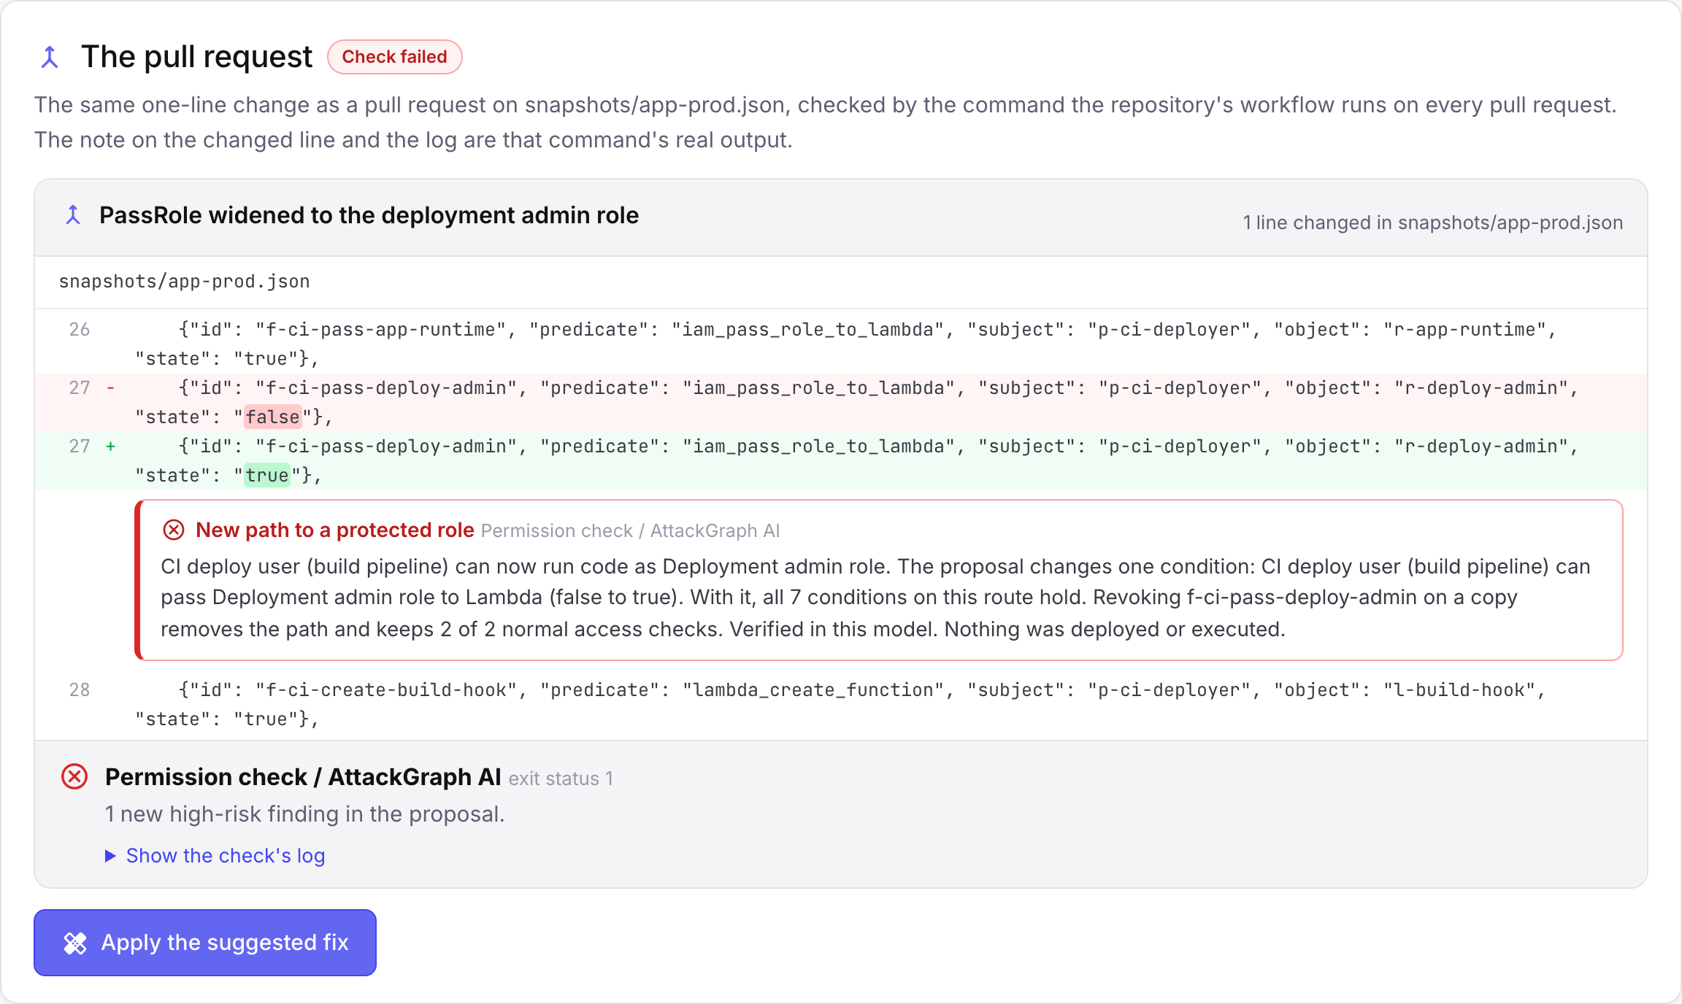


Blocked on the exact line
Catch it in review
Runs on every pull request
A GitHub Actions check. No AWS keys needed.
Fails on a new route to admin
It marks line 27, the line that opens it.
Passes once it's fixed
Revert the line and the check goes green.
Notes:
The engine runs as a GitHub Actions check on every pull request. In the demo, line 27 of the snapshot flips PassRole from false to true. The check fails with exit status 1 and leaves a note on that exact line with the route and the suggested fix. Apply the fix and the same check passes.

Slide 7
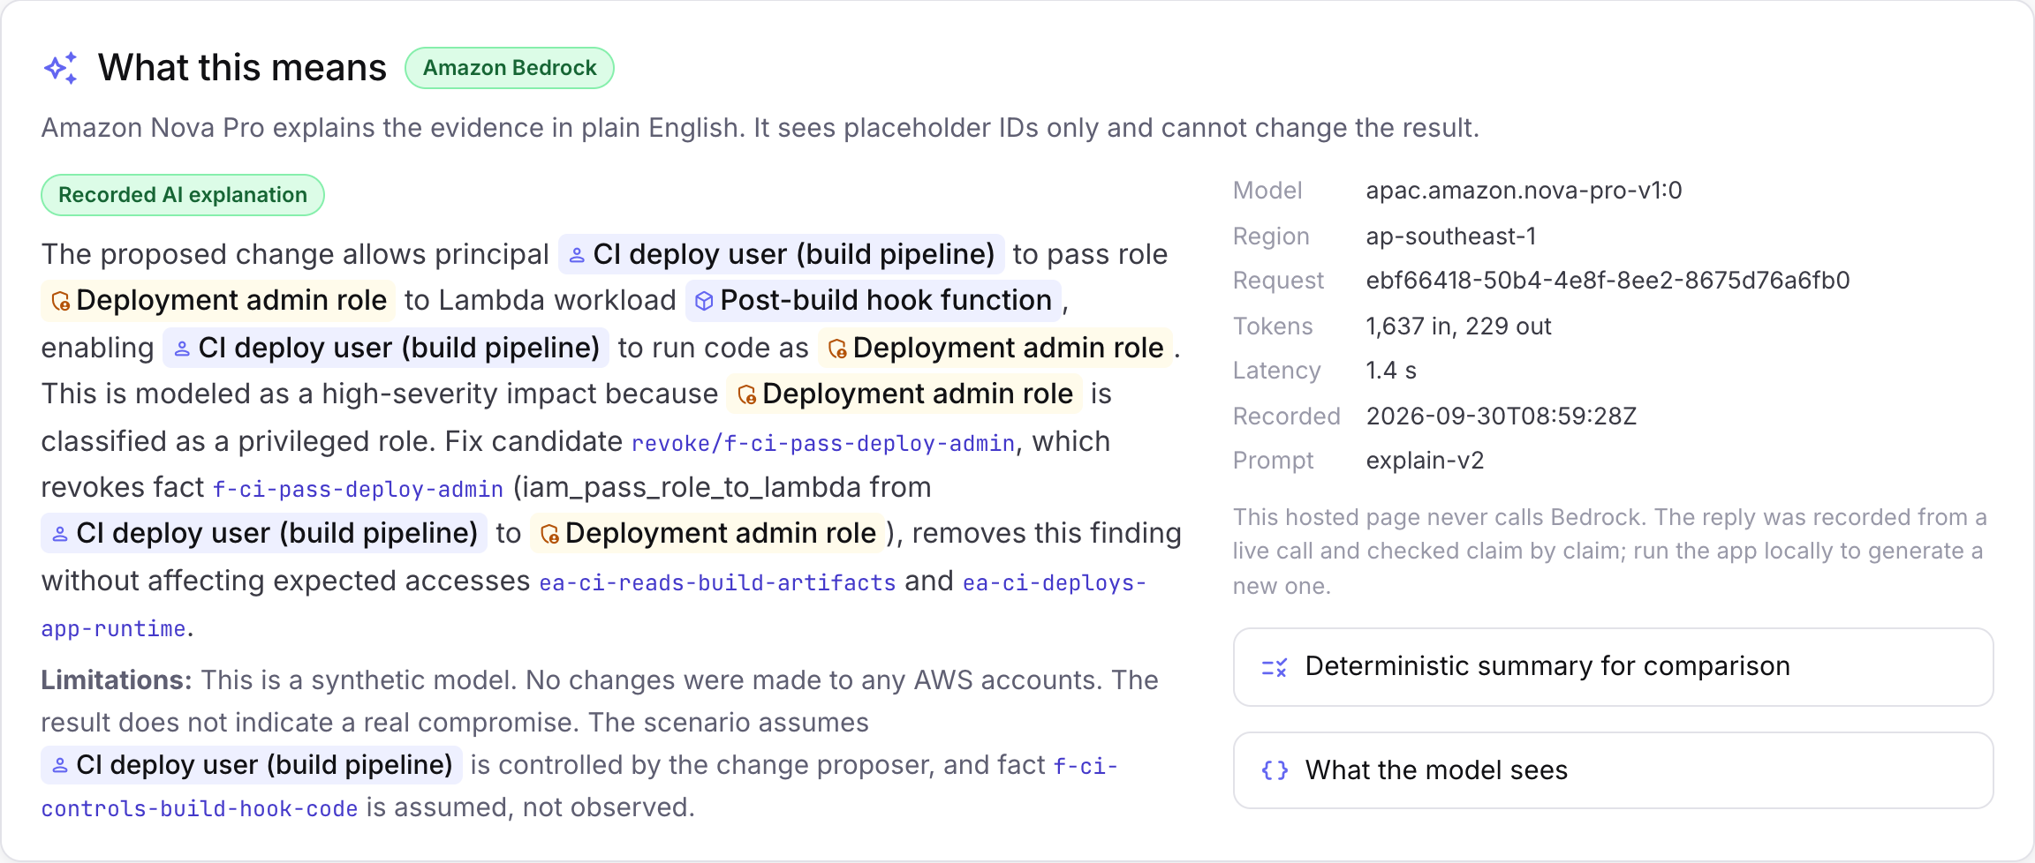





AI explains. The engine decides.
Powered by Amazon Bedrock
The engine decides
Fixed rules find the route, set the severity and test the fix.
Amazon Bedrock explains
Amazon Nova Pro writes the summary. It:
sees placeholder IDs, never real names
Real Amazon Nova Pro reply
cannot add findings or fixes
Recorded from a live call on 30 September 2026. Every ID the model cites is checked against the evidence.
is rejected if it cites anything unknown
Notes:
This is the AWS AI part. The deterministic engine decides the finding and tests the fix. Amazon Nova Pro on Amazon Bedrock turns that evidence into a plain-English explanation. It only sees placeholder IDs, it cannot add findings or fixes, and any reply that cites something outside the evidence is rejected. The reply on screen is a real one recorded on 30 September.

Slide 8


Close the route, keep the app working
Test the fix
CI deploy user
REVOKED
Post-build hook
no longer reachable
Deployment admin role
High-risk paths
Normal access
1 → 0
2 of 2
Before the fix, then after
Expected access checks still pass
Verified in this model
Tested on a copy. Nothing is deployed and no AWS account is touched.
Notes:
The engine revokes only the new grant on a copy of the proposal and reruns everything. The route closes: high-risk paths go from 1 to 0. The two expected-access checks, reading build artifacts and using the app runtime role, still pass. We say verified in this model, because we tested the model, not a real AWS account.

Slide 9



Honest by design
Built to be checked, not trusted
Unknown is never a pass
Synthetic data only
The AI can't change the result
If a permission isn't described, the result is incomplete and the check fails.
It never connects to a real AWS account. Nothing is deployed or run.
Every reply is validated. Anything unsupported is thrown away.
We say “verified in this model”, never “secure”.
Notes:
A missing fact is unknown, not safe, so an incomplete result fails the check. The prototype reads synthetic snapshots only and never connects to or changes an AWS account. The AI explains but cannot add findings, change severity or invent fixes.

Slide 10



How it is built
Under the hood
What you get
Snapshots
Python engine
GitHub Actions check
Streamlit app
Before and after, as synthetic JSON
Checks the input, finds routes with NetworkX, tests fixes
Live demo on Vercel
Markdown report
Amazon Bedrock · Amazon Nova Pro
Called through the Converse API only to write the explanation. Its only AWS call.
200+
~10 ms
10 / 10
automated tests
per check
Nova Pro replies validated
Notes:
Snapshots go into a Python engine that validates them, evaluates two rule families and finds the shortest route with NetworkX, then simulates each fix. Amazon Nova Pro on Amazon Bedrock is called through the Converse API only for the explanation. Outputs: a GitHub Actions check, a Streamlit app, the static demo on Vercel and a Markdown report.

Slide 11



Try it yourself
Or ask us for a walkthrough right here.
Live demo
attackgraph-ai.vercel.app/demo
2½-minute video
youtu.be/dAE6y8M9iQI
Scan for the live demo
Source code
github.com/Ducksss/attackgraph-ai
attackgraph-ai.vercel.app/demo
Next: read Terraform plans and real IAM policies, and cover more AWS services.
Notes:
The live demo runs the real engine on the bundled scenarios, with no sign-up. The video is a two-and-a-half-minute walkthrough. Next steps: read Terraform plans and real IAM policies instead of hand-written snapshots, evaluate policy controls, and add more rule families.

