Slide 1

A HANDS-ON INTRODUCTION
Vibe coding
& vibe
engineering
Chai Pin Zheng
Reactor School
01
Notes:
Introduce the workshop as a practical exploration of describing software, checking what AI builds, and taking responsibility for the result.
Adapted from Damian Gordon, Introduction to Vibe Coding and Vibe Engineering. https://www.slideshare.net/slideshow/introduction-to-vibe-coding-and-vibe-engineering-ffb1/278597288

Slide 2

WHO I AM
Chai Pin Zheng
Year 2 Computer Science, NUS
NUS Overseas Colleges, Vietnam
Product Engineer, Reactor School
I build the platform for programme
operations and alumni tracking.
Resumify co-founder
22
hackathon winner
AI resume support for ex-offenders
02
Notes:
Second Brain: 05-knowledge/people/chai-pin-zheng.md, updated 10 September 2026; 03-professional/community/community-events-context-2026-09-04.md.
Introduce yourself through the products you build. NUS Year 2 Computer Science and Reactor School are current owner-confirmed descriptions. Reactor work covers programme and alumni operations. Resumify co-founder status is owner-confirmed. Six first-place finishes: AverixHacks 2026, HackOMania 2024, Code for Change 2023, Innovate2Educate 2023, HackLah 2023, NUS LifeHack 2023. Additional community context: technical lead and co-organiser of The LaunchPad Challenge, technology/scaling at The Collective, and co-host of Sip & Scale Saigon. Portrait: owner-supplied canonical profile photo, 3 September 2026.
Adapted from Damian Gordon, Introduction to Vibe Coding and Vibe Engineering. https://www.slideshare.net/slideshow/introduction-to-vibe-coding-and-vibe-engineering-ffb1/278597288

Slide 3
Today’s workshop
01
Describe the idea
Translate a vague intention into a clear brief.
02
Build and refine
Run a small app and give specific feedback.
03
Check the result
Test the behaviour and discuss what makes it ready.
03
Notes:
The goal is to leave with a working small prototype and a way to judge its behaviour. Use the README in this workshop repository for the complete prompts.
Adapted from Damian Gordon, Introduction to Vibe Coding and Vibe Engineering. https://www.slideshare.net/slideshow/introduction-to-vibe-coding-and-vibe-engineering-ffb1/278597288

Slide 4
What is vibe coding?
Describe what you want.
AI drafts the software.
You run it, react to it, and refine the result.
04
Notes:
The term can mean different things. In this workshop it describes a prompt-led way to explore software by describing the desired result, running what AI generates, and refining through feedback. In the stricter usage, the developer pays little attention to the underlying code. Adding deliberate review and verification moves the practice toward engineering. Avoid implying that every use of AI for code is vibe coding.
Adapted from Damian Gordon, Introduction to Vibe Coding and Vibe Engineering. https://www.slideshare.net/slideshow/introduction-to-vibe-coding-and-vibe-engineering-ffb1/278597288

Slide 5
The personal shopper analogy
01
02
03
Your brief
Their draft
Your feedback
“A relaxed outfit for
a hot afternoon.”
They choose a first
combination for you.
“Lighter colours.
Less formal.”
In software, you still decide whether the result fits the need.
05
Notes:
A personal shopper interprets the look you want, suggests outfits and responds to feedback. The analogy explains iteration. It does not imply AI has human judgment or that a visually pleasing app is technically sound.
Adapted from Damian Gordon, Introduction to Vibe Coding and Vibe Engineering. https://www.slideshare.net/slideshow/introduction-to-vibe-coding-and-vibe-engineering-ffb1/278597288

Slide 6

The first draft is a starting point
01 Describe
The user and the outcome
02 Generate
One small runnable version
03 Inspect
What really happens?
04 Refine
One specific mismatch
06
Notes:
Examples, not a ranking. Choose according to your starting point and how much code control you need. Product names checked September 2026. Cursor Agent can edit files and run commands: https://cursor.com/docs/agent/overview . Replit Agent builds apps from chat: https://replit.com/products/agent . Lovable turns prompts into apps: https://docs.lovable.dev/tips-tricks/from-idea-to-app . Ordinary chat can help with planning and snippets, but execution depends on the environment and available tools.
Adapted from Damian Gordon, Introduction to Vibe Coding and Vibe Engineering. https://www.slideshare.net/slideshow/introduction-to-vibe-coding-and-vibe-engineering-ffb1/278597288

Slide 7
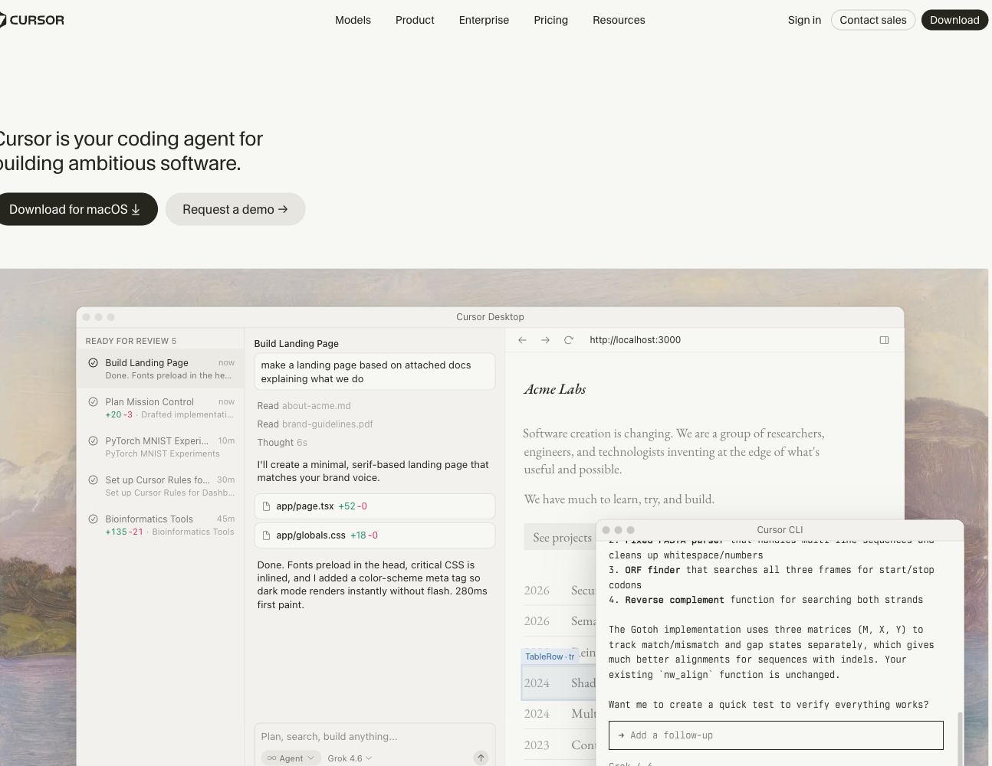
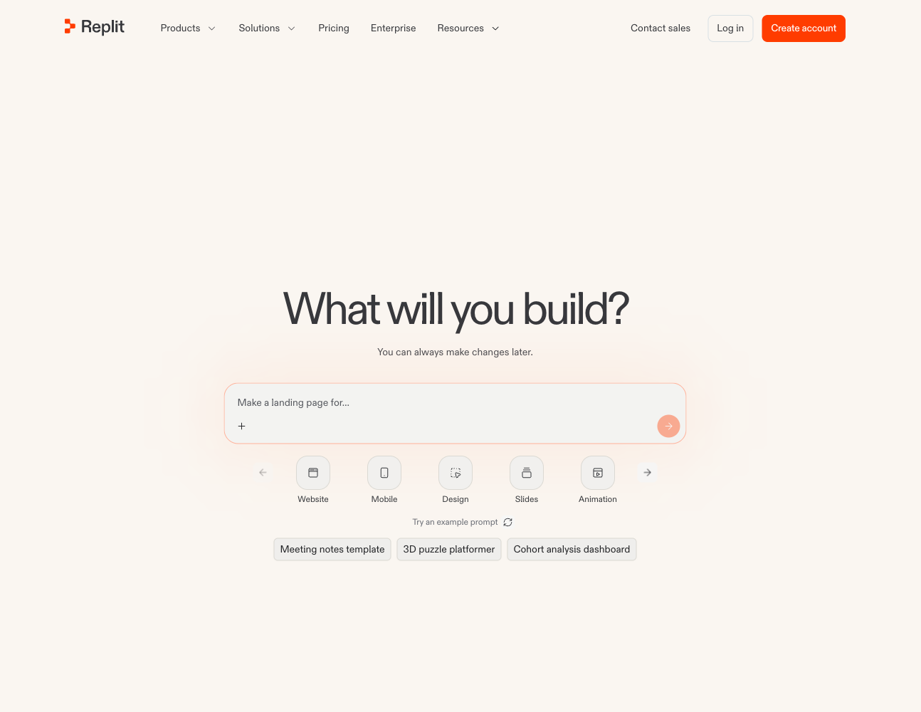
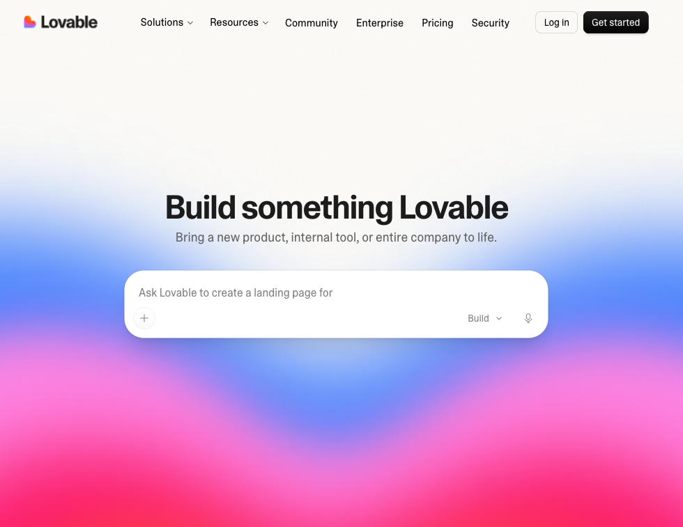
Different ways into the same loop
Cursor
Replit Agent
Lovable
An existing codebase
A new app in a browser
A prompt and a preview
07
Notes:
Examples, not a ranking. Choose according to your starting point and how much code control you need. Product names checked September 2026. Cursor Agent can edit files and run commands: https://cursor.com/docs/agent/overview . Replit Agent builds apps from chat: https://replit.com/products/agent . Lovable turns prompts into apps: https://docs.lovable.dev/tips-tricks/from-idea-to-app . Ordinary chat can help with planning and snippets, but execution depends on the environment and available tools.
Adapted from Damian Gordon, Introduction to Vibe Coding and Vibe Engineering. https://www.slideshare.net/slideshow/introduction-to-vibe-coding-and-vibe-engineering-ffb1/278597288

Slide 8
A good prompt guideline
01
Purpose
Who is it for, and what should they accomplish?
02
Visual direction
Name the mood, layout, colours or reference.
03
Scope and constraints
Specify behaviour, stack and what is out of scope.
04
Deliverable
Ask for runnable code and setup instructions.
05
Acceptance checks
Define the actions and outcomes you will verify.
08
Notes:
The source prompt guide separates intent, vibe, constraints and output format. Add acceptance checks so the audience can distinguish an attractive draft from a correct result.
Adapted from Damian Gordon, Introduction to Vibe Coding and Vibe Engineering. https://www.slideshare.net/slideshow/introduction-to-vibe-coding-and-vibe-engineering-ffb1/278597288

Slide 9
A vague prompt
“Build a landing page for a
meditation app using React
and Tailwind. Make it look nice
and modern. Add some animations.”
Who is it for? What does a button do? What counts as done?
09
Notes:
This is the exact vague prompt from the workshop README. Do not promise it will create a bad-looking page. It leaves many choices unspecified and can still produce a good result. Ask the audience which decisions the AI must now make.
Adapted from Damian Gordon, Introduction to Vibe Coding and Vibe Engineering. https://www.slideshare.net/slideshow/introduction-to-vibe-coding-and-vibe-engineering-ffb1/278597288

Slide 10
A specific prompt
PURPOSE
Build “Still”, a meditation page for busy students.
DESIGN
Warm cream, sage green, generous space, gentle motion.
BEHAVIOUR
Both session buttons open a 60-second breathing timer.
Add start, pause, reset and a completion message.
CONSTRAINTS
React + Tailwind. Mobile layout. Keyboard access.
Reduced motion. No login, backend or paid services.
VERIFY
Check both buttons, timer states and mobile overflow.
10
Notes:
Condensed teaching version of README.md. The full exact prompt is in the workshop repository and should be copied from there during the exercise. It specifies the navigation, hero, breathing circle, three benefits, footer, 60-second timer, five-second cues, start/pause/reset controls, mobile layout and accessibility. No login, backend or paid services.
Adapted from Damian Gordon, Introduction to Vibe Coding and Vibe Engineering. https://www.slideshare.net/slideshow/introduction-to-vibe-coding-and-vibe-engineering-ffb1/278597288

Slide 11
A vocabulary for the visual brief
Visual | Motion | Tone | Style
Soft, dreamy | Slow, fluid | Playful, formal | Retro, brutalist
Cosy, warm | Springy, elastic | Gentle, sharp | Minimal, maximal
Dark, moody | Quick, responsive | Calming, bold | Glassy, grainy
“Calm” becomes more useful with a palette, layout and motion limit.
11
Notes:
Adapted from the source deck’s visual, motion, tone and style vocabulary. These are starting points, not acceptance criteria. Pair subjective words with a reference or observable design decision.
Adapted from Damian Gordon, Introduction to Vibe Coding and Vibe Engineering. https://www.slideshare.net/slideshow/introduction-to-vibe-coding-and-vibe-engineering-ffb1/278597288

Slide 12
Feedback that changes the result
INSTEAD OF “MAKE IT BETTER”
“Reduce the hero to one headline
and one primary action.”
“Use a serif heading for a vintage feel.”
“Slow the motion and respect reduced motion.”
“Keep the timer behaviour unchanged.”
12
Notes:
Refine one dimension at a time. State what to preserve when changing another part. Stack changes can have broad consequences, so request them deliberately.
Adapted from Damian Gordon, Introduction to Vibe Coding and Vibe Engineering. https://www.slideshare.net/slideshow/introduction-to-vibe-coding-and-vibe-engineering-ffb1/278597288

Slide 13
Good habits during iteration
01
One useful slice
Make one user flow work before expanding scope.
02
Specific feedback
Include the action, expected result and actual result.
03
A working checkpoint
Save a version you can return to before major edits.
04
A human review
Read the changes and check the real app.
13
Notes:
Keep the first version small. Give the model the relevant context and constraints. Run each iteration and inspect the actual behaviour. Save a working checkpoint before broader changes. Human review remains part of the loop.
Adapted from Damian Gordon, Introduction to Vibe Coding and Vibe Engineering. https://www.slideshare.net/slideshow/introduction-to-vibe-coding-and-vibe-engineering-ffb1/278597288

Slide 14
Where it can go wrong
01
Understanding gaps
You may struggle to change code you cannot explain.
02
Debugging loops
Repeated guesses can introduce new failures.
03
Security mistakes
Check secrets, permissions and untrusted inputs.
04
Rights and attribution
Review dependencies, assets and licence obligations.
14
Notes:
Discuss risks without implying that every generated result has them. A plausible explanation is not proof. Diagnose failures from real behaviour and logs. Limit access and check data flows. Rights, dependencies and attribution require review before release. This is an engineering checklist, not legal advice.
Adapted from Damian Gordon, Introduction to Vibe Coding and Vibe Engineering. https://www.slideshare.net/slideshow/introduction-to-vibe-coding-and-vibe-engineering-ffb1/278597288

Slide 15
Plausible output can still be wrong
Invented facts
Does the API, package or citation exist?
Contradictions
Do the code, explanation and requirements agree?
Repetition or ambiguity
Does it repeat work or leave behaviour unclear?
Bias and stereotyping
Who could the wording or assumptions exclude?
Overgeneralisation or toxicity
Does it make unjustified claims or harmful statements?
15
Notes:
Preserve the source’s error categories: contradictions, repetition, ambiguity, stereotyping, hallucinations, bias, overgeneralisation and toxicity. Group them into observable review questions. These are possible failure modes, not a claim that every model output exhibits them.
Adapted from Damian Gordon, Introduction to Vibe Coding and Vibe Engineering. https://www.slideshare.net/slideshow/introduction-to-vibe-coding-and-vibe-engineering-ffb1/278597288

Slide 16
What AI makes easier
01
02
03
Starting
Routine work
Exploration
Turn a plain-language idea into something you can try.
Draft repeated code and spend time on the difficult decisions.
Try alternate layouts or interactions before committing.
The benefit depends on how well you can judge the output.
16
Notes:
The source describes accessibility, efficiency and creativity. Present these as possible benefits, not guaranteed productivity improvements. Results depend on the task, the tools and the user’s ability to evaluate the output.
Adapted from Damian Gordon, Introduction to Vibe Coding and Vibe Engineering. https://www.slideshare.net/slideshow/introduction-to-vibe-coding-and-vibe-engineering-ffb1/278597288

Slide 17
THE ENGINEERING PART
Vibe
engineering
AI-assisted delivery,
with evidence and ownership.
17
Notes:
Here, vibe engineering means using AI within an accountable delivery process. A solo developer can use these practices too. Terminology varies, and agentic engineering is also common. Further reading: https://simonwillison.net/2025/Oct/7/vibe-engineering/
Adapted from Damian Gordon, Introduction to Vibe Coding and Vibe Engineering. https://www.slideshare.net/slideshow/introduction-to-vibe-coding-and-vibe-engineering-ffb1/278597288

Slide 18
Exploration and accountable delivery
Dimension | Vibe coding | Vibe engineering
Focus | Explore a working idea | Deliver maintainable software
AI’s role | Generate a draft | Work within a defined task
Workflow | Prompt and refine | Specify, build, review, verify
Quality | Looks right when tried | Checks show required behaviour
Context | Mostly in the conversation | Decisions stay with the project
18
Notes:
A teaching comparison, not a universal taxonomy. Tools overlap and an individual can work with engineering discipline. The source frames the distinction around individual productivity versus organisational transformation; the practical distinction is the delivery process. https://simonwillison.net/2025/Oct/7/vibe-engineering/
Adapted from Damian Gordon, Introduction to Vibe Coding and Vibe Engineering. https://www.slideshare.net/slideshow/introduction-to-vibe-coding-and-vibe-engineering-ffb1/278597288

Slide 19
Core engineering principles
01
Defined responsibilities
Give the agent a bounded task and relevant context.
02
Verification
Check outcomes with tests and a real preview.
03
Repeatable workflow
Use a consistent path from brief to review.
04
Persistent knowledge
Record decisions and setup beside the code.
05
Human direction
Own the trade-offs and the release decision.
19
Notes:
The source identifies defined AI responsibilities, verification-driven development, structured workflows, knowledge capture and human strategic direction. Explain each in operational terms. A passing test is evidence about the case it covers, not universal correctness.
Adapted from Damian Gordon, Introduction to Vibe Coding and Vibe Engineering. https://www.slideshare.net/slideshow/introduction-to-vibe-coding-and-vibe-engineering-ffb1/278597288

Slide 20
The delivery workflow
01
A clear specification
Human defines the problem and acceptance checks.
02
An implementation
Agent drafts the code and relevant tests.
03
A review
Human examines the design and changed behaviour.
04
Evidence
Tests and a preview expose regressions or gaps.
05
A recorded decision
Save the code, rationale and operating notes.
20
Notes:
Walk through a feature as work moves between a human, an agent and the checks. Retain relevant decisions in the repository so the next iteration starts with usable context. https://simonwillison.net/2025/Oct/7/vibe-engineering/
Adapted from Damian Gordon, Introduction to Vibe Coding and Vibe Engineering. https://www.slideshare.net/slideshow/introduction-to-vibe-coding-and-vibe-engineering-ffb1/278597288

Slide 21
The tools around the agent
01
Code and commands
A coding agent works in the project environment.
02
Tests and automation
The project’s tests and CI report what passed.
03
Version control
A diff shows exactly what changed.
04
Durable context
README, decisions and project instructions.
21
Notes:
The source separates code generation, test generation, context and organisation-wide collaboration. Current tooling combines these capabilities. Cursor can edit and run commands: https://cursor.com/docs/agent/overview . GitHub Copilot supports code review: https://docs.github.com/en/copilot/concepts/agents/code-review . Tool capability alone does not establish a reliable process.
Adapted from Damian Gordon, Introduction to Vibe Coding and Vibe Engineering. https://www.slideshare.net/slideshow/introduction-to-vibe-coding-and-vibe-engineering-ffb1/278597288

Slide 22
What changes for a team
01
02
03
More direction
More review
Shared context
People define the problem, constraints and system design.
Someone owns correctness, security and maintainability.
The team keeps decisions and operating knowledge accessible.
A useful team measure: working changes that stay working.
22
Notes:
Discuss potential organisational implications rather than predicting that every team will reorganise the same way. People may spend less time on repetitive implementation and more on specification, review, architecture and operations. Establish ownership and access boundaries. Measure reliability and delivered value, not the volume of generated code.
Adapted from Damian Gordon, Introduction to Vibe Coding and Vibe Engineering. https://www.slideshare.net/slideshow/introduction-to-vibe-coding-and-vibe-engineering-ffb1/278597288

Slide 23
Workshop: the same app, two prompts
BUILD “STILL”, A MEDITATION LANDING PAGE
A
Vague prompt
B
Specific prompt
Same tool. Same model. Fresh projects. Then compare.
23
Notes:
Use the full vague and specific prompts in README.md. Start two fresh projects with the same tool and model, run one prompt in each, then compare appearance, behaviour and mobile layout. Results vary. A vague prompt can still create an attractive page. Missing features in that version illustrate unspecified requirements, not a failure to follow its brief.
Adapted from Damian Gordon, Introduction to Vibe Coding and Vibe Engineering. https://www.slideshare.net/slideshow/introduction-to-vibe-coding-and-vibe-engineering-ffb1/278597288

Slide 24
What counts as done?
01
The page matches
Student audience, cream and sage, clear session action.
02
The actions work
Both buttons open the breathing exercise.
03
Timer behaviour
Start, pause, reset and completion all work.
04
People can use it
Mobile layout, keyboard access and reduced motion.
What did you specify, and what did the AI decide for you?
24
Notes:
Use these checks against the specific prompt. Run them rather than accepting a generated claim. Timer checks include start, pause, reset to 60 seconds, alternating cues every five seconds and the final completion message. On mobile check stacked layout and no horizontal overflow. Test keyboard operation and reduced-motion preference.
Adapted from Damian Gordon, Introduction to Vibe Coding and Vibe Engineering. https://www.slideshare.net/slideshow/introduction-to-vibe-coding-and-vibe-engineering-ffb1/278597288

Slide 25
DISCUSSION
What would
you build?
And how would you know it works?
github.com/Ducksss
25
Notes:
Invite questions about the comparison, prompting, debugging and the boundary between exploration and production delivery. Public GitHub profile: https://github.com/Ducksss . Original learning material by Damian Gordon; the full source URL is retained below.
Adapted from Damian Gordon, Introduction to Vibe Coding and Vibe Engineering. https://www.slideshare.net/slideshow/introduction-to-vibe-coding-and-vibe-engineering-ffb1/278597288

