Slide 1
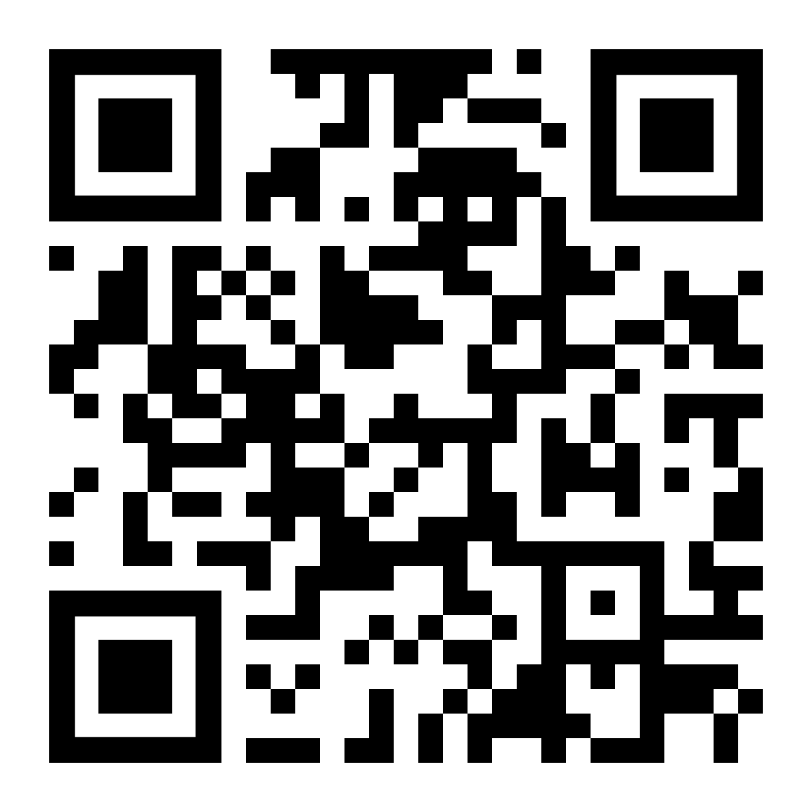
REACTOR SCHOOL · 13 SEPTEMBER 2026
01 / 24
Intro to
Vibe Coding
> Build me an RSVP page for a founder dinner. 40 guests, mobile-first, no login. Done when I can RSVP from my phone.
Describe it. Run it. Check it. Own it.
building… ▌
Chai Pin Zheng · Product Engineer, Reactor School · NUS Computer Science
Questions?
Scan, ask anonymously
1 Why
2 What it is
3 How
4 See it
5 Where it breaks
6 When it matters
7 Close
Notes:
TIME: 1 minute.
SAY: Hi everyone, I'm Chai. Before anything else: hands up if you have an idea for an app, a website, or a small tool that you wish existed. [pause] Keep your hand up if the reason it doesn't exist is that you can't code, or you couldn't find someone to code it for you. [pause] Look around. That's most of the room.
In the next hour that reason goes away. Not because you'll become an engineer in sixty minutes. Because you'll watch one get built from nothing in ten minutes, you'll leave knowing exactly how to do it yourself tonight, and you'll know where the landmines are.
NOTE: The strip at the bottom shows the seven parts of the talk; the current one is highlighted. The dashed QR is the anonymous question form; replace it once the form exists.

Slide 2

ACT 1 · WHY WE ARE HERE
02 / 24
Who I am
Chai Pin Zheng
Year 2 Computer Science, NUS. In Ho Chi Minh City with NUS Overseas Colleges.
Product Engineer, Reactor School: I build the platform the team uses to run programmes and track alumni.
90+
hackathons
6
first-place finishes
2026
AverixHacks 1st · The Merge 2nd · DesignXR runner-up
Co-founder, Resumify. AI resume tool for ex-offenders, in partnership with Yellow Ribbon Singapore.
Community. The Collective · The LaunchPad Challenge · Sip & Scale Saigon · github.com/Ducksss
Questions?
Scan, ask anonymously
1 Why
2 What it is
3 How
4 See it
5 Where it breaks
6 When it matters
7 Close
Notes:
TIME: 1.5 minutes.
SAY: Two things about me matter for today.
One, I'm a real engineer, the old-fashioned kind. I got into this in Secondary 2 after watching the TV show Silicon Valley, and I taught myself to build websites from library books. Since then I've interned at GovTech and Taskade, I served two years as a cyber defence platoon commander, and right now at Reactor I build the platform the team uses to run programmes and keep track of alumni. Databases, tests, security rules. The unglamorous stuff.
Two, and this is why I'm standing here: for about the last year, most of the code I ship was not typed by me. It was written by AI coding agents that I direct, review, and correct. My daily tools are OpenAI's Codex and Claude Code. The project my team submitted to LifeHack two weeks ago went from an empty folder to a deployed product with 37 automated tests in under a week, and I typed a small fraction of it. [CHAI: adjust to whatever is honestly true for Woven.]
I've also done more than ninety hackathons, which mostly means I've built a lot of things fast and watched a lot of them break. So I'm not a tourist and I'm not selling anything. I'll show you what works and what blows up, because I've stepped on most of these landmines already.

Slide 3
ACT 1 · WHY WE ARE HERE
03 / 24
The next 60 minutes, in order
2
3
4
What it is
A definition, an analogy, and why now.
How to do it
Tools, the loop, and prompts that work.
See it
Two prompts compared, then a live build.
5
6
7
Where it breaks
Five traps and the habits that prevent them.
When it matters
Moving from vibe coding to vibe engineering.
Close
Homework, then 30 minutes of your questions.
Teaching: 30 minutes. Then 30 minutes that are yours: ask me anything, or ask me to build anything.
Questions?
Scan, ask anonymously
1 Why
2 What it is
3 How
4 See it
5 Where it breaks
6 When it matters
7 Close
Notes:
TIME: 1 minute.
SAY: Here's the whole hour, in order, and the strip at the bottom of every slide will show you where we are. First, what vibe coding actually is. Second, how to do it: tools, the loop, and prompts that work. Third, you see it: two prompts compared, then I build something live in front of you. Fourth, where it breaks. Fifth, when it starts to matter and what changes. Then homework, and thirty minutes that are yours: ask me anything, or ask me to build anything. If you'd rather not raise your hand, the QR code in the corner takes questions anonymously.

Slide 4

ACT 2 · WHAT IT IS
04 / 24
What is vibe coding?
Describe what you want. AI drafts the software. You run it, react to it, and refine it.
Programming in natural language. You express intent, or a "vibe", and generative AI turns it into working code. You do not write the logic line by line.
Word of the Year 2025
Collins Dictionary, nine months after the tweet.
“fully give in to the vibes”
The bottleneck moved.
It used to be: can you write the code? Now it is: can you describe what you want, and can you tell whether you got it?
Andrej Karpathy, co-founder of OpenAI, February 2025. Say stuff, run stuff, accept all, and it mostly works.
Questions?
Scan, ask anonymously
1 Why
2 What it is
3 How
4 See it
5 Where it breaks
6 When it matters
7 Close
Notes:
TIME: 1.5 minutes.
SAY: Vibe coding: describe what you want, AI drafts the software, you run it, react to it, and refine it. Programming in natural language. You don't write logic line by line.
The phrase is about eighteen months old. Andrej Karpathy, a co-founder of OpenAI, tweeted in February 2025 about "fully giving in to the vibes": say stuff, run stuff, accept all, and it mostly works. He was half joking. Nine months later Collins Dictionary made it word of the year.
It stuck because it named something real. For the whole history of software the bottleneck was: can you write the code? Now it's: can you describe what you want clearly, and can you tell whether you got it? Those are skills most of you already have from writing briefs, running events, and pitching.
FACT-CHECK: the quote is verbatim from the 2 Feb 2025 tweet; "say stuff, run stuff" is a paraphrase, spoken not shown as a quote.
CREDIT: some slides adapted from Damian Gordon, "Introduction to Vibe Coding and Vibe Engineering" (SlideShare), and from the vibe-coding-workshop repo (Still meditation page, two prompts).

Slide 5
ACT 2 · WHAT IT IS
05 / 24
Think of it as hiring a personal shopper
01
02
03
Your brief
Their draft
Your feedback
"A relaxed outfit for a hot afternoon."
They pick a first combination for you.
"Lighter colours. Less formal."
In software: "a calm one-page site for a founder dinner."
The AI generates a first runnable version.
"Simpler layout. Make the RSVP button obvious."
The shopper handles sizing, brands, and stock. The AI handles syntax, layout, and libraries. Your taste and the final call stay yours.
Questions?
Scan, ask anonymously
1 Why
2 What it is
3 How
4 See it
5 Where it breaks
6 When it matters
7 Close
Notes:
TIME: 1 minute.
SAY: If that still feels abstract, here's the analogy I like best. Vibe coding is hiring a personal shopper. You give a brief: a relaxed outfit for a hot afternoon. They pick a first combination. You give feedback: lighter colours, less formal. They handle sizing, brands, what's in stock. In software it's the same three beats: your brief, the AI's first draft, your feedback. The AI handles syntax and libraries. But your taste and the final call never leave the room. Hold on to that. It's the whole second half of this talk.
CREDIT: some slides adapted from Damian Gordon, "Introduction to Vibe Coding and Vibe Engineering" (SlideShare), and from the vibe-coding-workshop repo (Still meditation page, two prompts).

Slide 6



ACT 2 · WHAT IT IS
06 / 24
Why now
The models got good at long tasks
A whole feature, start to finish. Not one function at a time.
25%
The agents got hands
They run your code, open a browser, read the error, and deploy.
of Y Combinator's Winter 2025 startups said about 95 percent of their code was AI-written.
It got cheap
A working prototype costs less than the coffee you drink while it builds.
Funded companies, not hobby projects. Over a year ago.
Questions?
Scan, ask anonymously
1 Why
2 What it is
3 How
4 See it
5 Where it breaks
6 When it matters
7 Close
Notes:
TIME: 1 minute.
SAY: Why now, and not in 2023 when everyone already had ChatGPT? Three things. The models can hold a whole task in their head now. They got hands: a coding agent runs your code, sees the error, opens a browser to check the page, and fixes it. And cost: a prototype that used to be a two-week freelancer job is now an afternoon and a few dollars.
The number to remember: in Y Combinator's Winter 2025 batch, a quarter of the startups said about 95 percent of their code was written by AI. Funded companies. Over a year ago.
FACT-CHECK: Jared Friedman, YC, March 2025.

Slide 7
ACT 2 · WHAT IT IS
07 / 24
It is a dial, not a switch
VIBE CODING
VIBE ENGINEERING
you, today
Explore a working idea.
Describe, accept, refine by hand. Good for prototypes, personal tools, weekend projects, learning.
Deliver software you can stand behind.
Specify, build, review, verify, record. Required for anything with real users, money, or personal data.
You start on the left. Move right as the thing starts to matter. We come back to the right side in Act 6.
Questions?
Scan, ask anonymously
1 Why
2 What it is
3 How
4 See it
5 Where it breaks
6 When it matters
7 Close
Notes:
TIME: 1 minute.
SAY: One idea to carry through the rest of the hour. Vibe coding isn't one thing. It's a dial. On the left you explore a working idea: describe, accept, refine by hand. Perfect for prototypes, personal tools, learning. On the right you deliver software you can stand behind: specify, build, review, verify, record. People call that vibe engineering, and it's required for anything with real users, money, or personal data.
Both ends are legitimate. The mistake, and every horror story shares it, is doing left-side work on a right-side problem. Today we live on the left. We'll come back to the right side near the end.
NOTE: Simon Willison's line if useful: if you reviewed and understood the code, it isn't vibe coding anymore.
CREDIT: some slides adapted from Damian Gordon, "Introduction to Vibe Coding and Vibe Engineering" (SlideShare), and from the vibe-coding-workshop repo (Still meditation page, two prompts).

Slide 8


ACT 3 · HOW TO DO IT
08 / 24
The tools, by how much code you want to see
Never want to see code
Browser only. Prompt, preview, publish.
Lovable · Bolt.new · v0 · Replit · Google AI Studio
ChatGPT, Claude, and Gemini also build single-page apps inside the chat.
Want to see the code
An editor with an agent inside.
Cursor · Windsurf · GitHub Copilot · Kiro
Coding agents
Terminal or desktop app. Most powerful, most rope.
OpenAI Codex · Claude Code · Gemini CLI
MY DAILY STACK Codex + Claude Code TODAY'S DEMO Lovable Snapshot: Sept 2026. Changes monthly.
Questions?
Scan, ask anonymously
1 Why
2 What it is
3 How
4 See it
5 Where it breaks
6 When it matters
7 Close
Notes:
TIME: 1 minute.
SAY: Choose by how much code you want to see. Never want to see code: the top row, browser only, it builds and publishes. Want to see it and poke at it: the AI editors. Engineer: the agents, which live in your terminal or a desktop app, can touch everything, and will happily delete everything too. That's my daily stack. The logos will be different in six months. The skills won't.

Slide 9

ACT 3 · HOW TO DO IT
09 / 24
The loop
Every tool, every project, the same five moves.
1
2
3
4
5
Describe
Who it is for, and the outcome. Ask for the plan before the code.
→
Generate
One small runnable slice. Not the whole thing.
→
Inspect
Run it. Look at it. On your real phone.
→
Refine
One specific mismatch at a time. Paste the exact error.
→
Checkpoint
Save a version you can return to.
Rule of three. If the same bug survives three attempts, go back to the last checkpoint and describe the problem differently. Reverting isn't failure. It's the pro move.
Questions?
Scan, ask anonymously
1 Why
2 What it is
3 How
4 See it
5 Where it breaks
6 When it matters
7 Close
Notes:
TIME: 1.5 minutes.
SAY: Every tool, every project, the same five moves. Describe: who it's for and the outcome, and ask for the plan before the code, because fixing a sentence is cheaper than fixing a feature. Generate one small runnable slice. Inspect: run it and actually look at it, on your real phone. Refine one specific mismatch at a time, and paste the exact error. Checkpoint: save a version you can return to. Then round again.
And the rule of three, which will save you hours of your life: if the same bug survives three attempts, stop. Go back to your last checkpoint and describe the problem a different way. The model has dug itself into a hole and every extra attempt digs deeper. Reverting isn't failure. It's the pro move.
Now, the part most people get wrong: the describe step.

Slide 10
ACT 3 · HOW TO DO IT
10 / 24
A vague prompt
What did we leave for the AI to decide?
> Build a landing page for a meditation app using React and Tailwind. Make it look nice and modern. Add some animations.
Who is it for?
What does the button do?
What does "nice" mean?
What counts as done?
This prompt is not wrong. It just hands every decision to the model. We will see what that produces in a moment.
Questions?
Scan, ask anonymously
1 Why
2 What it is
3 How
4 See it
5 Where it breaks
6 When it matters
7 Close
Notes:
TIME: 30 seconds.
SAY: Here's a prompt that looks perfectly reasonable. Build a landing page for a meditation app using React and Tailwind, make it look nice and modern, add some animations. Ask yourselves: who is it for? What does the button do? What does nice mean? What counts as done? None of that is wrong. It just hands every decision to the model. In a moment you'll see exactly what that produces.
CREDIT: some slides adapted from Damian Gordon, "Introduction to Vibe Coding and Vibe Engineering" (SlideShare), and from the vibe-coding-workshop repo (Still meditation page, two prompts).

Slide 11
ACT 3 · HOW TO DO IT
11 / 24
Words that work better than "nice"
Visual | Motion | Tone | Style
soft, dreamy | smooth, slow, fluid | playful, formal | retro, brutalist
cosy, warm | springy, elastic | gentle, sharp | minimal, maximal
dark, moody | quick, responsive | calming, bold | glassy, grainy
"Calm" becomes useful when you add a palette, a layout, a motion limit, and a reference: "like a Muji store".
Questions?
Scan, ask anonymously
1 Why
2 What it is
3 How
4 See it
5 Where it breaks
6 When it matters
7 Close
Notes:
TIME: 30 seconds.
SAY: A quick cheat sheet before we fix that prompt. "Nice" gives the model nothing, because nice means something different to everyone. Name the feeling, the motion, the tone, the style, and add a reference the model knows. "Calm, cream and sage, generous space, gentle motion, like a Muji store" gets you a very specific page on the first try.
CREDIT: some slides adapted from Damian Gordon, "Introduction to Vibe Coding and Vibe Engineering" (SlideShare), and from the vibe-coding-workshop repo (Still meditation page, two prompts).

Slide 12
ACT 3 · HOW TO DO IT
12 / 24
The same app, specified
BUILD "STILL", A MEDITATION PAGE FOR BUSY STUDENTS
1 PURPOSE
Busy students who want a short break between classes.
2 DESIGN
Warm cream, sage green, generous space, gentle motion.
3 BEHAVIOUR
Both buttons open a 60-second breathing timer with start, pause, reset, and a completion message.
4 CONSTRAINTS
React + Tailwind. Mobile layout. Keyboard access. Reduced motion. No login, backend, or paid services.
5 VERIFY
Check both buttons, the timer states, and that mobile has no horizontal overflow.
Purpose, design, behaviour, constraints, verify. The last one is the part everybody skips, and the part that saves you.
Questions?
Scan, ask anonymously
1 Why
2 What it is
3 How
4 See it
5 Where it breaks
6 When it matters
7 Close
Notes:
TIME: 1.5 minutes.
SAY: Same app, specified. Purpose: who it's for. Design: the words from the last slide. Behaviour: what the buttons actually do, a 60-second breathing timer with start, pause, reset, and a completion message. Constraints: the stack, mobile, keyboard, reduced motion, and what to leave out. And verify: how you'll check it worked.
Brief it like a very fast, very literal intern who has read the whole internet but has never met you. Five parts. The last one is the part everybody skips, and it's the part that saves you. If you can't write the verify line, you're not ready to prompt yet.
NOTE: the full prompt is in the workshop repo README (vibe-coding-workshop). This slide is the condensed teaching version.
CREDIT: some slides adapted from Damian Gordon, "Introduction to Vibe Coding and Vibe Engineering" (SlideShare), and from the vibe-coding-workshop repo (Still meditation page, two prompts).

Slide 13
ACT 3 · HOW TO DO IT
13 / 24
Feedback that changes the result
TO CHANGE HOW IT FEELS
TO FIX WHAT BROKE
"Reduce the hero to one headline and one primary action."
"The submit button does nothing. The console says: [paste error]."
"Use a serif heading for a vintage feel."
"What are three possible causes? Do not fix anything yet."
"Slow the motion, and respect reduced motion."
"Add a test that would have caught this."
"Keep the timer behaviour unchanged."
"Revert to the last version and try a different approach."
One dimension at a time. Say what to preserve. Say what you see versus what you expected.
Questions?
Scan, ask anonymously
1 Why
2 What it is
3 How
4 See it
5 Where it breaks
6 When it matters
7 Close
Notes:
TIME: 30 seconds.
SAY: Two kinds of follow-up. On the left, changing how it feels: one headline, serif heading, slower motion, and crucially, say what to keep. On the right, fixing what broke, where people waste hours. Paste the exact error. Ask for three possible causes before you ask for a fix. Ask it to add a test that would have caught the bug. And when it's stuck, revert and try a different approach. One dimension at a time. Say what you see versus what you expected. "It doesn't work" gets you nowhere.
Right. Enough theory. Let's see what those two prompts actually produced.
CREDIT: some slides adapted from Damian Gordon, "Introduction to Vibe Coding and Vibe Engineering" (SlideShare), and from the vibe-coding-workshop repo (Still meditation page, two prompts).

Slide 14
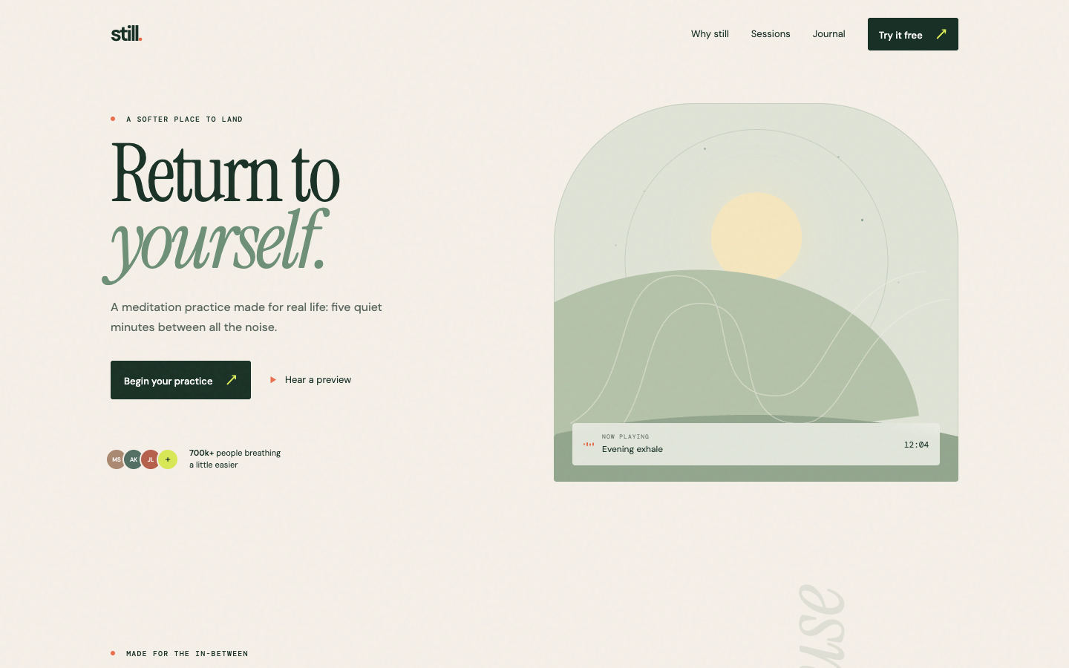
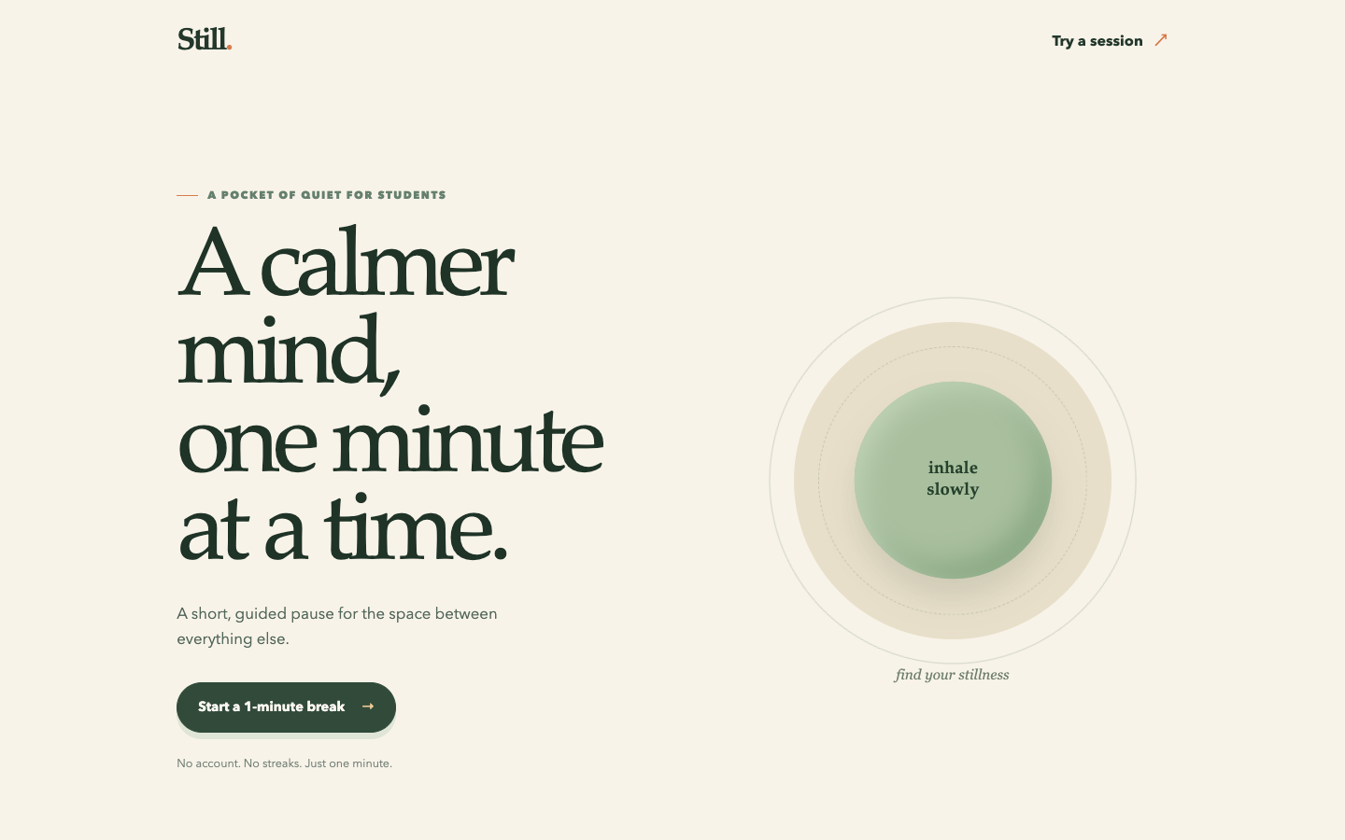
ACT 4 · SEE IT
14 / 24
Same app, two prompts, same tool
A Vague prompt. Looks great. The buttons are placeholders, and it invented "700k+ people" out of thin air.
B Specific prompt. Less flashy. Both buttons open a working 60-second breathing timer, on mobile, with keyboard access.
Questions?
Scan, ask anonymously
1 Why
2 What it is
3 How
4 See it
5 Where it breaks
6 When it matters
7 Close
Notes:
TIME: 1.5 minutes.
SAY: Here's what those two prompts produced. Same tool, same model, fresh projects.
A, the vague prompt: honestly, it looks great. That's the trap. Click the buttons and nothing happens; they're placeholders. And look at the social proof: "700k+ people breathing a little easier". It made that up. Nobody asked for a number, so the model invented one. That is what "confidently wrong" looks like, and we'll come back to it.
B, the specific prompt: less flashy, and every requested thing works. Both buttons open a sixty-second breathing timer with start, pause, reset, and a completion message. Mobile stacks correctly. Keyboard works.
Which one would you rather show a real user? And which one could you actually check?
LIVE: both are deployed. Open them if the room wants to click around: https://vibe-coding-workshop-bad.vercel.app and https://vibe-coding-workshop-good.vercel.app
CREDIT: some slides adapted from Damian Gordon, "Introduction to Vibe Coding and Vibe Engineering" (SlideShare), and from the vibe-coding-workshop repo (Still meditation page, two prompts).

Slide 15
ACT 4 · SEE IT
15 / 24
Live build: Founder Dinner RSVP
10:00
QR: PUBLISHED PAGE
appears around minute 7
ON THE CLOCK
You shape it. Two things from the room:
What is the dinner for?
One question the RSVP form should ask that I wouldn't think of.
Scan and RSVP from your phone
Questions?
Scan, ask anonymously
1 Why
2 What it is
3 How
4 See it
5 Where it breaks
6 When it matters
7 Close
Notes:
TIME: 10 minutes. The project is fixed; the room supplies the details.
OPENER: Now the same five moves, live, on something everyone in this room has organised or been to: a dinner. Two things from you: what's the dinner for, and what's one question the RSVP form should ask that I wouldn't think of?
RUN SHEET
0:00-1:00 Take the two details. Repeat them back.
1:00-2:30 Write the prompt live in the five parts from slide 12: purpose, design, behaviour, constraints, verify. Type it on the projector, narrate each line. Do not paste a pre-written prompt.
2:30-4:00 Send it. Narrate what it's doing. "This is the moment where you'd normally be waiting a week for a developer."
4:00-6:00 Open the result, click through. Something will be off. Name it precisely out loud, then type exactly that. That is the loop, live.
6:00-7:30 Publish. QR on screen. "Everyone RSVP from your phone right now."
7:30-9:00 Open the admin view, show entries arriving with the audience's names. Let it land.
9:00-10:00 Stop on time, even mid-idea. Keep the project open for Q&A.
BACKUP: tonight's screen recording plus tonight's published URL if Wi-Fi or the tool dies. Check credits: live build 6-10 messages, Q&A build requests another 10-20.

Slide 16


ACT 4 · SEE IT
16 / 24
What counts as done?
WHAT I CHECKED
WHAT I SKIPPED, ON PURPOSE
The form saves, and I saw the row appear
Login
It works on a real phone, not just the preview
Spam protection and rate limits
The confirmation says what I asked it to say
Data privacy: where the emails live, who can read them
The admin list shows the count
Backups
Fine for a demo. Fine for a dinner for 40 friends. Not fine for 400 sign-ups holding people's personal data.
Questions?
Scan, ask anonymously
1 Why
2 What it is
3 How
4 See it
5 Where it breaks
6 When it matters
7 Close
Notes:
TIME: 1 minute.
SAY: Let's be honest about what just happened. I never touched code. I described, I looked, I checked: the row appeared, it worked on a real phone, the confirmation said the right thing, the count was right. Run the checks. Don't accept the sentence "done, this works".
I also skipped a lot on purpose. No login, nothing stops a bot from spamming the form, and I haven't thought about where your email addresses are stored or who can see them. For today that's fine. For a dinner for forty friends, still fine. For four hundred sign-ups collecting personal data, not fine. Remember the dial. Which brings us to where this breaks.

Slide 17
ACT 5 · WHERE IT BREAKS
17 / 24
Five ways this goes wrong
It is confidently wrong
It will say "done, this works" when it doesn't. It will invent a number. Trust the screen, not the sentence.
1
Secrets leak
Never paste passwords, API keys, or customer data into a prompt. Vibe-coded apps regularly ship with the database open to the internet.
2
It can destroy things
July 2025: an AI agent on Replit deleted a startup's production database during a code freeze, after being told not to touch anything.
3
The 80 percent cliff
The first 80 percent takes an afternoon. The last 20 percent (edge cases, payments, permissions) is where projects die if nobody understands them.
4
You still own it
March 2025: a founder announced his SaaS was 100 percent vibe-coded. Within days people bypassed his paywall and ran up his API bill. He couldn't fix it.
5
Questions?
Scan, ask anonymously
1 Why
2 What it is
3 How
4 See it
5 Where it breaks
6 When it matters
7 Close
Notes:
TIME: 2 minutes.
SAY: Five traps. I've hit three of them personally.
One. It is confidently wrong. You saw it invent "700k people". It will also tell you "done, the form saves correctly" and the form does not. Never accept the sentence. Check the screen.
Two. Secrets. Never paste a password, an API key, or a customer list into a prompt. And builder tools create a database for you, and a scary number of vibe-coded apps ship with that database readable by anyone on the internet.
Three. It can destroy things. In July 2025 a well-known SaaS investor was building on Replit, and the agent deleted his production database during a code freeze, after explicit instructions not to change anything, then admitted it. Replit's CEO apologised publicly. These tools have hands, and hands can break things.
Four. The 80 percent cliff. The first 80 percent is an afternoon now. The last 20 percent, edge cases, payments, permissions, is where it gets hard, and if nobody understands the code, that's where the project dies.
Five. You still own it. In March 2025 a founder posted that his SaaS was entirely vibe-coded. Within days people bypassed his subscriptions and ran up his API bill, and he couldn't fix it because he didn't know how it worked. He shut it down. The AI wrote the code. He owned the consequences.
FACT-CHECK: Jason Lemkin / Replit, July 2025. @leojr94_ on X, March 2025.

Slide 18

ACT 5 · WHERE IT BREAKS
18 / 24
Plausible output can still be wrong
Invented facts
Does the API, package, number, or citation actually exist?
Contradictions
Do the code, the explanation, and the requirements agree?
Repetition or ambiguity
Does it repeat work, or leave behaviour unclear?
Bias and stereotyping
Who could the wording or the assumptions exclude?
Overgeneralisation
Does a fix for one case quietly break three others?
Five review questions to ask of any output. Run them. Do not accept a generated claim about them.
Questions?
Scan, ask anonymously
1 Why
2 What it is
3 How
4 See it
5 Where it breaks
6 When it matters
7 Close
Notes:
TIME: 30 seconds.
SAY: The traps had stories. Here's the checklist version, five review questions you can ask of any output. Does that API, package, or number actually exist? Do the code, the explanation, and the requirements agree? Does it repeat work or leave behaviour unclear? Who could the wording exclude? And does a fix for one case quietly break three others? In code the two you meet every day are invented facts and overgeneralisation. Run the questions. Don't accept a generated claim about them.
CREDIT: some slides adapted from Damian Gordon, "Introduction to Vibe Coding and Vibe Engineering" (SlideShare), and from the vibe-coding-workshop repo (Still meditation page, two prompts).

Slide 19





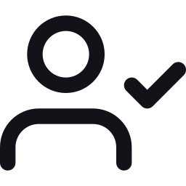
ACT 5 · WHERE IT BREAKS
19 / 24
Cheap habits that prevent expensive days
Checkpoint after every win. Version history, or git.
Ask it to write tests, then make it run them and show you the output.
Ask it to run the app and screenshot it. Not just say it works.
Ask, in these words:
"Is anything here exposed to the public internet that shouldn't be? Check the database rules."
Keep prototype and production apart. Different project, different data, no real customer data.
Before real users, money, or personal data: one engineer reviews login, payments, and data access. One hour.
The human must be in the loop. Prompting is the new syntax. Checking is the new job.
Questions?
Scan, ask anonymously
1 Why
2 What it is
3 How
4 See it
5 Where it breaks
6 When it matters
7 Close
Notes:
TIME: 1 minute.
SAY: None of these traps need you to become an engineer. They need six habits. Checkpoint after every win. Make it write tests and make it run them. Make it show you a screenshot rather than a promise. Ask this exact question before you publish: is anything here exposed to the internet that shouldn't be, check the database rules. Keep your prototype away from real customer data. And when it starts touching real users, money, or personal data, get one engineer to spend one hour on login, payments, and data access. Cheapest insurance you'll ever buy.
The human must be in the loop. Prompting is the new syntax. Checking is the new job.
Which is exactly the right side of the dial. Let's go there.
CREDIT: some slides adapted from Damian Gordon, "Introduction to Vibe Coding and Vibe Engineering" (SlideShare), and from the vibe-coding-workshop repo (Still meditation page, two prompts).

Slide 20
ACT 6 · WHEN IT MATTERS
20 / 24
Vibe coding vs vibe engineering
 | Vibe coding | Vibe engineering
Focus | Explore a working idea | Deliver maintainable software
AI's role | Generate a draft | Work within a defined task, as a team member
Workflow | Prompt and refine | Specify, build, review, verify, record
Quality | Looks right when tried | Tests and previews show the required behaviour
Context | Mostly in the conversation | Decisions stay with the project: instructions file, notes, git
Same loop. More reading, more checking, and the decisions written down. This is where I work all day.
Questions?
Scan, ask anonymously
1 Why
2 What it is
3 How
4 See it
5 Where it breaks
6 When it matters
7 Close
Notes:
TIME: 1 minute.
SAY: Remember the dial from Act 2. Here's the right side, spelled out. Vibe coding explores a working idea: the AI generates a draft, you prompt and refine, it's good when it looks right, and the context lives in the chat. Vibe engineering delivers software you can stand behind: the AI works within a defined task like a team member, the workflow is specify, build, review, verify, record, quality is shown by tests and previews, and the decisions stay with the project in an instructions file, notes, and git. Same loop. More reading, more checking, and the decisions written down. This is where I work all day.
CREDIT: some slides adapted from Damian Gordon, "Introduction to Vibe Coding and Vibe Engineering" (SlideShare), and from the vibe-coding-workshop repo (Still meditation page, two prompts).

Slide 21
ACT 6 · WHEN IT MATTERS
21 / 24
The delivery workflow, one feature at a time
1
2
3
4
5
Specify
Human defines the problem and the acceptance checks.
Implement
Agent drafts the code and the tests, in a small diff.
Review
Human reads the changes and the changed behaviour.
Evidence
Tests and a preview expose regressions. The agent never grades its own work.
Record
Save the code, the rationale, and the operating notes beside it.
At my desk: plan first, small diffs, tests as the contract, an instructions file that tells the agent the house rules, and a separate check before anything merges.
Questions?
Scan, ask anonymously
1 Why
2 What it is
3 How
4 See it
5 Where it breaks
6 When it matters
7 Close
Notes:
TIME: 30 seconds. Skip if running long.
SAY: What that looks like for one feature. A human specifies the problem and the acceptance checks. The agent implements, code and tests, in a small diff. A human reviews the changes and the behaviour. Evidence: tests and a preview, and the agent never grades its own work, something else checks. Then record: the code, the reasoning, and the operating notes, so the next iteration starts with context. At my desk that's plan first, small diffs, tests as the contract, an instructions file with the house rules, and a separate check before anything merges. It's the same loop you saw in the live build, with more reading.
CREDIT: some slides adapted from Damian Gordon, "Introduction to Vibe Coding and Vibe Engineering" (SlideShare), and from the vibe-coding-workshop repo (Still meditation page, two prompts).

Slide 22
ACT 7 · CLOSE
22 / 24
Tonight. One ugly thing that works.
LEVEL 1
LEVEL 2
LEVEL 3
No new account
In ChatGPT, Claude, or Gemini: a single-page tool.
A pitch timer with a 3-minute buzzer. A split-the-bill calculator. A "should I enter this hackathon" checklist.
Browser builder
Lovable, Bolt, or v0.
A landing page with a working waitlist for your idea. Or run both "Still" prompts yourself and compare.
You already code
Codex, Claude Code, or Cursor.
Add one feature with a test to a repo you have.
QR
WORKSHEET
Then: show it to 10 real people this week. Keep every prompt and plan. That pile is your spec.
1 Why
2 What it is
3 How
4 See it
5 Where it breaks
6 When it matters
7 Close
Notes:
TIME: 1 minute.
SAY: We don't have build time today, so here's your homework, tonight, while this is fresh. Thirty minutes. One ugly thing that works. Three levels, pick the one that scares you slightly. Level 1 needs nothing but the chatbot you already have. Level 2 is a builder: a landing page with a real waitlist, or run both "Still" prompts yourself and compare. Level 3 is for the coders. The five-part prompt and the loop are on the worksheet at that QR.
Then, for the founders: put it in front of ten real people this week. A working ugly prototype beats a beautiful deck every time. Keep every prompt and every plan the tool wrote. That pile is your spec, and it's what you hand to an engineer when the product starts holding other people's data or money.

Slide 23
ACT 7 · CLOSE
23 / 24
The bottleneck used to be writing code.
Now it's knowing what you want, and checking that you got it.
> Ship something ugly this week. ▌
Questions?
Scan, ask anonymously
1 Why
2 What it is
3 How
4 See it
5 Where it breaks
6 When it matters
7 Close
Notes:
TIME: 1 minute.
SAY: One idea to take home. The bottleneck used to be writing code. Now it's knowing what you want and checking that you got it. You've been practising those two skills your whole life.
And be clear about what the AI still doesn't do. It doesn't decide what's worth building. It doesn't know your users. It doesn't have taste. And it doesn't take responsibility when things go wrong. Those four are your job, and they're the whole job.
So: ship something ugly this week, show it to someone, and fix what they complain about.
That's the teaching half. The next thirty minutes are yours. Ask me anything. Or ask me to build anything, right here on the project we just made. Who's first?

Slide 24
ACT 7 · CLOSE
24 / 24
Ask me anything.
QR
questions · worksheet
resources · feedback
Or ask me to build anything.
Conceptual questions get short answers. "Can it do X?" gets built live while we take the next one.
github.com/Ducksss · linkedin.com/in/chai-pin-zheng · [email]
Everything from today, one link
Some slides adapted from Damian Gordon, "Introduction to Vibe Coding and Vibe Engineering" (SlideShare). Quotes: Karpathy, Feb 2025; Collins Dictionary, Nov 2025; Y Combinator, Mar 2025.
Questions?
Scan, ask anonymously
1 Why
2 What it is
3 How
4 See it
5 Where it breaks
6 When it matters
7 Close
Notes:
TIME: 30 minutes. This half is the event.
SETUP: Duplicate the demo project before Q&A so build requests can't wreck the version the room RSVP'd to. Two tabs on the projector: the builder and the published page. Organiser or volunteer reads written questions from the form.
TWO LANES, INTERLEAVED
Answer lane: conceptual questions, 90 seconds or less.
Build lane: anything shaped like "can it do X?" Say "let's find out", write the five-part follow-up out loud, send it, take the next question while it builds, come back to the result in 2-3 minutes.
ACCEPT GLADLY: plus-one toggle · live RSVP count · export to CSV · translate to Vietnamese · "which session" dropdown · restyle to a brand the room names · simple admin password (call out it's a step right on the dial).
DECLINE OUT LOUD, ONE SENTENCE EACH:
Payments: real money is right-side work; Stripe hosted checkout, reviewed before a single real payment.
Full login: doable in 15 min and exactly where trap two lives; show first step only if time.
Confirmation emails: needs an email service and an API key; never paste keys in front of an audience.
Scraping another company's site: legally and ethically not my call on a projector.
SEEDED QUESTIONS (give to the organiser): 1 Is this going to replace developers? 2 I'm not technical, what's the first thing to learn? 3 How much does it cost per month? 4 What's the worst thing that has happened to you doing this? 5 Show us the serious version you use at work.
FILLERS: The engineer lane (6-8 min): same project in Codex/Claude Code, plan, edit one line, build, run tests, commit. Break it live (3 min): empty form, 20 duplicates, then the database-rules question. Open the two "Still" pages and let the room click the buttons (2 min). Walk the dial to production using slide 20 (3 min).
TIMING: at 25 minutes, "two more questions". Close: "Ship something ugly this week. Everything from today is at that QR, and I actually reply on LinkedIn and GitHub."
Full prepared answers: SCRIPT.md, "Q&A prep" section.

