Slide 1


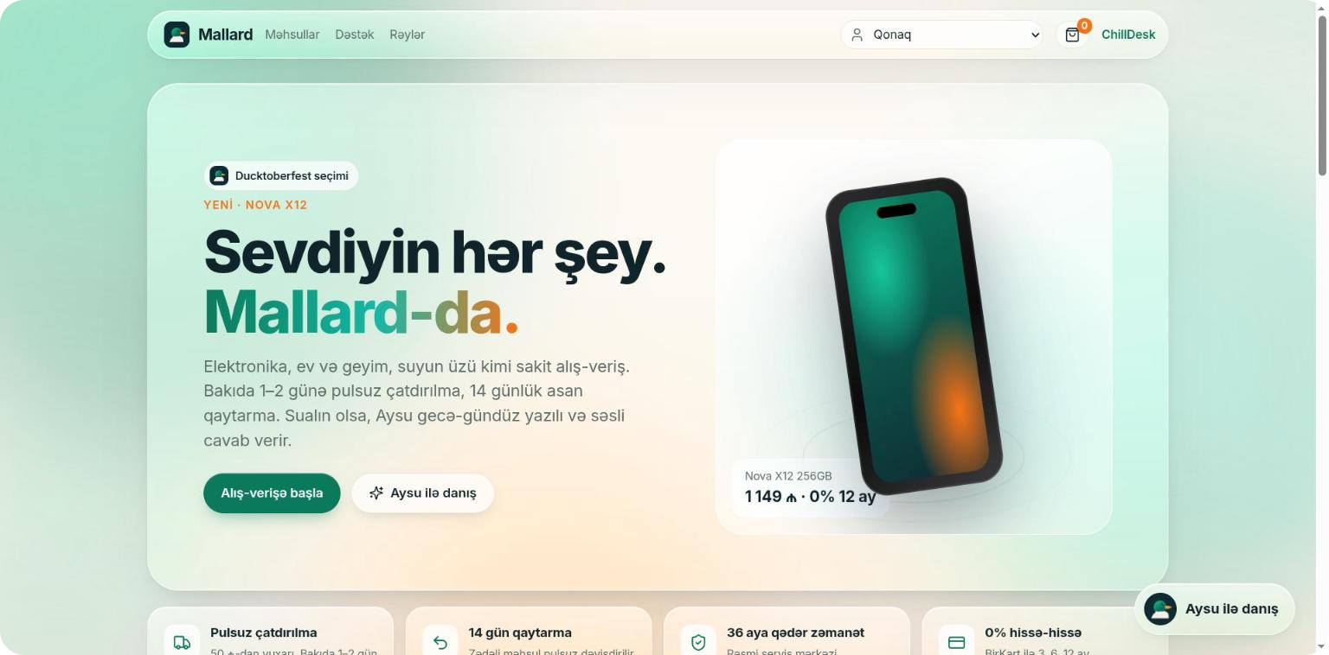

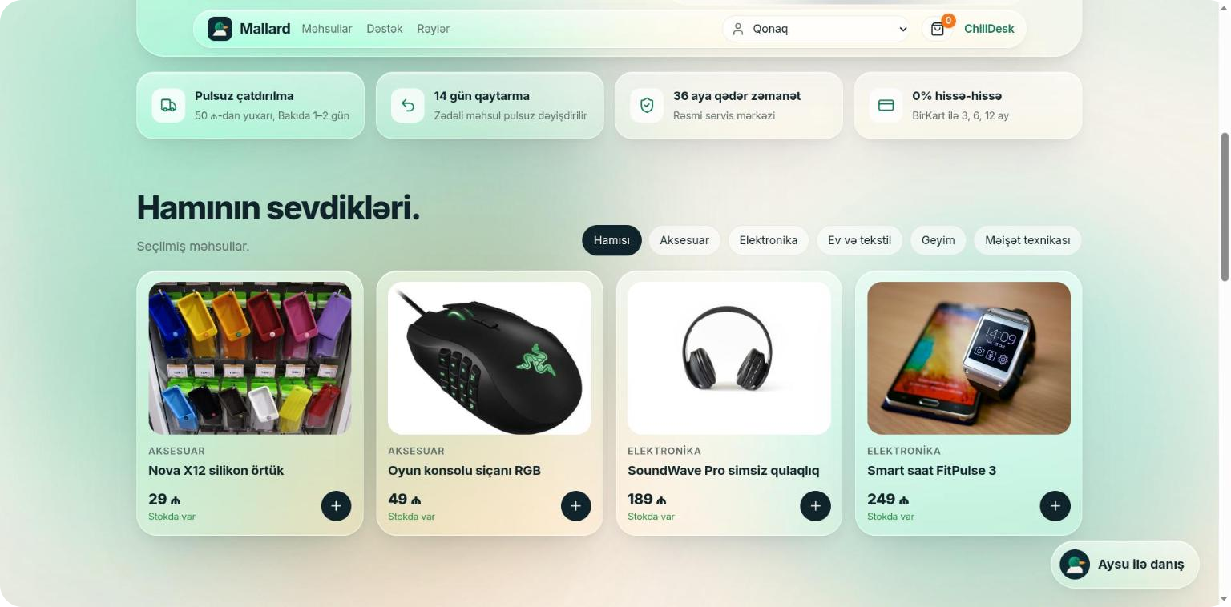

ChillDesk
An open-weight Gemma 4 AI support agent for online stores
Best Use of Gemma 4
Best Open-Source AI Project
team-Chill · Ducktoberfest Baku 2026 · Hacktoberfest Hack Day
Notes:
ChillDesk is an AI support agent for an online store called Mallard. Its brain is open-weight Gemma 4. Chat, photos and voice calls live in one place, and the follow-up work after each conversation happens automatically.

Slide 2



Support is slow, costly and scattered
24/7 questions
Manual checks
Manual wrap-up
“Where is my order?”, “when do I get my money back?” The same questions repeat day and night while customers wait in a queue.
A damaged-product photo, a phone call, a receipt: an operator checks each one and decides by hand.
Summary, category, ticket and a follow-up email take minutes after every conversation.
A small store can’t afford a 24/7 support team.
Notes:
The problem: support questions repeat, photos and calls are checked by hand, and work remains after each conversation. For a small store that is expensive.

Slide 3
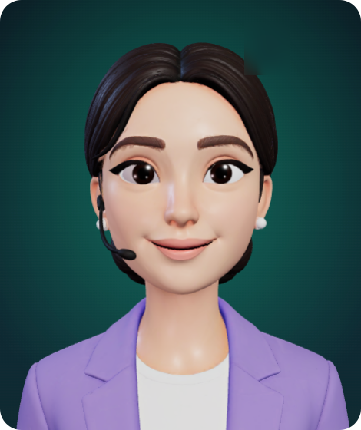




Meet Aysu
Chat that takes action
Gemma 4 function calling: finds and tracks orders, opens returns and tickets
Sees photos
Damaged-product photo → Gemma 4 vision → decision
Voice calls, 3D Aysu
Lip sync and tone-driven emotion, in Azerbaijani
Automation
Summary, priority, auto-ticket, follow-up email
Aysu · Mallard support agent
Notes:
Aysu does four things: real actions through tools, understanding photos, voice calls with a 3D avatar, and automation after each conversation.

Slide 4
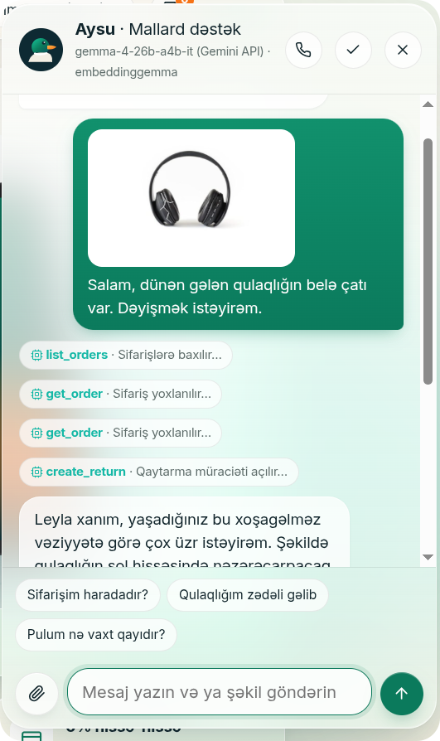
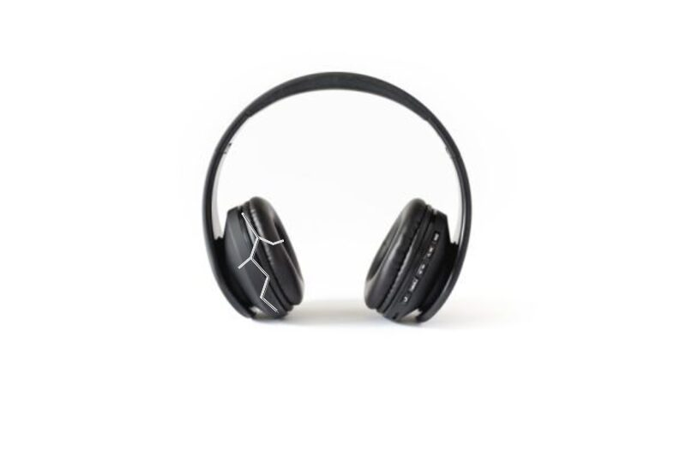
Send a photo, get it solved
1
Gemma 4 reads the photo
“crack on the left ear cup” → photo_assessment
2
list_orders → get_order
Finds Leyla’s order ML-1042 in Neon
The photo the customer sent
3
create_return
Policy engine: 14 days + damage = free replacement
≈13 seconds · 4 tool calls · 0 operators
4
Answer + return RT-…
A courier swaps the old one for a new one
Notes:
Live scenario: the customer sends a photo of cracked headphones. Gemma 4 describes the photo, finds the order and opens a replacement through the policy engine. Every step is visible in the chat.

Slide 5
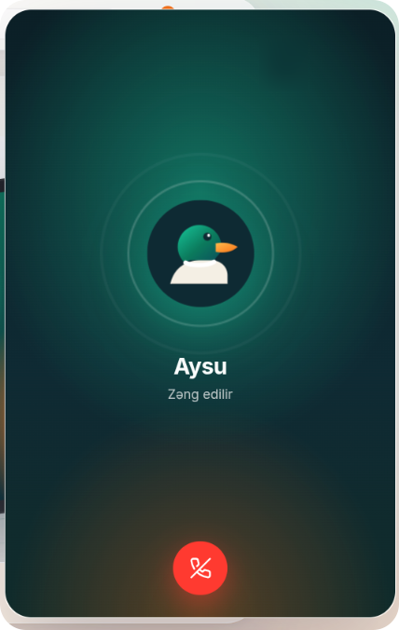
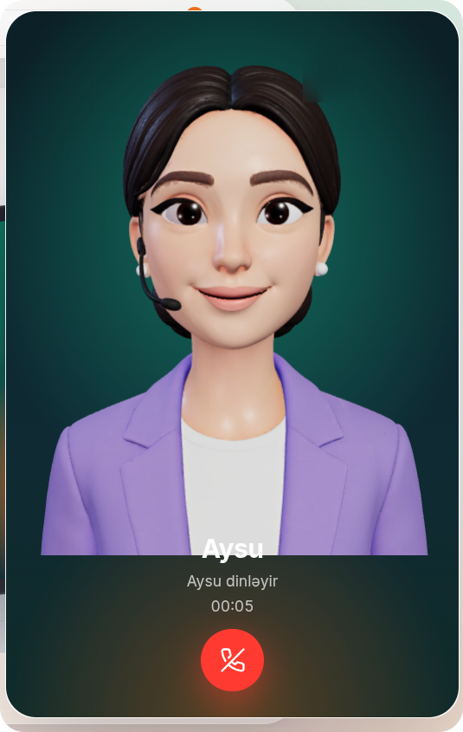




Just like a call: voice Aysu
The brain is Gemma 4
ElevenLabs does only STT/TTS; our Custom LLM endpoint writes the answer
Character-level lip sync
Per-character timing of every audio chunk + real loudness
Emotion follows the tone
[empathetically] changes both the voice and the face
Feels like a real call
425 Hz ringback, Aysu appears when she picks up
Notes:
Voice: ElevenLabs recognizes and speaks, but Gemma 4 writes the answer. The avatar moves its lips to character timings, and the tone tag Gemma picks changes both the voice and the face.

Slide 6
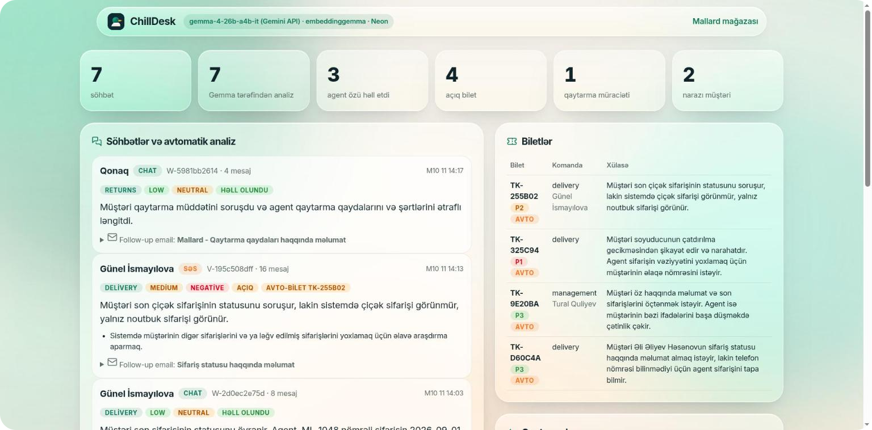
The chat ends, the work gets done
Gemma 4 → JSON
Summary
Category
Urgency
Sentiment
Resolved?
Needs a human?
Auto-ticket
Follow-up email
KB gap
Notes:
When a conversation ends, or goes quiet for 10 seconds, Gemma 4 analyzes it: summary, priority, sentiment, an auto-ticket if needed, and a ready follow-up email. Everything is written to Neon and shown on the dashboard.

Slide 7
Architecture
Gemma 4 26B MoE
Gemini API · function calling · vision
Browser
Mallard store · Aysu widget · ChillDesk dashboard
FastAPI backend
/api/chat (SSE) · /v1/chat/completions · automation
Gemma 4 E4B
Ollama · local fallback (on 429)
ElevenLabs
STT (Scribe v2) · TTS · WebSocket
Neon Postgres + pgvector
customers, orders, returns, tickets, conversations
EmbeddingGemma
local RAG · 768-dim
Notes:
The browser sends chat over SSE and voice through ElevenLabs, which calls our OpenAI-compatible endpoint. The backend runs the Gemma 4 agent loop, tools write to Neon, and the knowledge base is searched with EmbeddingGemma and pgvector. If the Gemini quota runs out, local Gemma 4 takes over.

Slide 8



We trained our own model: Unsloth QLoRA
229
1B
8 GB
284 s
labelled Azerbaijani conversations
parameters — Gemma 3 1B (4-bit)
laptop GPU (RTX 4070)
training time
1 · Data
2 · Train
3 · Eval
We sample the labels first (7 categories × 3 urgencies × 3 sentiments, 12 products, 6 customer styles), then Gemma 4 26B writes a matching conversation. The ground truth is exact.
Unsloth QLoRA, rank 16, loss on the JSON answer only. The small model learns our labelling rules.
40 held-out conversations: base 1B vs fine-tuned 1B vs Gemma 4 26B. Every field is scored separately.
Notes:
Goal: run conversation analysis offline on a small open model. A teacher model wrote the data, but we chose the labels up front, so the correct answers are known exactly.

Slide 9
Result: small model, big jump
61%
fine-tuned 1B mean accuracy
30%
same model, not fine-tuned
76%
Gemma 4 26B, zero-shot
Notes:
On the held-out set: the same 1B model before and after fine-tuning, plus 26-billion-parameter Gemma 4 zero-shot. The fine-tuned small model learned our labelling rules and runs locally, offline.

Slide 10




Open all the way down
Gemma 4 26B / E4B
EmbeddingGemma
Gemma 3 1B + LoRA
Agent, vision, analysis
Local RAG embeddings
Fine-tuned analyst
Apache 2.0
Gemma Terms
Gemma Terms
Unsloth · Ollama
Neon · pgvector
ChillDesk code
Training and local inference
Postgres + vector search
github.com/Ducktoberfest/team-Chill
Apache 2.0 · MIT
Apache 2.0 · PostgreSQL
MIT
Notes:
The whole AI layer is the open-weight Gemma family. The code is MIT; the README lists the models, licenses and how to run it.

Slide 11
Thank you!
Now let’s call Aysu.
github.com/Ducktoberfest/team-Chill
team-Chill · Ducktoberfest Baku 2026
Notes:
Thank you. Next, the live demo: a call to Aysu, a damaged-product photo and the automatic analysis on the dashboard.

