Slide 1
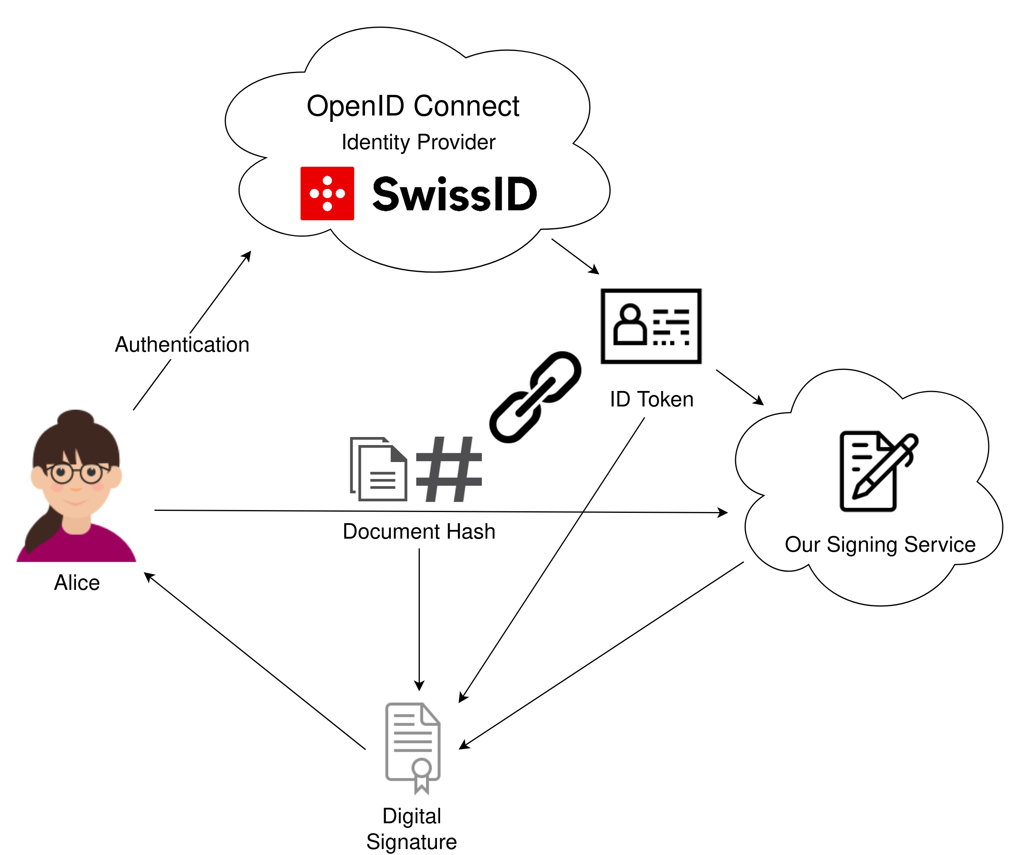
Abstract
With Remote Signing, users no longer hold on to the cryptographic keys themselves, instead a remote service generates keys in their name. This has a serious drawback: the signing service is able to sign arbitrary documents without the user's consent. In this thesis, we provide a specification as well as a proof-of-concept implementation of a Remote Signing Service that does not require the user to trust it unconditionally.
Remote Signing Services
Such services allow people to create digital signatures, no matter where they are, what device they are using, and without the need for them to carry their private key with them. However, since these services are in possession of the user's private key, they are able to sign any document they want without the user's consent or knowledge. These are legally binding signatures, recognised in a court of law. Such services can sign arbitrary, legally binding contracts in their user's name.
Our Solution
In our solution, the signing service alone cannot sign a document, despite possessing of the user's private key. We accomplish this by distributing the trust between the identity provider and the signing service, and by cryptographically linking the intent of the user to sign specific documents, the authentication for that intent, and the signature created by the signing service.
Standard Protocols
We achieve this by combining existing, widely-used, standard technologies such as OIDC (OpenID Connect), CMS (Cryptographic Message Syntax), Protocol Buffers and X.509.
Platform Independent
Our Remote Signing Service can be used on any device with a web browser supporting
WebAssembly and a working internet connection.
The generated signature can be verified either online in the browser, regardless of platform or offline with our verifying tool on Mac OS X, Linux and Windows.
Trustworthy Remote Signing
Graduate(s): | Gabor Tanz Patrick Hirt
Professor: | Gerhard Hassenstein Dr. Annett Laube
Expert: | Dr. Andreas Spichiger
Bachelor Thesis 2019/20 Degree Programme Computer Science

