Slide 1
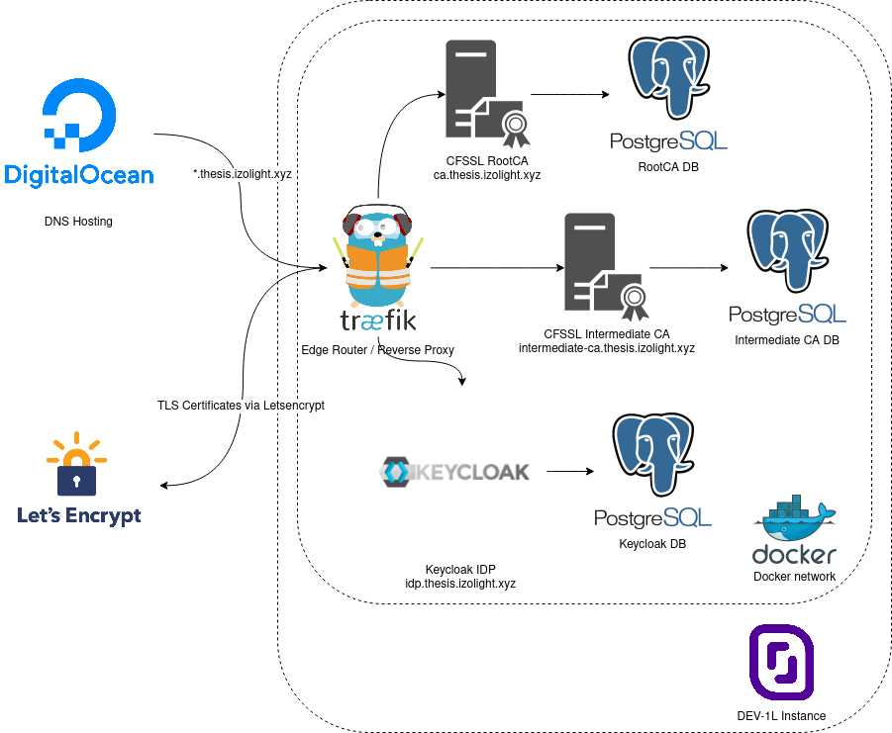
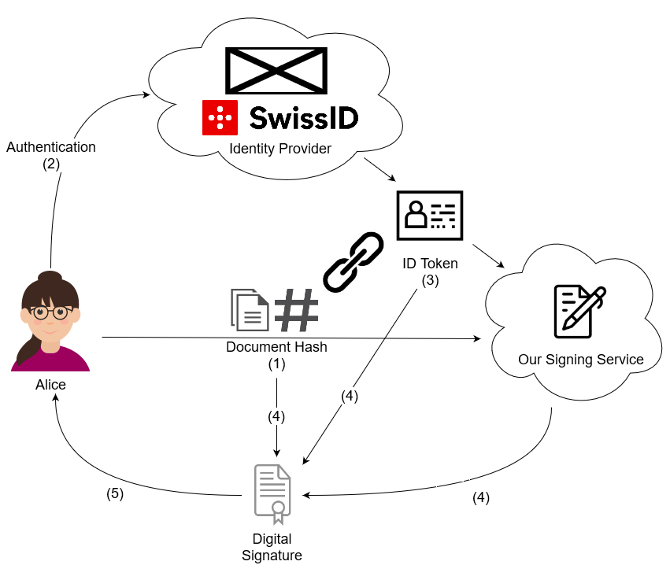
Abstract
With Remote Signing, users no longer hold on to the cryptographic keys themselves, instead a remote service generates keys in their name. This has a serious drawback: the signing service is able to sign arbitrary documents without the user's consent. In this thesis, we provide a specification as well as a proof-of-concept of a Remote Signing Service that does not require the user to trust it unconditionally.
Remote Signing Services
Such services allow people to create digital signatures, no matter where they are, what
device they are using, and without the need
for them to carry their private key with them. However, since these services are in possession of the user's private key, they are able to sign any document they want without the user's consent or knowledge. These are signatures recognised in a court of law. Such services can sign arbitrary, legally binding contracts in their user's name.
Our Solution
In our solution, the signing service alone cannot sign a document, despite possessing the user's private key. We accomplish this by distributing the trust between the identity provider and the
signing service, and by cryptographically linking the intent of the user to sign specific documents, the authentication for that intent, and the signature created by the signing service.
In order to prototype our application without relying on external services, we set up our own infrastructure consisting of a PKI (with root and intermediate CA) and an identity provider. For this we used the open source components cfssl for the CA, and keycloak for the IdP.
The signing service is implemented in Kotlin, the verification service in Go and the frontend in TypeScript and Rust.
Standard Protocols
We combine existing, widely-used, standard technologies such as OIDC (OpenID Connect), CMS (Cryptographic Message Syntax) and X.509.
Platform Independence
Our Remote Signing Service can be used on any device with a web browser supporting WebAssembly and a working internet connection.
The generated signature can be verified either online or offline with our verification tool on Linux, Mac OS X and Windows.
Auxiliary Infrastructure Overview
Signing Workflow Overview
Trustworthy Remote Signing
Graduate(s): | Gabor Tanz Patrick Hirt
Professor: | Gerhard Hassenstein Dr. Annett Laube
Expert: | Dr. Andreas Spichiger
Bachelor Thesis 2019/20 Degree Programme Computer Science

