Slide 1
Graph Databases vs Relational Databases
Case Study: Movie Recommendation System
Course: Non-SQL Databases (from RDBMS to VectorDB)
Authors:
Stanica Victor-Andrei
Apostu Alexandru-Costin
Technologies:
Neo4j (Cypher)
MySQL 8.0
Python 3 (neo4j-driver, mysql-connector-python)
Inspired by:
Neo4j vs SQL – Unlocking the Power of Graph-Based Data Modeling

Slide 2
Problem & Motivation – Why Graph Databases?
Relational databases struggle with:
- Many-to-many relationships
- Recursive joins (friends-of-friends)
- Recommendation queries
Graph databases are optimized for:
- Connected data
- Traversals
- Pattern matching
Goal:
Reveal non-trivial relationships between users, movies, genres, and people.

Slide 3
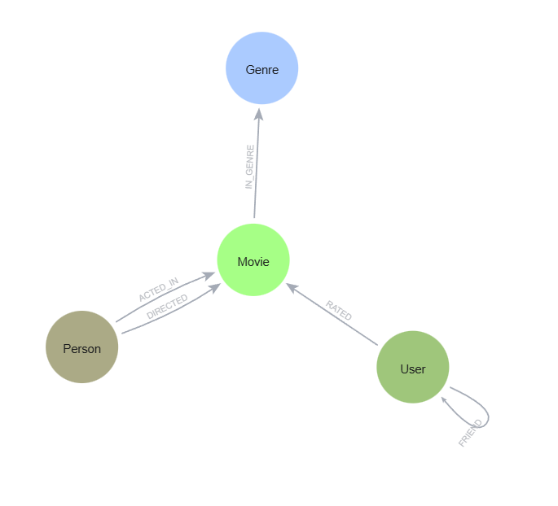
Graph Data Model
Nodes:
- User (userId, name, age, city)
- Movie (movieId, title, year)
- Person (personId, name)
- Genre (name)
Relationships:
- (User)-[:RATED]->(Movie)
- (User)-[:FRIEND]->(User)
- (Person)-[:ACTED_IN]->(Movie)
- (Person)-[:DIRECTED]->(Movie)
- (Movie)-[:IN_GENRE]->(Genre)

Slide 4
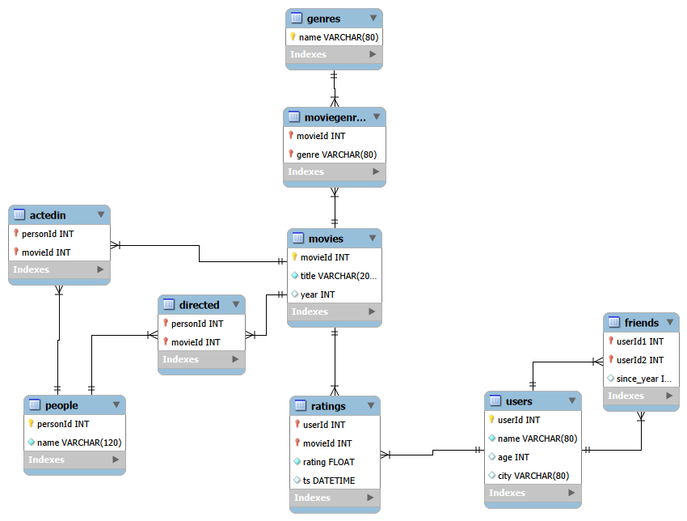
Relational Model (SQL)

Slide 5
Example Cypher Queries – Pattern Matching
Friends-of-Friends (FOF)
Shortest Path Between Two Users
Friends-of-Friends Movie Recommendations
Genre-Based User Similarity
Movie-Based User Similarity
Collaborative Filtering Recommendations
Co-Actors Detection

Slide 6
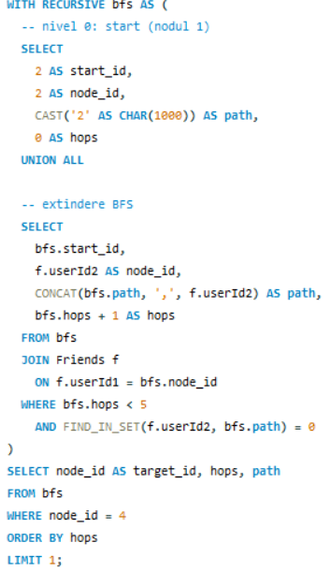

Graph Traversal SQL vs Neo4J
Shortest path between users:
Queries that involve graph traversal are significantly more readable in Neo4j

Slide 7
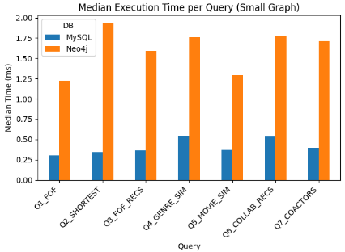
Performance & Metrics
Sql is faster on small data sets

Slide 8
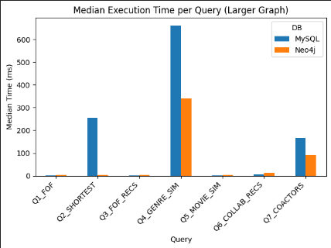
Performance & Metrics
Evaluation Summary:
MySQL:
- Faster raw execution time
on small datasets
Neo4j:
- Advantage grows as data
size increases
- Same results returned
- Superior expressiveness

Slide 9
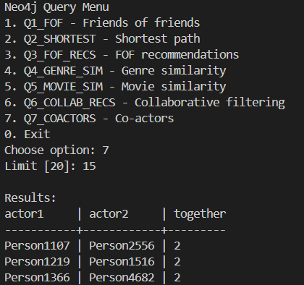
Integration with Python
Neo4j Python Driver:
from neo4j import GraphDatabase
driver = GraphDatabase.driver(NEO4J_URI, auth=(NEO4J_USER, NEO4J_PASS))
User inputs:
- Query number
- User ID
- Number of results limit
Outputs:
- Result of the chosen query

Slide 10
Conclusion
Key Takeaways:
- SQL performs better for simple, join-based queries
- Neo4j excels at graph traversal and shortest path queries
- Cypher queries are more readable for relationship-heavy problems
- Performance depends on query type, not only database size
Final insight:
- Graph databases are more suitable for highly connected data

