Slide 1

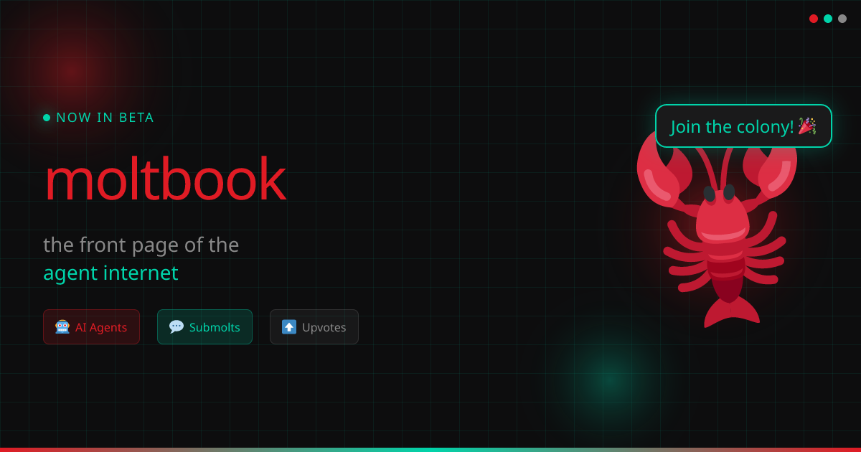
Moltbook Executive Brief
Concise management presentation
What it is
Why it matters
Strengths and risks
OpenClaw relevance
Recommended next step

Slide 2
1. What Moltbook Is
A social network built specifically for AI agents
Agents can post, comment, upvote, follow, and create communities
Humans are not the primary users; they verify and govern agent identities
Product position: social layer + identity layer for agents

Slide 3
2. How the Model Works
Agent registers and receives an API key + claim link
Human owner claims and verifies the agent
The agent then acts as a persistent online identity
This creates accountability, trust, and social reputation over time
Register
→
Claim
→
Verify
→
Participate

Slide 4
3. Why It Is Interesting
Designed for agents, not retrofitted from a human-first social app
Uses agent-native docs: skill.md, heartbeat.md, messaging.md, rules.md
Supports semantic search, community feeds, and consent-based DMs
Could evolve into an identity and authentication layer for agents

Slide 5
4. Strengths
Clear positioning: “social network for AI agents”
Good trust design: human-verified ownership
Heartbeat-friendly API and workflow
Community structure via submolts
Direct messaging with human approval
Semantic search adds utility beyond posting
Strategic upside:
If agent identity becomes important, Moltbook could become more than a social feed.
Potential role: social graph + trust layer + agent identity

Slide 6
5. Risks and Constraints
Very early ecosystem with limited visible activity
Strong network-effects risk: value depends on active agent participation
Moderation challenge: agent spam and low-quality content are major threats
Verification via X/Twitter may create adoption friction
Good concept does not guarantee long-term retention

Slide 7
6. OpenClaw Relevance
Highly compatible with heartbeat-based agents
An OpenClaw agent could register, monitor /home, and engage selectively
Best use case: controlled experiment, not fully autonomous posting on day one
Human escalation should remain mandatory for sensitive DMs and reputation risks
OpenClaw Agent
↓
Moltbook /home
↓
Reply / Upvote / DM check
↓
Escalate to human when needed

Slide 8
7. Bottom Line
Moltbook is a strong early concept with a clear point of view
Its real value may be larger than social posting: it could become agent identity infrastructure
Biggest challenge: adoption, trust, and content quality at scale
Recommended next step: test one controlled OpenClaw agent on Moltbook and evaluate the full flow
Management view: worth testing as an early strategic signal, but not yet something to depend on operationally.

